Slide 1

CEN429 Secure Programming · Week 9
Advanced Obfuscation and Diversification
CEN429 Secure Programming — Week 9
Asst. Prof. Dr. Uğur CORUH · 13.11.2026
RTEU Computer Engineering · 2026-2027 Fall
Notes:
Speaker note: This week we cover advanced code obfuscation rules. Framework: obfuscation does not make something unbreakable, it makes it expensive. We present every technique as a security rule — what it protects, its cost, its limit, how it is measured. Key protection is not obfuscation (week 11).

Slide 2
CEN429 Secure Programming · Week 9
Today's Plan (3 Hours)
Hour | Section | Topic
1 | 1–2 | Why is obfuscation a rule? · MATE · taxonomy · rule template
2 | 3 | Control-flow rules (K-01…K-06)
3 | 4–6 | Data rules · virtualisation/dynamic · diversification · measurement
RTEU Computer Engineering · 2026-2027 Fall
2
Notes:
Speaker note: Today we take the obfuscation introduction from week 4 to an advanced level and add measurement. Main framework: obfuscation does not give unbreakability, it raises cost. We present every technique as a "rule."

Slide 3
CEN429 Secure Programming · Week 9
A Brief History — Where Does Code Obfuscation Come From?
• 1976 — Diffie & Hellman: the idea of "incomprehensible but working" (protection through effort)
• 1997 — Collberg et al. taxonomy + potency–resilience–stealth–cost (this course's five families)
• 2001 — Barak et al.: perfect obfuscation is impossible → not "unbreakability" but cost
• 2002 — Chow et al. whitebox AES (week 11) · 2010s Tigress, O-LLVM (week 14)
Obfuscation is a practical delaying discipline built on top of an impossibility theorem.
RTEU Computer Engineering · 2026-2027 Fall
3

Slide 4
CEN429 Secure Programming · Week 9
Where Have We Come From, Where Are We Going?
• Week 4: symbol/string obfuscation, an introduction to flattening (first acquaintance)
• This week (9): the same techniques, advanced + how to measure them
• Week 11: whitebox (for the key)
• Week 14: the automated form of these same rules (Tigress)
These three weeks form one whole: rule → whitebox → automation
RTEU Computer Engineering · 2026-2027 Fall
4

Slide 5
CEN429 Secure Programming · Week 9
Learning Outcome
This week is about LO.3 (binary application protections).
By the end, you will be able to:
• Write obfuscation as a security rule
• State each technique's cost and limit
• Measure a protection and justify it
RTEU Computer Engineering · 2026-2027 Fall
5

Slide 6
CEN429 Secure Programming · Week 9
1. Why Is Obfuscation a Rule?
RTEU Computer Engineering · 2026-2027 Fall
6

Slide 7
CEN429 Secure Programming · Week 9
First, a Question
You have delivered a mobile app to the user.
• Whose machine is the code running on now?
• Are your server-side security checks still valid here?
• How many times can the attacker try?
RTEU Computer Engineering · 2026-2027 Fall
7
Notes:
Speaker note: Have the students answer first. Answer: on the attacker's machine, server-side checks no longer apply, unlimited attempts.

Slide 8
CEN429 Secure Programming · Week 9
MATE: the Attacker at the End
Man-At-The-End = an attacker who possesses the program itself.
• The binary is in their hands
• They can read and modify memory
• They have a decompiler and a debugger in hand
• They can try as many times as they like
This is also called the white-box model (week 1).
RTEU Computer Engineering · 2026-2027 Fall
8

Slide 9
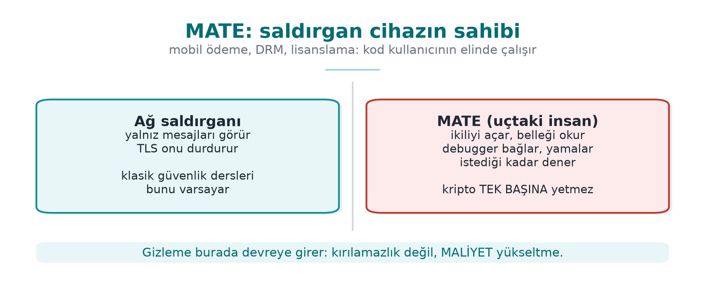
CEN429 Secure Programming · Week 9
The MATE Attacker Model — Diagram
RTEU Computer Engineering · 2026-2027 Fall
9

Slide 10
CEN429 Secure Programming · Week 9
Black Box ≠ White Box
 | Black box | White box (MATE)
Sees | Input/output | Everything
Environment | Remote server | The attacker's device
Attempts | Limited | Unlimited
Defence | Crypto, verification | + obfuscation, RASP, whitebox
Cryptography assumes a black box; that assumption collapses on delivery.
RTEU Computer Engineering · 2026-2027 Fall
10

Slide 11
CEN429 Secure Programming · Week 9
The Honest Truth
An attacker with enough time, skill, and motivation breaks every obfuscation.
Cookbook (Recipe 12.1): anti-tampering is not "unbreakable."
So what is the goal, then?
RTEU Computer Engineering · 2026-2027 Fall
11

Slide 12
CEN429 Secure Programming · Week 9
The Goal: Make Breaking It Uneconomical
Obfuscation is a tool for raising cost, not for keeping a secret.
• Make breaking it expensive
• Make automating it harder
• Buy time for the other layers
Let's turn these into three rules.
RTEU Computer Engineering · 2026-2027 Fall
12

Slide 13
CEN429 Secure Programming · Week 9
Rule 1 — Push the Cost Above the Value
The attack must be more expensive than the protected asset.
• Protecting a 10 TL secret with 1000 TL of effort: a waste
• Protecting a 1000 TL secret with 10 TL of effort: insufficient
First determine the asset's value, then choose the protection.
RTEU Computer Engineering · 2026-2027 Fall
13

Slide 14
CEN429 Secure Programming · Week 9
Rule 2 — Break Automation
An attack that works on one copy should not work on every copy.
• This is called diversification (section 5 of this week)
• With tooling in week 14 (Tigress --Seed)
One crack should not open every door.
RTEU Computer Engineering · 2026-2027 Fall
14

Slide 15
CEN429 Secure Programming · Week 9
Rule 3 — Buy Time for the Other Layers
Obfuscation is not a defence on its own; it is a layer.
• RASP (week 6) protects it while it is running
• Integrity checking, server-side checks
• Holding out until the key/version is renewed is enough
RTEU Computer Engineering · 2026-2027 Fall
15

Slide 16
CEN429 Secure Programming · Week 9
The Source's Language: Every Countermeasure Is a "Rule"
The technical guide writes every countermeasure under three headings:
• Description — what it protects
• Implementation — how it is done
• Example usage — where
Usually with a compliance ID too (e.g., "sensitive data is never logged in plain text").
We will write it the same way: what it protects · how · cost · limit.
RTEU Computer Engineering · 2026-2027 Fall
16

Slide 17
CEN429 Secure Programming · Week 9
2. Taxonomy and Rule Template
RTEU Computer Engineering · 2026-2027 Fall
17

Slide 18
CEN429 Secure Programming · Week 9
What Does Obfuscation Hide?
Collberg's classification: we split obfuscation by what it hides.
There are five families. Let's go through them in order.
RTEU Computer Engineering · 2026-2027 Fall
18

Slide 19
CEN429 Secure Programming · Week 9
Family 1 — Layout
What does it hide? Names, format, metadata.
• Making symbols invisible
• Making function/file names meaningless
• Stripping logging from the release build
We met this in week 4; this week we go deeper.
RTEU Computer Engineering · 2026-2027 Fall
19

Slide 20
CEN429 Secure Programming · Week 9
Family 2 — Data
What does it hide? Constants, strings, variables.
• String encoding
• Constant transforms
• Variable splitting/merging
• Opaque boolean
→ Section 4 of this week.
RTEU Computer Engineering · 2026-2027 Fall
20

Slide 21
CEN429 Secure Programming · Week 9
Family 3 — Control Flow
What does it hide? The algorithm's structure.
• Control-flow flattening
• Opaque predicates
• Bogus and dead branches
• Random exit
→ Section 3 of this week (coming up shortly).
RTEU Computer Engineering · 2026-2027 Fall
21

Slide 22
CEN429 Secure Programming · Week 9
Family 4 — Anti-Analysis
What does it hide? The analysis tools' own work.
• Structures that mislead a decompiler
• Decoding code at runtime
→ Concept this week, RASP in week 6.
RTEU Computer Engineering · 2026-2027 Fall
22

Slide 23
CEN429 Secure Programming · Week 9
Family 5 — Virtualisation
What does it hide? The machine code itself.
• Turning a function into a custom VM's bytecode
→ Concept this week (K-10), with tooling in week 14 (Tigress Virtualize).
RTEU Computer Engineering · 2026-2027 Fall
23

Slide 24
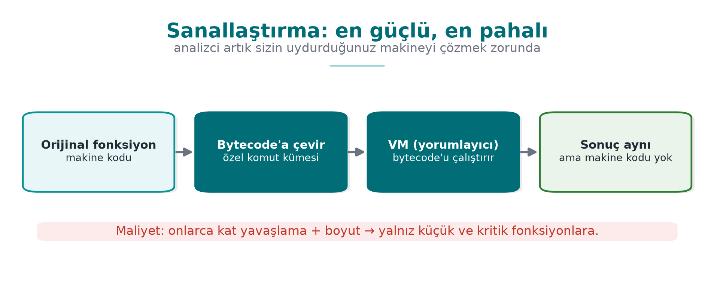
CEN429 Secure Programming · Week 9
Virtualisation — Diagram
RTEU Computer Engineering · 2026-2027 Fall
24

Slide 25
CEN429 Secure Programming · Week 9
The Five Families: Summary
Family | Hides
Layout | Name, format
Data | Constant, string, variable
Control flow | Structure
Anti-analysis | Tool's work
Virtualisation | Machine code
Rule: the families are used together, not alone.
RTEU Computer Engineering · 2026-2027 Fall
25

Slide 26
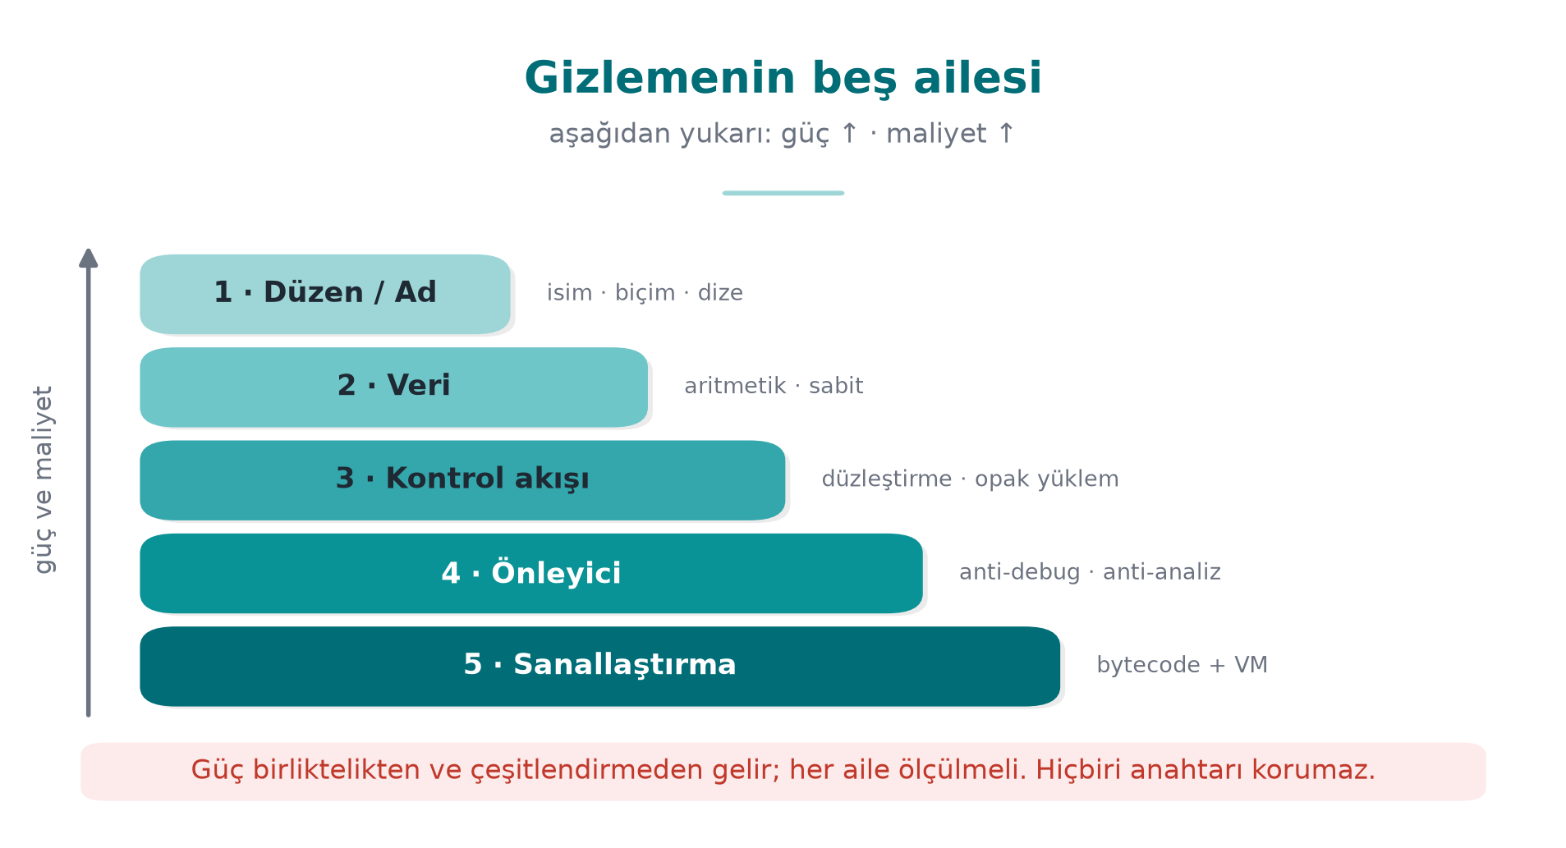
CEN429 Secure Programming · Week 9
Five Families — Potency ↑ Cost ↑
RTEU Computer Engineering · 2026-2027 Fall
26

Slide 27
CEN429 Secure Programming · Week 9
In the Field: All Together
The native countermeasures listed in a certified product cover this entire map:
symbol hiding · name obfuscation · arithmetic transform · string encoding · opaque boolean · bogus operation · dead branch · flattening · random exit · stripping logging
None of them is strong alone; strength comes from togetherness.
RTEU Computer Engineering · 2026-2027 Fall
27

Slide 28
CEN429 Secure Programming · Week 9
What Obfuscation GIVES
• A delay against static analysis (strings, symbols, decompilation)
• Resistance against automated attack (via diversification)
• Time for the other layers
• A measurable increase in cost
RTEU Computer Engineering · 2026-2027 Fall
28

Slide 29
CEN429 Secure Programming · Week 9
What Obfuscation DOES NOT Give
• The secrecy of a secret → that is cryptography's job
• Protection against reading memory → RASP, whitebox
• Permanent security → there is no such thing as "unbreakable"
• Free protection → every obfuscation comes with a cost
RTEU Computer Engineering · 2026-2027 Fall
29

Slide 30
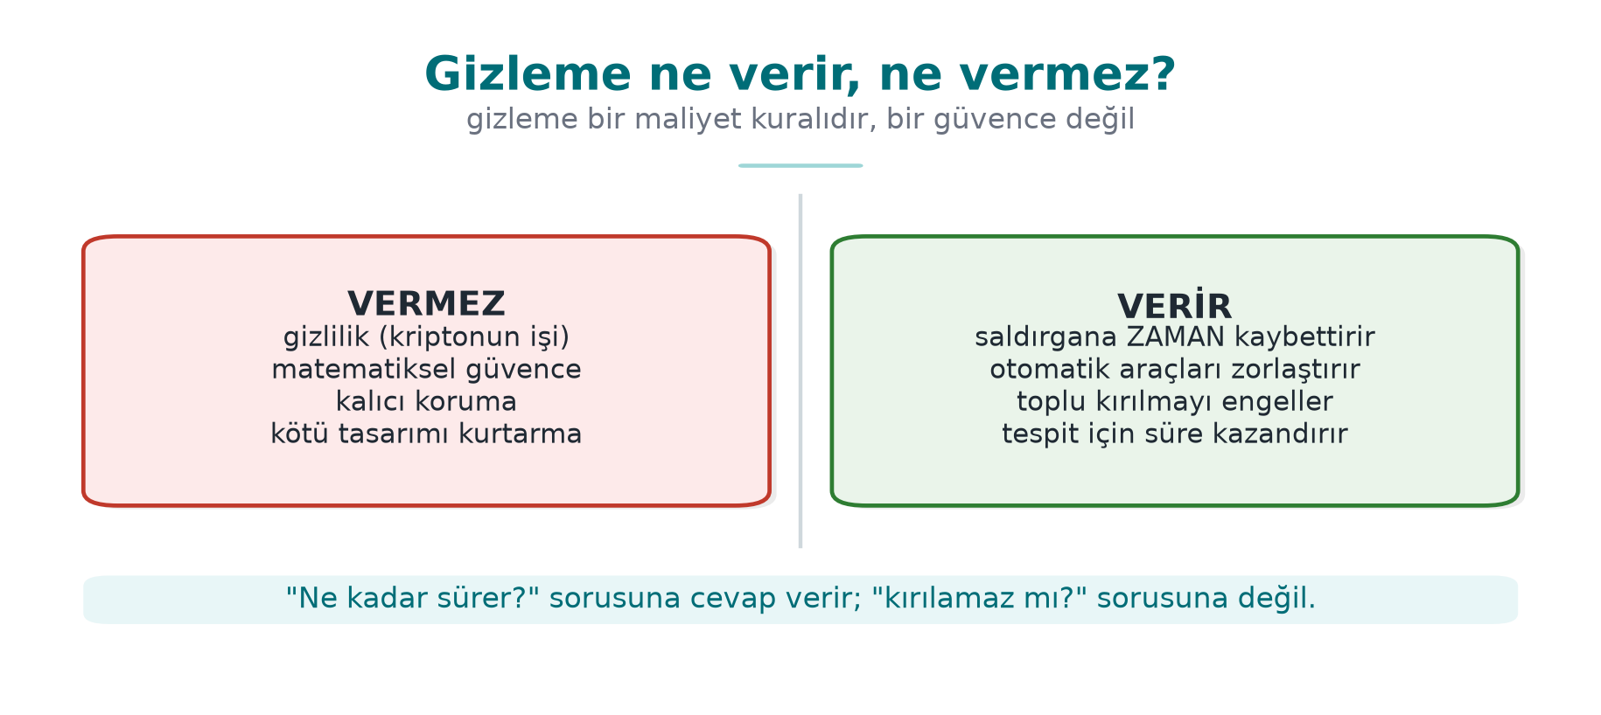
CEN429 Secure Programming · Week 9
What Obfuscation Gives and Does Not Give — Diagram
RTEU Computer Engineering · 2026-2027 Fall
30

Slide 31
CEN429 Secure Programming · Week 9
⚠️ The Most Common Mistake
Mistaking obfuscation for storing a key.
• An embedded/hidden key is still there
• The program has to use it while it runs → it is exposed in memory
• The decoding logic is inside too
Secrecy is cryptography's job, not obfuscation's. (week 3)
RTEU Computer Engineering · 2026-2027 Fall
31

Slide 32
CEN429 Secure Programming · Week 9
The "Protection Rule" Template
KURAL K-xx: <teknik>
Neyi korur? : hangi varlık / kod bölümü
Hangi tehdit?: statik / dinamik / otomatik / kurcalama
Nasıl? : bir cümle (kavram)
Maliyet : boyut, hız, bakım, hata ayıklama
Sınır : neyi korumaz
Ölçüm : etkinlik nasıl doğrulanır
RTEU Computer Engineering · 2026-2027 Fall
32

Slide 33
CEN429 Secure Programming · Week 9
Why Is the "Measurement" Line Required?
Obfuscation is not "present/absent."
• The evaluator (week 13) asks how much each layer delays the attack
• Protection without measurement = a claim, not evidence
In the project you will write S9 using this template.
RTEU Computer Engineering · 2026-2027 Fall
33

Slide 34
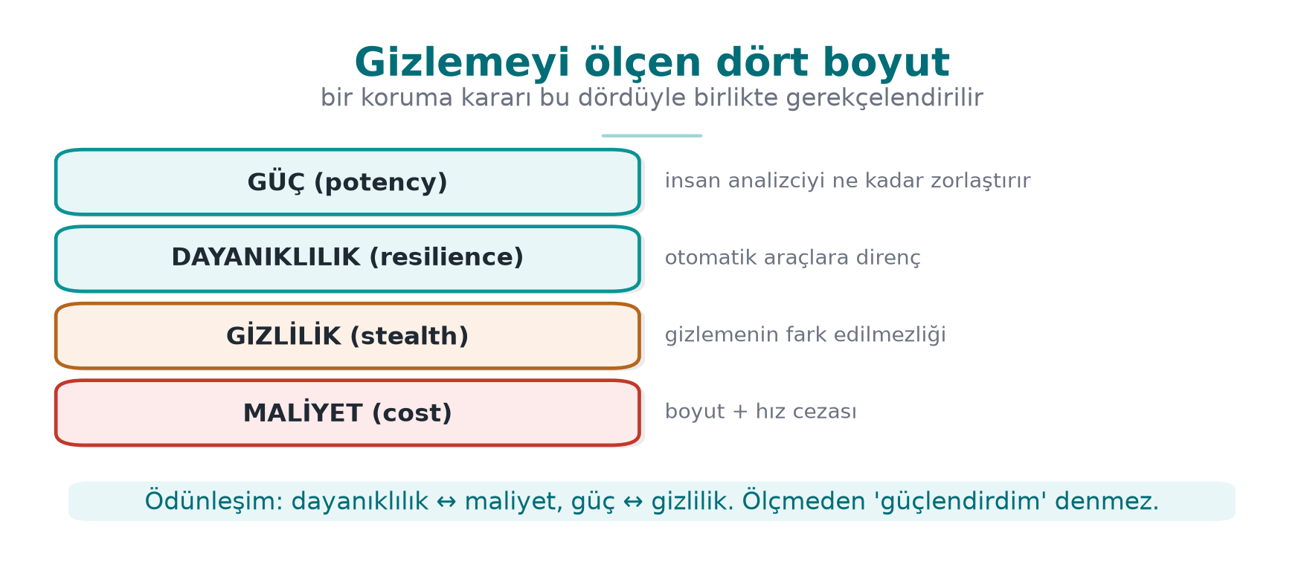
CEN429 Secure Programming · Week 9
Four Metrics — Diagram
RTEU Computer Engineering · 2026-2027 Fall
34

Slide 35
CEN429 Secure Programming · Week 9
Section 2 — Quick Check
1. How does the MATE attacker differ from a black box?
2. What were obfuscation's three rules?
3. Does obfuscation protect a key? Why?
RTEU Computer Engineering · 2026-2027 Fall
35
Notes:
Speaker note: have them answer first, then open this slide.

Slide 36
CEN429 Secure Programming · Week 9
Section 2 — Answers
1. MATE possesses the program (the code/memory is theirs, unlimited attempts); a black box only sees input/output.
2. Push the cost above the value · break automation (diversify) · buy time for the other layers.
3. No. The key is exposed in memory while running and the decoding logic is inside; secrecy is cryptography's job.
RTEU Computer Engineering · 2026-2027 Fall
36

Slide 37
CEN429 Secure Programming · Week 9
0. Basic Concepts First
RTEU Computer Engineering · 2026-2027 Fall
37
Notes:
Speaker note: This section assumes no prior knowledge. We define every term here; we will use these terms in the sections that follow. Do not rush.

Slide 38
CEN429 Secure Programming · Week 9
Why Does This Section Exist?
This week's subject is code obfuscation. But first let's pin down a few basic terms.
Without knowing these terms, the subject stays up in the air.
We assume you know nothing — that is a good starting point.
RTEU Computer Engineering · 2026-2027 Fall
38

Slide 39
CEN429 Secure Programming · Week 9
What Is Source Code?
• The human-readable program text that you write (e.g., a C file).
• Example: int topla(int a, int b) { return a + b; }
Source code is compiled and turned into the form the machine runs.
RTEU Computer Engineering · 2026-2027 Fall
39

Slide 40
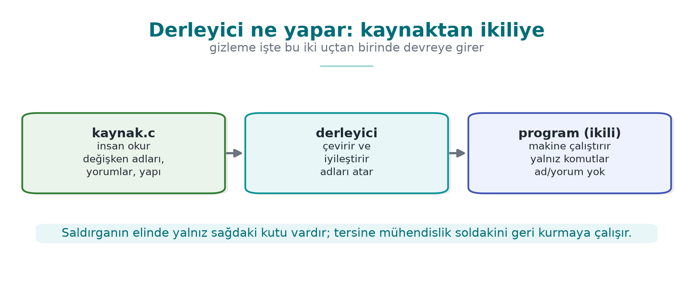
CEN429 Secure Programming · Week 9
Compiler and Binary
• Compiler: the program that translates source code into machine code (gcc, clang).
• Binary: the result of compilation; the file the computer runs directly (.exe, .so).
RTEU Computer Engineering · 2026-2027 Fall
40

Slide 41
CEN429 Secure Programming · Week 9
Machine Code and Assembly
• Machine code: the numeric instructions the processor understands.
• Assembly: a somewhat more human-readable form of machine code (mov, cmp, jmp).
This is what you see when you open a binary.
RTEU Computer Engineering · 2026-2027 Fall
41

Slide 42
CEN429 Secure Programming · Week 9
What Is Reverse Engineering?
Reverse engineering: looking at a binary and trying to work out what the program does.
This is the attacker's basic job.
RTEU Computer Engineering · 2026-2027 Fall
42

Slide 43
CEN429 Secure Programming · Week 9
Decompiler
• Decompiler: a tool that turns a binary back into a form close to readable code.
• Examples: Ghidra, IDA.
Goal: someone with no access to the source can infer the logic just by looking at the binary.
RTEU Computer Engineering · 2026-2027 Fall
43

Slide 44
CEN429 Secure Programming · Week 9
The strings Command
• `strings`: a simple tool that lists the readable text inside a binary.
• strings program → text such as "Lisans gecersiz", "http://...".
This is usually the attacker's first step.
RTEU Computer Engineering · 2026-2027 Fall
44

Slide 45
CEN429 Secure Programming · Week 9
Symbol and Symbol Table
• Symbol: the name of a function or variable inside a binary (e.g., lisans_dogrula).
• Symbol table: the list of these names.
If the name lisans_dogrula is visible, the attacker knows where to look.
RTEU Computer Engineering · 2026-2027 Fall
45

Slide 46
CEN429 Secure Programming · Week 9
Debugger
• Debugger: a tool that runs a program step by step and shows its variables (gdb, lldb).
• An attacker can stop the program, read memory, and change values.
RTEU Computer Engineering · 2026-2027 Fall
46

Slide 47
CEN429 Secure Programming · Week 9
Bit, Byte, Hexadecimal
• Bit: 0 or 1.
• Byte: 8 bits.
• Hexadecimal (hex): written with a 0x prefix; 0x2A = 42.
We will see values like 0x5A in the code; these are just numbers.
RTEU Computer Engineering · 2026-2027 Fall
47

Slide 48
CEN429 Secure Programming · Week 9
What Is XOR?
• XOR (^): 1 if the two bits differ, 0 if they are the same.
• Property: a ^ b ^ b == a → it undoes itself.
c = a ^ 0x5A; /* şifrele */
a = c ^ 0x5A; /* geri çöz */
It is heavily used in obfuscation because it is reversible.
RTEU Computer Engineering · 2026-2027 Fall
48

Slide 49
CEN429 Secure Programming · Week 9
What Is Entropy (Randomness)?
• Entropy: how "random" a piece of data looks.
• Cryptographic keys look high-entropy (irregular bytes).
If an attacker sees a high-entropy block in a binary, they say "there might be a key here."
RTEU Computer Engineering · 2026-2027 Fall
49

Slide 50
CEN429 Secure Programming · Week 9
Function, Branch, Condition
• Function: a block of code that does one job (erisim_ver).
• Branch: a fork in the road, like an if.
• Condition: the expression that decides which way the branch goes.
RTEU Computer Engineering · 2026-2027 Fall
50

Slide 51
CEN429 Secure Programming · Week 9
Basic Block
• Basic block: a sequence of instructions that runs straight through, with no branch.
• When an if is reached the block ends, and two new blocks begin.
Program = basic blocks wired together.
RTEU Computer Engineering · 2026-2027 Fall
51

Slide 52
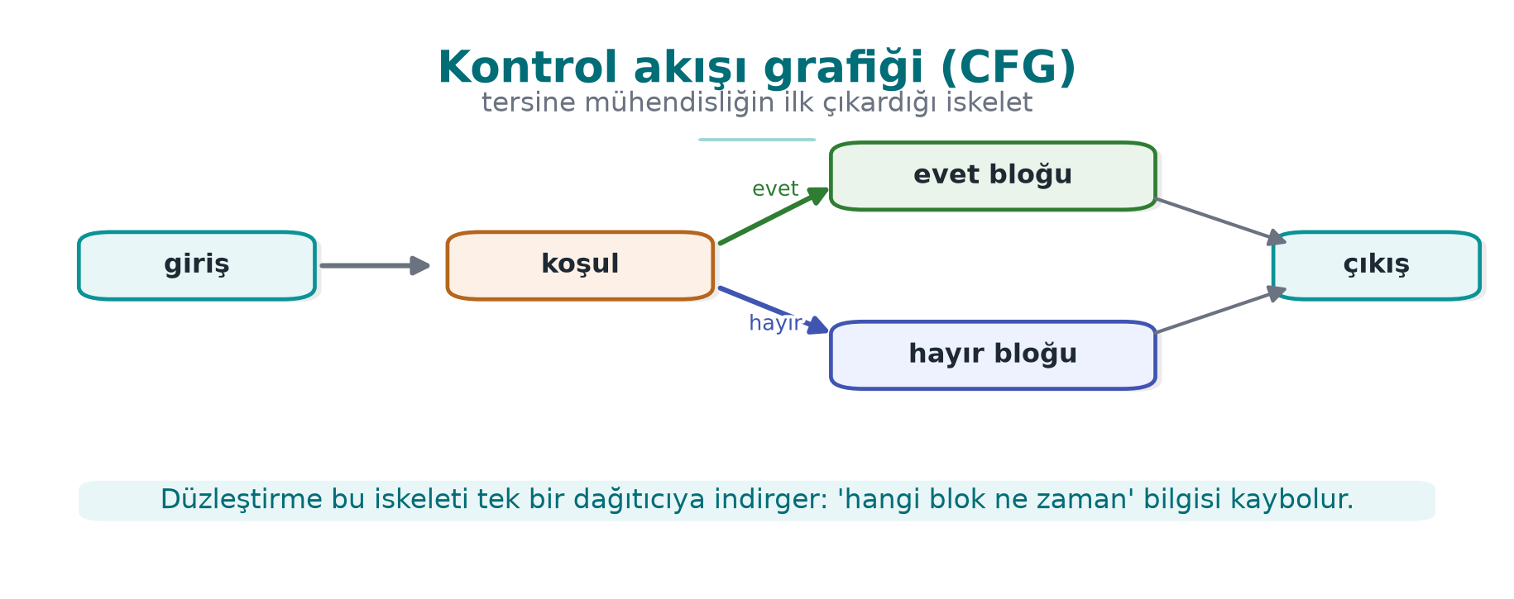
CEN429 Secure Programming · Week 9
Control Flow Graph (CFG)
• CFG (Control Flow Graph): a diagram that makes basic blocks its nodes and the transitions between them its edges.
• It is the program's "road map."
RTEU Computer Engineering · 2026-2027 Fall
52

Slide 53
CEN429 Secure Programming · Week 9
Compiler Flag
• Compiler flag: an option passed to the compiler (e.g., -O2, -DGUNLUK_ACIK).
• The same source can be compiled differently with different flags (e.g., with logging / without logging).
RTEU Computer Engineering · 2026-2027 Fall
53

Slide 54
CEN429 Secure Programming · Week 9
What Is a Log?
• Log: the informational messages a program writes while it runs (printf("...")).
• Problem: if sensitive information or internal state ends up in the log, the attacker reads it.
RTEU Computer Engineering · 2026-2027 Fall
54

Slide 55
CEN429 Secure Programming · Week 9
Now We're Ready
We now know the following terms:
source · compiler · binary · decompilation · strings · symbol · debugger · XOR · entropy · branch · basic block · CFG · log
We will use these constantly throughout the week. Come back to this section whenever you get stuck.
RTEU Computer Engineering · 2026-2027 Fall
55

Slide 56
CEN429 Secure Programming · Week 9
This Week's Question in One Sentence
I have delivered the program to the user; the attacker now owns it. How do I make it harder for them to read and modify my code?
Answer: code obfuscation rules. Let's begin.
RTEU Computer Engineering · 2026-2027 Fall
56

Slide 57
CEN429 Secure Programming · Week 9
3. Control-Flow Rules
RTEU Computer Engineering · 2026-2027 Fall
57

Slide 58
CEN429 Secure Programming · Week 9
What Is a Control Flow Graph (CFG)?
A compiled function's skeleton:
• Which check happens in what order?
• Which branch leads to success?
The attacker's first job is to extract this skeleton.
RTEU Computer Engineering · 2026-2027 Fall
58

Slide 59
CEN429 Secure Programming · Week 9
The Purpose of This Section
In week 4 we introduced flattening.
In this section we add the rules that strengthen it:
K-01 opaque predicate · K-02 arithmetic encoding · K-03 bogus/dead · K-04 flattening (in depth) · K-05 random exit · K-06 call hiding
All examples are synthetic, built around a single check: erisim_ver.
RTEU Computer Engineering · 2026-2027 Fall
59

Slide 60
CEN429 Secure Programming · Week 9
K-01 · Opaque Predicates and Loops
RTEU Computer Engineering · 2026-2027 Fall
60

Slide 61
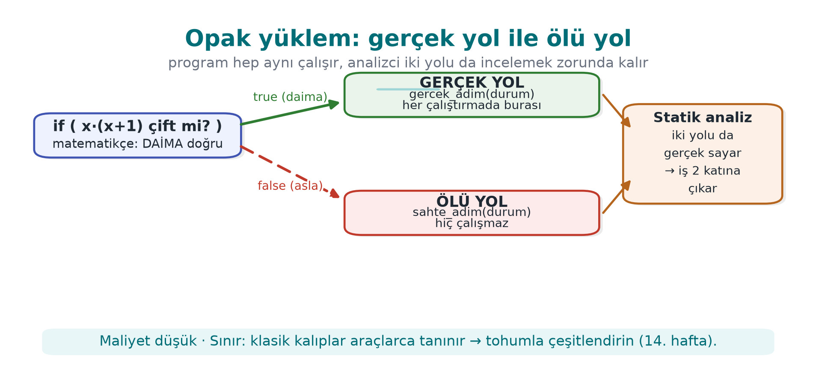
CEN429 Secure Programming · Week 9
Opaque Predicate — Diagram
RTEU Computer Engineering · 2026-2027 Fall
61

Slide 62
CEN429 Secure Programming · Week 9
K-01 · What Does It Protect?
• Which condition a branch is taken under
• How many times a loop runs
Idea: branch on an expression whose value the programmer knows but the tool cannot easily resolve.
RTEU Computer Engineering · 2026-2027 Fall
62

Slide 63
CEN429 Secure Programming · Week 9
K-01 · Opaque Predicate Example
/* x*(x+1) daima çifttir → sonuç daima true */
static int opak_dogru(unsigned x) {
return ((x * (x + 1)) & 1u) == 0;
}
The programmer knows: it is always true. Static analysis cannot easily prove this.
RTEU Computer Engineering · 2026-2027 Fall
63

Slide 64
CEN429 Secure Programming · Week 9
K-01 · How Is It Used?
if (opak_dogru(sayac)) {
durum = gercek_adim(durum); /* daima buraya girer */
} else {
durum = sahte_adim(durum); /* ölü yol: hiç çalışmaz */
}
The analyst thinks both paths are "real"; they spend their time on the fake path.
RTEU Computer Engineering · 2026-2027 Fall
64

Slide 65
CEN429 Secure Programming · Week 9
K-01 · Opaque Loop
The guide makes loops a separate rule:
• for/while are never shown directly
• Hidden inside flattening
• The body is split into small blocks
• Iteration is driven by a state variable
The information "this loop runs N times" cannot be read off the CFG.
RTEU Computer Engineering · 2026-2027 Fall
65

Slide 66
CEN429 Secure Programming · Week 9
K-01 · Cost and Limit
• Cost: low–medium (extra arithmetic/branch)
• Limit: well-known opaque predicate patterns are recognised automatically
• Countermeasure: diversify (section 5)
• Measurement: basic block count before/after
RTEU Computer Engineering · 2026-2027 Fall
66

Slide 67
CEN429 Secure Programming · Week 9
K-02 · Arithmetic Encoding
RTEU Computer Engineering · 2026-2027 Fall
67

Slide 68
CEN429 Secure Programming · Week 9
K-02 · What Does It Protect?
Constants and simple computations.
It hides directly readable hints like "this number is 0x1F, this operation is an XOR."
RTEU Computer Engineering · 2026-2027 Fall
68

Slide 69
CEN429 Secure Programming · Week 9
K-02 · Equivalent Expressions (MBA)
Replace an operation with an equivalent one that produces the same result but looks complex:
a + b ≡ (a ^ b) + 2*(a & b)
x * 2 ≡ x << 1
Same result, complex appearance. (MBA = mixed boolean-arithmetic)
RTEU Computer Engineering · 2026-2027 Fall
69

Slide 70
CEN429 Secure Programming · Week 9
K-02 · Hide the Constant
/* 0x2A doğrudan yazılmaz; iki parçadan üretilir */
static uint8_t esik(void) {
uint8_t a = 0x37, b = 0x1D;
return (uint8_t)(a ^ b); /* = 0x2A */
}
Searching the binary for 0x2A returns nothing.
RTEU Computer Engineering · 2026-2027 Fall
70

Slide 71
CEN429 Secure Programming · Week 9
K-02 · Cost and Limit
• Cost: low
• Limit: MBA simplifiers (arybo/msynth) can undo many expressions
• Rule: weak on its own → combine it with control flow
• Measurement: a byte/strings search for the constant should return nothing
RTEU Computer Engineering · 2026-2027 Fall
71

Slide 72
CEN429 Secure Programming · Week 9
K-03 · Bogus Operations and Dead Branches
RTEU Computer Engineering · 2026-2027 Fall
72

Slide 73
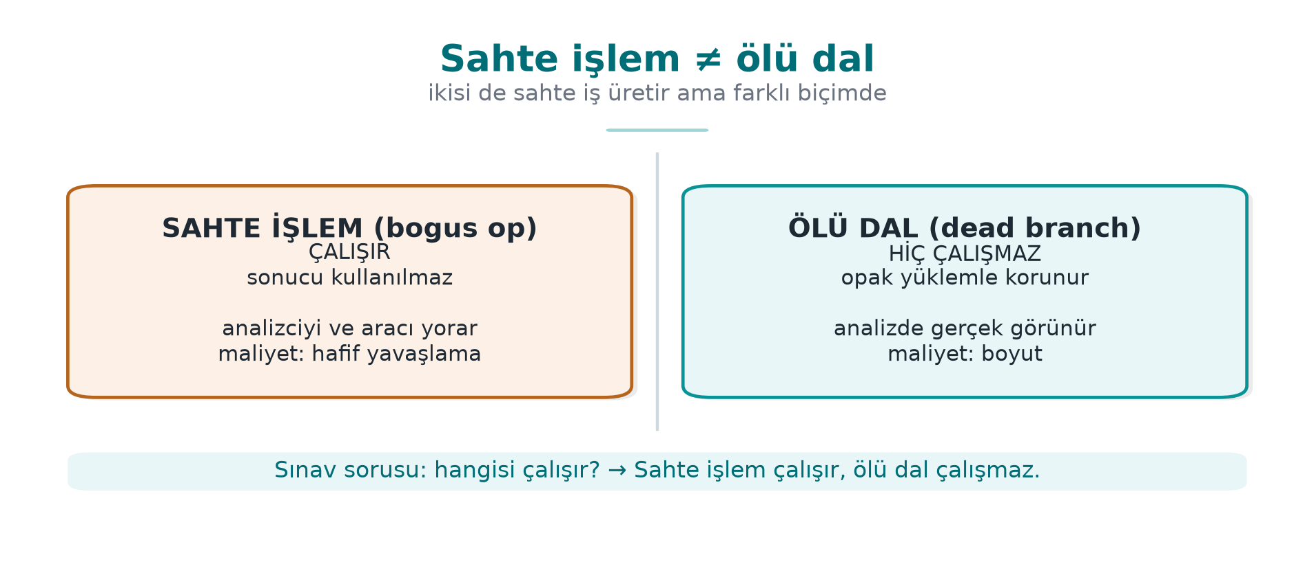
CEN429 Secure Programming · Week 9
Bogus Operation ≠ Dead Branch — Diagram
RTEU Computer Engineering · 2026-2027 Fall
73

Slide 74
CEN429 Secure Programming · Week 9
K-03 · The Two Are Different!
The guide makes these separate rules. The difference is critical:
• Bogus operation: runs, does not change the result
• Dead branch: never runs (protected by an opaque predicate)
RTEU Computer Engineering · 2026-2027 Fall
74

Slide 75
CEN429 Secure Programming · Week 9
K-03 · Comparison
 | Bogus operation | Dead branch
Does it run? | Yes | No
Result | Unchanged | (does not run)
Purpose | Hide the real thing in a crowd | Show a fake path
RTEU Computer Engineering · 2026-2027 Fall
75

Slide 76
CEN429 Secure Programming · Week 9
K-03 · Bogus Operation Example
crc = crc32_guncelle(crc, veri, n);
crc ^= (sabit ^ sabit); /* = crc; sonuç aynı */
sabit ^ sabit == 0 → the CRC does not change, but the code gets more crowded.
RTEU Computer Engineering · 2026-2027 Fall
76

Slide 77
CEN429 Secure Programming · Week 9
K-03 · Dead Branch Example
if (opak_yanlis()) { /* daima false */
sahte_kontrol(); /* hiç çalışmaz */
}
The analyst treats this block as "real" and examines it; they waste time.
RTEU Computer Engineering · 2026-2027 Fall
77

Slide 78
CEN429 Secure Programming · Week 9
K-03 · Cost and Limit
• Cost: low (bogus operation) → medium (dead branches grow the CFG)
• Limit: dead code elimination drops the branch once the opaque predicate protecting it is solved
• Dependency: depends on the opaque predicate's quality
• Measurement: time needed to tell dead branches apart from real ones
RTEU Computer Engineering · 2026-2027 Fall
78

Slide 79
CEN429 Secure Programming · Week 9
K-04 · Control-Flow Flattening
RTEU Computer Engineering · 2026-2027 Fall
79

Slide 80
CEN429 Secure Programming · Week 9
K-04 · What Does It Protect?
The algorithm's structure:
• The natural adjacency of blocks
• The information "which block leads to which"
RTEU Computer Engineering · 2026-2027 Fall
80

Slide 81
CEN429 Secure Programming · Week 9
K-04 · Idea: Vertical → Horizontal
• Normal: blocks follow one another (vertical flow)
• Flattened: all blocks sit in a single switch dispatcher (horizontal)
• The order can only be read from a state variable
RTEU Computer Engineering · 2026-2027 Fall
81

Slide 82
CEN429 Secure Programming · Week 9
K-04 · Template
int durum = BASLA;
for (;;) switch (durum) {
case BASLA: durum = ADIM1; break;
case ADIM1: durum = kosul ? ADIM2 : HATA; break;
case ADIM2: durum = BITIR; break;
case HATA: return RED;
case BITIR: return IZIN;
default: return RED; /* rastgele çıkış (K-05) */
}
RTEU Computer Engineering · 2026-2027 Fall
82

Slide 83
CEN429 Secure Programming · Week 9
K-04 · Weak on Its Own
We said back in week 4: an experienced analyst can solve this template fairly quickly.
Strength comes from reinforcements. In order:
RTEU Computer Engineering · 2026-2027 Fall
83

Slide 84
CEN429 Secure Programming · Week 9
K-04 · Reinforcement 1 — State Values (K-02)
• Scattered, arithmetically produced values instead of case 1, 2, 3
• The sequence is invisible
• Which step follows which cannot be read
RTEU Computer Engineering · 2026-2027 Fall
84

Slide 85
CEN429 Secure Programming · Week 9
K-04 · Reinforcement 2 — Bogus/Dead (K-03)
• Bogus cases are added
• Telling which case is real becomes harder
RTEU Computer Engineering · 2026-2027 Fall
85

Slide 86
CEN429 Secure Programming · Week 9
K-04 · Reinforcement 3 — Random Exit (K-05)
• Errors exit through the default branch with an unpredictable state
• Where the failure happened cannot be read
RTEU Computer Engineering · 2026-2027 Fall
86

Slide 87
CEN429 Secure Programming · Week 9
K-04 · Reinforcement 4 — Opaque Transitions (K-01)
• case transitions depend on opaque conditions, not fixed values
• Static tracing becomes even harder
RTEU Computer Engineering · 2026-2027 Fall
87

Slide 88
CEN429 Secure Programming · Week 9
K-04 · Cost and Limit
• Cost: medium–high (block/branch count grows a lot, performance drops)
• Limit: flattening alone → can be undone with symbolic execution (section 5)
• Strength: comes from the reinforcements
• Measurement: CFG node/edge count, tracing time
RTEU Computer Engineering · 2026-2027 Fall
88

Slide 89
CEN429 Secure Programming · Week 9
K-05 · Random Exit
RTEU Computer Engineering · 2026-2027 Fall
89

Slide 90
CEN429 Secure Programming · Week 9
K-05 · What Does It Protect?
Where a check fails.
The attacker typically:
• Finds the "failure branch"
• Turns it into the "success branch"
RTEU Computer Engineering · 2026-2027 Fall
90

Slide 91
CEN429 Secure Programming · Week 9
K-05 · How?
if (!imza_gecerli(p)) {
durum = kararsiz_deger(); /* switch'te tanımsız → default */
break;
}
There is no direct return RED; the state goes to an unpredictable value.
RTEU Computer Engineering · 2026-2027 Fall
91

Slide 92
CEN429 Secure Programming · Week 9
K-05 · Success Should Exit the Same Way Too
• A successful exit uses the same method too
• So success and failure look alike in the flow
• The analyst cannot say "this is the accept branch"
RTEU Computer Engineering · 2026-2027 Fall
92

Slide 93
CEN429 Secure Programming · Week 9
K-05 · Cost and Limit
• Cost: low
• Limit: not meaningful on its own, only together with flattening
• Goal: a single-byte patch should not be enough to bypass the check
• Measurement: time needed for a "find and flip the failure branch" attack
RTEU Computer Engineering · 2026-2027 Fall
93

Slide 94
CEN429 Secure Programming · Week 9
K-06 · Call and Dependency Hiding
RTEU Computer Engineering · 2026-2027 Fall
94

Slide 95
CEN429 Secure Programming · Week 9
K-06 · What Does It Protect?
Hints like: "this function calls memcmp, so it must be doing a comparison."
Standard library calls tell the attacker what you are doing.
RTEU Computer Engineering · 2026-2027 Fall
95

Slide 96
CEN429 Secure Programming · Week 9
K-06 · How?
• Your own constant-time esit_mi instead of memcmp on the critical path
• No recognisable name appears to the linker
• Bogus parameters: add parameters that are never used → the signature becomes misleading
RTEU Computer Engineering · 2026-2027 Fall
96

Slide 97
CEN429 Secure Programming · Week 9
K-06 · ⚠️ Do Not Break Constant-Timeness
When you write your own comparison, make sure it stays constant-time (week 3).
• An early-exit comparison → opens a side channel
• Do not create a new hole while adding a protection
RTEU Computer Engineering · 2026-2027 Fall
97

Slide 98
CEN429 Secure Programming · Week 9
K-06 · Cost and Limit
• Cost: low–medium (your own versions need maintenance)
• Limit: behavioural analysis can still reveal what it does → this is a delay
• Measurement: count of recognisable library calls in the binary
RTEU Computer Engineering · 2026-2027 Fall
98

Slide 99
CEN429 Secure Programming · Week 9
Section 3 — Summary
• K-01 opaque predicate/loop · K-02 arithmetic encoding
• K-03 bogus operation ≠ dead branch
• K-04 flattening (with reinforcements)
• K-05 random exit · K-06 call hiding
None is sufficient on its own; together and measured.
RTEU Computer Engineering · 2026-2027 Fall
99

Slide 100
CEN429 Secure Programming · Week 9
Section 3 — Quick Check
1. What is the difference between a bogus operation and a dead branch?
2. What are the 4 rules that strengthen flattening?
3. Which attack does random exit make harder?
RTEU Computer Engineering · 2026-2027 Fall
100
Notes:
Speaker note: have them answer first, then open.

Slide 101
CEN429 Secure Programming · Week 9
Section 3 — Answers
1. A bogus operation runs but does not change the result; a dead branch, protected by an opaque predicate, never runs at all.
2. Hide the state values (K-02) · bogus/dead blocks (K-03) · random exit (K-05) · opaque predicate transitions (K-01).
3. The "find the failure branch and flip it to success" attack; a single-byte patch is no longer enough.
RTEU Computer Engineering · 2026-2027 Fall
101

Slide 102
CEN429 Secure Programming · Week 9
4. Data and Whole-Program Rules
RTEU Computer Engineering · 2026-2027 Fall
102

Slide 103
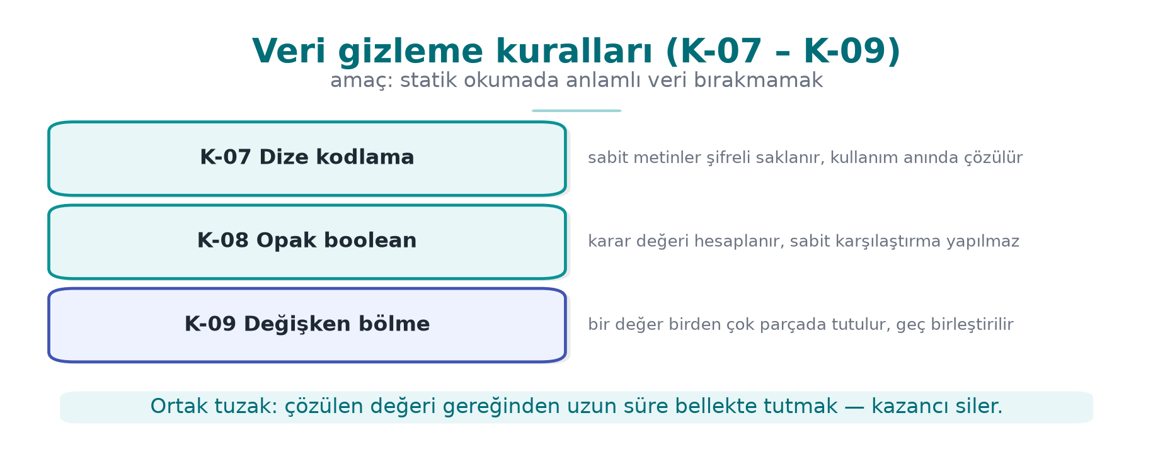
CEN429 Secure Programming · Week 9
Data Obfuscation Rules K-07–K-09 — Diagram
RTEU Computer Engineering · 2026-2027 Fall
103

Slide 104
CEN429 Secure Programming · Week 9
Control Flow ≠ Data
• Control flow (section 3): hides the algorithm's structure
• Data obfuscation (this section): hides the values the program processes
Strings, constants, tables, variables.
RTEU Computer Engineering · 2026-2027 Fall
104

Slide 105
CEN429 Secure Programming · Week 9
K-07 · String Encoding
RTEU Computer Engineering · 2026-2027 Fall
105

Slide 106
CEN429 Secure Programming · Week 9
K-07 · What Does It Protect?
The readable text inside a binary.
The cheapest attack step: strings.
"Lisans gecersiz" or a URL → tells the attacker exactly where to look.
RTEU Computer Engineering · 2026-2027 Fall
106

Slide 107
CEN429 Secure Programming · Week 9
K-07 · Idea
• Sensitive strings are encoded before compilation (e.g., XOR)
• They stay encoded in the binary
• Decoded at the moment of use
• Wiped the instant the job is done
RTEU Computer Engineering · 2026-2027 Fall
107

Slide 108
CEN429 Secure Programming · Week 9
K-07 · Example (Synthetic)
static const uint8_t GIZLI[] = {0x3B,0x2A,0x2E,0x2E,0x2D};
void kullan(void) {
char tmp[sizeof GIZLI];
for (size_t i=0;i<sizeof GIZLI;i++)
tmp[i] = GIZLI[i] ^ 0x5A; /* çöz */
isle(tmp, sizeof GIZLI);
memset_s_benzeri(tmp, sizeof tmp); /* hemen sil */
}
RTEU Computer Engineering · 2026-2027 Fall
108

Slide 109
CEN429 Secure Programming · Week 9
K-07 · ⚠️ Critical Limit
• The decoded string is exposed in memory while running
• The decoding key is also in the binary
• This is a static-scan countermeasure
In the field: the decoding key is split and distributed, and the decoding function gets extra checks.
RTEU Computer Engineering · 2026-2027 Fall
109

Slide 110
CEN429 Secure Programming · Week 9
K-07 · String Obfuscation ≠ Key Storage
Again: string obfuscation stops strings, it does not protect a key.
• For the key → whitebox (week 11) or hardware
• Measurement: the sensitive string must not be found in strings output
RTEU Computer Engineering · 2026-2027 Fall
110

Slide 111
CEN429 Secure Programming · Week 9
K-08 · Opaque Boolean
RTEU Computer Engineering · 2026-2027 Fall
111

Slide 112
CEN429 Secure Programming · Week 9
K-08 · Problem: Plain 0/1 Is Dangerous
Returning a check's result as a plain 0/1:
• The attacker flips a single byte
• "Failure" becomes "success"
RTEU Computer Engineering · 2026-2027 Fall
112

Slide 113
CEN429 Secure Programming · Week 9
K-08 · Idea
Tie the true/false value to:
• Multiple values
• In a way a single-byte patch cannot flip
Functions return an opaque return code instead of a plain boolean.
RTEU Computer Engineering · 2026-2027 Fall
113

Slide 114
CEN429 Secure Programming · Week 9
K-08 · Example (Concept)
typedef struct { uint32_t a, b; } Karar;
static Karar izin_ver(void) {
return (Karar){ 0xA3C1u, 0x5C3Eu }; /* a ^ b == 0xFFFF */
}
static int karar_izin_mi(Karar k) {
return (k.a ^ k.b) == 0xFFFFu;
}
The calling side verifies both fields.
RTEU Computer Engineering · 2026-2027 Fall
114

Slide 115
CEN429 Secure Programming · Week 9
K-08 · Cost and Limit
• Cost: low
• Limit: solvable with enough scrutiny
• Goal: block a single-byte patch and crude branch-flipping
• Measurement: independent points > 1 needed to flip the result
RTEU Computer Engineering · 2026-2027 Fall
115

Slide 116
CEN429 Secure Programming · Week 9
K-09 · Variable Splitting and Restructuring
RTEU Computer Engineering · 2026-2027 Fall
116

Slide 117
CEN429 Secure Programming · Week 9
K-09 · What Does It Protect?
The recognisable footprint of a sensitive variable in memory.
Patterns like "a 32-byte block = an AES key" point the attacker straight at it.
RTEU Computer Engineering · 2026-2027 Fall
117

Slide 118
CEN429 Secure Programming · Week 9
K-09 · How?
• Split a variable (produce a 32-bit value from two 16-bit shares)
• Merge several variables into a single word
• Rearrange arrays
• Change buffer size/order/layout
• Fill with random values after use
RTEU Computer Engineering · 2026-2027 Fall
118

Slide 119
CEN429 Secure Programming · Week 9
K-09 · Cost and Limit
• Cost: low–medium
• Limit: only slows down static/pattern analysis
• Measurement: time needed to recognise the sensitive buffer from the pattern
RTEU Computer Engineering · 2026-2027 Fall
119

Slide 120
CEN429 Secure Programming · Week 9
Whole-Program Rules: K-10, K-11, K-12
RTEU Computer Engineering · 2026-2027 Fall
120

Slide 121
CEN429 Secure Programming · Week 9
K-10 · Virtualisation (Concept)
What does it protect? A function's machine code.
How? The function → a custom VM's bytecode; the bytecode and a small interpreter are embedded in the binary.
The attacker does not see familiar code — they see a custom instruction set they must first solve.
RTEU Computer Engineering · 2026-2027 Fall
121

Slide 122
CEN429 Secure Programming · Week 9
K-10 · Cost and Limit
• Cost: high (interpreted code is slow; maintenance is expensive)
• Use: only the most critical, small, rarely-changing functions
• Limit: once the VM is solved once, everything it protects opens up; if not diversified, every copy is identical
• Week 14: Tigress Virtualize
RTEU Computer Engineering · 2026-2027 Fall
122

Slide 123
CEN429 Secure Programming · Week 9
K-11 · Compiler-Based (O-LLVM)
What does it protect? The rules above, applied through a compiler pass, not by hand.
• LLVM-based obfuscators: flattening, bogus control flow, instruction-substitution passes
• The source stays readable; protection is a compile option
• A different seed per build → easy diversification
RTEU Computer Engineering · 2026-2027 Fall
123

Slide 124
CEN429 Secure Programming · Week 9
K-11 · Cost and Limit
• Cost: medium (depends on the passes selected)
• Limit: known pass patterns are recognisable; stay current with the tool's version
• Measurement: the difference between binaries produced with different seeds
RTEU Computer Engineering · 2026-2027 Fall
124

Slide 125
CEN429 Secure Programming · Week 9
K-12 · Dynamic Encryption (Concept)
What does it protect? The most sensitive code sections, by keeping them encrypted in the binary.
How? The section stays encrypted → decoded only right when it is about to run → then re-encrypted/wiped.
RTEU Computer Engineering · 2026-2027 Fall
125

Slide 126
CEN429 Secure Programming · Week 9
K-12 · ⚠️ Risk
• Directly conflicts with OS memory protections (DEP/NX, W^X)
• Done wrong, it both crashes and opens a new hole
• The code sits exposed in memory for a moment while running → a memory dump can catch it
RTEU Computer Engineering · 2026-2027 Fall
126

Slide 127
CEN429 Secure Programming · Week 9
K-12 · Rule
If adding one protection turns off another, measure the net gain and record the trade-off.
In practice it is used very selectively, on small sections.
RTEU Computer Engineering · 2026-2027 Fall
127

Slide 128
CEN429 Secure Programming · Week 9
The Java/Managed Side (from Week 5)
• This week's rules are for native (C/C++)
• The managed-language equivalent: ProGuard/R8 name obfuscation + dead code elimination + shrinking
• APIs reached via -keep and reflection
RTEU Computer Engineering · 2026-2027 Fall
128

Slide 129
CEN429 Secure Programming · Week 9
The Two Sides Work Together
• The Java side is obfuscated with R8
• The native side, with this week's rules
• Cross-check: native verifies Java's integrity, Java verifies native's (week 6, RASP)
RTEU Computer Engineering · 2026-2027 Fall
129

Slide 130
CEN429 Secure Programming · Week 9
Section 4 — Summary
• K-07 string encoding · K-08 opaque boolean · K-09 variable splitting
• K-10 virtualisation (expensive) · K-11 compiler-based (O-LLVM) · K-12 dynamic (risky)
Data obfuscation complements control-flow obfuscation.
RTEU Computer Engineering · 2026-2027 Fall
130

Slide 131
CEN429 Secure Programming · Week 9
Section 4 — Quick Check
1. Does string obfuscation protect the key?
2. Why does an opaque boolean make a single-byte patch harder?
3. What are virtualisation's two biggest costs?
RTEU Computer Engineering · 2026-2027 Fall
131
Notes:
Speaker note: have them answer first, then open; then move to section 5.

Slide 132
CEN429 Secure Programming · Week 9
Section 4 — Answers
1. No. The decoded string is exposed in memory; the decoding key is inside; it only stops static (strings) scanning.
2. The result depends on multiple values; flipping it requires changing >1 independent points.
3. High performance cost (tens of times slower) and high maintenance cost; that is why it is used only on small/critical functions.
RTEU Computer Engineering · 2026-2027 Fall
132

Slide 133
CEN429 Secure Programming · Week 9
5. Diversification and Measurement
RTEU Computer Engineering · 2026-2027 Fall
133

Slide 134
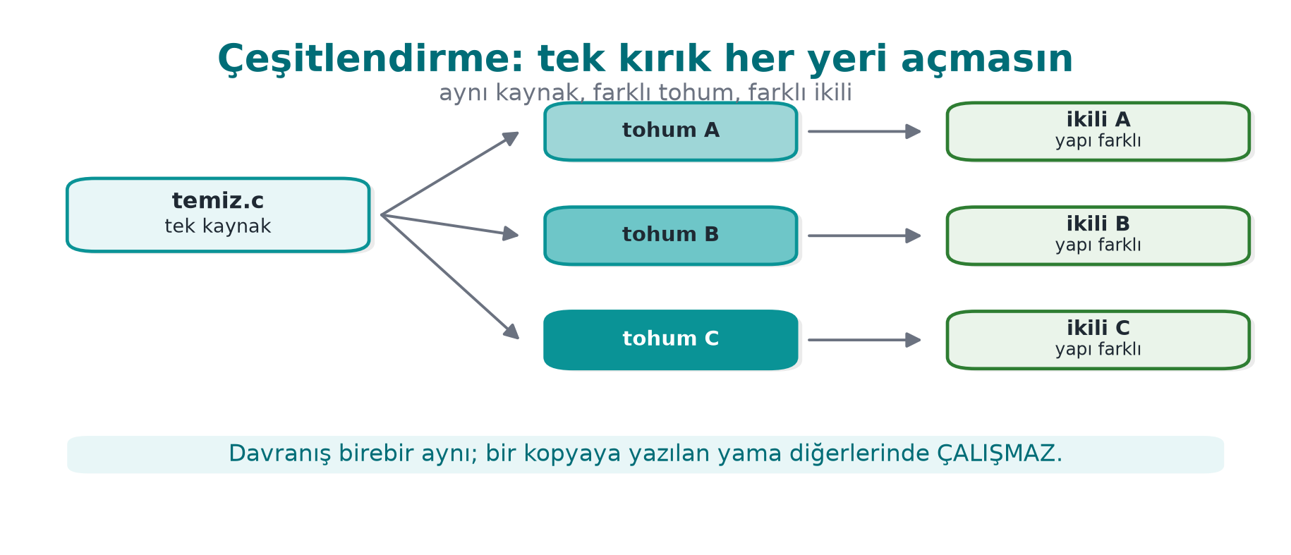
CEN429 Secure Programming · Week 9
Diversification — Diagram
RTEU Computer Engineering · 2026-2027 Fall
134

Slide 135
CEN429 Secure Programming · Week 9
Diversification: Recall Rule 2
An attack that works on one copy should not work on every copy.
If the attacker can crack one copy and distribute the patch/script to everyone, one crack opens every door.
RTEU Computer Engineering · 2026-2027 Fall
135

Slide 136
CEN429 Secure Programming · Week 9
What Is Diversification?
Producing binaries from the same source that are behaviourally equivalent, structurally different.
Opaque predicates, bogus blocks, state values change from copy to copy.
RTEU Computer Engineering · 2026-2027 Fall
136

Slide 137
CEN429 Secure Programming · Week 9
Two Kinds of Diversification
• In space: every build/distribution gets a different seed
  – An attack written for one copy does not work on another
• In time: every release gets a new arrangement
  – An attack written for the old release breaks in the new one
Works together with key/version renewal (week 10).
RTEU Computer Engineering · 2026-2027 Fall
137

Slide 138
CEN429 Secure Programming · Week 9
What Does Diversification Prevent?
• It does not raise obfuscation's potency (a single copy can still be cracked)
• But it prevents scaling
Week 14: with tooling, via Tigress --Seed, RandomFuns.
RTEU Computer Engineering · 2026-2027 Fall
138

Slide 139
CEN429 Secure Programming · Week 9
Diversification Effectiveness: a Simple Metric
• Compile the same source with two different seeds
• Measure the byte difference of the protected functions
• The higher the difference, the lower the odds that an attack on one works on the other
Write this metric into S9.
RTEU Computer Engineering · 2026-2027 Fall
139

Slide 140
CEN429 Secure Programming · Week 9
Measuring Obfuscation
RTEU Computer Engineering · 2026-2027 Fall
140

Slide 141
CEN429 Secure Programming · Week 9
Why Measure?
To defend a protection decision.
Collberg's framework: four dimensions.
These four are the foundation of week 13's attack potential scoring.
RTEU Computer Engineering · 2026-2027 Fall
141

Slide 142
CEN429 Secure Programming · Week 9
Metric 1 — Potency
Question: how incomprehensible is it to a human?
How: complexity metrics — CFG node/edge count, cyclomatic complexity, nesting depth (before/after).
RTEU Computer Engineering · 2026-2027 Fall
142

Slide 143
CEN429 Secure Programming · Week 9
Metric 2 — Resilience
Question: how much does it withstand an automated tool?
How: how long/successfully a deobfuscation tool (symbolic execution, a simplifier) takes to undo the protection.
RTEU Computer Engineering · 2026-2027 Fall
143

Slide 144
CEN429 Secure Programming · Week 9
Metric 3 — Stealth
Question: does the obfuscation give itself away?
How: is obfuscated code statistically distinguishable from normal code?
If it is distinguishable, the attacker knows where to look.
RTEU Computer Engineering · 2026-2027 Fall
144

Slide 145
CEN429 Secure Programming · Week 9
Metric 4 — Cost
Question: how much does it cost us?
How: size increase, runtime, memory, maintenance, debugging difficulty.
RTEU Computer Engineering · 2026-2027 Fall
145

Slide 146
CEN429 Secure Programming · Week 9
The Four Metrics Trade Off
Raising | Result
Potency ↑ / resilience ↑ | Cost ↑
Complexity ↑ | Stealth ↓ (draws more attention)
Good decision: balance the four against the value of the asset.
RTEU Computer Engineering · 2026-2027 Fall
146

Slide 147
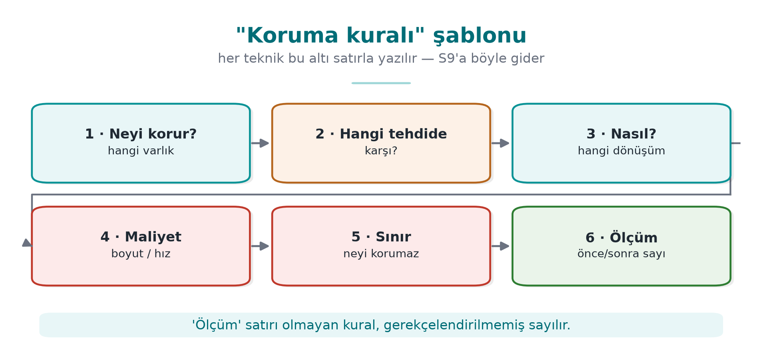
CEN429 Secure Programming · Week 9
Decision Rule (Write into S9)
RTEU Computer Engineering · 2026-2027 Fall
147

Slide 148
CEN429 Secure Programming · Week 9
Deobfuscation and Resilience
RTEU Computer Engineering · 2026-2027 Fall
148

Slide 149
CEN429 Secure Programming · Week 9
Why Should We Know the Other Side's Tools?
To measure resilience correctly.
We learn these to test our own defence — not to attack.
RTEU Computer Engineering · 2026-2027 Fall
149

Slide 150
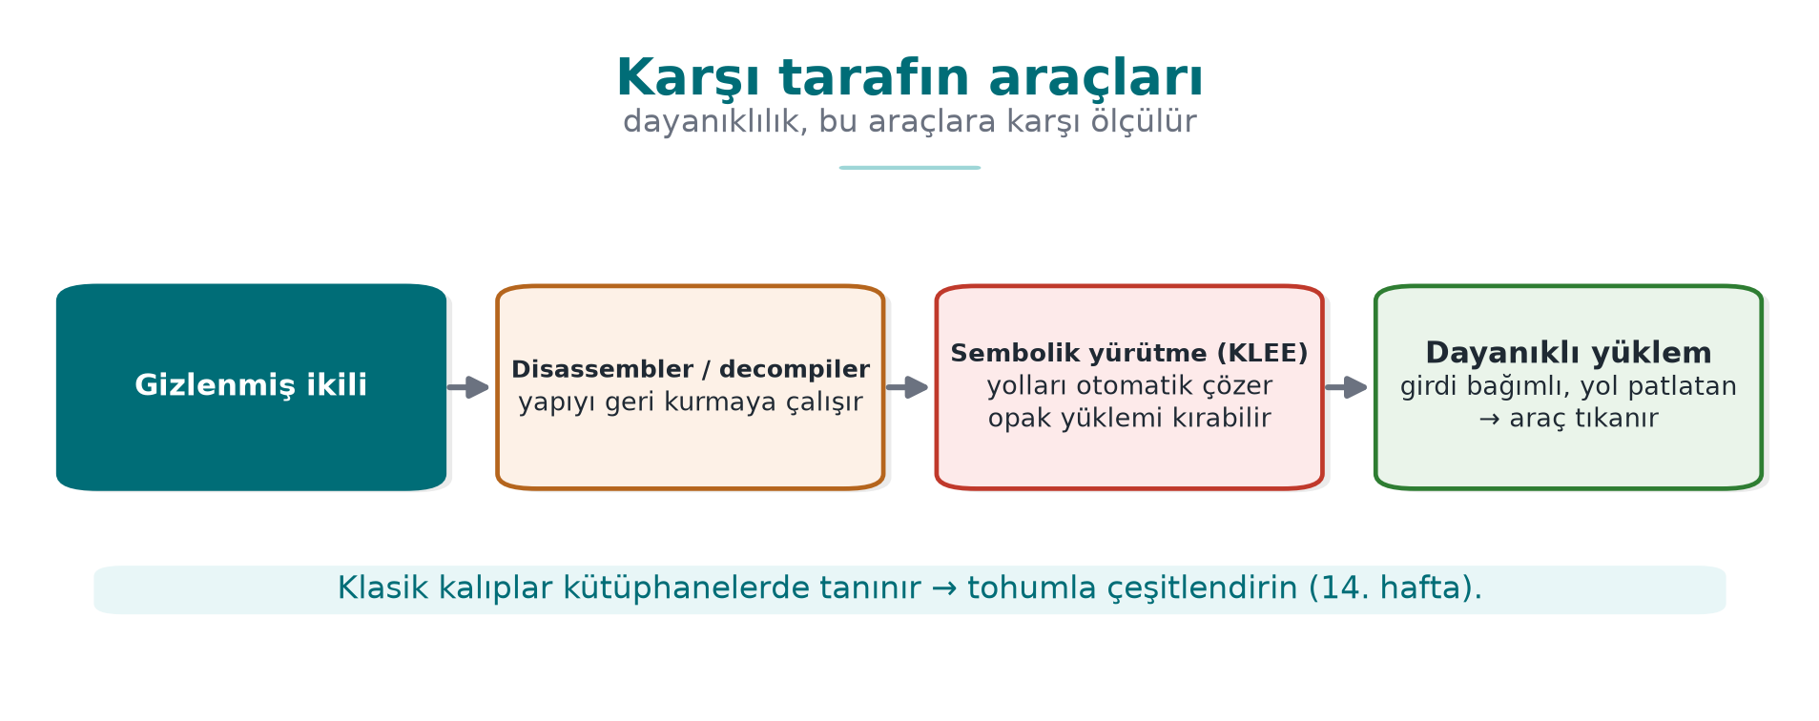
CEN429 Secure Programming · Week 9
The Other Side's Tools — Diagram
RTEU Computer Engineering · 2026-2027 Fall
150

Slide 151
CEN429 Secure Programming · Week 9
Tool 1 — Symbolic Execution (KLEE)
• Program paths are solved as mathematical constraints
• Opaque predicates and flattening can be undone this way
Resilience rule: tie opaque predicates to structures that are expensive to solve (factorization, hashing), grow the state space — but measure the cost.
RTEU Computer Engineering · 2026-2027 Fall
151

Slide 152
CEN429 Secure Programming · Week 9
Tool 2 — MBA Simplifier
• Undoes arithmetic encoding (K-02)
Rule: do not count arithmetic encoding as a secrecy layer on its own; combine it with control flow.
RTEU Computer Engineering · 2026-2027 Fall
152

Slide 153
CEN429 Secure Programming · Week 9
Tool 3 — Pattern Recognition
• Recognises known library/pass patterns
Rule: diversify; do not rely on a single opaque predicate pattern or a single VM design.
RTEU Computer Engineering · 2026-2027 Fall
153

Slide 154
CEN429 Secure Programming · Week 9
Main Takeaway
Banescu et al. (Tigress + KLEE): how much each transform withstands symbolic execution is measured.
Resilience is not a claim, it is a measured quantity.
Do not say "strong"; say "it withstood this much against this tool."
RTEU Computer Engineering · 2026-2027 Fall
154

Slide 155
CEN429 Secure Programming · Week 9
6. Layered Defence, Project, Closing
RTEU Computer Engineering · 2026-2027 Fall
155

Slide 156
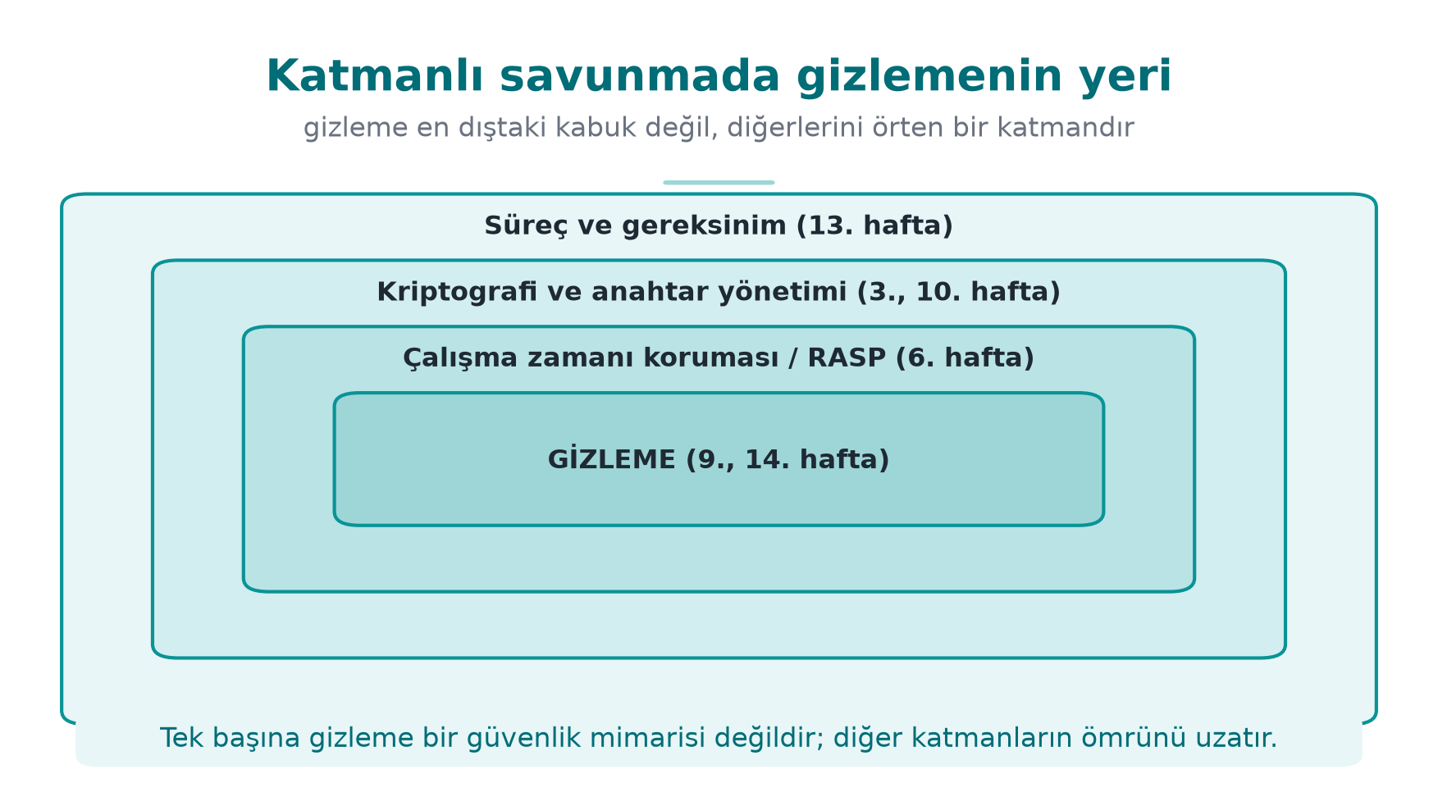
CEN429 Secure Programming · Week 9
Obfuscation in Layered Defence — Diagram
RTEU Computer Engineering · 2026-2027 Fall
156

Slide 157
CEN429 Secure Programming · Week 9
Obfuscation's Place in Layered Defence
Layer | Week | Relationship
Memory safety/secure compilation | 4 | Does not replace it; works together
RASP | 6 | Obfuscation also hides RASP; RASP protects obfuscation while it runs
Whitebox | 11 | The real protection for the key; obfuscation is the shell
Key renewal | 10 | Time "until it is renewed"
Certification | 12–13 | The delay is scored
RTEU Computer Engineering · 2026-2027 Fall
157

Slide 158
CEN429 Secure Programming · Week 9
An Observation from the Field
In a certified product, the native countermeasures cover all of this week's rules.
But the document notes, next to every one of them: "not strong on its own."
What convinces an evaluator: togetherness + diversification + measured delay.
RTEU Computer Engineering · 2026-2027 Fall
158

Slide 159
CEN429 Secure Programming · Week 9
Project · S9 (Advanced Hardening) — 1
1. Protection table
For 2–3 critical sections (license, key derivation, integrity), fill in the rule template:
what it protects · threat · how · cost · limit · measurement
RTEU Computer Engineering · 2026-2027 Fall
159

Slide 160
CEN429 Secure Programming · Week 9
Project · S9 — 2
2. Measurement
For at least one technique, before/after:
• Count of sensitive strings in strings output
• CFG node count
• Binary size, the duration of an operation
RTEU Computer Engineering · 2026-2027 Fall
160

Slide 161
CEN429 Secure Programming · Week 9
Project · S9 — 3, 4
3. Diversification decision: yes/no + justification
4. Limit and remaining risk: what does each protection not protect?
"This string obfuscation does not protect the key; for the key see S8 whitebox/hardware."
RTEU Computer Engineering · 2026-2027 Fall
161

Slide 162
CEN429 Secure Programming · Week 9
Through an Evaluator's Eyes
What S9 is graded on is not "I used a lot of techniques."
It is graded on: the justification and measurement of every technique.
An unmeasured protection = a claim. Not evidence.
RTEU Computer Engineering · 2026-2027 Fall
162

Slide 163
CEN429 Secure Programming · Week 9
Self-Check (1–6)
1. What is MATE? Why does it leave cryptography insufficient on its own?
2. "Makes it expensive" — give an asset-value example?
3. Bogus operation ≠ dead branch?
4. Why is flattening weak on its own? Name 3 reinforcements?
5. Which attack does random exit make harder?
6. Does string obfuscation protect the key?
RTEU Computer Engineering · 2026-2027 Fall
163

Slide 164
CEN429 Secure Programming · Week 9
Self-Check — Answers (1–6)
1. MATE = Man-At-The-End: the attacker fully possesses the device (memory, debugger, key). Crypto assumes a secure endpoint; under MATE the key is exposed while running → crypto alone is not enough.
2. Obfuscation does not mean unbreakable; it demands more time/skill/tools for the attack. If breaking 100 TL worth of content requires 10,000 TL of effort, the attacker gives up.
3. A bogus operation runs but its result is not used (it tires the analyst out); a dead branch, protected by an opaque predicate, never runs.
4. In flattening, the dispatcher pattern is recognisable and the state variable can be tracked. Reinforcements: opaque predicate · encrypting the state variable · bogus states/blocks + random exit.
5. It makes pattern-matching and automated-script attacks (expecting the same pattern for the same input) and symbolic execution harder.
6. No. String/table obfuscation makes static strings scanning harder, but the key is exposed in memory while running → whitebox/HSM is required.
RTEU Computer Engineering · 2026-2027 Fall
164

Slide 165
CEN429 Secure Programming · Week 9
Self-Check (7–12)
1. What are virtualisation's two costs?
2. Which OS protection does self-modifying code conflict with?
3. The four metrics; which ones trade off?
4. Does diversification prevent potency or scaling?
5. Which rules does KLEE break? How is resilience increased?
6. Fill in the rule template for a section.
RTEU Computer Engineering · 2026-2027 Fall
165

Slide 166
CEN429 Secure Programming · Week 9
Self-Check — Answers (7–12)
1. A large performance penalty (the interpreter is slow) + a size increase (VM + bytecode); maintenance/debugging difficulty.
2. W^X / DEP-NX (writable-and-executable memory is forbidden); writing to a code page needs mprotect/VirtualProtect, which is blocked or suspicious.
3. Potency · resilience · stealth · cost. Potency/resilience ↑ → cost ↑ and stealth ↓ (looks abnormal). Main trade-off: resilience ↔ cost.
4. It prevents scaling — it does not raise a single copy's strength; a crack does not spread to every copy (it breaks reuse of the attack).
5. KLEE is symbolic execution; it can solve opaque predicates/flattening. Rule: make predicates resistant to symbolic execution (input-dependent, hard to solve); path-exploding structures raise resilience.
6. Example: Rule [flattening] → Goal [hide the flow] → How [Tigress Flatten + opaque predicate] → Measurement [size +X%, speed −Y%, instructions N→M]. The measurement line is required.
RTEU Computer Engineering · 2026-2027 Fall
166

Slide 167
CEN429 Secure Programming · Week 9
Summary: This Week in One Sentence
Obfuscation does not give unbreakability, it raises cost; its strength comes from togetherness, diversification, and being measured.
RTEU Computer Engineering · 2026-2027 Fall
167

Slide 168
CEN429 Secure Programming · Week 9
Next Week
Week 10 — Certificates and Cryptographic Methods
We said "obfuscation does not protect the key" → choosing keys correctly, their lifecycle, PKI. Week 11 whitebox · week 14 Tigress (the automated form of these rules).
RTEU Computer Engineering · 2026-2027 Fall
168

Slide 169
CEN429 Secure Programming · Week 9
Appendix A · An End-to-End Worked Example
RTEU Computer Engineering · 2026-2027 Fall
169

Slide 170
CEN429 Secure Programming · Week 9
Goal
We take a single synthetic check (erisim_ver) and protect it layer by layer.
At every step: what was added · what we gained · what we paid.
RTEU Computer Engineering · 2026-2027 Fall
170
Notes:
Speaker note: This section combines all the rules in a single example; it can be done live on the board.

Slide 171
CEN429 Secure Programming · Week 9
Step 0 · Unprotected Start
int erisim_ver(const char *jeton) {
if (jeton_gecerli(jeton))
return IZIN; /* tek dal, tek dönüş */
return RED;
}
Weakness: a single branch, strings, bypassed with a single-byte patch.
RTEU Computer Engineering · 2026-2027 Fall
171

Slide 172
CEN429 Secure Programming · Week 9
Step 0 · What Does the Attacker Do?
• strings → IZIN/RED and the related strings
• Decompile → a single if, two returns
• Flip the failure branch to success (a single byte)
Time: minutes. Skill: low.
RTEU Computer Engineering · 2026-2027 Fall
172

Slide 173
CEN429 Secure Programming · Week 9
Step 1 · K-07 Encode the String/Constant
/* IZIN/RED ve dizgeler artık düz görünmez */
static int izin_kodu(void){ return 0x9E ^ 0x9F; } /* =1 */
• Gain: strings does not find the sensitive text
• Cost: very low
RTEU Computer Engineering · 2026-2027 Fall
173

Slide 174
CEN429 Secure Programming · Week 9
Step 1 · Measurement
Metric | Step 0 | Step 1
Sensitive strings in strings | 3 | 0
Binary size | baseline | +0.5%
The first layer is the cheapest and gives the highest return.
RTEU Computer Engineering · 2026-2027 Fall
174

Slide 175
CEN429 Secure Programming · Week 9
Step 2 · K-02 Arithmetic Encoding
/* karşılaştırma karmaşık ama denk bir ifadeye döner */
int esik = ((a ^ b) + 2*(a & b)); /* = a + b */
• Gain: the constant/computation is not directly readable
• Cost: low
RTEU Computer Engineering · 2026-2027 Fall
175

Slide 176
CEN429 Secure Programming · Week 9
Step 3 · K-04 Flatten
int durum = BASLA;
for(;;) switch(durum){
case BASLA: durum = kontrol()?ADIM:HATA; break;
case ADIM: durum = BITIR; break;
case HATA: return RED;
case BITIR: return IZIN;
}
No single if anymore; the order lives in the state variable.
RTEU Computer Engineering · 2026-2027 Fall
176

Slide 177
CEN429 Secure Programming · Week 9
Step 3 · What Changed?
• The CFG is now "horizontal" — the blocks sit in one switch
• Which branch means "success" cannot be read directly
• Cost: medium (more blocks/branches, a bit slower)
RTEU Computer Engineering · 2026-2027 Fall
177

Slide 178
CEN429 Secure Programming · Week 9
Step 4 · K-05 Random Exit
if (!kontrol()) { durum = kararsiz_deger(); break; } /* →default */
• Where the error was caught cannot be read from the flow
• A single-byte patch is no longer enough
RTEU Computer Engineering · 2026-2027 Fall
178

Slide 179
CEN429 Secure Programming · Week 9
Step 5 · K-03 Bogus + Dead
crc ^= (s ^ s); /* sahte işlem: sonuç aynı */
if (opak_yanlis()) sahte(); /* ölü dal: çalışmaz */
• The real logic sits in a crowd
• Cost: medium
RTEU Computer Engineering · 2026-2027 Fall
179

Slide 180
CEN429 Secure Programming · Week 9
Step 6 · K-08 Opaque Boolean
Karar k = izin_ver(); /* a^b==0xFFFF */
if (karar_izin_mi(k)) uygula();
• The result is not a plain 0/1 → a single byte cannot flip it
• Flipping it requires multiple points
RTEU Computer Engineering · 2026-2027 Fall
180

Slide 181
CEN429 Secure Programming · Week 9
The Cumulative Effect of the Layers
Step | Rule | Attack time (relative) | Cost
0 | — | 1× | —
1 | K-07 | 2× | very low
2 | K-02 | 3× | low
3 | K-04 | 8× | medium
4–6 | K-05/03/08 | 20×+ | medium
(Relative, for illustration; real values are measured.)
RTEU Computer Engineering · 2026-2027 Fall
181

Slide 182
CEN429 Secure Programming · Week 9
Step 7 · K-10 Virtualisation?
• Only for the most critical function
• Cost: high (tens of times slower)
• Unnecessary for most checks
Rule: do not go this far if the value is low.
RTEU Computer Engineering · 2026-2027 Fall
182

Slide 183
CEN429 Secure Programming · Week 9
End to End: Takeaway
• Every layer made the attack a little more expensive
• Every layer added a cost
• Where you stop depends on the asset's value and on what you measured
This table is exactly the protection table you will put into S9.
RTEU Computer Engineering · 2026-2027 Fall
183

Slide 184
CEN429 Secure Programming · Week 9
Appendix B · Reading and Measuring a CFG
RTEU Computer Engineering · 2026-2027 Fall
184

Slide 185
CEN429 Secure Programming · Week 9
What Is a CFG, and How Do You Read It?
• Node: a basic block (an instruction sequence with no branch)
• Edge: a transition between blocks (a branch)
• A decompiler (e.g., Ghidra) draws the CFG
We measure obfuscation's strength using node/edge count.
RTEU Computer Engineering · 2026-2027 Fall
185

Slide 186
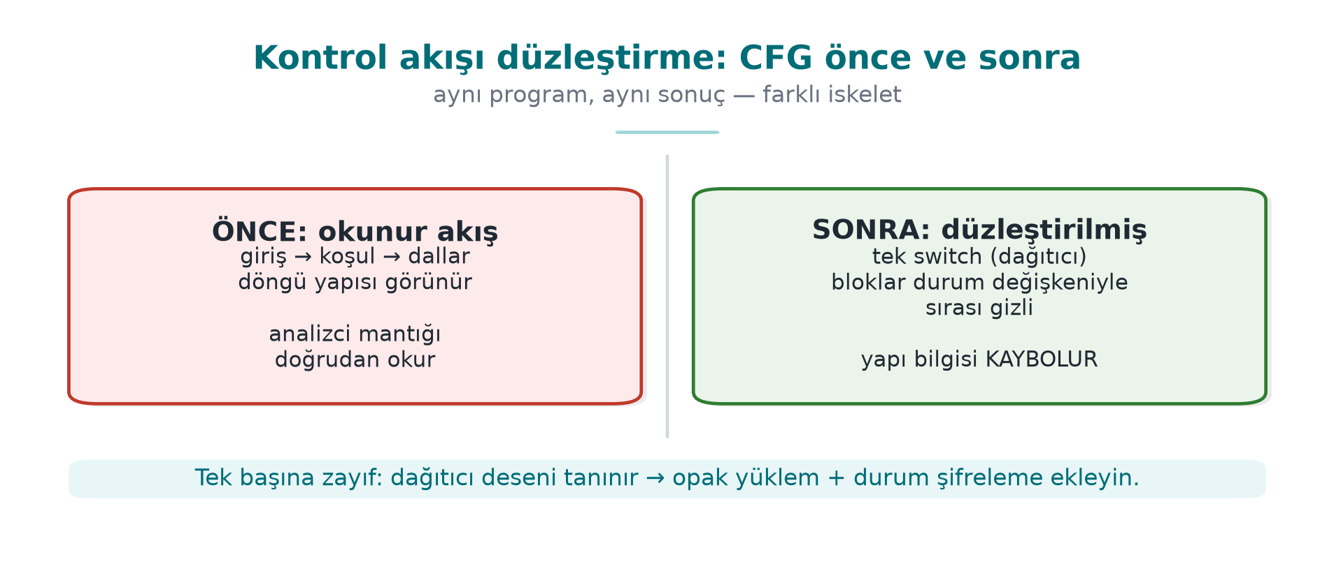
CEN429 Secure Programming · Week 9
Before Flattening (Concept)
Few nodes, readable flow.
RTEU Computer Engineering · 2026-2027 Fall
186

Slide 187
CEN429 Secure Programming · Week 9
After Flattening (Concept)
Many nodes, a single hub; "which block comes next" cannot be read.
RTEU Computer Engineering · 2026-2027 Fall
187

Slide 188
CEN429 Secure Programming · Week 9
Potency Measurement Example
Metric | Before | After
Basic blocks | 5 | 34
Edges | 6 | 60
Cyclomatic complexity | 3 | 28
You take these numbers from the decompiler and write them into S9.
RTEU Computer Engineering · 2026-2027 Fall
188

Slide 189
CEN429 Secure Programming · Week 9
Cost Measurement Example
size ./program_temiz ./program_gizli # boyut
# süre: aynı girdiyle N kez çalıştır, ortalama
Metric | Before | After
Size | 100 KB | 128 KB
Runtime | 1.0× | 1.7×
RTEU Computer Engineering · 2026-2027 Fall
189

Slide 190
CEN429 Secure Programming · Week 9
Interpreting the Measurement
• Potency ↑ (34 blocks) and cost ↑ (28% size, 1.7× time)
• This trade-off is expected
• Decision: is the gain acceptable given the asset's value?
Do not say "strong"; show these numbers.
RTEU Computer Engineering · 2026-2027 Fall
190

Slide 191
CEN429 Secure Programming · Week 9
Appendix C · Increasing Resilience
RTEU Computer Engineering · 2026-2027 Fall
191

Slide 192
CEN429 Secure Programming · Week 9
Against Symbolic Execution — Step by Step
1. Flattening alone → the solver resolves the paths
2. Tie the opaque predicate to a structure that is expensive to solve
3. Grow the state space (more cases)
4. Measure the cost — resilience can grow exponentially, and so can cost
RTEU Computer Engineering · 2026-2027 Fall
192

Slide 193
CEN429 Secure Programming · Week 9
Against Pattern Recognition — Step by Step
1. A single opaque predicate pattern → recognisable
2. Use multiple patterns
3. Diversify (seed)
4. Change the patterns with every release (in time)
RTEU Computer Engineering · 2026-2027 Fall
193

Slide 194
CEN429 Secure Programming · Week 9
Against the MBA Simplifier
1. Do not count arithmetic encoding on its own
2. Use it interleaved with control flow
3. Tie encoded constants to opaque predicates
Layers being interlinked makes them harder to solve separately.
RTEU Computer Engineering · 2026-2027 Fall
194

Slide 195
CEN429 Secure Programming · Week 9
Resilience: the Golden Rule
Produce a number:
"This transform pipeline, against this tool, did not let it solve a problem of this size within this time."
Not a claim, a measurement.
RTEU Computer Engineering · 2026-2027 Fall
195

Slide 196
CEN429 Secure Programming · Week 9
Appendix D · Terms and Closing
RTEU Computer Engineering · 2026-2027 Fall
196

Slide 197
CEN429 Secure Programming · Week 9
Glossary (1)
Term | Meaning
MATE / white box | An attacker who possesses the program
Opaque predicate | A condition whose value the programmer knows, that the tool struggles to resolve
Flattening | Moving the flow into a single switch
Bogus operation | Code that runs but does not change the result
Dead branch | A branch (protected by an opaque predicate) that never runs
RTEU Computer Engineering · 2026-2027 Fall
197

Slide 198
CEN429 Secure Programming · Week 9
Glossary (2)
Term | Meaning
Opaque boolean | A true/false value that cannot be flipped with a single byte
Virtualisation | Turning a function into custom VM bytecode
Diversification | Structurally different copies from the same source
Potency/resilience/stealth/cost | The obfuscation metrics
RTEU Computer Engineering · 2026-2027 Fall
198

Slide 199
CEN429 Secure Programming · Week 9
Sources
• Cookbook (Viega & Messier) Chapter 12 — anti-tampering
• Secure programming technical guide — native countermeasures
• Collberg & Nagra, Surreptitious Software — taxonomy, measurement
• Schrittwieser et al. (ACM CSUR 2016) — overview, deobfuscation
• Banescu et al. — Tigress + KLEE resilience measurement
• Obfuscator-LLVM — compiler-based
RTEU Computer Engineering · 2026-2027 Fall
199

Slide 200
CEN429 Secure Programming · Week 9
What Carries Over to the Project from This Week
• S9: protection table (rule template) + measurement + diversification decision + remaining risk
• S15: (week 14) putting obfuscation into the build pipeline
• S16: (week 12) testing that obfuscation does not break behaviour
RTEU Computer Engineering · 2026-2027 Fall
200

Slide 201
CEN429 Secure Programming · Week 9
Final Word
Obfuscation is not a fortress, it is a delaying layer.
Its strength: togetherness + diversification + measurement.
For the key: cryptography (10) and whitebox (11). Automation: Tigress (14).
RTEU Computer Engineering · 2026-2027 Fall
201

