Slide 1

CEN429 Secure Programming · Week 7
Midterm Project Demonstrations
CEN429 Secure Programming — Week 7
Asst. Prof. Dr. Uğur CORUH · 30.10.2026
RTEU Computer Engineering · 2026-2027 Fall
Notes:
Speaker note: This week is not a lecture but a demonstration week: each team shows the midterm sections of its security guide and its working application.

Slide 2
CEN429 Secure Programming · Week 7
This Week: Midterm Project Demonstrations (RAP1)
• No lecture; each team submits its interim report and demonstrates its application
• RAP1 = 60% of the midterm · Quiz-1 = 40% → Grade_Midterm = 0.6·RAP1 + 0.4·QUIZ1
• Detailed rubric: project guide · order, timing, submission time: in class
• ⚠️ Late submissions are not accepted
RTEU Computer Engineering · 2026-2027 Fall
2

Slide 3
CEN429 Secure Programming · Week 7
Midterm Rubric: Five Criteria
Criterion | LO | Guide
Security analysis | 1 | S2 · S3 interface table · S4 threat/attacker model
Data security | 2 | S5 asset list · S7 shell matrix
C/C++ hardening and RASP | 3 | S9 (basic) · S10
Project management | 5 | S13 process, SBOM · GitHub repo and plan
Interim report | 7 | All midterm sections
RTEU Computer Engineering · 2026-2027 Fall
3

Slide 4
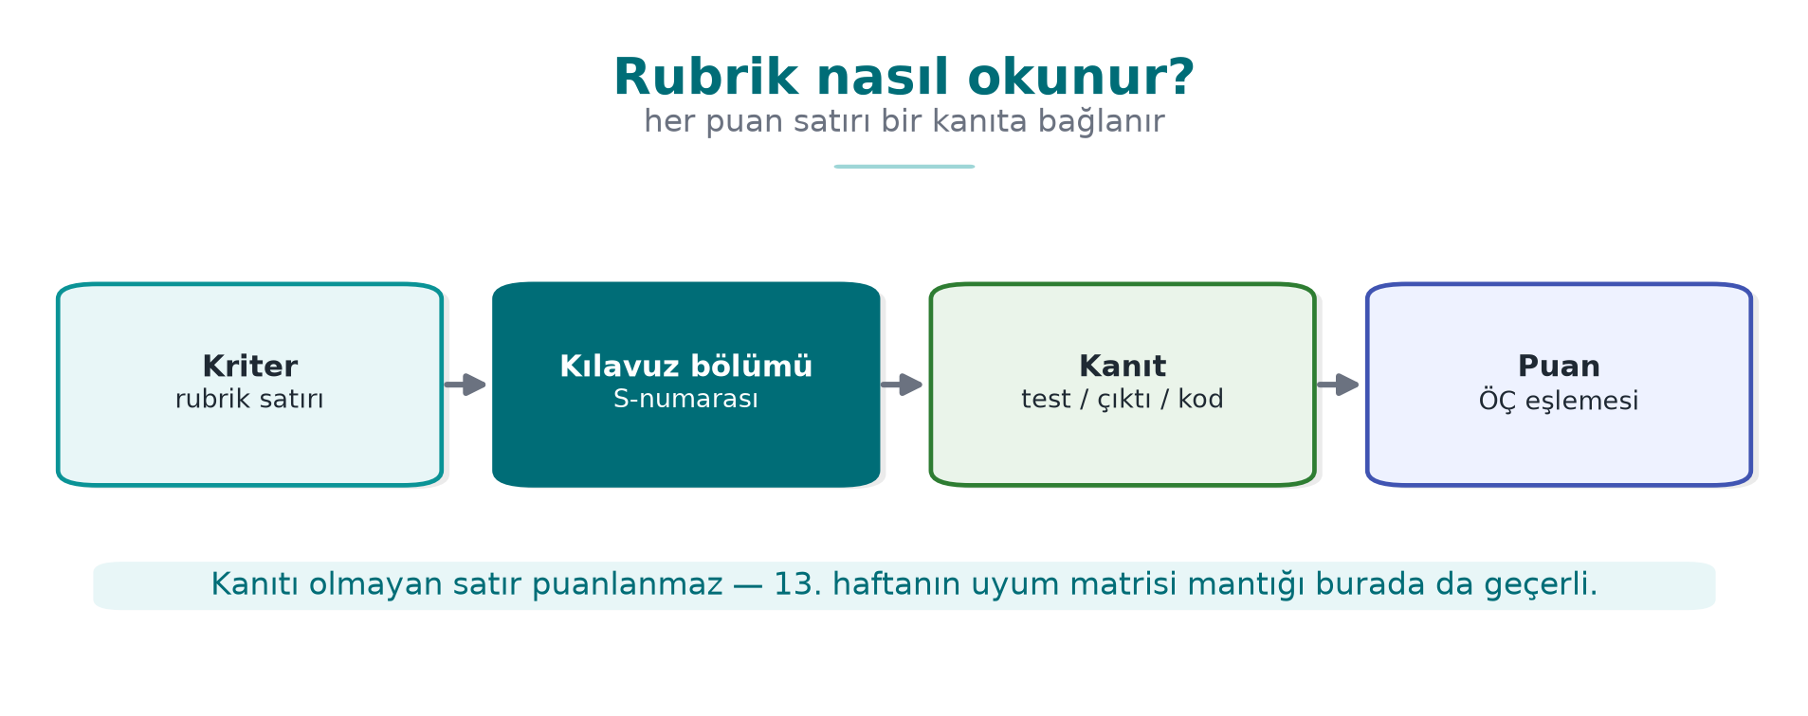
CEN429 Secure Programming · Week 7
How the Rubric Is Read — Diagram
RTEU Computer Engineering · 2026-2027 Fall
4

Slide 5
CEN429 Secure Programming · Week 7
Which Sections in the Interim Report?
Complete | Draft / brief / plan
S0 cover · S2 overview · S3 architecture · S4 threat model | S1 scope (draft) · S5 assets (draft)
S7 data security · S10 RASP · S13 process | S9 hardening (basic) · S12 reporting (brief)
 | S16 testing (plan) · S17 compliance matrix (draft)
Left for the final: S6 · S8 · S11 · S14 · S15
RTEU Computer Engineering · 2026-2027 Fall
5

Slide 6
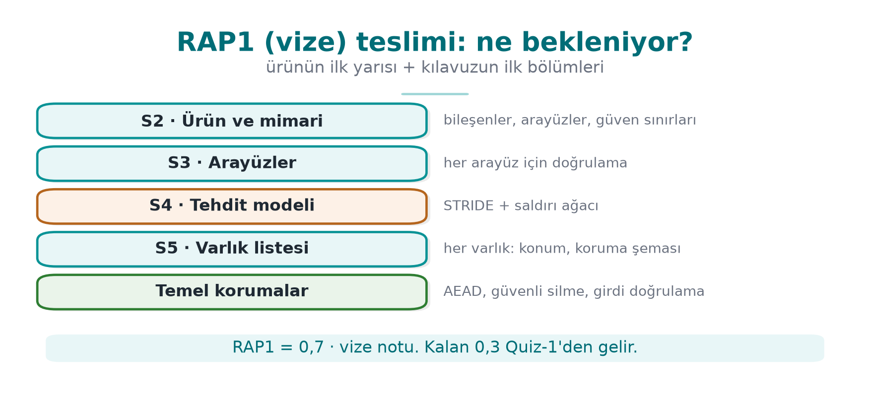
CEN429 Secure Programming · Week 7
RAP1 Submission — Diagram
RTEU Computer Engineering · 2026-2027 Fall
6

Slide 7
CEN429 Secure Programming · Week 7
Preparation Checklist
Week | What you should be able to show
1 | Repo + plan · S2 · S3 interface table · S4 STRIDE + attack tree · S5 draft
2 | Every threat → CWE + CVSS v3.1 vector
3 | S7 algorithm/key/binding · shell matrix · CSPRNG · AEAD verification
4 | S9 protection table · CERT findings · ASan+UBSan · fuzz result
5 | SBOM + scan · input validation table
6 | S10 RASP inventory · response policy · a bypass attempt
RTEU Computer Engineering · 2026-2027 Fall
7

Slide 8
CEN429 Secure Programming · Week 7
Suggested Demonstration Flow
1. Product and architecture (S2–S3): one diagram, trust boundaries
2. Threats and assets (S4–S5): the three most critical threats
3. Live demonstration: at least one control working live
4. Evidence: protection table, sanitizer/fuzz, SBOM — command + output
5. Remaining risk and plan: what remains before the final?
For every control: What does it protect? · How was it built? · How was it proven?
RTEU Computer Engineering · 2026-2027 Fall
8

Slide 9
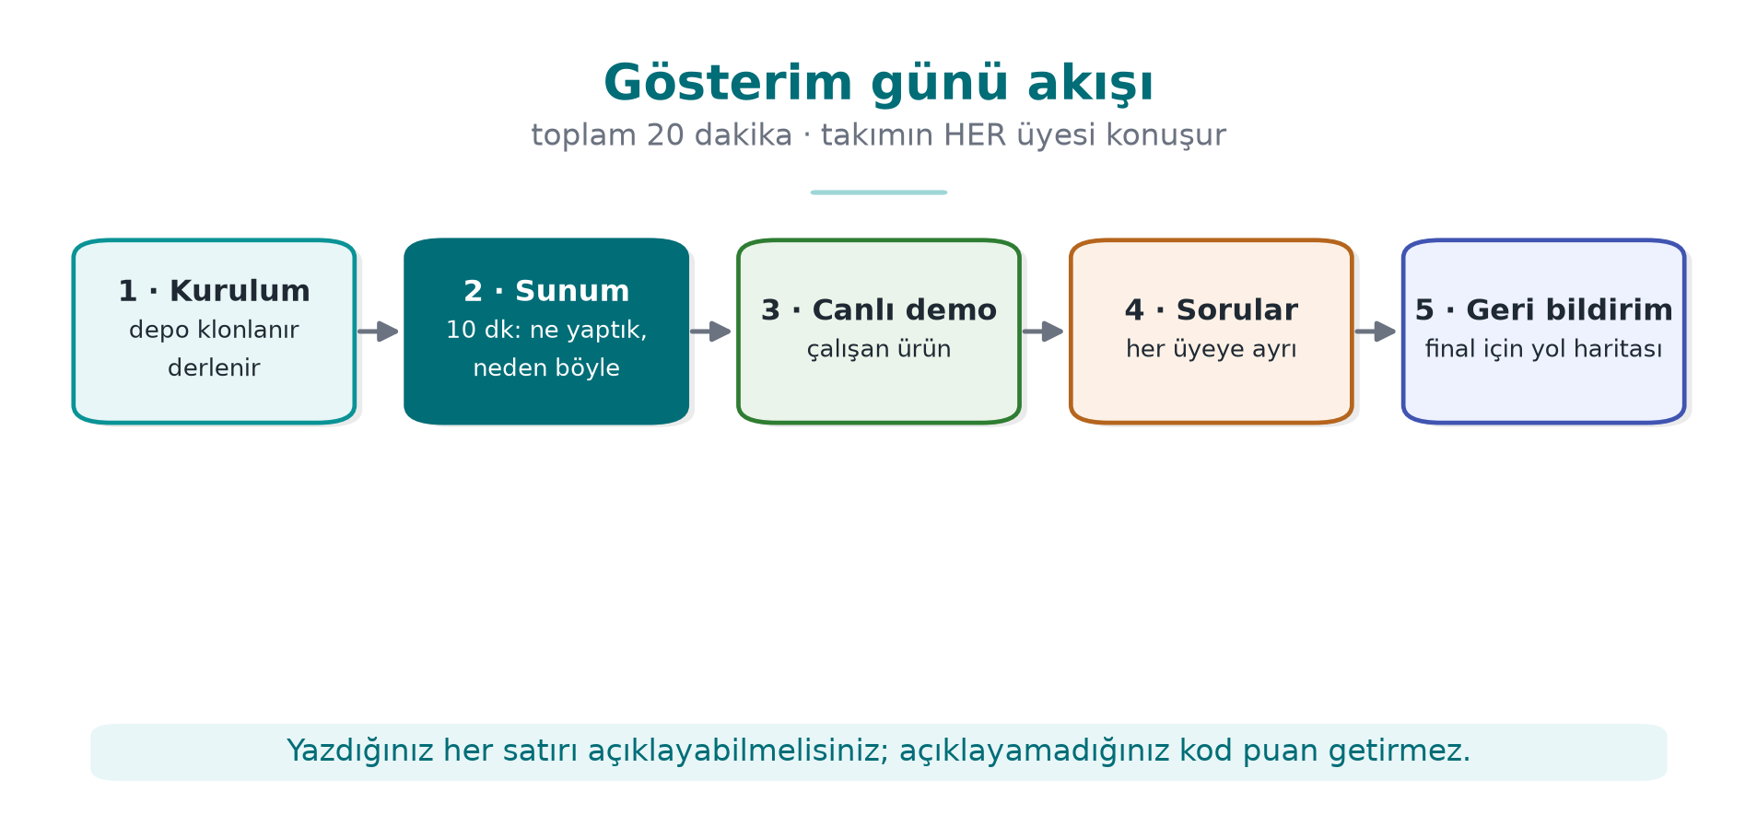
CEN429 Secure Programming · Week 7
Demonstration Day Flow — Diagram
RTEU Computer Engineering · 2026-2027 Fall
9

Slide 10
CEN429 Secure Programming · Week 7
Sample Questions
• Which flow crossing a trust boundary is the riskiest?
• How long does this asset stay unencrypted in memory, and where is it wiped?
• Where does the key come from, where does it live? Can the nonce repeat?
• Which compiler protection is turned off, and why?
• What happens when a RASP check fails?
• Does the SBOM contain a vulnerable component? Are you affected?
RTEU Computer Engineering · 2026-2027 Fall
10

Slide 11
CEN429 Secure Programming · Week 7
Common Mistakes
Mistake | Why is it a problem?
Guide and code are inconsistent | One of the most serious findings
"Secure" claimed without evidence | Not scored
Keys/logs/code missing from the asset list | What is not in the list is not protected
Threat table from general knowledge | Project-specific threats get missed
Unrehearsed demonstration | Time is wasted
Real password/key/personal data in the repo | A serious security mistake; values must be synthetic
RTEU Computer Engineering · 2026-2027 Fall
11

Slide 12
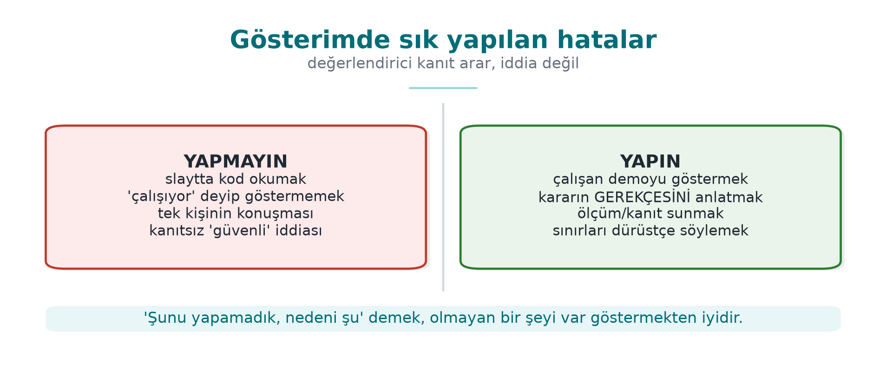
CEN429 Secure Programming · Week 7
Common Mistakes — Diagram
RTEU Computer Engineering · 2026-2027 Fall
12

Slide 13
CEN429 Secure Programming · Week 7
Academic Integrity and After
• Uncredited code/text, work from outside the team, fabricated results are not acceptable
• Every submitted line must be explainable
• Any team member may be asked a question
After the demonstration: write the feedback as a finding list (finding · severity · fix · date) → a small model of Week 12
Final sections: S6 · S8 · S11 · S14 · S15 · S16 results · S17
RTEU Computer Engineering · 2026-2027 Fall
13

Slide 14
CEN429 Secure Programming · Week 7
Next Week
Week 8 — Midterm Exam Week: Quiz-1
• Scope: weeks 1–6
• Study guide and sample questions: Week 8 page
RTEU Computer Engineering · 2026-2027 Fall
14

Slide 15
CEN429 Secure Programming · Week 7
Appendix · Rubric Item by Item
RTEU Computer Engineering · 2026-2027 Fall
15
Notes:
Speaker note: For the midterm demonstration (RAP1), we explain what evidence each rubric item expects.

Slide 16
CEN429 Secure Programming · Week 7
What Does the Rubric Measure?
The midterm demonstration measures the first half of your project:
• product, architecture, threat model
• asset management
• basic protections
• documentation and presentation
RTEU Computer Engineering · 2026-2027 Fall
16

Slide 17
CEN429 Secure Programming · Week 7
Item · Product and Architecture
• What does it do, which components?
• One diagram + the three most critical assets.
• Evidence: S2–S4 documentation.
RTEU Computer Engineering · 2026-2027 Fall
17

Slide 18
CEN429 Secure Programming · Week 7
Item · Threat Model
• STRIDE / attack tree.
• A control for every threat.
• Evidence: S4 threat table.
RTEU Computer Engineering · 2026-2027 Fall
18

Slide 19
CEN429 Secure Programming · Week 7
Item · Asset Management
• Asset list + C/I/I+.
• Lifecycle.
• Evidence: S5.
RTEU Computer Engineering · 2026-2027 Fall
19

Slide 20
CEN429 Secure Programming · Week 7
Item · Basic Protections
• Cryptography (S8, partial), secure code (S9, partial).
• Evidence: code + tests.
RTEU Computer Engineering · 2026-2027 Fall
20

Slide 21
CEN429 Secure Programming · Week 7
Item · Documentation and Presentation
• Consistency, version identity.
• Clear delivery.
• Evidence: the entire guide.
RTEU Computer Engineering · 2026-2027 Fall
21

Slide 22
CEN429 Secure Programming · Week 7
Appendix · Demonstration Flow
RTEU Computer Engineering · 2026-2027 Fall
22

Slide 23
CEN429 Secure Programming · Week 7
Flow · 1. Summary
• Product, architecture, the three most critical assets.
• One diagram, two minutes.
RTEU Computer Engineering · 2026-2027 Fall
23

Slide 24
CEN429 Secure Programming · Week 7
Flow · 2. Threat Model
• One example from STRIDE and the attack tree.
• "This threat, that control."
RTEU Computer Engineering · 2026-2027 Fall
24

Slide 25
CEN429 Secure Programming · Week 7
Flow · 3. Live Demonstration
• Show a control working live.
• E.g., encrypted data, a verified signature.
RTEU Computer Engineering · 2026-2027 Fall
25

Slide 26
CEN429 Secure Programming · Week 7
Flow · 4. Evidence
• Tests, protection table.
• "This command, this output."
RTEU Computer Engineering · 2026-2027 Fall
26

Slide 27
CEN429 Secure Programming · Week 7
Flow · 5. Remaining Risk
• What did you deliberately scope out?
• Honest analysis earns points.
RTEU Computer Engineering · 2026-2027 Fall
27

Slide 28
CEN429 Secure Programming · Week 7
Appendix · Preparation Checklist
RTEU Computer Engineering · 2026-2027 Fall
28

Slide 29
CEN429 Secure Programming · Week 7
Checklist · Documentation
•
•
•
RTEU Computer Engineering · 2026-2027 Fall
29

Slide 30
CEN429 Secure Programming · Week 7
Checklist · Demonstration
•
•
•
RTEU Computer Engineering · 2026-2027 Fall
30

Slide 31
CEN429 Secure Programming · Week 7
Checklist · Security
•
•
•
RTEU Computer Engineering · 2026-2027 Fall
31

Slide 32
CEN429 Secure Programming · Week 7
Appendix · Sample Questions
RTEU Computer Engineering · 2026-2027 Fall
32

Slide 33
CEN429 Secure Programming · Week 7
Question 1
Your three most critical assets and their C/I/I+ labels?
Keep your answer ready; know the lifecycle of every asset.
RTEU Computer Engineering · 2026-2027 Fall
33

Slide 34
CEN429 Secure Programming · Week 7
Question 2
Which control against this threat, and how was it verified?
Show the threat → control → evidence chain.
RTEU Computer Engineering · 2026-2027 Fall
34

Slide 35
CEN429 Secure Programming · Week 7
Question 3
Where does this key come from, where does it live, when is it deleted?
Explain the key's lifecycle.
RTEU Computer Engineering · 2026-2027 Fall
35

Slide 36
CEN429 Secure Programming · Week 7
Question 4
What is your remaining risk? Why is it acceptable?
Answer honestly and with justification.
RTEU Computer Engineering · 2026-2027 Fall
36

Slide 37
CEN429 Secure Programming · Week 7
Appendix · Common Mistakes
RTEU Computer Engineering · 2026-2027 Fall
37

Slide 38
CEN429 Secure Programming · Week 7
Mistake List
• Guide and code version differ.
• "Done" without evidence.
• Live demo crashes (no backup).
• Remaining-risk section is empty.
• Real data in the repo.
RTEU Computer Engineering · 2026-2027 Fall
38

Slide 39
CEN429 Secure Programming · Week 7
Final Word (RAP1)
A demonstration is a presentation of evidence: every claim should be backed by a document, a test, or live output.
Midterm feedback becomes a finding–action list at the final.
RTEU Computer Engineering · 2026-2027 Fall
39

