Slide 1

CEN429 Secure Programming · Week 5
Code Hardening: Java and Interpreted Languages
CEN429 Secure Programming — Week 5
Asst. Prof. Dr. Uğur CORUH · 16.10.2026
RTEU Computer Engineering · 2026-2027 Fall
Notes:
Speaker note: This week we move to managed languages: memory safety comes for free, but injection, deserialisation, readable bytecode and dependencies bring new risks.
Speaker note: This week we move to managed languages: memory safety comes for free, but injection, deserialisation, readable bytecode and dependencies bring new risks.
Speaker note: This week we move to managed languages: memory safety comes for free, but injection, deserialisation, readable bytecode and dependencies bring new risks.

Slide 2
CEN429 Secure Programming · Week 5
Today's plan (3 hours)
Hour | Section | Topic
1 | 0–3 | Basic concepts · managed languages · CERT Java · the root of injection
2 | 4–9 | SQL/command/path injection · deserialisation · XML/XXE · Python/JS
3 | 10–16 | Bytecode · ProGuard/R8 · string obfuscation · Android · SBOM · project
RTEU Computer Engineering · 2026-2027 Fall
2
Notes:
Speaker note: We cover Java/interpreted languages' counterpart of week 4's C/C++ material. We assume zero prior knowledge; every term will be defined.

Slide 3
CEN429 Secure Programming · Week 5
Short history — managed languages and the gaps that remain
• 1995 — Java/JVM: most memory bugs end at the language level
• 1998 — SQL injection is documented · 2003 OWASP Top 10
• 2002 — ProGuard (later R8): because bytecode is easy to reverse
• 2015 deserialisation · 2020–21 SolarWinds and Log4Shell → the SBOM era
The language solves memory bugs; it does not solve injection or dependency risk.
RTEU Computer Engineering · 2026-2027 Fall
3

Slide 4
CEN429 Secure Programming · Week 5
Where does this week fit?
• Week 4: C/C++ hardening (memory bugs).
• This week (5): Java/interpreted languages — most memory bugs are solved, but a new class appears: injection and dependency.
• The binary-protection side: ProGuard/R8 and SBOM.
RTEU Computer Engineering · 2026-2027 Fall
4

Slide 5
CEN429 Secure Programming · Week 5
Learning outcome
This week is about LO.3 / LO.4.
By the end you will be able to:
• Recognise and prevent the injection class (SQL, command, path, XML, deserialisation)
• Obfuscate with ProGuard/R8 and write -keep rules
• Produce an SBOM and manage dependency risk
RTEU Computer Engineering · 2026-2027 Fall
5

Slide 6
CEN429 Secure Programming · Week 5
Main idea
A managed language largely solves memory bugs; but data mixing with commands (injection) exists in every language.
Today we look at this common root and the language-specific defences.
RTEU Computer Engineering · 2026-2027 Fall
6

Slide 7
CEN429 Secure Programming · Week 5
0. Basic concepts (from scratch)
RTEU Computer Engineering · 2026-2027 Fall
7
Notes:
Speaker note: We define basic Java/web terms from scratch.

Slide 8
CEN429 Secure Programming · Week 5
Why this section exists
This section assumes no prior knowledge.
• We define, from scratch, the terms we will use for the rest of the week.
• If you do not know a term, read here first.
• The sections that follow build on top of these terms.
RTEU Computer Engineering · 2026-2027 Fall
8

Slide 9
CEN429 Secure Programming · Week 5
What is a managed language?
• Managed language: a language that manages memory automatically (Java, C#, Python, JS).
• The programmer does not call malloc/free; the garbage collector (GC) handles it.
• → most memory bugs (overflow, UAF) disappear.
RTEU Computer Engineering · 2026-2027 Fall
9

Slide 10
CEN429 Secure Programming · Week 5
The JVM and bytecode
• JVM (Java Virtual Machine): the virtual machine that runs Java.
• Bytecode: the intermediate form Java source is compiled into (.class files).
• Bytecode is machine-independent; the JVM executes it.
RTEU Computer Engineering · 2026-2027 Fall
10

Slide 11
CEN429 Secure Programming · Week 5
The garbage collector (GC)
• GC (Garbage Collector): automatically cleans up objects that are no longer used.
• The programmer never frees memory by hand.
• This is why UAF/double free is almost nonexistent in Java.
RTEU Computer Engineering · 2026-2027 Fall
11

Slide 12
CEN429 Secure Programming · Week 5
What is injection?
• Injection: user data being interpreted as a command.
• Example: text entered as a username leaking into a SQL query as a command.
• The main theme of this week.
RTEU Computer Engineering · 2026-2027 Fall
12

Slide 13
CEN429 Secure Programming · Week 5
SQL and databases
• SQL: a database query language (SELECT ... WHERE ...).
• The application puts user input into the query.
• If put in wrong → SQL injection.
RTEU Computer Engineering · 2026-2027 Fall
13

Slide 14
CEN429 Secure Programming · Week 5
Parameterised query
• Parameterised query (prepared statement): the query skeleton is fixed; the data is supplied separately, as parameters.
• Data is never interpreted as a command.
• The real fix against SQL injection.
RTEU Computer Engineering · 2026-2027 Fall
14

Slide 15
CEN429 Secure Programming · Week 5
Serialisation
• Serialisation: converting an object to a byte sequence (to save or send it).
• Deserialisation: converting the bytes back into an object.
• Deserialising untrusted bytes is dangerous (code execution).
RTEU Computer Engineering · 2026-2027 Fall
15

Slide 16
CEN429 Secure Programming · Week 5
XML and XXE
• XML: a structured data format (built from tags).
• XXE (XML External Entity): abuse of XML's "external entity" feature → file reading, SSRF.
• External entities are disabled in the XML parser.
RTEU Computer Engineering · 2026-2027 Fall
16

Slide 17
CEN429 Secure Programming · Week 5
Path traversal
• Path traversal: escaping outside the allowed folder with ../.
• Like files/../../etc/passwd.
• Prevented with canonicalisation + a root check.
RTEU Computer Engineering · 2026-2027 Fall
17

Slide 18
CEN429 Secure Programming · Week 5
ProGuard and R8
• ProGuard / R8: tools that shrink Java/Android bytecode and obfuscate names.
• R8 is Android's default tool.
• Name obfuscation + dead-code elimination + shrinking.
RTEU Computer Engineering · 2026-2027 Fall
18

Slide 19
CEN429 Secure Programming · Week 5
The -keep rule
• `-keep`: telling ProGuard/R8 "do not change this class's/method's name."
• Code called by name through reflection has to be kept.
• A wrong -keep → either a crash or weak obfuscation.
RTEU Computer Engineering · 2026-2027 Fall
19

Slide 20
CEN429 Secure Programming · Week 5
What is reflection?
• Reflection: finding and calling a class/method by its name, at run time.
• Class.forName("..."), getMethod("...").
• Obfuscation can break this → -keep is required.
RTEU Computer Engineering · 2026-2027 Fall
20

Slide 21
CEN429 Secure Programming · Week 5
What is an SBOM?
• SBOM (Software Bill of Materials): the software's bill of materials — which libraries, which versions.
• When a vulnerability is disclosed in a library, it answers "are we affected?" quickly.
• Formats: CycloneDX, SPDX.
RTEU Computer Engineering · 2026-2027 Fall
21

Slide 22
CEN429 Secure Programming · Week 5
Dependency
• Dependency: the external libraries your project uses.
• Even if your own code is secure, a flaw in a dependency affects you.
• Supply-chain security.
RTEU Computer Engineering · 2026-2027 Fall
22

Slide 23
CEN429 Secure Programming · Week 5
Now we are ready
Terms:
managed language · JVM/bytecode · GC · injection · SQL/parameterised query · serialisation · XML/XXE · path traversal · ProGuard/R8 · -keep · reflection · SBOM · dependency
Now: what do managed languages solve, and what do they not solve?
RTEU Computer Engineering · 2026-2027 Fall
23

Slide 24
CEN429 Secure Programming · Week 5
1. Managed languages and the root of injection
RTEU Computer Engineering · 2026-2027 Fall
24

Slide 25
CEN429 Secure Programming · Week 5
What does a managed language solve?
• Automatic memory management (GC) → overflow, UAF, double free are largely gone.
• Array access is bounds-checked → ArrayIndexOutOfBounds (a crash, not exploitation).
• Type safety is stricter.
RTEU Computer Engineering · 2026-2027 Fall
25

Slide 26
CEN429 Secure Programming · Week 5
What does a managed language NOT solve?
• Injection (data = command) — exists in every language.
• Logic errors, authorisation errors.
• Dependency vulnerabilities.
• Deserialisation attacks.
Memory bugs went down; the new front is injection and the supply chain.
RTEU Computer Engineering · 2026-2027 Fall
26

Slide 27
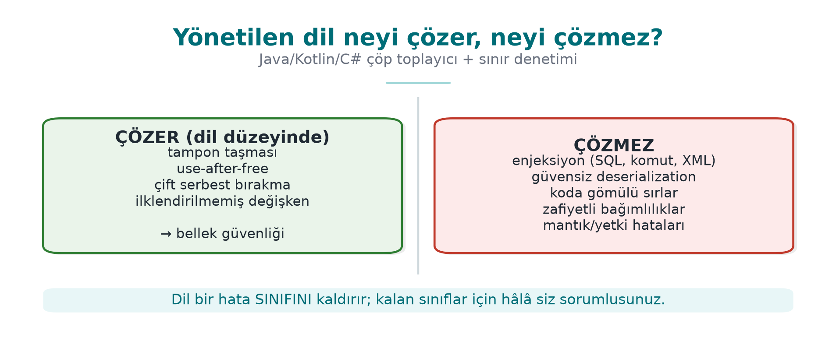
CEN429 Secure Programming · Week 5
Managed language: solves / does not solve — diagram
RTEU Computer Engineering · 2026-2027 Fall
27

Slide 28
CEN429 Secure Programming · Week 5
SEI CERT Oracle Java
• A separate rule book for Java (CERT Oracle Coding Standard for Java).
• Same structure: noncompliant example + compliant solution + risk.
• Sample areas: injection, serialisation, concurrency, sensitive data.
RTEU Computer Engineering · 2026-2027 Fall
28

Slide 29
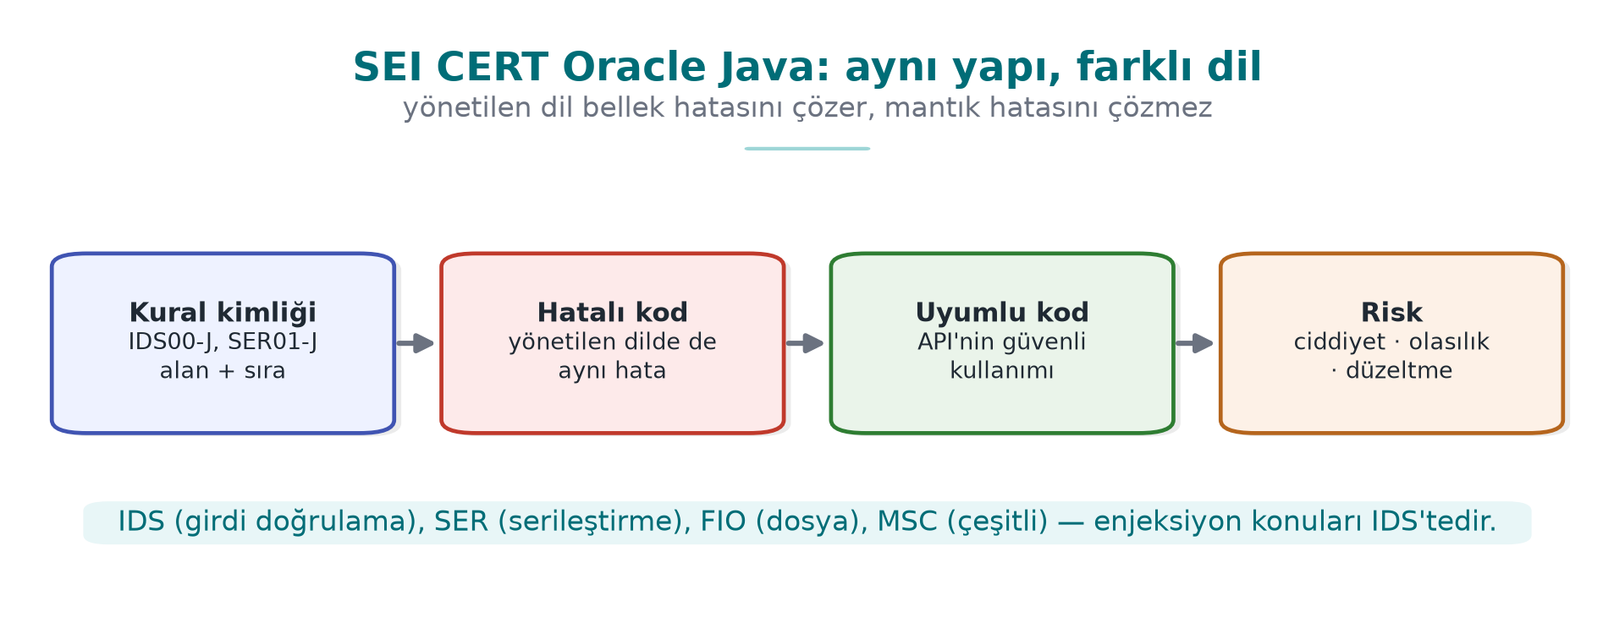
CEN429 Secure Programming · Week 5
CERT Oracle Java — diagram
RTEU Computer Engineering · 2026-2027 Fall
29

Slide 30
CEN429 Secure Programming · Week 5
SEI CERT · rules touching this week
Prefix | Category | Rule (example)
IDS | Input validation | IDS00-J SQL · IDS07-J Runtime.exec · IDS16/17-J XML
FIO | Input/output | FIO16-J: canonicalise path names
SER | Serialisation | SER12-J: do not deserialise untrusted data
MSC | Miscellaneous | MSC03-J: do not embed sensitive information in code
ERR | Error handling | ERR01-J: do not leak sensitive information in an exception
IDs end with the -J suffix.
RTEU Computer Engineering · 2026-2027 Fall
30

Slide 31
CEN429 Secure Programming · Week 5
Sensitive data in Java
• Java String is immutable → it cannot be erased from memory.
• For a password/key use char[], and fill it (Arrays.fill) once you are done.
• The GC does not guarantee when it will collect.
RTEU Computer Engineering · 2026-2027 Fall
31

Slide 32
CEN429 Secure Programming · Week 5
The common root of injection
Injection = data mixing with command.
• User data goes to an interpreter (SQL, shell, XML) as a command.
• The root is the same; the target (SQL/shell/XML) changes.
RTEU Computer Engineering · 2026-2027 Fall
32

Slide 33
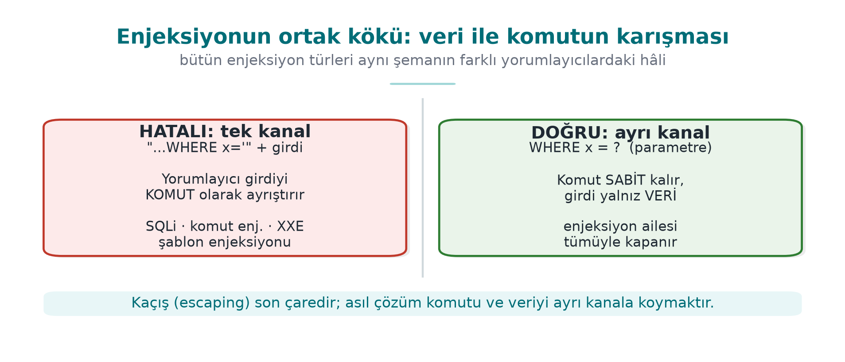
CEN429 Secure Programming · Week 5
The root of injection — data or code? — diagram
RTEU Computer Engineering · 2026-2027 Fall
33

Slide 34
CEN429 Secure Programming · Week 5
The common root of the fix
The same principle in every injection type:
• Separate data from code (a parameterised API).
• Never embed data into a command via string concatenation.
• Allow list + context-appropriate escaping (last resort).
RTEU Computer Engineering · 2026-2027 Fall
34

Slide 35
CEN429 Secure Programming · Week 5
One channel or two channels? — table
Interpreter | One channel (wrong) | Two channels (correct)
SQL engine | "...WHERE name='" + name + "'" | PreparedStatement + ?
Shell | exec("sh -c '...' " + host) | ProcessBuilder(...) — no shell
File system | new File(root, request) | Canonicalise + root check
XML | Building XML by string concatenation | Building elements with a DOM/StAX API
Same principle, four different interpreters.
RTEU Computer Engineering · 2026-2027 Fall
35

Slide 36
CEN429 Secure Programming · Week 5
Injection families (today)
• SQL injection
• Command injection
• Path traversal
• Deserialisation
• XML/XXE, templates, XSS
All share the same root and the same fix logic.
RTEU Computer Engineering · 2026-2027 Fall
36

Slide 37
CEN429 Secure Programming · Week 5
Rule of this section
A managed language solves the memory bug; it does not solve injection.
• The root of injection is always the same: data = command.
• The fix is always the same: separate data from code.
• We will now see this principle applied to each injection type in turn.
RTEU Computer Engineering · 2026-2027 Fall
37

Slide 38
CEN429 Secure Programming · Week 5
Section 1 — quick check
1. Which error class does a managed language largely solve?
2. What does it not solve?
3. What is the common root of injection?
RTEU Computer Engineering · 2026-2027 Fall
38
Notes:
Speaker note: Next, SQL injection.

Slide 39
CEN429 Secure Programming · Week 5
Section 1 — answers
1. Memory-safety bugs (buffer overflow, use-after-free, double/dangling pointer) — through the GC + bounds checking.
2. Logic/injection/authorisation bugs, unsafe deserialisation, weak cryptography, dependency flaws — these are above the language, unsolved.
3. Untrusted DATA mixing with CODE/command in the same channel; the interpreter parses the data as a command.
RTEU Computer Engineering · 2026-2027 Fall
39

Slide 40
CEN429 Secure Programming · Week 5
2. SQL injection
RTEU Computer Engineering · 2026-2027 Fall
40

Slide 41
CEN429 Secure Programming · Week 5
Buggy code
String q = "SELECT * FROM kul WHERE ad = '" + ad + "'";
stmt.executeQuery(q); // HATALI: ad komuta karışır
What if ad contains a quote and SQL?
RTEU Computer Engineering · 2026-2027 Fall
41

Slide 42
CEN429 Secure Programming · Week 5
Attack · example
The user enters this as ad:
' OR '1'='1
The query becomes:
SELECT * FROM kul WHERE ad = '' OR '1'='1'
'1'='1' is always true → all rows are returned.
RTEU Computer Engineering · 2026-2027 Fall
42

Slide 43
CEN429 Secure Programming · Week 5
Why did it happen?
• ad was concatenated into the query text.
• The quote closed the data and moved into the command part.
• Data and command got mixed.
RTEU Computer Engineering · 2026-2027 Fall
43

Slide 44
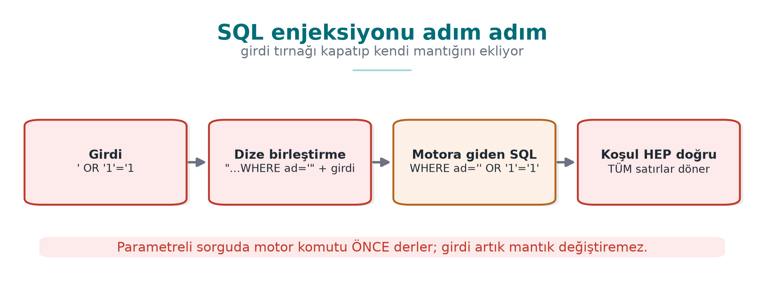
CEN429 Secure Programming · Week 5
SQL injection step by step — diagram
RTEU Computer Engineering · 2026-2027 Fall
44

Slide 45
CEN429 Secure Programming · Week 5
Correct · parameterised query
PreparedStatement ps =
con.prepareStatement("SELECT * FROM kul WHERE ad = ?");
ps.setString(1, ad); // ad yalnız VERİ
ps.executeQuery();
? is a parameter; ad is never interpreted as a command.
RTEU Computer Engineering · 2026-2027 Fall
45

Slide 46
CEN429 Secure Programming · Week 5
Why does it work?
• The query skeleton is sent (compiled) to the database beforehand.
• ad is bound afterwards as data.
• Even if it contains a quote, it stays data.
RTEU Computer Engineering · 2026-2027 Fall
46

Slide 47
CEN429 Secure Programming · Week 5
Other layers
• Least privilege: the application's DB user should do only what is needed.
• Input validation: an allow list, regardless.
• If you use an ORM, use its parameterised API too (not string concatenation).
RTEU Computer Engineering · 2026-2027 Fall
47

Slide 48
CEN429 Secure Programming · Week 5
⚠️ Escaping is the last resort
• Manually escaping quotes is error-prone; every DB is different.
• The always-first priority is a parameterised query.
• Escaping only where parameters are not possible, and carefully.
RTEU Computer Engineering · 2026-2027 Fall
48

Slide 49
CEN429 Secure Programming · Week 5
SQL injection · rule of this section
• Never build a query with string concatenation.
• Always use a parameterised query (PreparedStatement, ?).
• Use an allow list for identifiers such as column/table names.
• Escaping only as a last resort.
RTEU Computer Engineering · 2026-2027 Fall
49

Slide 50
CEN429 Secure Programming · Week 5
3. Command injection
RTEU Computer Engineering · 2026-2027 Fall
50

Slide 51
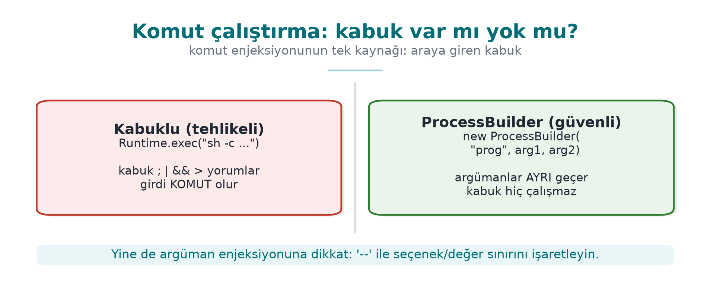
CEN429 Secure Programming · Week 5
Shell or no shell — diagram
RTEU Computer Engineering · 2026-2027 Fall
51

Slide 52
CEN429 Secure Programming · Week 5
Buggy code
Runtime.getRuntime().exec("ping " + host); // HATALI
What if host contains a shell metacharacter?
RTEU Computer Engineering · 2026-2027 Fall
52

Slide 53
CEN429 Secure Programming · Week 5
Attack · example
As host:
example.com; rm -rf veri
The shell runs this as two commands: ping and rm.
(The example is synthetic; never run it.)
RTEU Computer Engineering · 2026-2027 Fall
53

Slide 54
CEN429 Secure Programming · Week 5
Why did it happen?
• The command was handed to a shell as text.
• ;, |, && are command separators in the shell.
• Data got mixed into the command line.
RTEU Computer Engineering · 2026-2027 Fall
54

Slide 55
CEN429 Secure Programming · Week 5
Correct · argument array
new ProcessBuilder("ping", "-c", "1", host).start();
• No shell; host is a single argument.
• Metacharacters are not interpreted.
RTEU Computer Engineering · 2026-2027 Fall
55

Slide 56
CEN429 Secure Programming · Week 5
Additional rules
• Where possible, do not run an external command at all; use a library API.
• If you must: a fixed path, an argument array, an allow list.
• Similar to ENV33-C: calling system()/a shell.
RTEU Computer Engineering · 2026-2027 Fall
56

Slide 57
CEN429 Secure Programming · Week 5
Command injection · rule of this section
• Where possible, never run an external command.
• If you must: a shell-less argument array (ProcessBuilder).
• A fixed path + allow list; watch input starting with - (argument injection).
RTEU Computer Engineering · 2026-2027 Fall
57

Slide 58
CEN429 Secure Programming · Week 5
4. Path traversal
RTEU Computer Engineering · 2026-2027 Fall
58

Slide 59
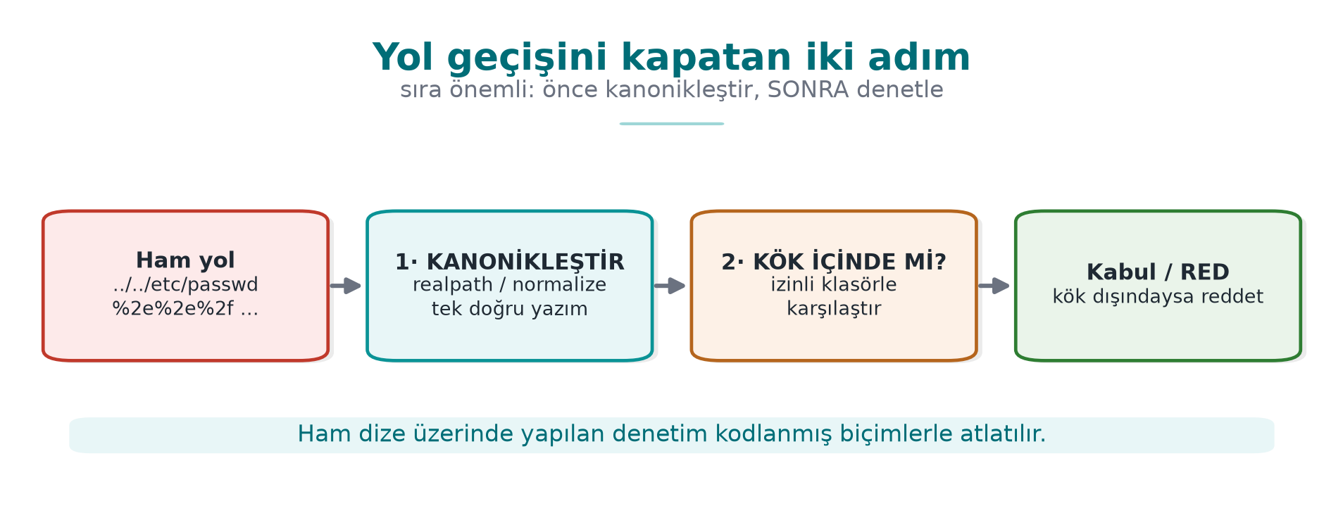
CEN429 Secure Programming · Week 5
Two steps that close off path traversal — diagram
RTEU Computer Engineering · 2026-2027 Fall
59

Slide 60
CEN429 Secure Programming · Week 5
Buggy code
File f = new File("yuklenen/" + adi); // HATALI
What if adi contains ../?
RTEU Computer Engineering · 2026-2027 Fall
60

Slide 61
CEN429 Secure Programming · Week 5
Attack · example
As adi:
../../etc/passwd
Result: yuklenen/../../etc/passwd → outside the allowed folder.
RTEU Computer Engineering · 2026-2027 Fall
61

Slide 62
CEN429 Secure Programming · Week 5
Why did it happen?
• adi was appended directly into the file path.
• The ../ sequence was read by the interpreter (the file system) as "go up a folder."
• There was no check: whether the folder was left was never even asked.
RTEU Computer Engineering · 2026-2027 Fall
62

Slide 63
CEN429 Secure Programming · Week 5
Correct · canonicalise + root check
Path kok = Paths.get("yuklenen").toRealPath();
Path hedef = kok.resolve(adi).normalize().toRealPath();
if (!hedef.startsWith(kok)) throw new SecurityException();
Is the canonical path inside the root? If not, reject.
RTEU Computer Engineering · 2026-2027 Fall
63

Slide 64
CEN429 Secure Programming · Week 5
Why does it work?
• First the path is turned canonical (single, definite).
• Then we check whether the canonical path is inside the root.
• ../, an encoded form (..%2f), or a symbolic link — all of them land on the same real path after canonicalisation; none of them can escape the check.
RTEU Computer Engineering · 2026-2027 Fall
64

Slide 65
CEN429 Secure Programming · Week 5
Path traversal · extra
• Restrict the file name to an allow list ([a-zA-Z0-9_.-]).
• Symbolic links (symlink) are resolved by canonicalisation.
• Do not make a user name directly into a file name.
RTEU Computer Engineering · 2026-2027 Fall
65

Slide 66
CEN429 Secure Programming · Week 5
Path traversal · rule of this section
• Never trust the raw string (contains("..") is not enough).
• First canonicalise, then check whether it is inside the root.
• Resolve symbolic links too (toRealPath()); repeat the check after the file is opened as well.
RTEU Computer Engineering · 2026-2027 Fall
66

Slide 67
CEN429 Secure Programming · Week 5
Three injections · common lesson
Type | Wrong | Correct
SQL | String concatenation | Parameterised query
Command | Text to the shell | Argument array
Path | Concatenating ../ | Canonicalise + root check
Same root: separate data from code/command.
RTEU Computer Engineering · 2026-2027 Fall
67

Slide 68
CEN429 Secure Programming · Week 5
Sections 2–4 — quick check
1. Why does ' OR '1'='1 return all rows?
2. Why is a ProcessBuilder argument array safe?
3. Which two steps close off path traversal?
RTEU Computer Engineering · 2026-2027 Fall
68
Notes:
Speaker note: Next, deserialisation and XML.

Slide 69
CEN429 Secure Programming · Week 5
Sections 2–4 — answers
1. Once joined into the string it makes the WHERE condition always true → all rows (data was parsed as code).
2. Arguments pass to the program, not the shell, one by one; there is no metacharacter interpretation (; |) → command injection is closed off.
3. (1) Convert to a canonical path (realpath/normalise), (2) verify it is inside the allowed root directory (an allow list). Never put user input directly into a path.
RTEU Computer Engineering · 2026-2027 Fall
69

Slide 70
CEN429 Secure Programming · Week 5
5. Unsafe deserialisation
RTEU Computer Engineering · 2026-2027 Fall
70

Slide 71
CEN429 Secure Programming · Week 5
Buggy code
Object o = new ObjectInputStream(giris).readObject(); // TEHLİKELİ
What if giris comes from an untrusted source?
RTEU Computer Engineering · 2026-2027 Fall
71

Slide 72
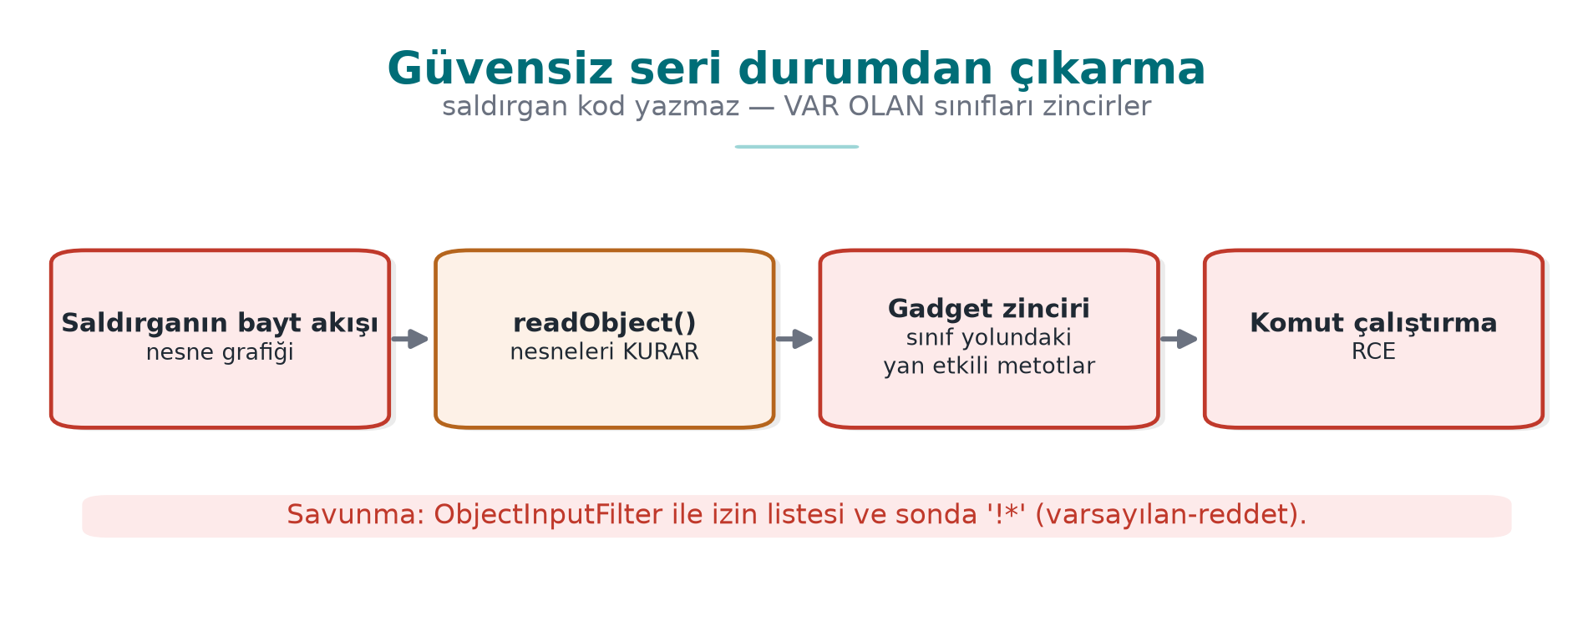
CEN429 Secure Programming · Week 5
Deserialisation gadget chain — diagram
RTEU Computer Engineering · 2026-2027 Fall
72

Slide 73
CEN429 Secure Programming · Week 5
The problem
• Turning untrusted bytes into an object is dangerous.
• In Java, ObjectInputStream.readObject() can run code while unpacking (gadget chains).
• Result: remote code execution.
RTEU Computer Engineering · 2026-2027 Fall
73

Slide 74
CEN429 Secure Programming · Week 5
Why is this so bad?
• Objects' constructors/methods run during unpacking.
• If suitable libraries (gadgets) are present, they can be chained to run commands.
• Input that looks like "just data" behaves like code.
RTEU Computer Engineering · 2026-2027 Fall
74

Slide 75
CEN429 Secure Programming · Week 5
Correct · best: do not do it at all
• Do not deserialise untrusted data with native serialisation.
• Use a JSON/data format + a strict schema instead.
• Read only the fields you expect.
RTEU Computer Engineering · 2026-2027 Fall
75

Slide 76
CEN429 Secure Programming · Week 5
If you must · filter
ObjectInputFilter f = ObjectInputFilter.Config
.createFilter("com.uygulama.*;!*"); // yalnız izinli sınıflar
ois.setObjectInputFilter(f);
• Allow list: only the expected classes.
• Also set a depth/size limit (against DoS).
RTEU Computer Engineering · 2026-2027 Fall
76

Slide 77
CEN429 Secure Programming · Week 5
Deserialisation · rule of this section
• Deserialising an untrusted byte stream hands the attacker the power to choose a class.
• Best: do not do it at all (JSON + a strict schema).
• If you must: an allow-list filter, a depth/size limit.
RTEU Computer Engineering · 2026-2027 Fall
77

Slide 78
CEN429 Secure Programming · Week 5
6. XML, templates, XSS
RTEU Computer Engineering · 2026-2027 Fall
78

Slide 79
CEN429 Secure Programming · Week 5
XXE · the problem
• XML lets you define an external entity; the parser resolves it.
• An attacker can use this to read files or make the server issue a request (SSRF).
RTEU Computer Engineering · 2026-2027 Fall
79

Slide 80
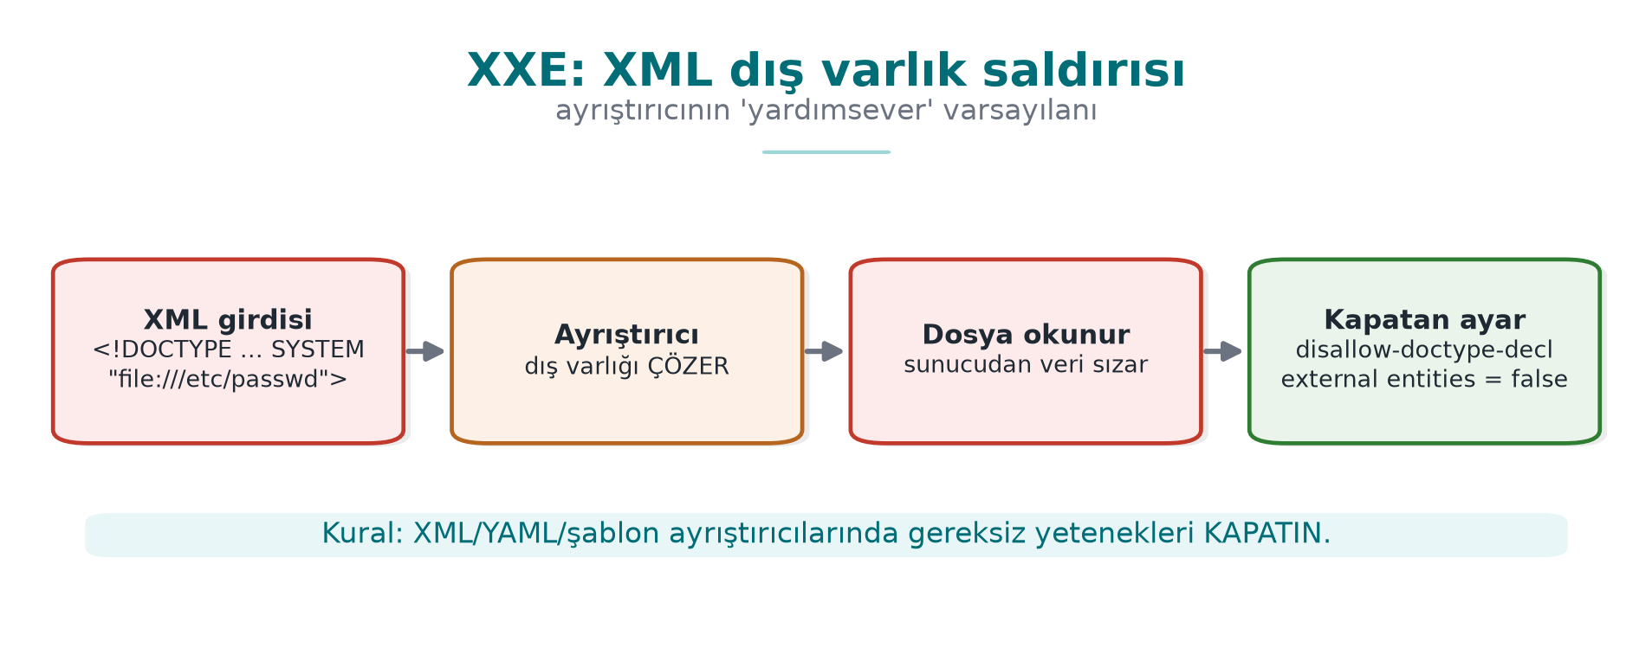
CEN429 Secure Programming · Week 5
XXE — diagram
RTEU Computer Engineering · 2026-2027 Fall
80

Slide 81
CEN429 Secure Programming · Week 5
XXE · correct
dbf.setFeature(
"http://apache.org/xml/features/disallow-doctype-decl", true);
// ya da dış varlıkları kapat
• Disable external entities, reject DOCTYPE.
• A one-line setting in most libraries.
RTEU Computer Engineering · 2026-2027 Fall
81

Slide 82
CEN429 Secure Programming · Week 5
Template injection (SSTI)
• Handing user input to a template engine as the template itself.
• The engine can run it like code.
• Rule: user input is data, the template is fixed.
RTEU Computer Engineering · 2026-2027 Fall
82

Slide 83
CEN429 Secure Programming · Week 5
XSS (briefly)
• XSS: user data leaking into a web page as HTML/JS.
• Fix: context-appropriate output encoding (HTML-encode), CSP.
• Same root again: data ≠ code.
RTEU Computer Engineering · 2026-2027 Fall
83

Slide 84
CEN429 Secure Programming · Week 5
XML/template/XSS · rule of this section
• Know which feature of the interpreter is turned on, and disable what is not needed.
• XML: external entities + DOCTYPE disabled.
• Templates: user data is only a variable, never the template itself.
• HTML: encode output context-appropriately.
RTEU Computer Engineering · 2026-2027 Fall
84

Slide 85
CEN429 Secure Programming · Week 5
7. The same bugs in Python and JavaScript
RTEU Computer Engineering · 2026-2027 Fall
85

Slide 86
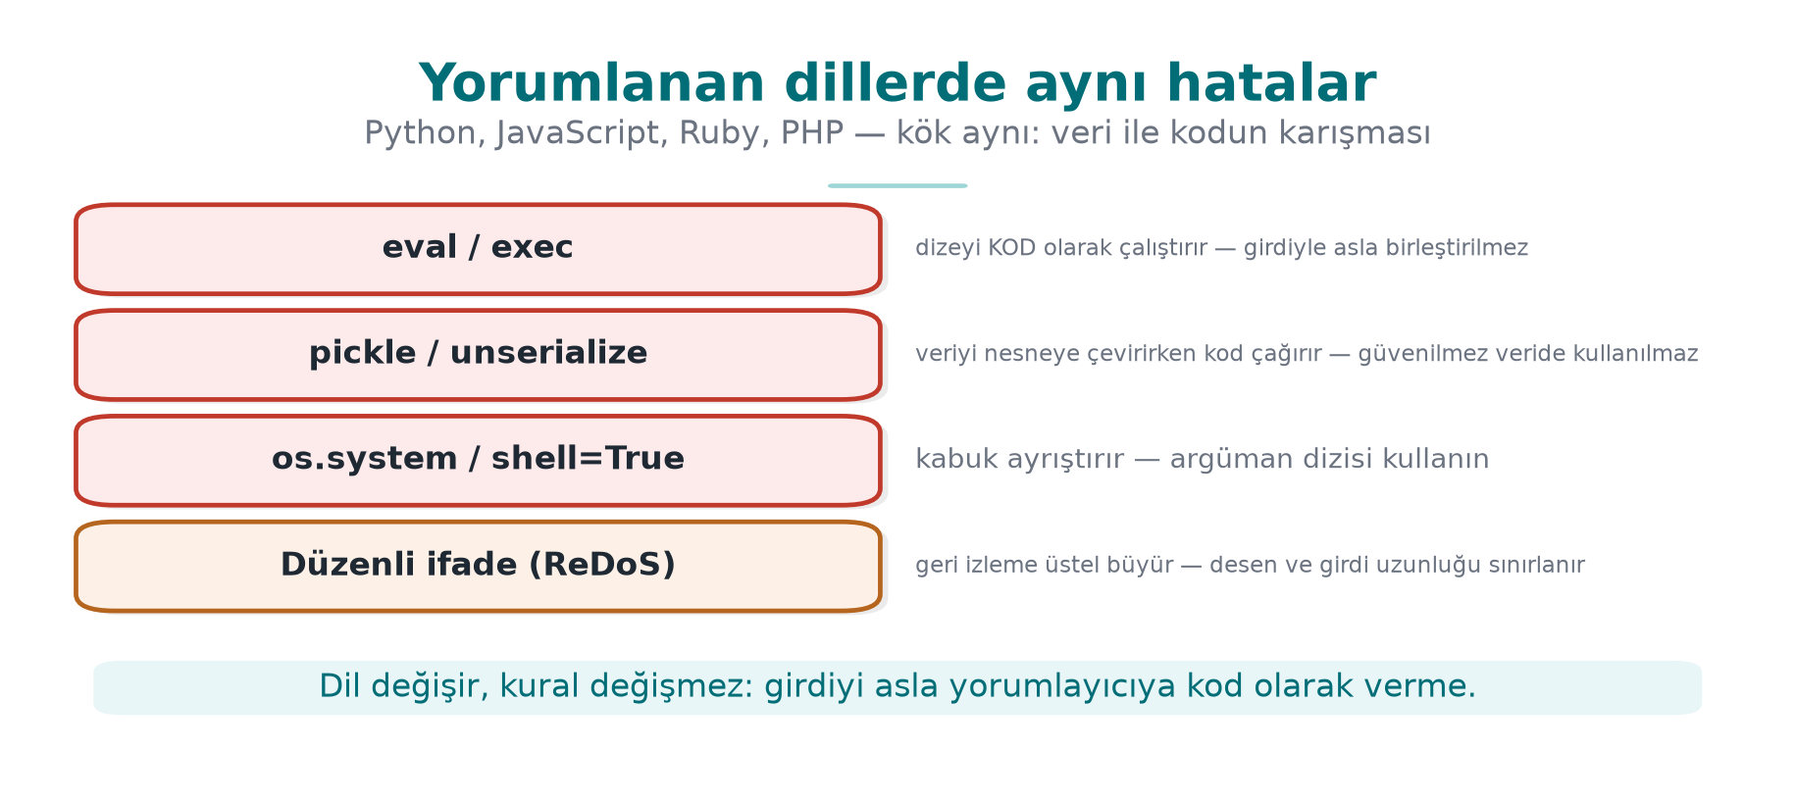
CEN429 Secure Programming · Week 5
The same bugs in interpreted languages — diagram
RTEU Computer Engineering · 2026-2027 Fall
86

Slide 87
CEN429 Secure Programming · Week 5
Same root, different language
• Injection exists in every language: Python os.system, JS child_process.
• The fix is the same: an argument array, a parameterised query.
RTEU Computer Engineering · 2026-2027 Fall
87

Slide 88
CEN429 Secure Programming · Week 5
Python · examples
• os.system("cmd " + x) → command injection; use subprocess.run([...]).
• eval(input) / pickle.loads(untrusted) → never with untrusted data.
• SQL: parameterised (cursor.execute("... ?", (x,))).
RTEU Computer Engineering · 2026-2027 Fall
88

Slide 89
CEN429 Secure Programming · Week 5
Python · eval example (code)
deger = eval(girdi) # HATALI: herhangi bir Python ifadesi
import ast
deger = ast.literal_eval(girdi) # Daha iyi: yalnız sabitler
deger = int(girdi) # En iyisi: beklenen türü ayrıştır
Rule: user data must never reach eval.
RTEU Computer Engineering · 2026-2027 Fall
89

Slide 90
CEN429 Secure Programming · Week 5
ReDoS (regular expression DoS)
• A bad regex can spend exponential time on certain input.
• An attacker can use this to lock up the CPU.
• Fix: a safe regex, an input-length limit, a timeout.
RTEU Computer Engineering · 2026-2027 Fall
90

Slide 91
CEN429 Secure Programming · Week 5
ReDoS · a concrete example
Desen: ^(a+)+$
Girdi: "aaaaaaaaaaaaaaaaaaaaaaaaaaaaa!"
• The engine tries millions of paths to prove there is no match.
• A single request locks the CPU for seconds/minutes (CWE-1333).
RTEU Computer Engineering · 2026-2027 Fall
91

Slide 92
CEN429 Secure Programming · Week 5
JavaScript · prototype pollution
• Prototype pollution: an attacker corrupts a property shared by all objects, through __proto__.
• Unexpected behaviour, authorisation bypass.
• Fix: safe merging, Object.create(null), up-to-date libraries.
RTEU Computer Engineering · 2026-2027 Fall
92

Slide 93
CEN429 Secure Programming · Week 5
Interpreted languages · common rule
• eval, exec, pickle, dynamic require → do not use with untrusted data.
• Input validation + a parameterised API + up-to-date dependencies.
RTEU Computer Engineering · 2026-2027 Fall
93

Slide 94
CEN429 Secure Programming · Week 5
Sections 5–9 — quick check
1. Why can unsafe deserialisation run code?
2. Which setting disables XXE?
3. What is ReDoS, and how is it mitigated?
RTEU Computer Engineering · 2026-2027 Fall
94
Notes:
Speaker note: Next, bytecode and obfuscation.

Slide 95
CEN429 Secure Programming · Week 5
Sections 5–9 — answers
1. While an object is being constructed, classes' side-effecting methods (readObject/gadget chain) fire → an attacker builds a flow using the object graph.
2. The parser setting that disables external entities and DOCTYPE (disallow-doctype-decl, external entities off).
3. ReDoS: a catastrophic-backtracking regex; bad input → exponential time → the CPU locks up. Mitigation: a linear-time engine (RE2), avoid nested quantifiers, a length/time limit.
RTEU Computer Engineering · 2026-2027 Fall
95

Slide 96
CEN429 Secure Programming · Week 5
8. Bytecode and decompilation
RTEU Computer Engineering · 2026-2027 Fall
96

Slide 97
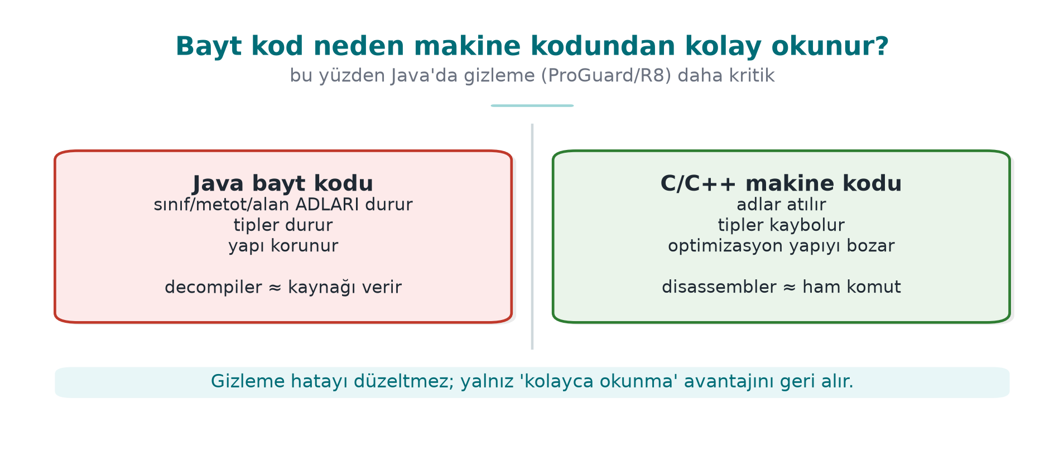
CEN429 Secure Programming · Week 5
Bytecode vs machine code — diagram
RTEU Computer Engineering · 2026-2027 Fall
97

Slide 98
CEN429 Secure Programming · Week 5
Java bytecode is easy to read
• .class/.jar bytecode decompiles back very close to the source.
• Tools: javap (disassembly), JD-GUI/CFR/Procyon (decompilation).
• Names, strings, structure are largely visible.
RTEU Computer Engineering · 2026-2027 Fall
98

Slide 99
CEN429 Secure Programming · Week 5
javap example
javap -c -p Uygulama.class # bayt kodunu sök
• Method names, calls, constants are visible.
• This is exactly why obfuscation is even more necessary in Java.
RTEU Computer Engineering · 2026-2027 Fall
99

Slide 100
CEN429 Secure Programming · Week 5
javap output — what is visible?
private static final java.lang.String GECERLI_PIN;
public boolean pinDogru(java.lang.String);
Code:
0: aload_1
1: ldc #7 // String 4729
3: invokevirtual #9 // String.equals
6: ireturn
There is no source code, but the constant (4729), the names (GECERLI_PIN, pinDogru) and the logic ("compare the input against this constant") are plainly visible.
RTEU Computer Engineering · 2026-2027 Fall
100

Slide 101
CEN429 Secure Programming · Week 5
Why is it easier than C?
• Bytecode is high-level and carries type information.
• Variable/method names are mostly preserved.
• → reverse engineering is cheap; obfuscation is essential.
RTEU Computer Engineering · 2026-2027 Fall
101

Slide 102
CEN429 Secure Programming · Week 5
⚠️ There are no secrets on the client
• Obfuscation makes this harder, but it does not really hide the secret.
• A key/password that does not have to live on the client → keep it on the server.
• A secret that has to live on the client needs whitebox cryptography (Week 11).
RTEU Computer Engineering · 2026-2027 Fall
102

Slide 103
CEN429 Secure Programming · Week 5
9. ProGuard and R8
RTEU Computer Engineering · 2026-2027 Fall
103

Slide 104
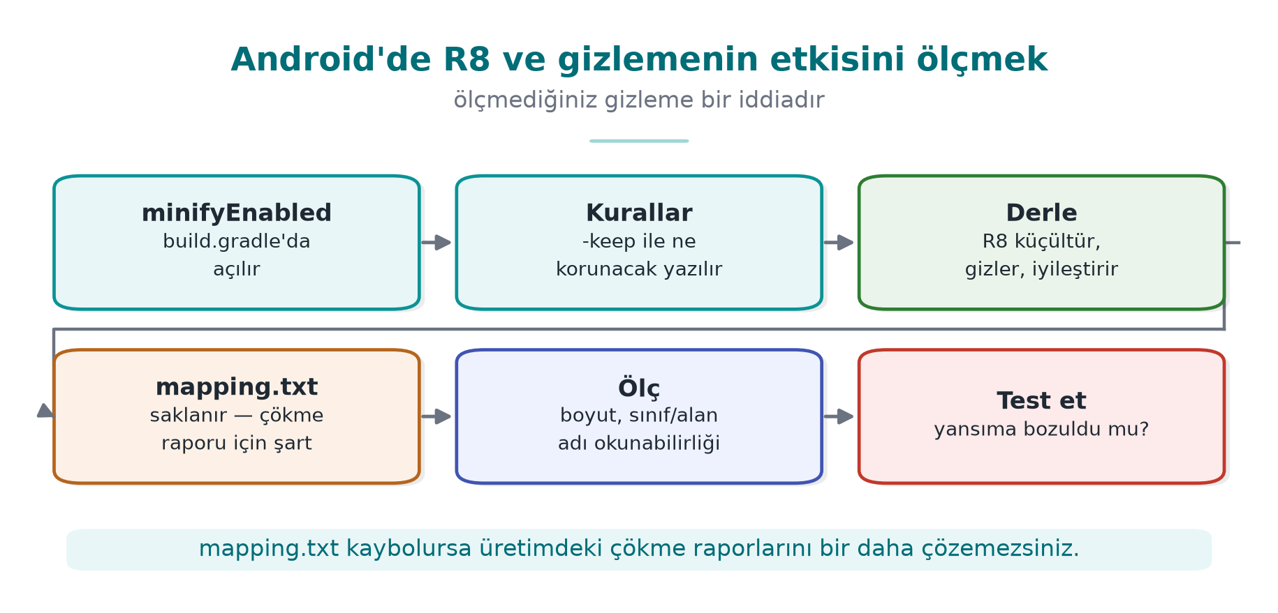
CEN429 Secure Programming · Week 5
R8 and the measurement steps — diagram
RTEU Computer Engineering · 2026-2027 Fall
104

Slide 105
CEN429 Secure Programming · Week 5
What do ProGuard/R8 do?
Three jobs:
• Shrinking: drops unused code.
• Optimisation: simplifies the code.
• Obfuscation: makes names meaningless (a, b, c).
RTEU Computer Engineering · 2026-2027 Fall
105

Slide 106
CEN429 Secure Programming · Week 5
ProGuard/R8 · four stages — table
Stage | What it does | Security contribution
Shrinking | Drops unused code | Attack surface shrinks
Optimisation | Inlining, constant folding | Structure moves away from the source
Obfuscation | Turns names into a, b, c | Meaningful names disappear
Preverification | Verification info for older JVMs | —
RTEU Computer Engineering · 2026-2027 Fall
106

Slide 107
CEN429 Secure Programming · Week 5
Name obfuscation example
LisansDenetleyici.dogrula() → a.b()
• Meaningful names disappear.
• The map gets harder for a reverse engineer.
• Removing dead code shrinks the binary.
RTEU Computer Engineering · 2026-2027 Fall
107

Slide 108
CEN429 Secure Programming · Week 5
Why is -keep needed?
• Code called by name through reflection (an API, entry points, JNI) must be kept.
• If obfuscation changes the name, the call breaks.
-keep class com.uygulama.Api { public *; }
RTEU Computer Engineering · 2026-2027 Fall
108

Slide 109
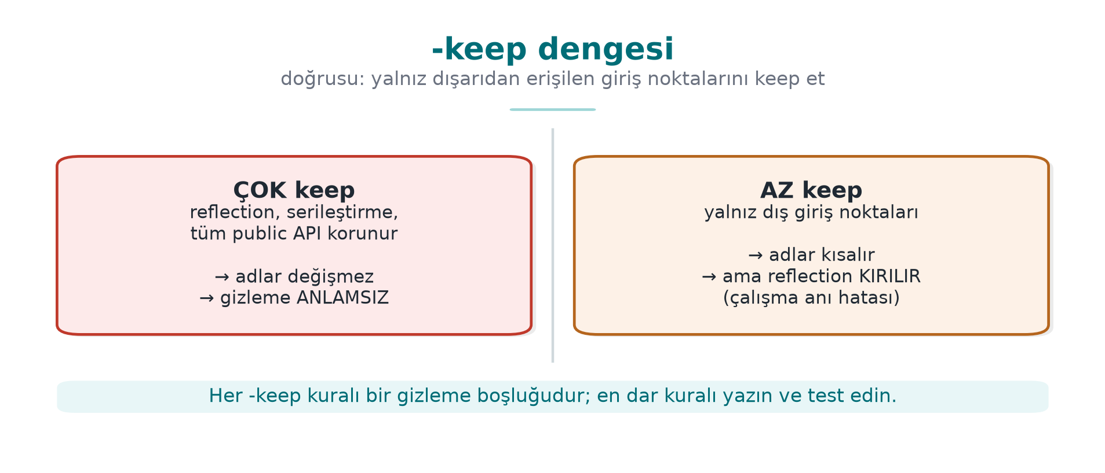
CEN429 Secure Programming · Week 5
The -keep balance — diagram
RTEU Computer Engineering · 2026-2027 Fall
109

Slide 110
CEN429 Secure Programming · Week 5
The -keep balance
• Too little `-keep`: the application crashes (reflection breaks).
• Too much `-keep`: obfuscation is weakened (everything stays exposed).
• Keep only the entry points that are genuinely required.
RTEU Computer Engineering · 2026-2027 Fall
110

Slide 111
CEN429 Secure Programming · Week 5
The mapping file
• R8 produces a mapping.txt: obfuscated name → real name.
• It is kept secret (not shipped), but it is retained to decode crash traces.
• Archived together with the version identifier.
RTEU Computer Engineering · 2026-2027 Fall
111

Slide 112
CEN429 Secure Programming · Week 5
Mapping file · example (mapping.txt)
com.ornek.odeme.KartYoneticisi -> com.ornek.a:
android.content.Context baglam -> a
boolean varsayilanKartiAyarla(java.lang.String) -> b
Old name → new name. This file completely undoes the obfuscation.
RTEU Computer Engineering · 2026-2027 Fall
112

Slide 113
CEN429 Secure Programming · Week 5
ProGuard/R8 · rule of this section
• Shrink + optimise + obfuscate; it does not obfuscate strings.
• -keep only for what is genuinely called through reflection/JNI.
• mapping.txt is a secret: keep it, do not distribute it.
RTEU Computer Engineering · 2026-2027 Fall
113

Slide 114
CEN429 Secure Programming · Week 5
10. String obfuscation and reflection
RTEU Computer Engineering · 2026-2027 Fall
114

Slide 115
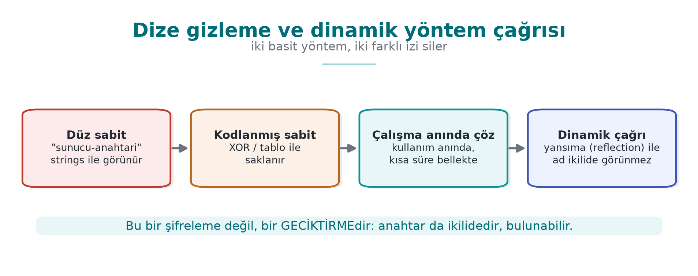
CEN429 Secure Programming · Week 5
String obfuscation and dynamic invocation — diagram
RTEU Computer Engineering · 2026-2027 Fall
115

Slide 116
CEN429 Secure Programming · Week 5
Strings are exposed in Java
• Constant strings inside .class appear in the clear (strings, a decompiler).
• Sensitive URLs, key fragments, messages leak.
RTEU Computer Engineering · 2026-2027 Fall
116

Slide 117
CEN429 Secure Programming · Week 5
String obfuscation
• Strings are encoded at build time, decoded at use.
• Same rule as Week 4: it stops strings, it does not keep a secret.
• The decoding code is also in the bytecode → limited protection.
RTEU Computer Engineering · 2026-2027 Fall
117

Slide 118
CEN429 Secure Programming · Week 5
⚠️ Reflection conflicts with obfuscation
• A call by name (getMethod("dogrula")) breaks after obfuscation.
• Fix: either -keep, or drop reflection and call directly.
• Reducing reflection is good for both security and obfuscation.
RTEU Computer Engineering · 2026-2027 Fall
118

Slide 119
CEN429 Secure Programming · Week 5
11. Android R8 and measurement
RTEU Computer Engineering · 2026-2027 Fall
119

Slide 120
CEN429 Secure Programming · Week 5
R8 on Android
• R8 is the default shrinker/obfuscator of the Android build.
• minifyEnabled true + proguard-rules.pro.
• Produces DEX (Android bytecode).
RTEU Computer Engineering · 2026-2027 Fall
120

Slide 121
CEN429 Secure Programming · Week 5
Turning R8 on for the release build
android { buildTypes { release {
minifyEnabled true
shrinkResources true
proguardFiles getDefaultProguardFile('proguard-android-optimize.txt'),
'proguard-rules.pro'
}}}
The debug build is not obfuscated; verify that the shipped build is the release one.
RTEU Computer Engineering · 2026-2027 Fall
121

Slide 122
CEN429 Secure Programming · Week 5
Measuring the effect of obfuscation
• Before/after obfuscation:
  – the ratio of meaningful names
  – the count of plain-text sensitive strings
  – APK size
• Measure it and write it into S9 (the measurement logic from Week 9).
RTEU Computer Engineering · 2026-2027 Fall
122

Slide 123
CEN429 Secure Programming · Week 5
Measurement table — extended
Metric | Expected change
Number of classes/methods | Decreases with shrinking
Meaningful-name ratio | Drops sharply with obfuscation
Plain-text sensitive strings | Goes to zero with string obfuscation
Package size | Decreases with shrinking
Number of log calls | Zero in the release
Time to locate a check | Increases (human trial)
RTEU Computer Engineering · 2026-2027 Fall
123

Slide 124
CEN429 Secure Programming · Week 5
Static analysis for Java
• SpotBugs, Error Prone, SonarQube.
• Checks close to the CERT Java rules.
• On every merge, in CI.
RTEU Computer Engineering · 2026-2027 Fall
124

Slide 125
CEN429 Secure Programming · Week 5
Sections 8–13 — quick check
1. Why is Java bytecode easier to read than C?
2. What is the -keep balance?
3. Why does reflection conflict with obfuscation?
RTEU Computer Engineering · 2026-2027 Fall
125
Notes:
Speaker note: Next, SBOM and dependency security.

Slide 126
CEN429 Secure Programming · Week 5
Sections 8–13 — answers
1. Bytecode is high-level; type and name metadata (class/field/method) are preserved → a decompiler produces near-source output. C compiles to machine code, discarding names.
2. The `-keep` balance: too much keep → obfuscation is weak; too little keep → reflection/serialisation breaks. Keep only the external entry points.
3. Reflection calls by string name; once the obfuscator renames it, the string no longer matches → a run-time error. Those names need to be kept (a gap in the obfuscation).
RTEU Computer Engineering · 2026-2027 Fall
126

Slide 127
CEN429 Secure Programming · Week 5
12. Dependency security and SBOM
RTEU Computer Engineering · 2026-2027 Fall
127

Slide 128
CEN429 Secure Programming · Week 5
The problem · supply chain
• Even if your own code is flawless, a flaw in a library you use affects you.
• A modern application contains hundreds of dependencies.
• "Which version do I have?" is a critical question.
RTEU Computer Engineering · 2026-2027 Fall
128

Slide 129
CEN429 Secure Programming · Week 5
Real examples
• Log4Shell (Log4j): a single library flaw affected millions of systems.
• A malicious package (typosquatting): a fake package with a similar name.
• An unmaintained/abandoned dependency.
RTEU Computer Engineering · 2026-2027 Fall
129

Slide 130
CEN429 Secure Programming · Week 5
Log4Shell · a concrete example (December 2021)
• A specific expression logged by Log4j 2 loaded and ran a class from a remote address.
• CVE-2021-44228, CVSS 10.0 (the highest score).
• The real crisis was not applying the patch: it was the question of which system had which version.
RTEU Computer Engineering · 2026-2027 Fall
130

Slide 131
CEN429 Secure Programming · Week 5
What is an SBOM? (recap)
• The software's bill of materials: which component, which version, which licence.
• When a flaw is announced, "am I affected?" is answered quickly.
RTEU Computer Engineering · 2026-2027 Fall
131

Slide 132
CEN429 Secure Programming · Week 5
SBOM formats
• CycloneDX (OWASP) — security-focused, widely used.
• SPDX (Linux Foundation) — strong on licensing too.
• Generated automatically by tools (during the build step).
RTEU Computer Engineering · 2026-2027 Fall
132

Slide 133
CEN429 Secure Programming · Week 5
A CycloneDX example (JSON, synthetic)
{
"bomFormat": "CycloneDX",
"components": [{
"type": "library", "name": "ornek-json", "version": "1.2.0",
"purl": "pkg:maven/com.ornek/ornek-json@1.2.0"
}]
}
Every component: name, version, purl (an ecosystem-independent, uniform identifier), a hash value.
RTEU Computer Engineering · 2026-2027 Fall
133

Slide 134
CEN429 Secure Programming · Week 5
What is VEX?
• VEX (Vulnerability Exploitability eXchange): shares "I have this flaw, but it is not exploitable" information.
• Reduces noise: not every CVE is a panic.
• Accompanies the SBOM.
RTEU Computer Engineering · 2026-2027 Fall
134

Slide 135
CEN429 Secure Programming · Week 5
Dependency management rules
• Pin versions; do not pull "latest" at random.
• Scan for known vulnerabilities (dependency-check, npm audit, pip-audit).
• A safe update process; apply critical patches fast.
RTEU Computer Engineering · 2026-2027 Fall
135

Slide 136
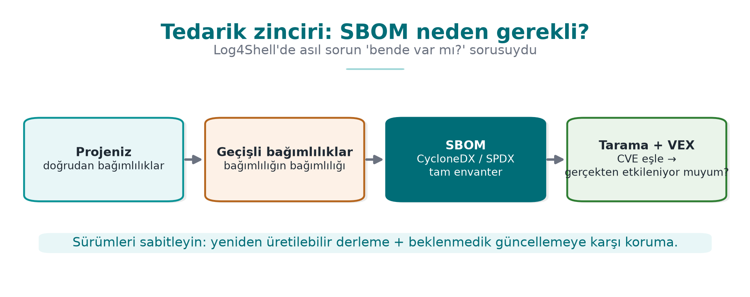
CEN429 Secure Programming · Week 5
SBOM generation · example flow
Each release's SBOM is stored with its release identifier.
RTEU Computer Engineering · 2026-2027 Fall
136

Slide 137
CEN429 Secure Programming · Week 5
Link to the project
• S13: a secure development process + SBOM.
• An up-to-date SBOM and dependency scan for every release.
• Handed-off requirements: "safe updates" belong to the upstream application (Week 13).
RTEU Computer Engineering · 2026-2027 Fall
137

Slide 138
CEN429 Secure Programming · Week 5
SBOM · rule of this section
• Even if your own code is flawless, your dependency's flaw affects you.
• SBOM = the bill of materials; VEX = the answer to "am I genuinely affected?"
• Pin the version, scan continuously, apply the critical patch fast.
RTEU Computer Engineering · 2026-2027 Fall
138

Slide 139
CEN429 Secure Programming · Week 5
Section 14 — quick check
1. What is an SBOM good for?
2. Why does VEX reduce noise?
3. Why do we pin dependency versions?
RTEU Computer Engineering · 2026-2027 Fall
139
Notes:
Speaker note: Next, the project and the solved self-check.

Slide 140
CEN429 Secure Programming · Week 5
Section 14 — answers
1. SBOM = a component/dependency inventory; when a new flaw appears it answers "do I have it?" quickly.
2. VEX states whether the flaw is genuinely exploitable in the product; unaffected ones are marked "not affected" → false alarms drop.
3. A pinned version = a reproducible build + supply-chain security; it blocks an unexpected/malicious update.
RTEU Computer Engineering · 2026-2027 Fall
140

Slide 141
CEN429 Secure Programming · Week 5
Project and closing
RTEU Computer Engineering · 2026-2027 Fall
141

Slide 142
CEN429 Secure Programming · Week 5
Project · S9/S13 (the Java side)
•
•
• -keep only the entry points that are needed.
• strings/a decompiler.
•
RTEU Computer Engineering · 2026-2027 Fall
142

Slide 143
CEN429 Secure Programming · Week 5
Solved self-check
RTEU Computer Engineering · 2026-2027 Fall
143

Slide 144
CEN429 Secure Programming · Week 5
Question 1
Which error class does a managed language solve, and which does it not?
Answer: It largely solves memory bugs (overflow, UAF). It does not solve injection, logic/authorisation errors, dependency, and deserialisation attacks.
RTEU Computer Engineering · 2026-2027 Fall
144

Slide 145
CEN429 Secure Programming · Week 5
Question 2
Why does `' OR '1'='1` return all rows?
Answer: The input enters the query through string concatenation; the quote closes the data, and OR '1'='1' is always true. A parameterised query prevents this.
RTEU Computer Engineering · 2026-2027 Fall
145

Slide 146
CEN429 Secure Programming · Week 5
Question 3
How does `ProcessBuilder` prevent command injection?
Answer: It supplies arguments as an array without using a shell; metacharacters (;, |) are not interpreted, and the input stays a single argument.
RTEU Computer Engineering · 2026-2027 Fall
146

Slide 147
CEN429 Secure Programming · Week 5
Question 4
Which two steps close off path traversal?
Answer: Canonicalisation (normalize/toRealPath) + a root check (startsWith(kok)). Plus a file-name allow list.
RTEU Computer Engineering · 2026-2027 Fall
147

Slide 148
CEN429 Secure Programming · Week 5
Question 5
Why is unsafe deserialisation dangerous? The fix?
Answer: Object methods run while unpacking; code can be run through a gadget chain. Fix: a data format + schema instead of native serialisation; if you must, an ObjectInputFilter allow list.
RTEU Computer Engineering · 2026-2027 Fall
148

Slide 149
CEN429 Secure Programming · Week 5
Question 6
What is XXE, and which setting disables it?
Answer: Abuse of XML external entities (file reading/SSRF). The parser setting that disables external entities and DOCTYPE.
RTEU Computer Engineering · 2026-2027 Fall
149

Slide 150
CEN429 Secure Programming · Week 5
Question 7
What are ReDoS and prototype pollution?
Answer: ReDoS: a bad regex spending exponential time (DoS). Prototype pollution: corrupting all objects through __proto__ in JS. Both need input validation + a safe API.
RTEU Computer Engineering · 2026-2027 Fall
150

Slide 151
CEN429 Secure Programming · Week 5
Question 8
Why does Java bytecode need obfuscation more than most?
Answer: Bytecode is high-level and carries type and name information; it decompiles very close to the source. Names/strings appear in the clear.
RTEU Computer Engineering · 2026-2027 Fall
151

Slide 152
CEN429 Secure Programming · Week 5
Question 9
What is the `-keep` balance?
Answer: Too little -keep → reflection breaks, the application crashes. Too much → obfuscation is weakened. Only the entry points genuinely called through reflection are kept.
RTEU Computer Engineering · 2026-2027 Fall
152

Slide 153
CEN429 Secure Programming · Week 5
Question 10
Does string obfuscation keep a key secret in Java?
Answer: No. It stops strings/static scanning, but the decoded string is in the clear in memory, and the decoding code is in the bytecode. A key needs different protection.
RTEU Computer Engineering · 2026-2027 Fall
153

Slide 154
CEN429 Secure Programming · Week 5
Question 11
What are SBOM and VEX for?
Answer: An SBOM is the component list; when a flaw is announced it tells you quickly whether you are affected. VEX states whether the flaw is exploitable, reducing noise.
RTEU Computer Engineering · 2026-2027 Fall
154

Slide 155
CEN429 Secure Programming · Week 5
Question 12
What is the common root and fix of every injection type?
Answer: Root: data mixing with command. Fix: separating data from code (a parameterised/argument-array API), not building a command with string concatenation.
RTEU Computer Engineering · 2026-2027 Fall
155

Slide 156
CEN429 Secure Programming · Week 5
Summary: this week in one sentence
A managed language solves memory bugs, but injection exists in every language; the fix is always separating data from the command, and on the protection side it is obfuscation (R8) and dependency/SBOM management.
RTEU Computer Engineering · 2026-2027 Fall
156

Slide 157
CEN429 Secure Programming · Week 5
Next week
Week 6 — RASP and run-time protection
Tamper/debugger detection, integrity checking, response policy and layered defence.
RTEU Computer Engineering · 2026-2027 Fall
157

Slide 158
CEN429 Secure Programming · Week 5
Appendix A · An injection from start to finish
RTEU Computer Engineering · 2026-2027 Fall
158
Notes:
Speaker note: We trace a single SQL injection from buggy code to the attack, the fix, and layered defence.

Slide 159
CEN429 Secure Programming · Week 5
Context · a login form
An application that logs a user in with a username and password.
String q = "SELECT * FROM kul WHERE ad='" + ad +
"' AND parola='" + p + "'";
Where is the mistake?
RTEU Computer Engineering · 2026-2027 Fall
159

Slide 160
CEN429 Secure Programming · Week 5
Step 1 · the attacker's input
Into the ad field:
yonetici' --
-- starts a comment in SQL; everything after it is ignored.
RTEU Computer Engineering · 2026-2027 Fall
160

Slide 161
CEN429 Secure Programming · Week 5
Step 2 · what does the query become?
SELECT * FROM kul WHERE ad='yonetici' -- ' AND parola='...'
The password check stayed inside the comment → an yonetici login with no password.
RTEU Computer Engineering · 2026-2027 Fall
161

Slide 162
CEN429 Secure Programming · Week 5
Step 3 · impact
• Authentication was bypassed.
• Further: reading other tables with UNION SELECT.
• ; DROP TABLE (if stacked queries are supported) — data loss.
RTEU Computer Engineering · 2026-2027 Fall
162

Slide 163
CEN429 Secure Programming · Week 5
Step 4 · the fix
PreparedStatement ps = con.prepareStatement(
"SELECT * FROM kul WHERE ad=? AND parola_ozet=?");
ps.setString(1, ad);
ps.setString(2, ozetle(p));
ad and the password are now data; -- has no effect.
RTEU Computer Engineering · 2026-2027 Fall
163

Slide 164
CEN429 Secure Programming · Week 5
Step 5 · layered defence
• Never store a password in plain text: a hash + salt (Week 3).
• Least privilege: the DB user only has SELECT.
• Input validation: an allow list for the username.
• Logging/monitoring: failed login attempts.
RTEU Computer Engineering · 2026-2027 Fall
164

Slide 165
CEN429 Secure Programming · Week 5
Lesson
• A single root: data got mixed with the command.
• The real fix: a parameterised query.
• But defence in depth at every layer.
RTEU Computer Engineering · 2026-2027 Fall
165

Slide 166
CEN429 Secure Programming · Week 5
Appendix B · A deserialisation mini case study
RTEU Computer Engineering · 2026-2027 Fall
166

Slide 167
CEN429 Secure Programming · Week 5
Scenario
An application deserialises a "session object" sent by the user using native serialisation:
Object o = new ObjectInputStream(giris).readObject(); // TEHLİKELİ
RTEU Computer Engineering · 2026-2027 Fall
167

Slide 168
CEN429 Secure Programming · Week 5
What could happen?
• The attacker prepares a gadget chain from libraries found on the classpath.
• The chain runs while unpacking → command execution.
• The input was thought to be "data," but it behaved like code.
RTEU Computer Engineering · 2026-2027 Fall
168

Slide 169
CEN429 Secure Programming · Week 5
Fix 1 · change the format
• JSON + a strict schema instead of native serialisation.
• Only the expected fields are read.
• The object graph never "comes alive."
RTEU Computer Engineering · 2026-2027 Fall
169

Slide 170
CEN429 Secure Programming · Week 5
Fix 2 · if you must, filter
ois.setObjectInputFilter(ObjectInputFilter.Config
.createFilter("com.uygulama.Oturum;!*")); // yalnız bu sınıf
• An allow list + a depth/size limit.
RTEU Computer Engineering · 2026-2027 Fall
170

Slide 171
CEN429 Secure Programming · Week 5
Case study · lesson
• Turning untrusted data into a "live object" is risky.
• Safest: never do it (use a data format).
• If you must: a strict allow list.
RTEU Computer Engineering · 2026-2027 Fall
171

Slide 172
CEN429 Secure Programming · Week 5
Appendix C · Injection, language by language
RTEU Computer Engineering · 2026-2027 Fall
172

Slide 173
CEN429 Secure Programming · Week 5
The same bug, three languages
Danger | Java | Python | JS
Command | Runtime.exec(str) | os.system(str) | exec(str)
Safe | ProcessBuilder([...]) | subprocess.run([...]) | execFile([...])
RTEU Computer Engineering · 2026-2027 Fall
173

Slide 174
CEN429 Secure Programming · Week 5
The same bug, extracting data
Danger | Java | Python | JS
Code execution | readObject | pickle.loads, eval | eval, Function
Safe | JSON + schema | json.loads | JSON.parse
The root is always the same: data ≠ code.
RTEU Computer Engineering · 2026-2027 Fall
174

Slide 175
CEN429 Secure Programming · Week 5
Three languages · one rule
• A dynamic "run" (eval, exec, pickle, readObject) → never with untrusted data.
• Command → an argument array.
• SQL → parameterised.
• Input → an allow list + rejection.
RTEU Computer Engineering · 2026-2027 Fall
175

Slide 176
CEN429 Secure Programming · Week 5
Appendices A–C · summary
• Injection is not tied to a language; it is tied to a pattern.
• Recognise the pattern: "is user data going to an interpreter as a command?"
• Once recognised, the fix is ready: separate.
RTEU Computer Engineering · 2026-2027 Fall
176

Slide 177
CEN429 Secure Programming · Week 5
Appendix D · R8 obfuscation, step by step
RTEU Computer Engineering · 2026-2027 Fall
177

Slide 178
CEN429 Secure Programming · Week 5
Step 1 · turn it on
build.gradle:
buildTypes { release {
minifyEnabled true
proguardFiles(..., 'proguard-rules.pro')
}}
Shrinking + obfuscation are turned on for the release build.
RTEU Computer Engineering · 2026-2027 Fall
178

Slide 179
CEN429 Secure Programming · Week 5
Step 2 · protect the entry points
-keep class com.uygulama.PublicApi { public *; }
-keepclassmembers class * {
@com.uygulama.Reflected *;
}
Keep only what is called through reflection/JNI.
RTEU Computer Engineering · 2026-2027 Fall
179

Slide 180
CEN429 Secure Programming · Week 5
Step 3 · build and verify
• Decompile the APK; see that names are a, b.
• Keep mapping.txt (do not distribute it).
• Test flows that use reflection (no crashes?).
RTEU Computer Engineering · 2026-2027 Fall
180

Slide 181
CEN429 Secure Programming · Week 5
Step 4 · measure
• Meaningful-name ratio: before 90% → after 10%.
• Plain sensitive-string count: before N → after 0.
• APK size: did it shrink?
Write the measurement into S9.
RTEU Computer Engineering · 2026-2027 Fall
181

Slide 182
CEN429 Secure Programming · Week 5
Step 5 · add string obfuscation
• Encode sensitive strings, decode at use, then wipe immediately.
• Must not appear in strings/a decompiler.
• Not a key; only a static-scanning deterrent.
RTEU Computer Engineering · 2026-2027 Fall
182

Slide 183
CEN429 Secure Programming · Week 5
Appendix E · SBOM, step by step
RTEU Computer Engineering · 2026-2027 Fall
183

Slide 184
CEN429 Secure Programming · Week 5
Step 1 · generate
# örnek: CycloneDX eklentisi
mvn org.cyclonedx:cyclonedx-maven-plugin:makeBom
A bom.json/bom.xml is produced during the build.
RTEU Computer Engineering · 2026-2027 Fall
184

Slide 185
CEN429 Secure Programming · Week 5
Step 2 · scan
dependency-check --scan . --format HTML
Maps known vulnerabilities (CVEs) to dependencies.
RTEU Computer Engineering · 2026-2027 Fall
185

Slide 186
CEN429 Secure Programming · Week 5
Step 3 · assess (VEX)
• For every flaw: do I have it? Is it exploitable?
• If not exploitable, mark it with VEX (noise drops).
• If exploitable: update or mitigate.
RTEU Computer Engineering · 2026-2027 Fall
186

Slide 187
CEN429 Secure Programming · Week 5
Step 4 · archive
• The SBOM + scan report are stored with the release identifier.
• When a new flaw appears: "which release had this dependency?" is answered fast.
RTEU Computer Engineering · 2026-2027 Fall
187

Slide 188
CEN429 Secure Programming · Week 5
Step 5 · process
• Pin versions; no automatic "latest" pulling.
• Apply critical patches fast.
• If you cannot handle safe updates yourself → hand it off (Week 13).
RTEU Computer Engineering · 2026-2027 Fall
188

Slide 189
CEN429 Secure Programming · Week 5
Appendix F · Quick reference
RTEU Computer Engineering · 2026-2027 Fall
189

Slide 190
CEN429 Secure Programming · Week 5
Common mistakes
• Building SQL/commands with string concatenation.
• eval/pickle/readObject with untrusted data.
• Leaving external entities open in XML.
• Protecting everything with -keep * (obfuscation wasted).
• Not scanning dependencies.
RTEU Computer Engineering · 2026-2027 Fall
190

Slide 191
CEN429 Secure Programming · Week 5
Glossary
Term | Meaning
Injection | Data = command mixing
Parameterised query | Data is bound separately
Deserialisation | Bytes → object (risky)
XXE | Abuse of an XML external entity
R8/ProGuard | Shrinking + name obfuscation
SBOM/VEX | Component list / exploitability
RTEU Computer Engineering · 2026-2027 Fall
191

Slide 192
CEN429 Secure Programming · Week 5
Checklist
•
•
•
•
• -keep minimal, measured
•
RTEU Computer Engineering · 2026-2027 Fall
192

Slide 193
CEN429 Secure Programming · Week 5
Final word (Week 5)
Even though the language solves memory bugs, injection and the supply chain remain your responsibility.
Separate data from code; obfuscate the binary with R8; manage dependencies with an SBOM.
RTEU Computer Engineering · 2026-2027 Fall
193

