Slide 1

CEN429 Secure Programming · Week 4
Code Hardening: C/C++
CEN429 Secure Programming — Week 4
Asst. Prof. Dr. Uğur CORUH · 09.10.2026
RTEU Computer Engineering · 2026-2027 Fall
Notes:
Speaker note: This week we harden the code itself: first bug-free code, then protections that limit the damage if a bug slips through, and finally obfuscation that makes it harder to read.
Speaker note: This week we harden the code itself: first bug-free code, then protections that limit the damage if a bug slips through, and finally obfuscation that makes it harder to read.

Slide 2
CEN429 Secure Programming · Week 4
Today's Plan (3 Hours)
Hour | Section | Topic
1 | 0–2 | Basic concepts · layers of hardening · SEI CERT · input validation
2 | 3–4 | Format string · UAF · integer/UB · error/signal · static analysis · sanitizers · fuzzing
3 | 5–7 | Compiler/OS protections · secure build pipeline · introduction to code obfuscation · project
RTEU Computer Engineering · 2026-2027 Fall
2
Notes:
Speaker note: This week we harden the code itself. We assume students know C but not security terms; we will define every term. Demos are under code/week-04.

Slide 3
CEN429 Secure Programming · Week 4
A Brief History — the Race Between Memory Bugs and Defences
• 1988 — Morris Worm announces the buffer overflow to the world
• 1996 — Smashing the Stack for Fun and Profit teaches exploitation to everyone
• 1998 → 2004 — canary (StackGuard) · ASLR (PaX) · DEP/NX · FORTIFY
• 2012–13 — AddressSanitizer and fuzzing (AFL) catch bugs automatically
This course follows this race: write the bug → let the tool catch it → let the compiler/OS protect.
RTEU Computer Engineering · 2026-2027 Fall
3

Slide 4
CEN429 Secure Programming · Week 4
Where Does This Week Fit?
• Weeks 1–3: security principles, threat model, cryptography.
• This week (4): hardening C/C++ code — write it bug-free, limit the damage if a bug slips through, make it harder to read.
• Week 5: the same topic for Java/interpreted languages.
RTEU Computer Engineering · 2026-2027 Fall
4

Slide 5
CEN429 Secure Programming · Week 4
Learning Outcome
This week is about LO.3 (binary application protections).
By the end, you will be able to:
• Recognise and fix common C/C++ vulnerabilities
• Use static analysis, sanitizers, fuzzing
• Turn on and verify compiler/OS protections
RTEU Computer Engineering · 2026-2027 Fall
5

Slide 6
CEN429 Secure Programming · Week 4
Three Layers, the Right Order
Code hardening is three layers. The order matters:
1. First, bug-free code (secure coding)
2. Then, limit the damage (compiler/OS protections)
3. Finally, make it harder to read (obfuscation)
⚠️ Obfuscation does not fix the bug.
RTEU Computer Engineering · 2026-2027 Fall
6

Slide 7
CEN429 Secure Programming · Week 4
Why This Order?
• Adding protection to buggy code is like painting over a rotten foundation.
• First remove the bug; then catch what slips through; finally slow down reverse engineering.
• We will see all three this week, in this order.
RTEU Computer Engineering · 2026-2027 Fall
7

Slide 8
CEN429 Secure Programming · Week 4
0. Basic Concepts (From Scratch)
RTEU Computer Engineering · 2026-2027 Fall
8
Notes:
Speaker note: We assume they know C syntax, but we define memory/security concepts from scratch.

Slide 9
CEN429 Secure Programming · Week 4
Memory: Stack and Heap
• Stack: automatically managed memory that holds the local variables of function calls.
• Heap: memory allocated manually with malloc/new, released with free/delete.
Both can be a source of overflows and bugs.
RTEU Computer Engineering · 2026-2027 Fall
9

Slide 10
CEN429 Secure Programming · Week 4
Pointer
• Pointer: a variable that holds a memory address.
• p is an address; *p is the value at that address.
• Wrong address → crash or wrong data.
RTEU Computer Engineering · 2026-2027 Fall
10

Slide 11
CEN429 Secure Programming · Week 4
Buffer and Overflow
• Buffer: a contiguous block of memory (e.g., char ad[16]).
• Overflow (buffer overflow): writing more data than the buffer can hold → corrupts neighbouring memory.
• A classic and dangerous class of bug.
RTEU Computer Engineering · 2026-2027 Fall
11

Slide 12
CEN429 Secure Programming · Week 4
Why Is an Overflow Dangerous?
• It can corrupt neighbouring variables or the return address.
• An attacker can use this to hijack control flow.
• This is why bounds checking is vital.
RTEU Computer Engineering · 2026-2027 Fall
12

Slide 13
CEN429 Secure Programming · Week 4
What Is Undefined Behaviour (UB)?
• Undefined behaviour: situations the C/C++ standard calls "the result is unspecified."
• Example: signed integer overflow, accessing past the end of an array.
• The compiler may handle this however it likes — it may even delete the corresponding check.
RTEU Computer Engineering · 2026-2027 Fall
13

Slide 14
CEN429 Secure Programming · Week 4
Compiler Flag
• Flag: an option passed to the compiler.
• Example: -O2 (optimisation), -Wall (warnings), -fsanitize=address.
• The right flags catch many bugs at compile time.
RTEU Computer Engineering · 2026-2027 Fall
14

Slide 15
CEN429 Secure Programming · Week 4
Warning vs Error
• Error: compilation stops.
• Warning: compilation continues but a problem is reported.
• Rule: turn warnings into errors (-Werror) — an ignored warning is a future vulnerability.
RTEU Computer Engineering · 2026-2027 Fall
15

Slide 16
CEN429 Secure Programming · Week 4
What Is a CWE?
• CWE (Common Weakness Enumeration): a numbered catalogue of software weaknesses.
• Example: CWE-416 = "use-after-free."
• Naming a finding with its CWE number makes it searchable.
RTEU Computer Engineering · 2026-2027 Fall
16

Slide 17
CEN429 Secure Programming · Week 4
What Is CERT?
• SEI CERT C/C++: the rulebook of secure coding.
• Every rule: a noncompliant example + a compliant solution + risk + a CWE link.
• Example: STR31-C = allocate sufficient memory for the string.
RTEU Computer Engineering · 2026-2027 Fall
17

Slide 18
CEN429 Secure Programming · Week 4
Static vs Dynamic Analysis
• Static analysis: examining code without running it (compiler warnings, clang-tidy).
• Dynamic analysis: observing code while it runs (sanitizers).
• The two complement each other.
RTEU Computer Engineering · 2026-2027 Fall
18

Slide 19
CEN429 Secure Programming · Week 4
What Is a Sanitizer?
• Sanitizer: a compiler tool that catches memory/UB bugs while the program runs.
• Example: ASan (address), UBSan (undefined behaviour).
• It does not ship in the release build; it is used in testing/CI.
RTEU Computer Engineering · 2026-2027 Fall
19

Slide 20
CEN429 Secure Programming · Week 4
What Is Fuzzing?
• Fuzzing: feeding a program random/unexpected inputs and looking for crashes.
• It finds inputs a human would never think of.
• Very powerful when combined with a sanitizer.
RTEU Computer Engineering · 2026-2027 Fall
20

Slide 21
CEN429 Secure Programming · Week 4
ASLR, NX/DEP, Canary
• ASLR: randomizes memory addresses (so the attacker cannot guess an address).
• NX/DEP: prevents bytes in a data region from being executed as code.
• Stack canary: a sentinel value just before the return address; if an overflow corrupts it, the program halts.
RTEU Computer Engineering · 2026-2027 Fall
21

Slide 22
CEN429 Secure Programming · Week 4
White-Box Attacker (Reminder)
• An attacker who possesses the program (Week 1's MATE).
• Reads strings, finds functions by name, bypasses checks.
• We will return to this in the obfuscation section (later today).
RTEU Computer Engineering · 2026-2027 Fall
22

Slide 23
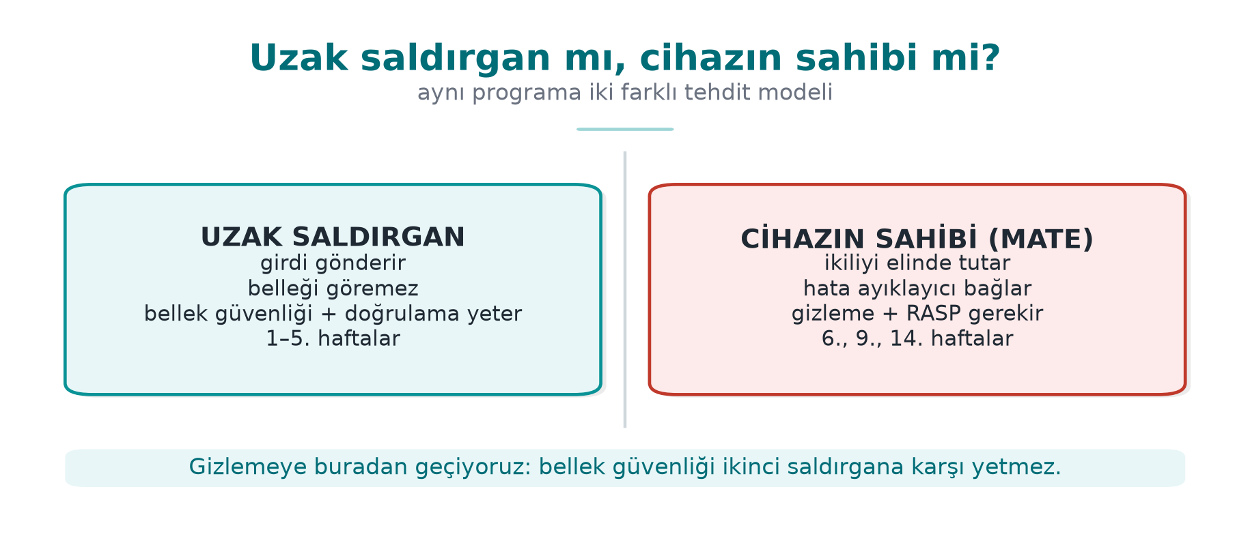
CEN429 Secure Programming · Week 4
Two Attacker Models — Diagram
RTEU Computer Engineering · 2026-2027 Fall
23

Slide 24
CEN429 Secure Programming · Week 4
CI (Continuous Integration)
• CI (Continuous Integration): a system that runs an automatic build + tests on every code change.
• It runs security tools (warnings, static analysis, sanitizers, fuzzing) on every merge.
RTEU Computer Engineering · 2026-2027 Fall
24

Slide 25
CEN429 Secure Programming · Week 4
Now We're Ready
Terms:
stack/heap · pointer · buffer/overflow · UB · flag · warning/error · CWE · CERT · static/dynamic · sanitizer · fuzzing · ASLR/NX/canary · CI
Now: the layers of code hardening.
RTEU Computer Engineering · 2026-2027 Fall
25

Slide 26
CEN429 Secure Programming · Week 4
1. Layers and SEI CERT
RTEU Computer Engineering · 2026-2027 Fall
26

Slide 27
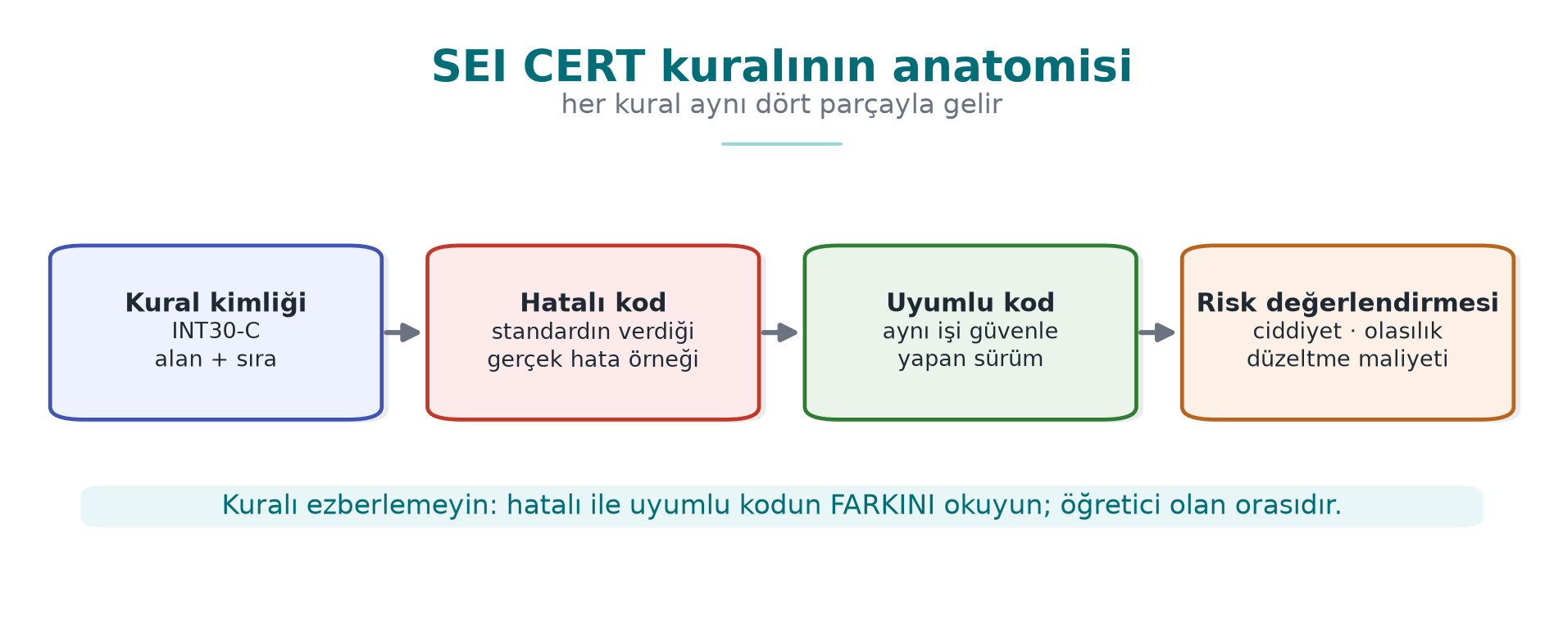
CEN429 Secure Programming · Week 4
Anatomy of a CERT Rule — Diagram
RTEU Computer Engineering · 2026-2027 Fall
27

Slide 28
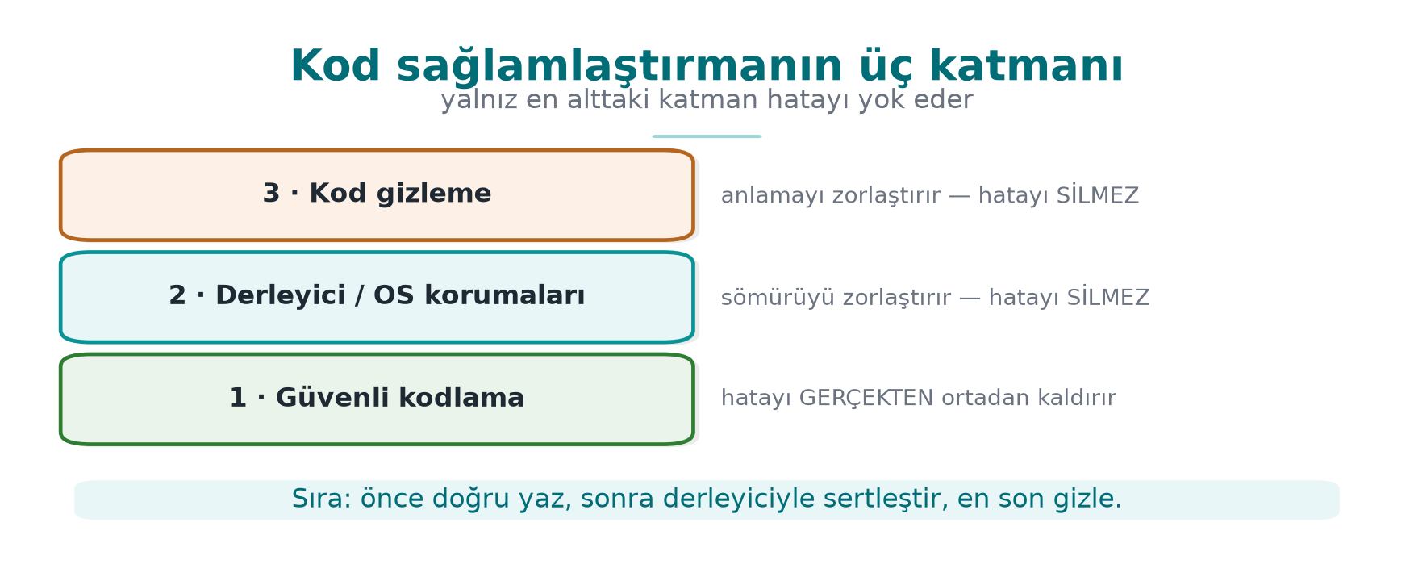
CEN429 Secure Programming · Week 4
Three Layers — Diagram
RTEU Computer Engineering · 2026-2027 Fall
28

Slide 29
CEN429 Secure Programming · Week 4
Layer 2 · Secure Coding
• Question: is there a bug in my code?
• Tools: CERT rules, sanitizers, fuzzing.
• Goal: not writing the bug in the first place.
RTEU Computer Engineering · 2026-2027 Fall
29

Slide 30
CEN429 Secure Programming · Week 4
Layer 3 · Compiler/OS
• Question: if a bug slips through, is it hard to exploit?
• Tools: canary, FORTIFY, ASLR, NX, RELRO, CFI.
• Goal: making exploitation of the remaining bug expensive.
RTEU Computer Engineering · 2026-2027 Fall
30

Slide 31
CEN429 Secure Programming · Week 4
Layer 4 · Obfuscation
• Question: does someone reading the code understand it?
• Tools: symbol/string hiding, removing logging, flattening.
• Goal: slowing down reverse engineering.
RTEU Computer Engineering · 2026-2027 Fall
31

Slide 32
CEN429 Secure Programming · Week 4
From the Field: Scheme Requirements
In a certified product:
• "Common vulnerabilities must be addressed: sensitive data, injection, overflow, language-specific weaknesses"
• "Defensive programming consistent across the entire codebase"
• "Protection against static and dynamic reverse engineering"
➡️ Eighteen hardening measures on the native side alone.
RTEU Computer Engineering · 2026-2027 Fall
32

Slide 33
CEN429 Secure Programming · Week 4
SEI CERT: What Does a Rule Look Like?
Parts of every CERT rule:
• Identifier: STR31-C, MEM50-CPP
• Title: one sentence
• Noncompliant example and compliant solution
• Risk level (L1/L2/L3) and a CWE link
RTEU Computer Engineering · 2026-2027 Fall
33

Slide 34
CEN429 Secure Programming · Week 4
Rule or Recommendation?
• Rule: violating it is a vulnerability, and it can be checked automatically.
• Recommendation: good practice.
• Start a review with L1 (highest risk) rules.
RTEU Computer Engineering · 2026-2027 Fall
34

Slide 35
CEN429 Secure Programming · Week 4
How Is the Risk Level Determined?
Risk = severity × likelihood × cost to fix.
• L1: high risk, these first.
• L2 / L3: progressively lower.
RTEU Computer Engineering · 2026-2027 Fall
35

Slide 36
CEN429 Secure Programming · Week 4
CERT Categories (1)
Abbreviation | Category | Example
INT | Integers | INT32-C: do not allow signed overflow
ARR/STR | Array/string | STR31-C: allocate sufficient space
MEM | Memory | MEM30-C: do not access freed memory
FIO | File I/O | FIO30-C: exclude input from the format string
RTEU Computer Engineering · 2026-2027 Fall
36

Slide 37
CEN429 Secure Programming · Week 4
CERT Categories (2)
Abbreviation | Category | Example
ENV | Environment | ENV33-C: do not call system()
SIG | Signals | SIG30-C: only safe fn. in the handler
ERR | Error handling | ERR33-C: detect a library error
CON/MSC | Concurrency/misc | CON43-C, MSC32-C
C++: MEM50-CPP, CTR50-CPP, STR50-CPP, EXP53-CPP, ERR50-CPP.
RTEU Computer Engineering · 2026-2027 Fall
37

Slide 38
CEN429 Secure Programming · Week 4
Automated CERT Auditing
• Warnings: -Wall -Wextra -Wformat=2 -Wconversion
• clang-tidy cert-*
• cppcheck --addon=cert
• MSVC /analyze
The evaluator runs this scan first, then reads by hand.
RTEU Computer Engineering · 2026-2027 Fall
38

Slide 39
CEN429 Secure Programming · Week 4
Input Validation
RTEU Computer Engineering · 2026-2027 Fall
39

Slide 40
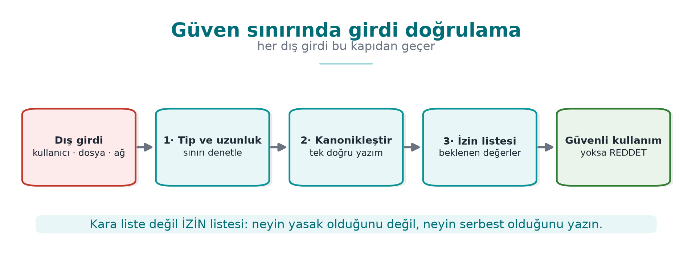
CEN429 Secure Programming · Week 4
Input Validation — Diagram
RTEU Computer Engineering · 2026-2027 Fall
40

Slide 41
CEN429 Secure Programming · Week 4
Where Does Input Come From?
From more places than you'd think. And all of it is untrusted:
• Command line, environment variables
• File, network
• IPC (another process on the same machine)
• Database, library interface (JNI)
RTEU Computer Engineering · 2026-2027 Fall
41

Slide 42
CEN429 Secure Programming · Week 4
Commonly Forgotten Inputs
• Even argv[0] can be the attacker's; PATH, LANG.
• Length fields inside a file format.
• Network: says "16 bytes," sends 1 byte.
• "Our own data" may have changed since.
RTEU Computer Engineering · 2026-2027 Fall
42

Slide 43
CEN429 Secure Programming · Week 4
Five Principles of Input Validation
1. Allow-list (enumerate what's permitted), not a deny-list.
2. Canonicalize first, then validate.
3. Length → type → range → format, in that order.
4. At the trust boundary, as early as possible.
5. Reject, don't "clean up" and use it anyway.
RTEU Computer Engineering · 2026-2027 Fall
43

Slide 44
CEN429 Secure Programming · Week 4
Principle 1 · Allow-List
• Deny-list: "these are forbidden" — something always gets forgotten.
• Allow-list: "only these are permitted" — a safe default.
Example: a username may only contain [a-z0-9_].
RTEU Computer Engineering · 2026-2027 Fall
44

Slide 45
CEN429 Secure Programming · Week 4
Principle 2 · Canonicalize
• The same thing, spelled differently: /tmp/../etc, %2e%2e/.
• Reduce it to one form (canonicalize) first, then check it.
• Otherwise the check can be bypassed.
RTEU Computer Engineering · 2026-2027 Fall
45

Slide 46
CEN429 Secure Programming · Week 4
Principle 3 · strtol, Not atoi
errno = 0;
long v = strtol(s, &son, 10);
if (son == s) return -1; /* rakam yok */
if (*son != '\0') return -1; /* "12abc" */
if (errno == ERANGE) return -1; /* taştı */
if (v < en_az || v > en_cok) return -1; /* iş kuralı */
RTEU Computer Engineering · 2026-2027 Fall
46

Slide 47
CEN429 Secure Programming · Week 4
Why Is atoi Dangerous?
• atoi("abc") = 0 (the error is silent)
• atoi("99999999999") = undefined (overflow)
• atoi("12abc") = 12 (the extra characters are ignored)
strtol reports every error to you; atoi does not.
RTEU Computer Engineering · 2026-2027 Fall
47

Slide 48
CEN429 Secure Programming · Week 4
Principle 3 · a Length-Prefixed Record
if (kalan < 3) return -1; /* başlık yok */
uint16_t uzunluk = tampon[1] << 8 | tampon[2];
if (uzunluk > kalan - 3) return -1; /* KAYNAK: bildirilen > gelen */
if (uzunluk > sizeof k->veri) return -1; /* HEDEF: sığmıyor */
memcpy(k->veri, tampon + 3, uzunluk);
RTEU Computer Engineering · 2026-2027 Fall
48

Slide 49
CEN429 Secure Programming · Week 4
Two Separate Checks, the Right Order
• Source check: is the declared length greater than the data that arrived?
• Destination check: does it fit in the destination buffer?
• Order: kalan < 3 first, so kalan - 3 does not wrap.
• In the field: every array coming from JNI is re-validated on the native side.
RTEU Computer Engineering · 2026-2027 Fall
49

Slide 50
CEN429 Secure Programming · Week 4
CERT Pair · STR31-C
strcpy(kopya, ad); /* HATALI */
int n = snprintf(kopya, sizeof kopya, "%s", ad);/* UYUMLU */
if (n < 0 || (size_t)n >= sizeof kopya) { /* kesildi */ }
strcpy does not know bounds; snprintf knows the size and reports truncation.
RTEU Computer Engineering · 2026-2027 Fall
50

Slide 51
CEN429 Secure Programming · Week 4
CERT Pair · INT30-C
size_t kalan = toplam - okunan; /* HATALI: okunan>toplam → dev sayı */
if (okunan > toplam) return HATA; /* UYUMLU: önce sırala */
size_t kalan = toplam - okunan;
Unsigned subtraction wraps; check the logic first.
RTEU Computer Engineering · 2026-2027 Fall
51

Slide 52
CEN429 Secure Programming · Week 4
CERT Pair · MEM30-C
for (d = bas; d; d = d->sonraki) free(d); /* HATALI */
while (d) { Dugum *s = d->sonraki; free(d); d = s; } /* UYUMLU */
Reading d->sonraki after free(d) = accessing freed memory.
RTEU Computer Engineering · 2026-2027 Fall
52

Slide 53
CEN429 Secure Programming · Week 4
CERT Pair · ERR33-C
FILE *f = fopen(yol,"rb"); fread(t,1,n,f); /* HATALI */
if (!f) return HATA;
if (fread(t,1,n,f) < n && ferror(f)) return HATA;/* UYUMLU */
Check every return value; fopen can return NULL.
RTEU Computer Engineering · 2026-2027 Fall
53

Slide 54
CEN429 Secure Programming · Week 4
Rule: Tie the Finding to an Identifier
Match every finding to a CERT identifier:
"This line is a MEM30-C violation (CWE-416)."
This makes the finding objective and searchable.
RTEU Computer Engineering · 2026-2027 Fall
54

Slide 55
CEN429 Secure Programming · Week 4
Section 1 — Quick Check
1. The three layers, and the right order?
2. Difference between a rule and a recommendation?
3. Why is atoi more dangerous than strtol?
RTEU Computer Engineering · 2026-2027 Fall
55
Notes:
Speaker note: Next, the format string vulnerability.

Slide 56
CEN429 Secure Programming · Week 4
Section 1 — Answers
1. Order: secure code (source) → compiler/tool protections → OS/runtime protections. First write it correctly, then harden it, then defend it at runtime.
2. A rule always applies, and violating it is a defect; a recommendation is good practice depending on context.
3. atoi does not report errors (undefined/0 on overflow/invalid input); strtol lets you check both the error and the bound via endptr+ERANGE.
RTEU Computer Engineering · 2026-2027 Fall
56

Slide 57
CEN429 Secure Programming · Week 4
2. Format String Vulnerability
RTEU Computer Engineering · 2026-2027 Fall
57

Slide 58
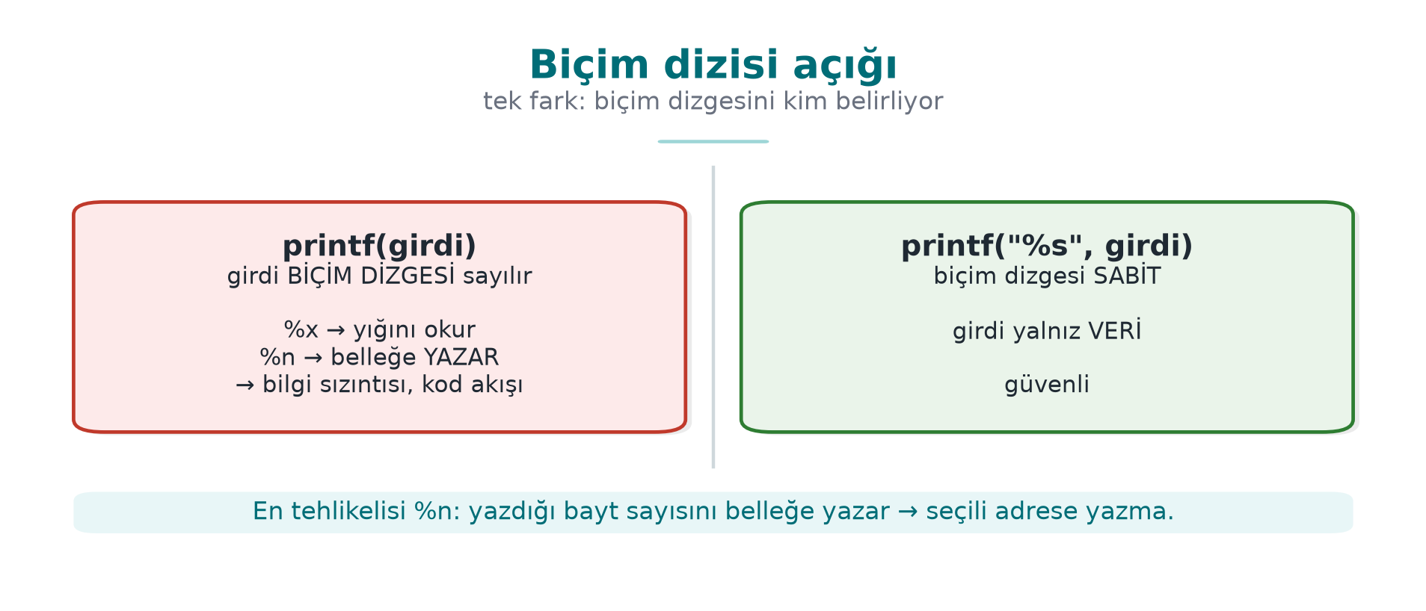
CEN429 Secure Programming · Week 4
Format String Vulnerability — Diagram
RTEU Computer Engineering · 2026-2027 Fall
58

Slide 59
CEN429 Secure Programming · Week 4
The Problem · printf(girdi)
printf(kullanici_girdisi); /* HATALI */
printf("%s", kullanici_girdisi); /* DOĞRU */
In the first case, user input is interpreted as a format string.
RTEU Computer Engineering · 2026-2027 Fall
59

Slide 60
CEN429 Secure Programming · Week 4
Why Is It Dangerous?
printf treats the % markers in the format string as a command.
If the user supplies %x, %s, %n, they make the program do work.
RTEU Computer Engineering · 2026-2027 Fall
60

Slide 61
CEN429 Secure Programming · Week 4
Marker · %x, %p
• Reads values off the stack and prints them.
• → information leak (addresses, secret values).
• Weakens ASLR (if an address leaks).
RTEU Computer Engineering · 2026-2027 Fall
61

Slide 62
CEN429 Secure Programming · Week 4
Marker · %s
• Treats a value on the stack as a pointer and reads the string at that address.
• Random address → crash or memory read.
RTEU Computer Engineering · 2026-2027 Fall
62

Slide 63
CEN429 Secure Programming · Week 4
Marker · %n
• Writes the number of characters printed so far to an address.
• → writes to memory → corruption, hijacking control.
• The most dangerous one.
RTEU Computer Engineering · 2026-2027 Fall
63

Slide 64
CEN429 Secure Programming · Week 4
The Same Bug Elsewhere
Not just printf:
syslog, fprintf, snprintf, err/warn — they all take a format string.
Rule: the format string is always constant (FIO30-C).
RTEU Computer Engineering · 2026-2027 Fall
64

Slide 65
CEN429 Secure Programming · Week 4
Demo 1 — Format String
code/week-04/01-format-string · CWE-134
Step | What Is Seen?
0 | GCC -Wformat-security warns; MSVC /analyze catches it
2 %x.%x… | The stack is dumped, the secret (synthetic) value appears
3 AAAA%n | Unprotected Linux crashes; Windows CRT rejects %n
4 | _FORTIFY_SOURCE: %n in writable segment
5 | Markers appear only as text
RTEU Computer Engineering · 2026-2027 Fall
65

Slide 66
CEN429 Secure Programming · Week 4
The Fix · Layer by Layer
1. The format string is always constant (FIO30-C).
2. Warning: -Wformat -Wformat-security -Werror=format-security.
3. Have the compiler check your own function too:
void gunluk_yaz(int duzey, const char *bicim, ...)
__attribute__((format(printf, 2, 3)));
1. Runtime: _FORTIFY_SOURCE=2; MS CRT has %n disabled.
RTEU Computer Engineering · 2026-2027 Fall
66

Slide 67
CEN429 Secure Programming · Week 4
3. Memory: Use-After-Free
RTEU Computer Engineering · 2026-2027 Fall
67

Slide 68
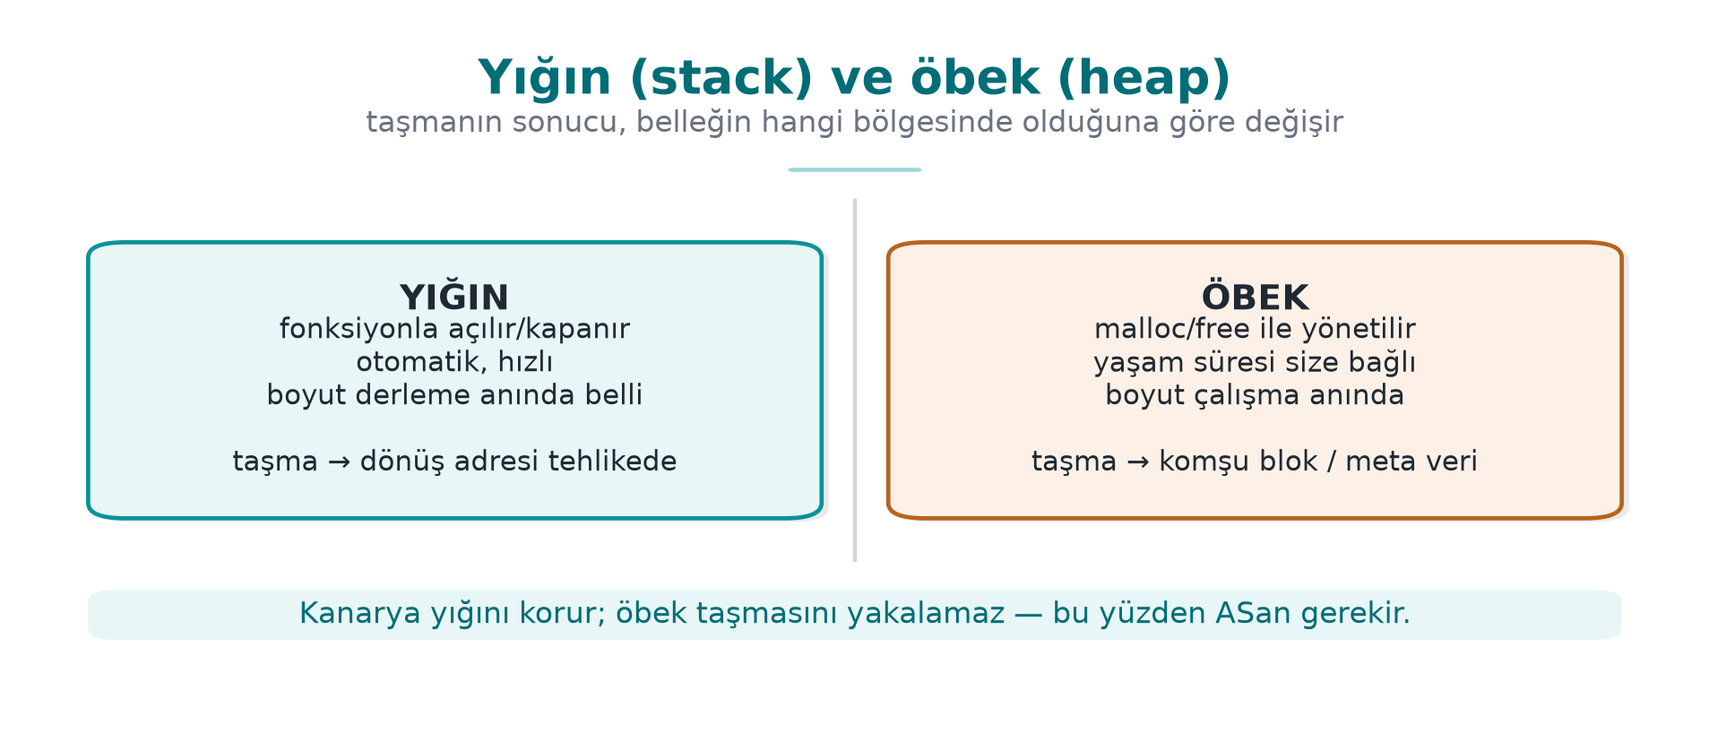
CEN429 Secure Programming · Week 4
Stack and Heap — Diagram
RTEU Computer Engineering · 2026-2027 Fall
68

Slide 69
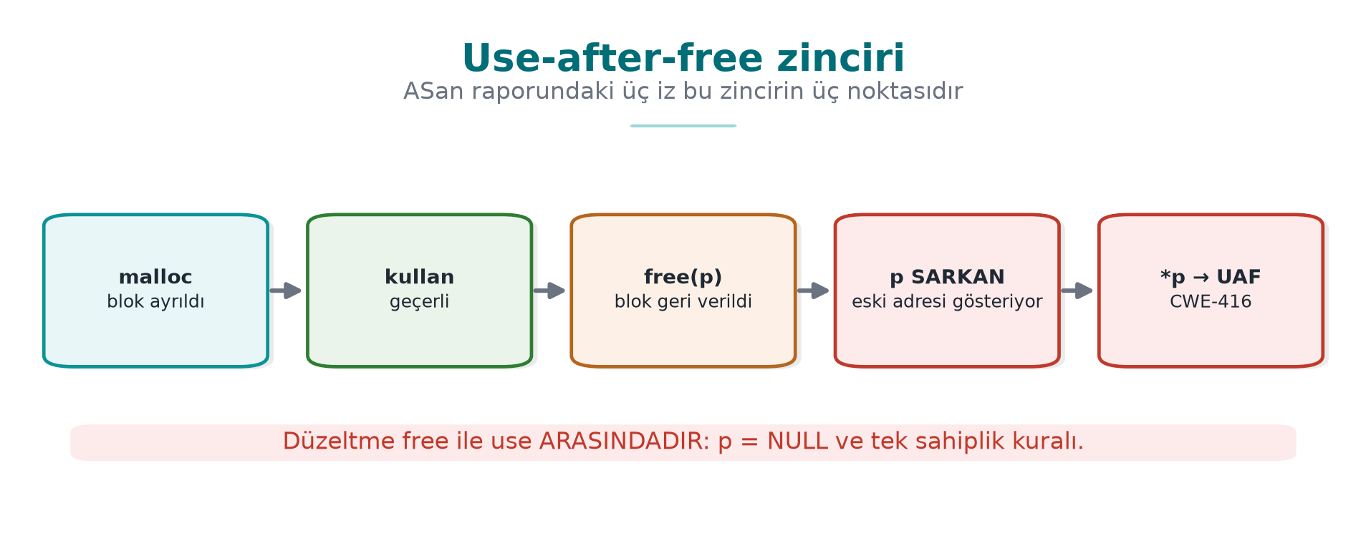
CEN429 Secure Programming · Week 4
Use-After-Free — Diagram
RTEU Computer Engineering · 2026-2027 Fall
69

Slide 70
CEN429 Secure Programming · Week 4
What Is UAF? · Step 1
• An object is on the heap.
• Two pointers point to the same object.
RTEU Computer Engineering · 2026-2027 Fall
70

Slide 71
CEN429 Secure Programming · Week 4
UAF · Step 2
• One of them frees it.
• The other still holds that address → a dangling pointer.
RTEU Computer Engineering · 2026-2027 Fall
71

Slide 72
CEN429 Secure Programming · Week 4
UAF · Step 3
• The allocator gives the same block to another object.
• The dangling pointer now reads/writes foreign data.
• If the object has a function pointer (C++ virtual table), the risk grows.
RTEU Computer Engineering · 2026-2027 Fall
72

Slide 73
CEN429 Secure Programming · Week 4
Why Is UAF So Common?
Most of the "memory corruption fixed" notes in browser/OS updates fall into this class.
Complex ownership → a dangling pointer.
RTEU Computer Engineering · 2026-2027 Fall
73

Slide 74
CEN429 Secure Programming · Week 4
Demo 2 — UAF and Double Free
code/week-04/02-kullanim-sonrasi · CWE-416/415 · MEM30-C
Step | What Is Seen?
1 | The freed block gets reused → role user → admin
2 ASan | heap-use-after-free + locations
3 | Double free → undefined behaviour
4 ASan | attempting double-free
5 | free + NULL, single owner → safe
RTEU Computer Engineering · 2026-2027 Fall
74

Slide 75
CEN429 Secure Programming · Week 4
ASan Report · Three Stack Traces
ERROR: heap-use-after-free
#0 oturum_kullan uaf.c:48 <- 1. KULLANIM
freed here:
#1 oturum_kapat uaf.c:31 <- 2. SERBEST BIRAKMA
allocated here:
#1 oturum_ac uaf.c:22 <- 3. AYIRMA
The fix is usually at location 2: the ownership decision was wrong there.
RTEU Computer Engineering · 2026-2027 Fall
75

Slide 76
CEN429 Secure Programming · Week 4
Fix · the C Side
• Set the pointer to NULL after free.
• Establish a single owner, a single release point.
• Write down the ownership rule: "who releases this memory?"
RTEU Computer Engineering · 2026-2027 Fall
76

Slide 77
CEN429 Secure Programming · Week 4
Fix · C++ Smart Pointers
Need | C++
Single owner | std::unique_ptr
Shared | std::shared_ptr
Non-owning observation | std::weak_ptr → lock()
Array | std::vector, std::array
if (auto o = onbellek.lock()) kullan(*o); // yoksa eski belleğe erişilmez
⚠️ get() is a raw pointer; when a vector grows, its iterators are invalidated.
RTEU Computer Engineering · 2026-2027 Fall
77

Slide 78
CEN429 Secure Programming · Week 4
Integers and UB
RTEU Computer Engineering · 2026-2027 Fall
78

Slide 79
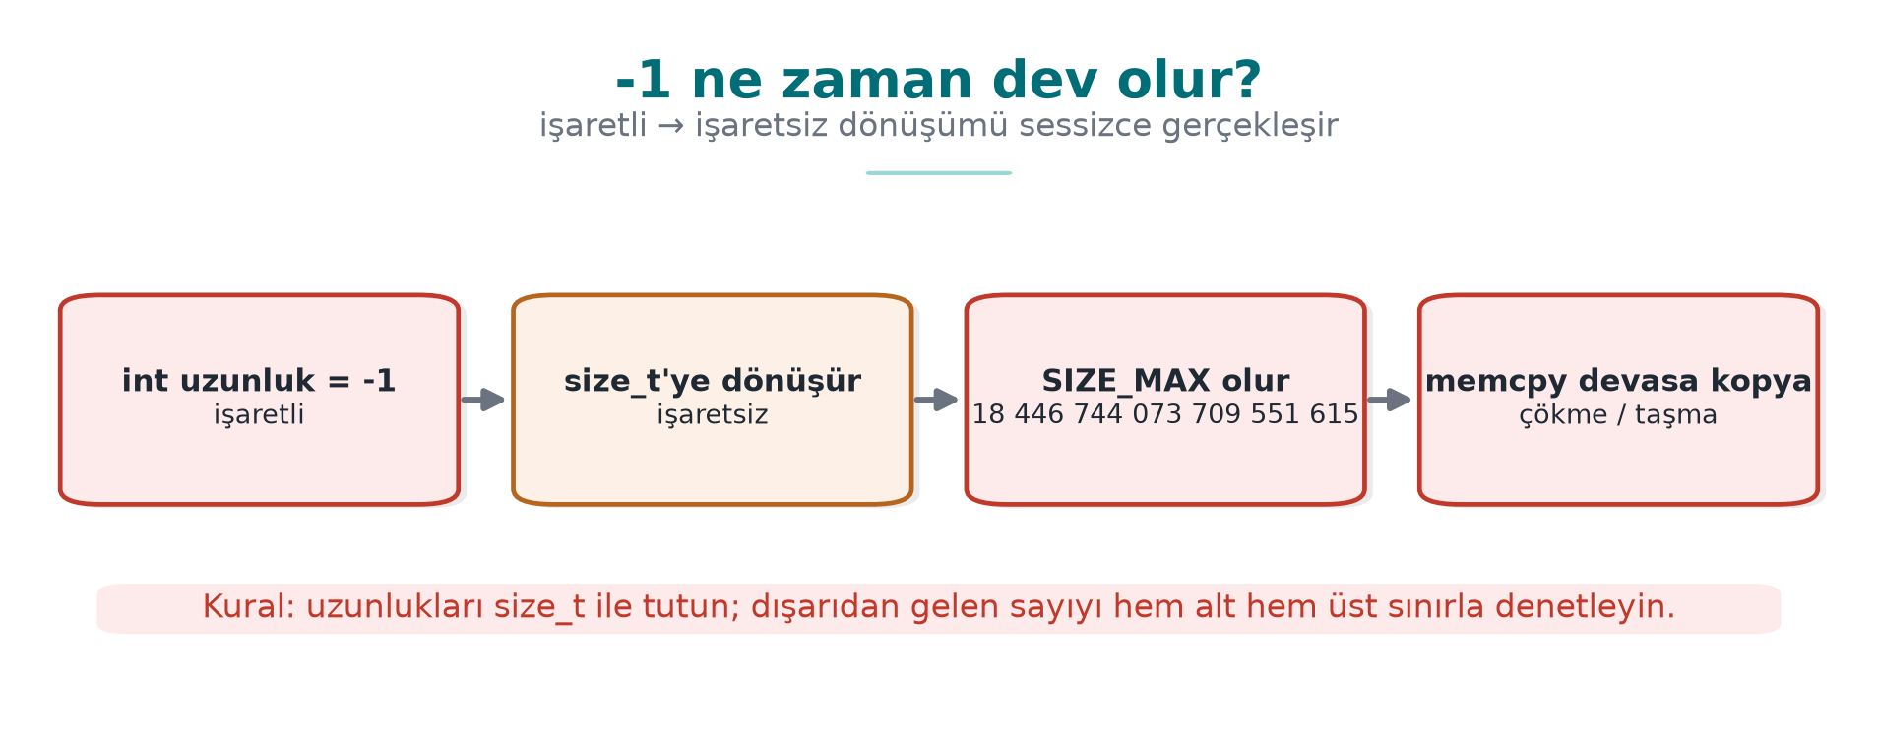
CEN429 Secure Programming · Week 4
Integer Overflow — Diagram
RTEU Computer Engineering · 2026-2027 Fall
79

Slide 80
CEN429 Secure Programming · Week 4
Four Integer Bugs
Bug | Example | Result
Unsigned wraparound | 0u - 1 = 4,294,967,295 | Logic error
Signed overflow | INT_MAX + 1 | Undefined
Conversion loss | long long→int | Truncation
Shift | 1 << 31 | Undefined
RTEU Computer Engineering · 2026-2027 Fall
80

Slide 81
CEN429 Secure Programming · Week 4
Why Does It Matter? · Multiplication Overflow
uint32_t boyut = adet * 4; /* adet = 0x40000001 → boyut = 4 */
dizi = malloc(boyut); /* küçük blok */
/* döngü adet kez yazar → öbek taşması */
Writing too much into a small allocated block = an overflow.
RTEU Computer Engineering · 2026-2027 Fall
81

Slide 82
CEN429 Secure Programming · Week 4
UB · the Compiler Can Delete the Check
if (x + 100 < x) /* "taşarsa küçülür" sanısı */
return -1; /* işaretli taşma UB → derleyici bu dalı SİLEBİLİR */
• It "works" at -O0, at -O2 the check disappears.
• UB cannot be relied on.
RTEU Computer Engineering · 2026-2027 Fall
82

Slide 83
CEN429 Secure Programming · Week 4
Correct: Check First
if ((b > 0 && a > INT_MAX - b) ||
(b < 0 && a < INT_MIN - b)) return false; /* taşma öncesi */
if (__builtin_mul_overflow(a, b, &sonuc)) return false; /* GCC/Clang */
/* C23: <stdckdint.h> ckd_add/ckd_mul · MSVC: <intsafe.h> */
Catch the overflow before it happens.
RTEU Computer Engineering · 2026-2027 Fall
83

Slide 84
CEN429 Secure Programming · Week 4
Demo 3 — UB and UBSan
code/week-04/03-tanimsiz-davranis · CWE-190/758
• Signed overflow, invalid shift, misaligned access
• On x86, most produce a wrong result silently
• -fsanitize=undefined → signed integer overflow: 2147483647 + 1 ...
• Windows: no UBSan → /RTC, /analyze, CERT
⚠️ -fwrapv hides the logic error; do not use it for diagnosis.
RTEU Computer Engineering · 2026-2027 Fall
84

Slide 85
CEN429 Secure Programming · Week 4
Error Handling and Signals
RTEU Computer Engineering · 2026-2027 Fall
85

Slide 86
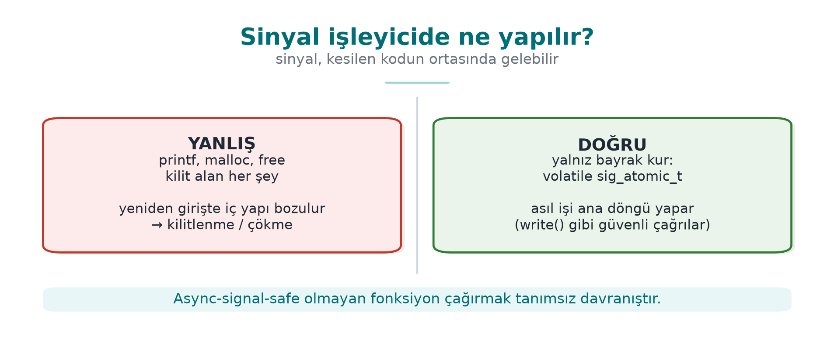
CEN429 Secure Programming · Week 4
Signal Handler — Diagram
RTEU Computer Engineering · 2026-2027 Fall
86

Slide 87
CEN429 Secure Programming · Week 4
Unchecked Return Value
Call | If Not Checked
malloc | Writing to NULL
setresuid | Stays privileged
RAND_bytes | The "random" key is zero
EVP_DecryptFinal_ex | Tampered data is assumed verified
RTEU Computer Engineering · 2026-2027 Fall
87

Slide 88
CEN429 Secure Programming · Week 4
Rules for Error Handling
1. Check every return value (ERR33-C); [[nodiscard]].
2. On error, return to a safe state (goto cleanup) — fail-closed.
3. The message must not give a hint: "no such user" ≠ "wrong password."
RTEU Computer Engineering · 2026-2027 Fall
88

Slide 89
CEN429 Secure Programming · Week 4
From the Field: Opaque Return Values
• Native functions do not return a detailed error code.
• Only success/failure, and even that is opaque (Week 9).
• A detailed code = a map for the attacker of "which check you tripped."
• A separate, secure channel for diagnosis → recorded as a trade-off.
RTEU Computer Engineering · 2026-2027 Fall
89

Slide 90
CEN429 Secure Programming · Week 4
Signal Handler · Rule
static volatile sig_atomic_t durdur = 0;
static void isleyici(int s){ (void)s; durdur = 1; } /* YALNIZ bayrak */
• No printf, malloc, free in the handler (SIG30-C).
• Do not call functions that are not async-signal-safe.
• sigaction() instead of signal().
RTEU Computer Engineering · 2026-2027 Fall
90

Slide 91
CEN429 Secure Programming · Week 4
Real Incident: regreSSHion
• 2024 CVE-2024-6387: the timeout signal handler called an unsafe logging function.
• Result: remote code execution risk.
• Lesson: only set a flag inside a handler.
RTEU Computer Engineering · 2026-2027 Fall
91

Slide 92
CEN429 Secure Programming · Week 4
Section 2–3 — Quick Check
1. Why is %n the most dangerous?
2. The three traces in a UAF report? Which one gets the fix?
3. Why can if (x+100 < x) be deleted?
4. Why is there no printf in a signal handler?
RTEU Computer Engineering · 2026-2027 Fall
92
Notes:
Speaker note: After the break, static analysis, sanitizers, fuzzing.

Slide 93
CEN429 Secure Programming · Week 4
Section 2–3 — Answers
1. %n WRITES the number of bytes printed so far to memory → an attacker can write to an address of their choosing and hijack control flow.
2. allocated-by · freed-by · use-here. The fix is usually between freed↔use: set the pointer to NULL after free, or fix the lifetime.
3. Signed overflow is undefined behaviour; the compiler assumes "overflow never happens" → the condition is always false → it deletes it. Do the check with __builtin_add_overflow.
4. printf is not async-signal-safe; if the handler re-enters it, locks/state get corrupted → deadlock/crash. Only safe calls like write are allowed.
RTEU Computer Engineering · 2026-2027 Fall
93

Slide 94
CEN429 Secure Programming · Week 4
4. Static Analysis, Sanitizers, Fuzzing
RTEU Computer Engineering · 2026-2027 Fall
94

Slide 95
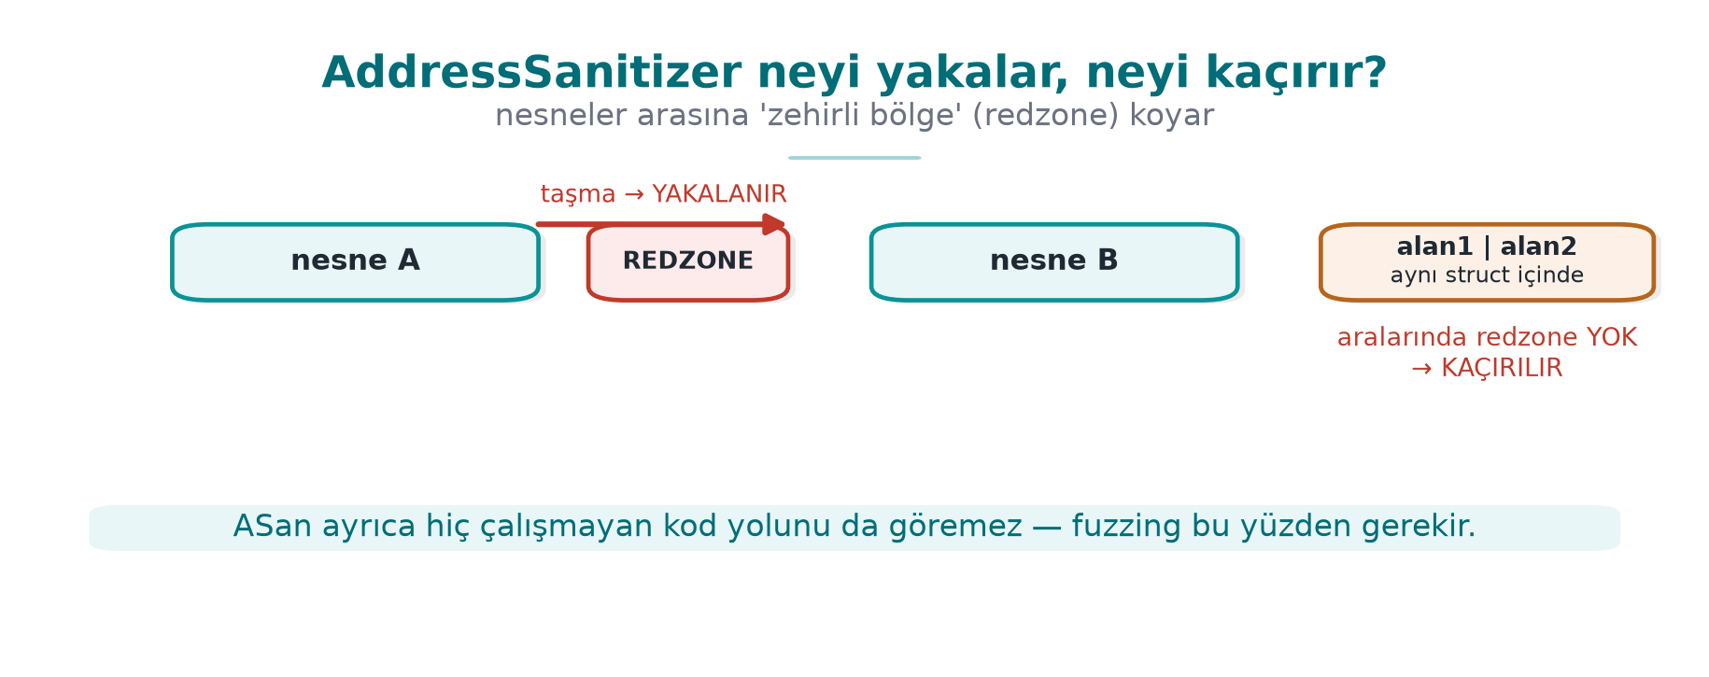
CEN429 Secure Programming · Week 4
ASan Redzone — Diagram
RTEU Computer Engineering · 2026-2027 Fall
95

Slide 96
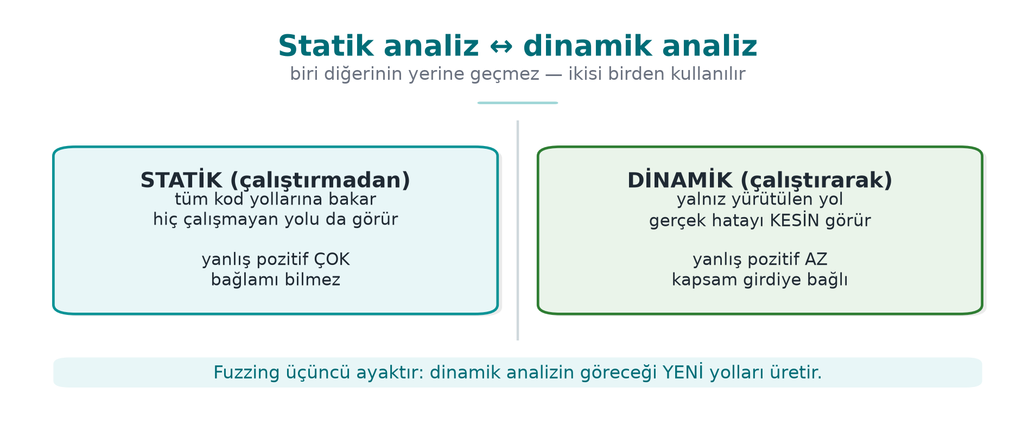
CEN429 Secure Programming · Week 4
Static ↔ Dynamic — Diagram
RTEU Computer Engineering · 2026-2027 Fall
96

Slide 97
CEN429 Secure Programming · Week 4
What Is Static Analysis? (Reminder)
Examining code without running it, looking for bugs.
Advantage: it also sees paths that never execute. Disadvantage: it produces false alarms.
RTEU Computer Engineering · 2026-2027 Fall
97

Slide 98
CEN429 Secure Programming · Week 4
Static Analysis · Layer by Layer
Level | Tool | What It Finds
Warnings | -Wall -Wextra -Wconversion | Conversion, format
Analyser | -fanalyzer, clang --analyze, /analyze | NULL, leaks
Rule | clang-tidy cert-*, cppcheck | CERT violation
Semantic | CodeQL, Semgrep | Data flow
Commercial | Coverity, Klocwork | Deep analysis
RTEU Computer Engineering · 2026-2027 Fall
98

Slide 99
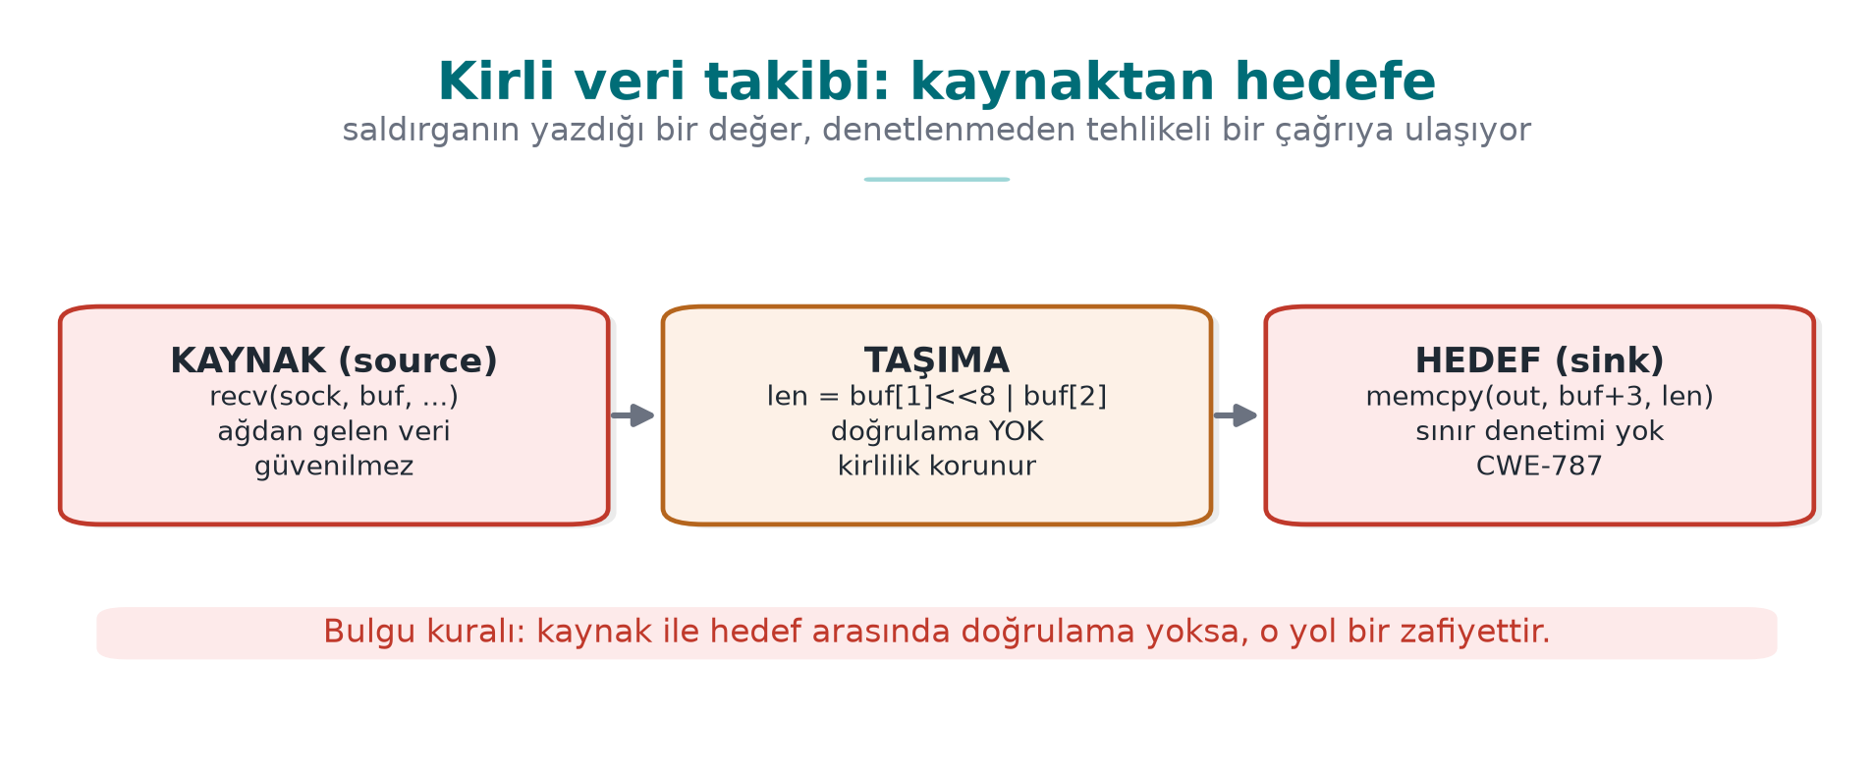
CEN429 Secure Programming · Week 4
Tainted Data: Source → Sink
The tool sees unvalidated data flowing to a dangerous place.
RTEU Computer Engineering · 2026-2027 Fall
99

Slide 100
CEN429 Secure Programming · Week 4
Living with False Alarms
1. Start with high-confidence rules.
2. Every suppression has a reason: // NOLINT(cert-err33-c): neden.
3. Zero warnings on new code (enforced by CI).
The evaluator asks for the developer's own scan report.
RTEU Computer Engineering · 2026-2027 Fall
100

Slide 101
CEN429 Secure Programming · Week 4
What Is a Sanitizer? (Reminder)
A tool that catches memory/UB bugs while the program runs.
Almost no false alarms; but it only finds bugs on the path that actually executes.
→ combine with tests + fuzzing.
RTEU Computer Engineering · 2026-2027 Fall
101

Slide 102
CEN429 Secure Programming · Week 4
The Sanitizer Family
Sanitizer | Finds | Flag
ASan | Overflow, UAF, double free | -fsanitize=address
LSan | Leaks | with ASan
UBSan | Overflow, shift, NULL | -fsanitize=undefined
MSan | Uninitialized reads | -fsanitize=memory
TSan | Data race | -fsanitize=thread
RTEU Computer Engineering · 2026-2027 Fall
102

Slide 103
CEN429 Secure Programming · Week 4
How Does ASan Work? · Shadow Memory
• One shadow byte per 8 bytes: how much of it is valid?
• A poisoned region (redzone) before/after arrays.
• Freed blocks wait in quarantine.
• A shadow check before every access.
RTEU Computer Engineering · 2026-2027 Fall
103

Slide 104
CEN429 Secure Programming · Week 4
ASan's Blind Spot
struct { char ad[8]; long yetki; } k;
strcpy(k.ad, uzun_girdi); /* ad → yetki taşar */
A field-to-field overflow inside the same structure → no poisoned region in between → ASan cannot see it (Week 1 Demo 3).
RTEU Computer Engineering · 2026-2027 Fall
104

Slide 105
CEN429 Secure Programming · Week 4
Sanitizers Do Not Ship in the Release Build
gcc -g -O1 -fno-omit-frame-pointer \
-fsanitize=address,undefined p.c -o p_test
• Slows things down (~2×), uses memory.
• Only in test/CI; disabled in the release build.
RTEU Computer Engineering · 2026-2027 Fall
105

Slide 106
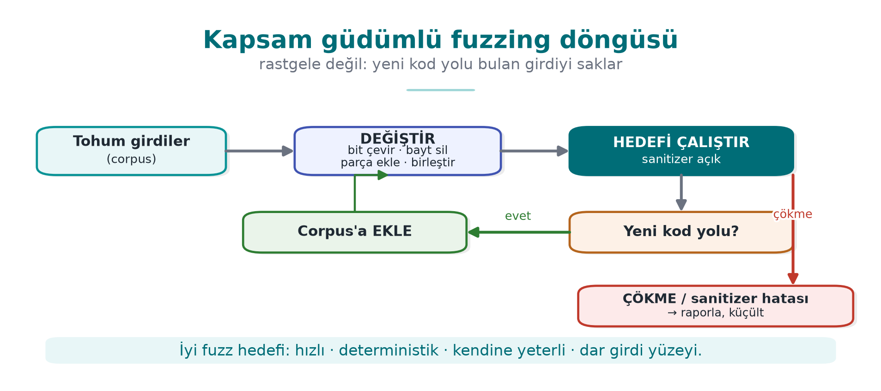
CEN429 Secure Programming · Week 4
What Is Fuzzing? · Coverage-Guided
An input that opens a new code path is saved and worked on further.
RTEU Computer Engineering · 2026-2027 Fall
106

Slide 107
CEN429 Secure Programming · Week 4
What Does Fuzzing Find?
• It finds magic bytes and the right length field on its own.
• Inputs a human would never think of.
• Tools: libFuzzer, AFL++, honggfuzz, OSS-Fuzz (tens of thousands of bugs).
RTEU Computer Engineering · 2026-2027 Fall
107

Slide 108
CEN429 Secure Programming · Week 4
Writing a Fuzz Target
int LLVMFuzzerTestOneInput(const uint8_t *veri, size_t boyut) {
ayristir(veri, boyut); /* sınanacak fonksiyon */
return 0;
}
clang -g -O1 -fsanitize=fuzzer,address fuzz.c ayristir.c -o f
./f corpus/ -max_total_time=10
RTEU Computer Engineering · 2026-2027 Fall
108

Slide 109
CEN429 Secure Programming · Week 4
A Good Fuzz Target
Four properties:
• Fast (no network/disk)
• Deterministic (same input → same result)
• Stateless (not affected by the previous call)
• Single job (tests one function)
RTEU Computer Engineering · 2026-2027 Fall
109

Slide 110
CEN429 Secure Programming · Week 4
Demo 4 — Finding Bugs with Fuzzing
code/week-04/04-fuzzing · CWE-125/787
Step | What Happens?
1 | tohum/normal.bin is fine
2 | libFuzzer ≤ 10 s → a crashing input
3 | Replay with ASan → full report
4 | Fixed version → no crash
5 | cokerten.bin is safely rejected
"This function was fuzzed for this long" = strong evidence (S16).
RTEU Computer Engineering · 2026-2027 Fall
110

Slide 111
CEN429 Secure Programming · Week 4
Section 4 — Quick Check
1. The difference between static and dynamic analysis?
2. Which overflow can ASan not see?
3. The four properties of a good fuzz target?
RTEU Computer Engineering · 2026-2027 Fall
111
Notes:
Speaker note: Next, compiler and OS protections.

Slide 112
CEN429 Secure Programming · Week 4
Section 4 — Answers
1. Static: examines all paths without running the code (can have false positives). Dynamic: while running, observes real bugs only on the path that actually executes.
2. ASan sees the places where it placed a redzone; it cannot see a field-to-field overflow inside an object, or paths that never execute.
3. Fast, deterministic, self-sufficient (not dependent on external state), a target that handles a narrow input surface and fails cleanly on a crash.
RTEU Computer Engineering · 2026-2027 Fall
112

Slide 113
CEN429 Secure Programming · Week 4
5. Compiler and OS Protections
RTEU Computer Engineering · 2026-2027 Fall
113
Notes:
Speaker note: These are the "limit the damage if a bug slips through" layer. None of them removes the bug; they make exploitation harder.

Slide 114
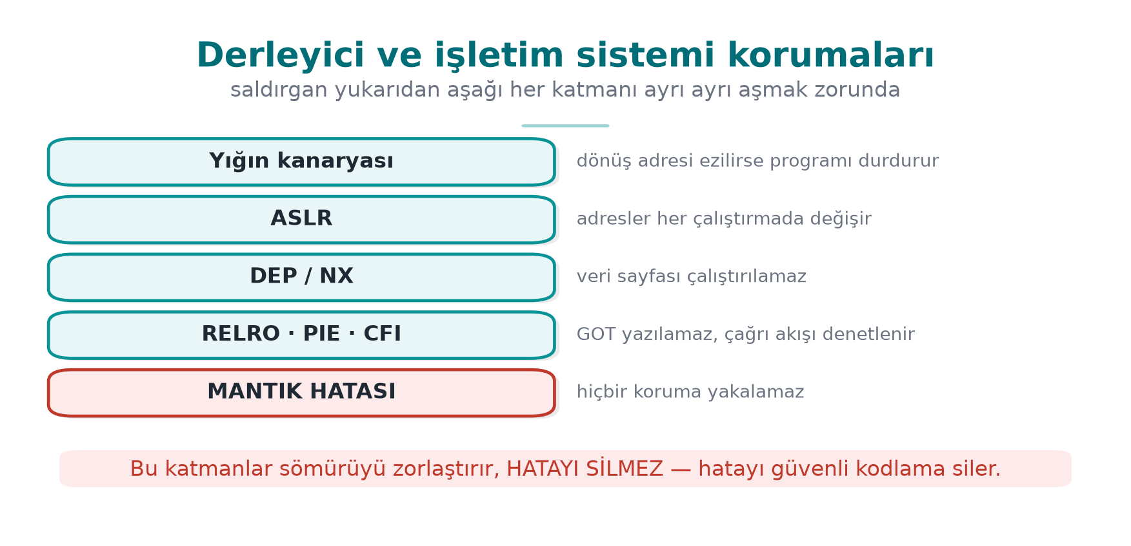
CEN429 Secure Programming · Week 4
Compiler/OS Protections — Diagram
RTEU Computer Engineering · 2026-2027 Fall
114

Slide 115
CEN429 Secure Programming · Week 4
Layer 3 · the Idea
Say a bug slipped through.
• There are automatic protections that make exploitation expensive.
• Most are turned on with a compile flag.
• Not free, but cheap.
RTEU Computer Engineering · 2026-2027 Fall
115

Slide 116
CEN429 Secure Programming · Week 4
Stack Canary
• A sentinel value is placed just before the return address.
• If an overflow corrupts this value, it is noticed before the return and the program halts.
• -fstack-protector-strong / MSVC /GS.
RTEU Computer Engineering · 2026-2027 Fall
116

Slide 117
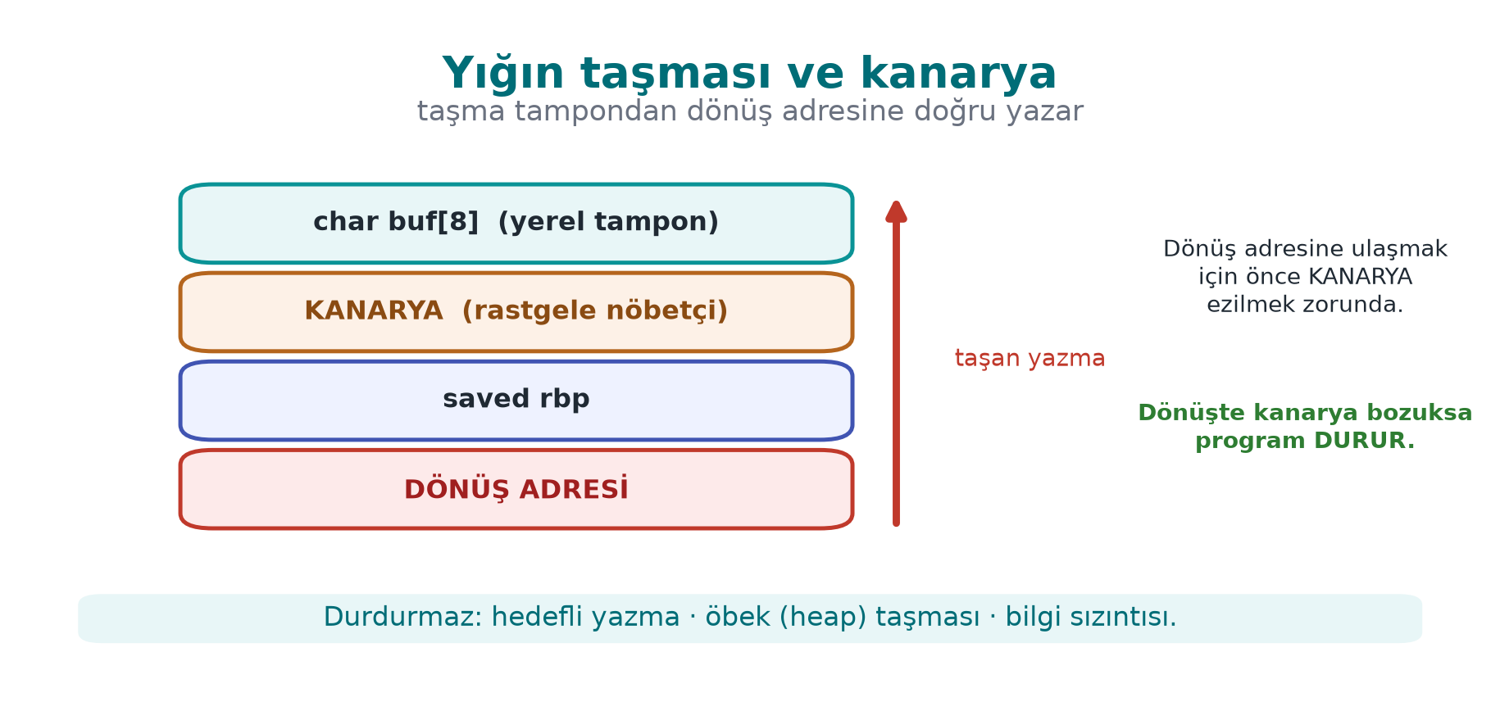
CEN429 Secure Programming · Week 4
Stack Overflow and Canary — Diagram
RTEU Computer Engineering · 2026-2027 Fall
117

Slide 118
CEN429 Secure Programming · Week 4
_FORTIFY_SOURCE
• Catches library calls that write more than a buffer's known size.
• -D_FORTIFY_SOURCE=2 (+ at least -O1).
• Does not protect your own loops.
RTEU Computer Engineering · 2026-2027 Fall
118

Slide 119
CEN429 Secure Programming · Week 4
PIE + ASLR
• ASLR: randomizes addresses.
• PIE: makes the program itself load at a random address too.
• -fPIE -pie / /DYNAMICBASE /HIGHENTROPYVA.
RTEU Computer Engineering · 2026-2027 Fall
119

Slide 120
CEN429 Secure Programming · Week 4
DEP/NX and RELRO
• DEP/NX: makes the data region non-executable (default).
• RELRO: makes tables like the GOT read-only → -Wl,-z,relro,-z,now.
RTEU Computer Engineering · 2026-2027 Fall
120

Slide 121
CEN429 Secure Programming · Week 4
CFI / CFG and the Shadow Stack
• CFI/CFG: checks that indirect calls only go to valid targets.
• -fcf-protection, -fsanitize=cfi / /guard:cf.
• Shadow stack: a second copy of the return addresses (CET).
RTEU Computer Engineering · 2026-2027 Fall
121

Slide 122
CEN429 Secure Programming · Week 4
Protections · One Table
Protection | GCC/Clang | MSVC
Canary | -fstack-protector-strong | /GS
FORTIFY | -D_FORTIFY_SOURCE=2 | Secure CRT
PIE/ASLR | -fPIE -pie | /DYNAMICBASE
NX | default | /NXCOMPAT
RELRO | -Wl,-z,relro,-z,now | —
CFI | -fcf-protection | /guard:cf
RTEU Computer Engineering · 2026-2027 Fall
122

Slide 123
CEN429 Secure Programming · Week 4
⚠️ Every Protection Has Limits
Protection | Stops | Does Not Stop
Canary | Overflow reaching the return address | Heap overflow, a leaked canary
FORTIFY | Library-call overflow | Your own loops
ASLR | Assuming a fixed address | Address leak
NX | Code in the data region | Code reuse (ROP)
RTEU Computer Engineering · 2026-2027 Fall
123

Slide 124
CEN429 Secure Programming · Week 4
The Main Rule
Every protection makes a technique harder; it does not remove a class of bug.
None of them is enough for a logic error → secure coding comes first.
RTEU Computer Engineering · 2026-2027 Fall
124

Slide 125
CEN429 Secure Programming · Week 4
Demo 5 — Turning Protections On and Off
code/week-04/05-derleyici-korumalari · CWE-121
• The same overflow: giris_zayif (off) vs giris_sert (on).
• Hardened: *** stack smashing detected *** / Windows 0xC0000409.
• Weak: silent corruption or a crash.
readelf -h p | grep Type # DYN = PIE
readelf -d p | grep BIND_NOW # tam RELRO
readelf -s p | grep __stack_chk # kanarya
RTEU Computer Engineering · 2026-2027 Fall
125

Slide 126
CEN429 Secure Programming · Week 4
Recommended Release Flags
GCC/Clang:
-O2 -D_FORTIFY_SOURCE=2 -fstack-protector-strong -fPIE -pie -Wl,-z,relro,-z,now -fcf-protection -Wall -Wextra -Wformat=2 -Werror=format-security
MSVC:
/O2 /GS /sdl /guard:cf /DYNAMICBASE /HIGHENTROPYVA /NXCOMPAT /CETCOMPAT /W4
RTEU Computer Engineering · 2026-2027 Fall
126

Slide 127
CEN429 Secure Programming · Week 4
Protection Table = Evidence
• The evaluator extracts a protection table for every binary and .so.
• A disabled protection is a finding; its justification must be in the trade-off record.
• Scheme: the application can also verify itself that the protections are enabled.
RTEU Computer Engineering · 2026-2027 Fall
127

Slide 128
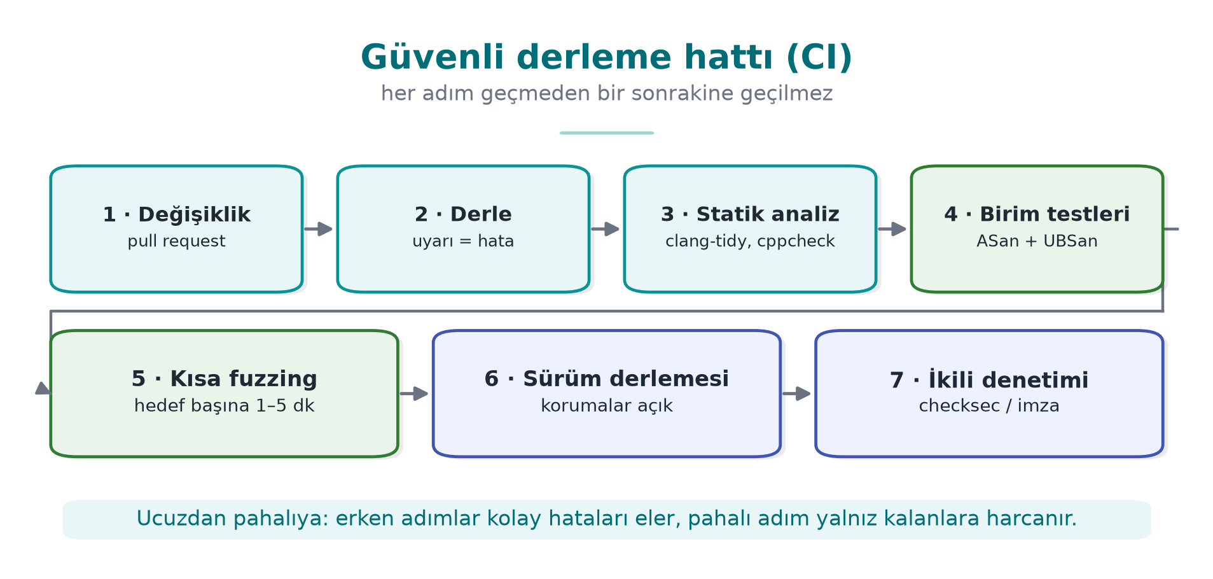
CEN429 Secure Programming · Week 4
Secure Build Pipeline (CI)
Every failing step stops the merge.
RTEU Computer Engineering · 2026-2027 Fall
128

Slide 129
CEN429 Secure Programming · Week 4
CI · Failure Criteria
Stage | Failure
Build | A single warning
Sanitizer-enabled test | Any report
Fuzzing | A new crash (old corpus = regression)
Binary audit | Log strings, symbols, a disabled protection
RTEU Computer Engineering · 2026-2027 Fall
129

Slide 130
CEN429 Secure Programming · Week 4
The Course's CMake Modes
Mode | Flags
korumasiz | -O0
optimize | -O2
asan | -O1 -fsanitize=address
denetimli | -O2 -D_FORTIFY_SOURCE=2
guvenli | -O2 + fixed source
Most of the protection flags: Demo 5's giris_sert.
RTEU Computer Engineering · 2026-2027 Fall
130

Slide 131
CEN429 Secure Programming · Week 4
The Build Environment Is a Target Too
• Access logging; pinning dependencies (Week 5's SBOM).
• Signed releases; reproducible builds.
• If the build machine is compromised, the entire product is affected.
RTEU Computer Engineering · 2026-2027 Fall
131

Slide 132
CEN429 Secure Programming · Week 4
Section 5 — Quick Check
1. What does the canary stop, and what does it not stop?
2. Why is ASLR weakened by an information leak?
3. Why is "no protection is enough for a logic error"?
RTEU Computer Engineering · 2026-2027 Fall
132
Notes:
Speaker note: Next, an introduction to code obfuscation.

Slide 133
CEN429 Secure Programming · Week 4
Section 5 — Answers
1. Stops: a sequential stack overflow that overwrites the return address (the canary gets corrupted). Does not stop: a targeted write, a heap overflow, an information leak.
2. A single leaked address reveals the module's base address (the offset is fixed) → the entire randomisation collapses.
3. Protections catch memory violations; incorrect authorization/business logic is a valid memory access → no protection is triggered. Correct design + review is required.
RTEU Computer Engineering · 2026-2027 Fall
133

Slide 134
CEN429 Secure Programming · Week 4
6. Introduction to Code Obfuscation
RTEU Computer Engineering · 2026-2027 Fall
134
Notes:
Speaker note: The introductory layer of obfuscation. Depth comes in Weeks 9 and 14.

Slide 135
CEN429 Secure Programming · Week 4
Layer 4 · Why?
• White-box attacker: reads strings, finds functions by name, bypasses checks.
• Obfuscation: same behaviour, harder to understand.
RTEU Computer Engineering · 2026-2027 Fall
135

Slide 136
CEN429 Secure Programming · Week 4
The Purpose of Obfuscation
Not making it impossible, but making it expensive (Cookbook 12.1):
• cost > the value being protected
• make automation harder (diversification, Week 14)
• buy time for the other layers
A few simple techniques + data hiding, rather than one advanced technique.
RTEU Computer Engineering · 2026-2027 Fall
136

Slide 137
CEN429 Secure Programming · Week 4
Obfuscation Map
Family | What It Hides | Week
Layout | Names, structure | 4
Data | Constants, strings, variables | 4, 9
Control flow | Algorithm structure | 4, 9
Preventive | Analysis tool | 9
Virtualisation | Machine code | 9, 14
RTEU Computer Engineering · 2026-2027 Fall
137

Slide 138
CEN429 Secure Programming · Week 4
From the Field: 18 Measures on the Native Side
Symbol visibility off · name mangling · constant arithmetic hiding · string encryption (decrypt on use, wipe immediately) · opaque booleans · your own library functions · fake operation/dead branch · flattening + randomised exit · no logging in the release build.
➡️ The strength comes from combining them, and from RASP.
RTEU Computer Engineering · 2026-2027 Fall
138

Slide 139
CEN429 Secure Programming · Week 4
Three Cheap Measures
Measure | How?
Hide symbols | static, -fvisibility=hidden, strip -s
Remove logging | Empty the macro at compile time
Hide strings | Encrypt at compile time, decrypt on use, wipe immediately
RTEU Computer Engineering · 2026-2027 Fall
139

Slide 140
CEN429 Secure Programming · Week 4
Logging Macro
#ifdef GUNLUK_ACIK
# define GUNLUK(...) fprintf(stderr, __VA_ARGS__)
#else
# define GUNLUK(...) ((void)0) /* dizge de çağrı da yok */
#endif
GUNLUK_ACIK is not defined in the release build → the logging is never compiled in.
RTEU Computer Engineering · 2026-2027 Fall
140

Slide 141
CEN429 Secure Programming · Week 4
⚠️ a Runtime Flag Is Not Enough
if (hata_ayikla) printf("..."); /* KÖTÜ */
• The string remains in the binary.
• The attacker can flip the flag and turn logging back on.
• The right way: remove it at compile time.
RTEU Computer Engineering · 2026-2027 Fall
141

Slide 142
CEN429 Secure Programming · Week 4
⚠️ String Hiding ≠ Key Storage
• The decrypted string sits in memory, in the clear, while it's in use.
• The decryption key is inside the program.
• What it stops: static scans like strings.
• Against someone inspecting it while running → RASP (6). A real key → whitebox (11).
RTEU Computer Engineering · 2026-2027 Fall
142

Slide 143
CEN429 Secure Programming · Week 4
Demo 6 — Symbol and String Leakage
code/week-04/06-sembol-dize · CWE-200/215
Step | What Happens?
1 | gizli_acik and gizli_kapali give the same result
2 strings | The license string and [LOG] are visible in the open one; not in the closed one
3 nm | lisans_dogrula is visible in the open one; no symbol in the closed one
4 | Windows: names are in the PDB; the closed build produces no PDB
RTEU Computer Engineering · 2026-2027 Fall
143

Slide 144
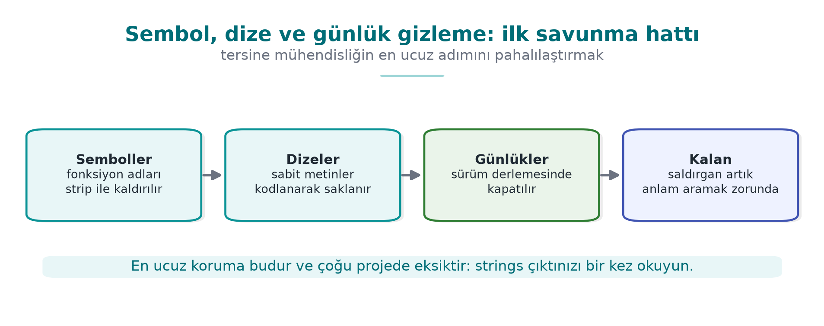
CEN429 Secure Programming · Week 4
Symbol and String Hiding — Diagram
RTEU Computer Engineering · 2026-2027 Fall
144

Slide 145
CEN429 Secure Programming · Week 4
Control-Flow Flattening
int durum = 1;
for (;;) switch (durum) {
case 1: durum = 2; break;
case 2: durum = (kosul ? 3 : 4); break;
case 3: durum = 5; break;
case 4: return BASARISIZ;
case 5: return BASARILI;
}
The blocks' natural adjacency is lost; the order lives only in the state variable.
RTEU Computer Engineering · 2026-2027 Fall
145

Slide 146
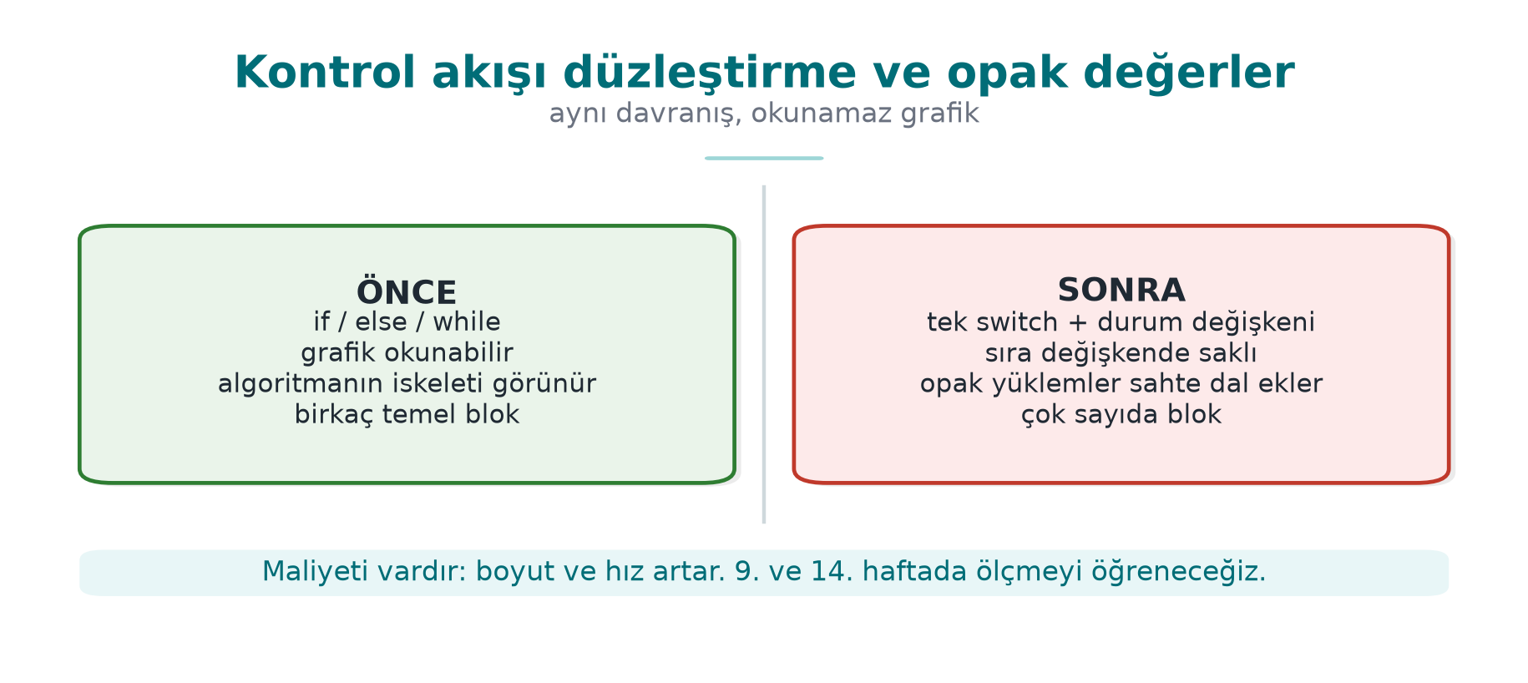
CEN429 Secure Programming · Week 4
Flattening: Before/After — Diagram
RTEU Computer Engineering · 2026-2027 Fall
146

Slide 147
CEN429 Secure Programming · Week 4
What Strengthens Flattening
• Hide the state values (arithmetic transformation)
• Fake/dead blocks (which one is real?)
• Randomised exit (where the error was caught becomes unreadable)
• Opaque values (a single byte cannot flip it)
The template alone is solved quickly on its own → Week 9 depth.
RTEU Computer Engineering · 2026-2027 Fall
147

Slide 148
CEN429 Secure Programming · Week 4
Demo 7 — Flattening
code/week-04/07-akis-duzlestirme
Step | What Happens?
1 | pin.c and pin_duz.c give the same result (the PIN is synthetic)
2 | objdump: the flattened version has far more branches
3 | Timing: the cost of flattening
➡️ Automated with Tigress's Flatten in Week 14; measuring effectiveness in Week 9.
RTEU Computer Engineering · 2026-2027 Fall
148

Slide 149
CEN429 Secure Programming · Week 4
Concept: Three Techniques Leading into Week 9
• Function name hiding: exported names are meaningless; readability handled via a macro.
• Allocation-size hiding: blur the "32 bytes = a key" tell.
• Dynamic decryption: sensitive code sits encrypted in the binary; conflicts with DEP/NX, used selectively.
RTEU Computer Engineering · 2026-2027 Fall
149

Slide 150
CEN429 Secure Programming · Week 4
Section 6 — Quick Check
1. Does obfuscation fix the bug?
2. Why isn't silencing logging with a runtime flag enough?
3. Three techniques that strengthen flattening?
RTEU Computer Engineering · 2026-2027 Fall
150
Notes:
Speaker note: Next, the project and the solved self-check.

Slide 151
CEN429 Secure Programming · Week 4
Section 6 — Answers
1. No. Obfuscation only makes reverse engineering harder; the bug stays where it is. Fix first, then obfuscate.
2. The string/code remains in the binary; the attacker can flip the flag or read the strings. Remove logging in the release build at compile time (macro/dead-code elimination).
3. Opaque predicates + fake blocks/dead branches + state-variable encoding & randomised exit (also name/string hiding).
RTEU Computer Engineering · 2026-2027 Fall
151

Slide 152
CEN429 Secure Programming · Week 4
7. Project and Closing
RTEU Computer Engineering · 2026-2027 Fall
152

Slide 153
CEN429 Secure Programming · Week 4
Project · S9 "Code Hardening" — 1
• checksec/dumpbin).
• clang-tidy/cppcheck; fix ≥ 5 findings (with rule ids).
RTEU Computer Engineering · 2026-2027 Fall
153

Slide 154
CEN429 Secure Programming · Week 4
Project · S9 — 2
•
•
• strings output.
Measure card: Description → Implementation → Verification → Residual risk.
RTEU Computer Engineering · 2026-2027 Fall
154

Slide 155
CEN429 Secure Programming · Week 4
Solved Self-Check
RTEU Computer Engineering · 2026-2027 Fall
155

Slide 156
CEN429 Secure Programming · Week 4
Question 1
Which of the three layers actually removes the bug?
Answer: Only secure coding (layer 2). Compiler/OS protections make exploitation harder; obfuscation slows down reading — neither one removes the bug.
RTEU Computer Engineering · 2026-2027 Fall
156

Slide 157
CEN429 Secure Programming · Week 4
Question 2
What is the mildest outcome of `printf(girdi)`?
Answer: An information leak (reading the stack via %x/%p). The worst is writing to memory via %n.
RTEU Computer Engineering · 2026-2027 Fall
157

Slide 158
CEN429 Secure Programming · Week 4
Question 3
The three stack traces in a UAF report? Which one gets the fix?
Answer: Use, free, allocation. The fix is usually at the free point (an ownership decision).
RTEU Computer Engineering · 2026-2027 Fall
158

Slide 159
CEN429 Secure Programming · Week 4
Question 4
Why can `if (x + 100 < x)` be deleted?
Answer: Signed integer overflow is undefined behaviour; the compiler assumes "overflow never happens" and can optimise the check away, deleting it.
RTEU Computer Engineering · 2026-2027 Fall
159

Slide 160
CEN429 Secure Programming · Week 4
Question 5
Why is there no `printf` in a signal handler?
Answer: printf/malloc are not async-signal-safe; if the handler calls them while interrupted mid-state, corruption follows. Only a flag is set (SIG30-C).
RTEU Computer Engineering · 2026-2027 Fall
160

Slide 161
CEN429 Secure Programming · Week 4
Question 6
Which overflow can ASan not see?
Answer: A field-to-field overflow inside the same structure (there is no poisoned region between them).
RTEU Computer Engineering · 2026-2027 Fall
161

Slide 162
CEN429 Secure Programming · Week 4
Question 7
The four properties of a good fuzz target?
Answer: Fast, deterministic, stateless, single job.
RTEU Computer Engineering · 2026-2027 Fall
162

Slide 163
CEN429 Secure Programming · Week 4
Question 8
What does the canary stop, and what does it not stop?
Answer: Stops: a stack overflow that reaches the return address. Does not stop: heap overflow, corruption of earlier variables, a leaked canary.
RTEU Computer Engineering · 2026-2027 Fall
163

Slide 164
CEN429 Secure Programming · Week 4
Question 9
Why is ASLR weakened by an information leak?
Answer: If one address leaks, the attacker can calculate the other addresses relative to it; the advantage of randomisation is lost.
RTEU Computer Engineering · 2026-2027 Fall
164

Slide 165
CEN429 Secure Programming · Week 4
Question 10
Why isn't silencing logging with a runtime flag enough?
Answer: The string remains in the binary and the attacker can flip the flag to turn logging back on. It must be removed at compile time.
RTEU Computer Engineering · 2026-2027 Fall
165

Slide 166
CEN429 Secure Programming · Week 4
Question 11
Three techniques that strengthen flattening?
Answer: Hiding state values, fake/dead blocks, a randomised exit point (and opaque values).
RTEU Computer Engineering · 2026-2027 Fall
166

Slide 167
CEN429 Secure Programming · Week 4
Question 12
Why is string hiding not the same as key storage?
Answer: The decrypted string is in memory, in the clear, while it's in use, and the decryption key sits inside the program; it only stops static scanning.
RTEU Computer Engineering · 2026-2027 Fall
167

Slide 168
CEN429 Secure Programming · Week 4
Summary: This Week in One Sentence
First bug-free code (CERT + sanitizer + fuzzing), then limit the damage (compiler/OS protections), and finally make it harder to read (obfuscation) — and no protection substitutes for secure coding.
RTEU Computer Engineering · 2026-2027 Fall
168

Slide 169
CEN429 Secure Programming · Week 4
Next Week
Week 5 — Code Hardening: Java and Interpreted Languages
Injection (SQL, command, path), obfuscation with ProGuard/R8, dependency security and SBOM.
Preparation: JDK 17+, Maven · code/week-05.
RTEU Computer Engineering · 2026-2027 Fall
169

Slide 170
CEN429 Secure Programming · Week 4
Appendix A · A Vulnerability, Start to Finish
RTEU Computer Engineering · 2026-2027 Fall
170
Notes:
Speaker note: We trace a single overflow from buggy code to attack, then to the fix. Can be worked through on the board.

Slide 171
CEN429 Secure Programming · Week 4
Buggy Code
void selamla(const char *ad) {
char tampon[16];
strcpy(tampon, ad); /* sınır yok */
printf("Merhaba %s\n", tampon);
}
What happens if ad is longer than 16 bytes?
RTEU Computer Engineering · 2026-2027 Fall
171

Slide 172
CEN429 Secure Programming · Week 4
What Happens? · Step by Step
• tampon is 16 bytes on the stack.
• strcpy copies ad all the way to its end, paying no attention to bounds.
• An ad longer than 16 → neighbouring memory (including the return address) is corrupted.
RTEU Computer Engineering · 2026-2027 Fall
172

Slide 173
CEN429 Secure Programming · Week 4
Attack · Outcome
• Short overflow: a neighbouring variable gets corrupted (a logic bug).
• Long overflow: the return address gets corrupted → crash or control hijacking.
• Without protection: a serious vulnerability (CWE-121).
RTEU Computer Engineering · 2026-2027 Fall
173

Slide 174
CEN429 Secure Programming · Week 4
Fix 1 · Bounded Copying
int n = snprintf(tampon, sizeof tampon, "%s", ad);
if (n < 0 || (size_t)n >= sizeof tampon) {
/* ad kesildi: reddet ya da işaretle */
}
snprintf knows the size and reports truncation.
RTEU Computer Engineering · 2026-2027 Fall
174

Slide 175
CEN429 Secure Programming · Week 4
Fix 2 · Layers
• Coding: snprintf (STR31-C).
• Compiler: -fstack-protector-strong (canary).
• FORTIFY: -D_FORTIFY_SOURCE=2 checks the library call.
• Testing: ASan catches the overflow with a long input.
RTEU Computer Engineering · 2026-2027 Fall
175

Slide 176
CEN429 Secure Programming · Week 4
Lesson: One Line, Many Layers
• One bug: strcpy.
• Defence: the right function + compiler protection + sanitizer testing.
• But the real fix is in the first line: bounded copying.
RTEU Computer Engineering · 2026-2027 Fall
176

Slide 177
CEN429 Secure Programming · Week 4
Appendix B · Common Mistakes
RTEU Computer Engineering · 2026-2027 Fall
177

Slide 178
CEN429 Secure Programming · Week 4
Mistake · Ignoring Warnings
• Something dismissed as "just a warning" is tomorrow's vulnerability.
• Turn the warning into an error with -Werror.
RTEU Computer Engineering · 2026-2027 Fall
178

Slide 179
CEN429 Secure Programming · Week 4
Mistake · Not Checking the Return Value
• malloc, fread, RAND_bytes can return NULL/an error.
• If not checked: a silent disaster (ERR33-C).
RTEU Computer Engineering · 2026-2027 Fall
179

Slide 180
CEN429 Secure Programming · Week 4
Mistake · Shipping the Sanitizer in the Release Build
• Sanitizers are for test/CI; they are slow and leak information.
• Disabled in the release build.
RTEU Computer Engineering · 2026-2027 Fall
180

Slide 181
CEN429 Secure Programming · Week 4
Mistake · Hiding UB with -fwrapv
• Making the overflow "defined" hides the logic error.
• Use UBSan to diagnose it, then fix it.
RTEU Computer Engineering · 2026-2027 Fall
181

Slide 182
CEN429 Secure Programming · Week 4
Mistake · Covering Up a Bug with Obfuscation
• Obfuscation does not fix the bug, it only hides it.
• Fix first, then obfuscate.
RTEU Computer Engineering · 2026-2027 Fall
182

Slide 183
CEN429 Secure Programming · Week 4
Mistake · "Cleaning Up" Input and Using It Anyway
• Reject dangerous input instead of trying to fix it.
• Allow-list + rejection is the safest approach.
RTEU Computer Engineering · 2026-2027 Fall
183

Slide 184
CEN429 Secure Programming · Week 4
Appendix C · Quick Reference
RTEU Computer Engineering · 2026-2027 Fall
184

Slide 185
CEN429 Secure Programming · Week 4
Glossary
Term | Meaning
UB | Undefined behaviour
UAF | Use-after-free
CERT/CWE | Rulebook / weakness catalogue
Sanitizer | Runtime bug detector
Fuzzing | Finding crashes with random input
Canary/ASLR/NX | Compiler/OS protections
RTEU Computer Engineering · 2026-2027 Fall
185

Slide 186
CEN429 Secure Programming · Week 4
Hardening Checklist
• -Werror and the CERT scan are clean
•
•
•
•
•
RTEU Computer Engineering · 2026-2027 Fall
186

Slide 187
CEN429 Secure Programming · Week 4
Final Word (Week 4)
Secure code is not written once; it is checked with tools on every build.
First correct code, then protection, finally obfuscation. The order matters.
RTEU Computer Engineering · 2026-2027 Fall
187

