Slide 1

CEN429 Secure Programming · Week 15
Final Project Demonstrations
CEN429 Secure Programming — Week 15
Asst. Prof. Dr. Uğur CORUH · 25.12.2026
RTEU Computer Engineering · 2026-2027 Fall
Notes:
Speaker note: Final demonstration week: each team shows the complete security guide, its protected application, and its test results.

Slide 2
CEN429 Secure Programming · Week 15
This Week: Final Project Demonstrations (RAP2)
• No lecture; final report (the complete guide) + protected application + test results
• RAP2 = 70% of the final · Quiz-2 = 30% · Course grade = 0.4·Grade_Midterm + 0.6·Grade_Final
• Detailed rubric: project guide · order and timing: in class
• ⚠️ No late submissions · a finding–action list for the midterm feedback
RTEU Computer Engineering · 2026-2027 Fall
2

Slide 3
CEN429 Secure Programming · Week 15
Final Rubric
Criterion | LO | Guide
Cryptography | 2 | S8
Secure communication | 4 | S6 · S11
Asset management | 5 | S5 (complete) · S8
Binary protections | 3 | S9 (advanced) · S15
Security testing and unit tests | 6 | S16 results
Standards | 7 | S1 · S14 · S17
Final report and presentation | 7 | All
RTEU Computer Engineering · 2026-2027 Fall
3

Slide 4
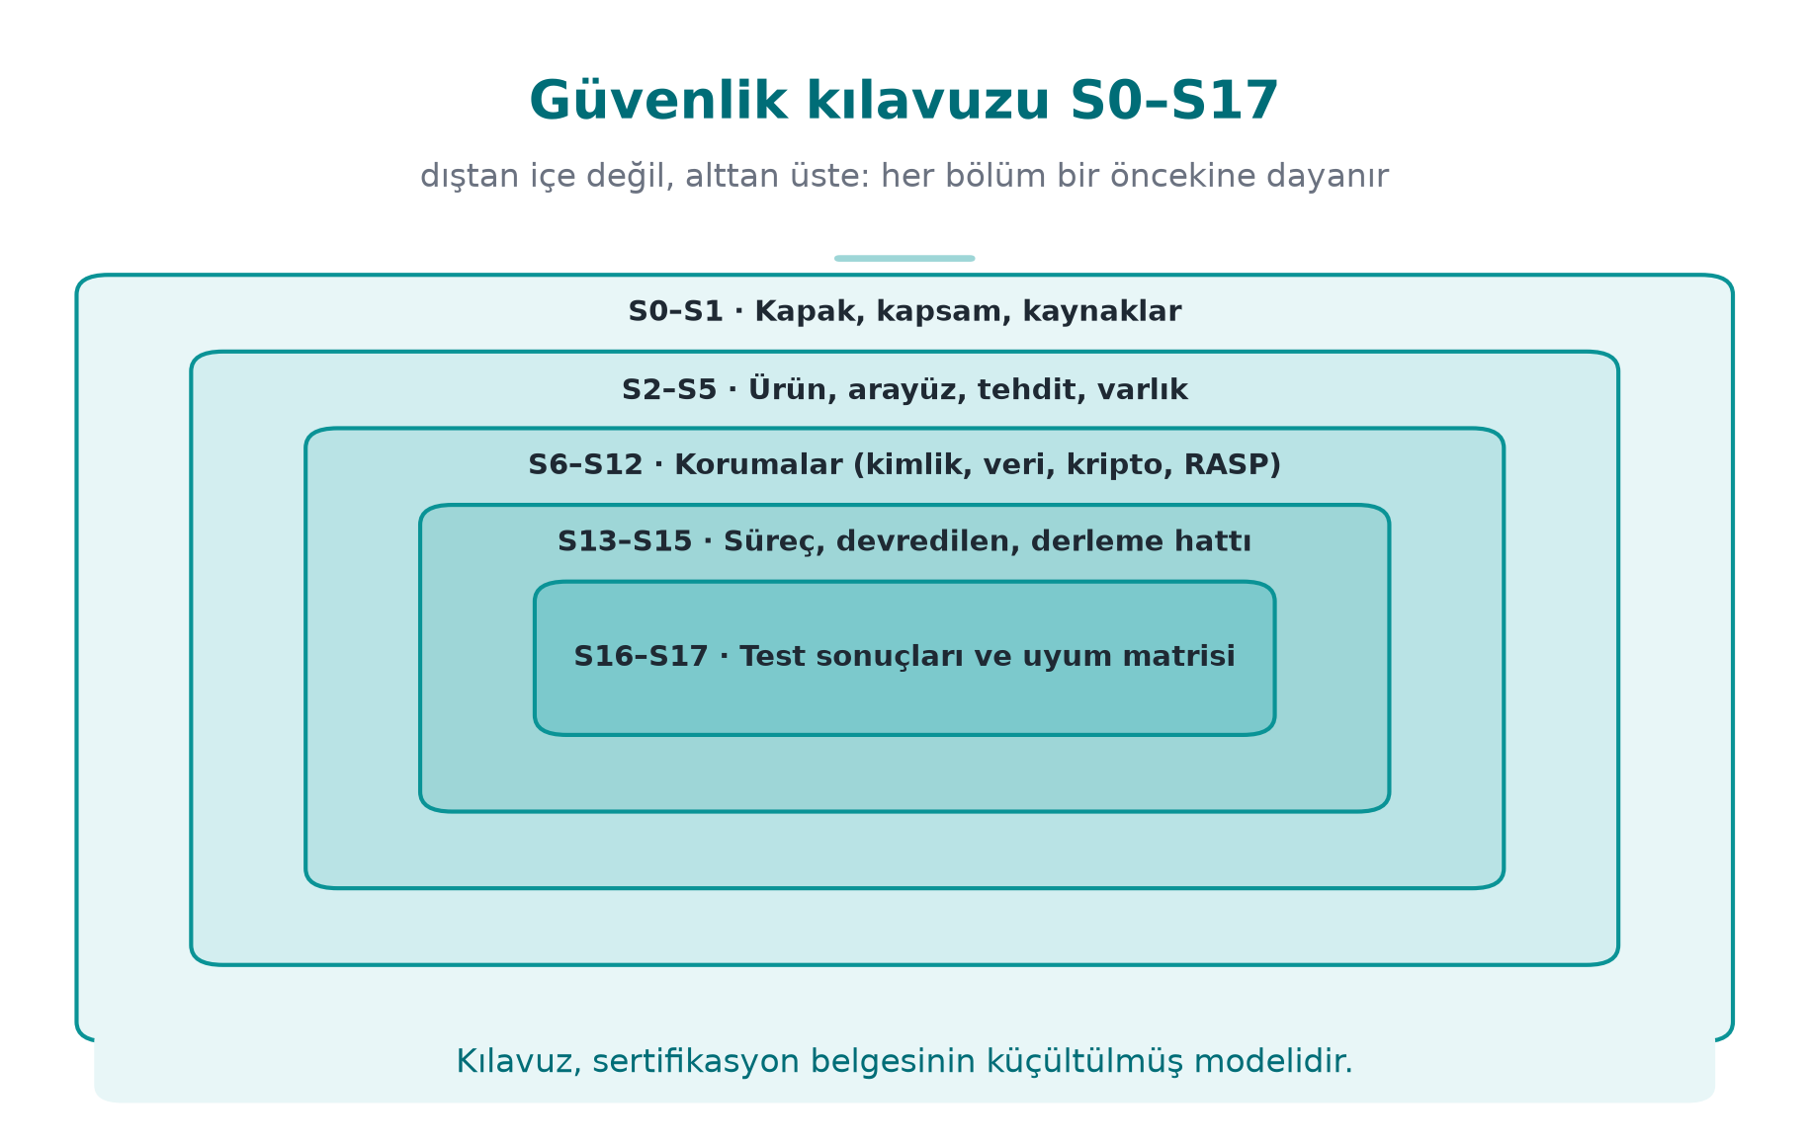
CEN429 Secure Programming · Week 15
Security Guide Map S0–S17 — Diagram
RTEU Computer Engineering · 2026-2027 Fall
4

Slide 5
CEN429 Secure Programming · Week 15
From Midterm to Final: New and Completed Sections
New | To be completed / updated
S6 identity and binding | S5 assets (complete)
S8 cryptography and keys | S9 hardening (advanced)
S11 secure communication | S12 reporting (complete)
S14 assumptions and deferred requirements | S13 updated SBOM
S15 build and deployment pipeline | S16 results · S17 complete matrix
RTEU Computer Engineering · 2026-2027 Fall
5

Slide 6
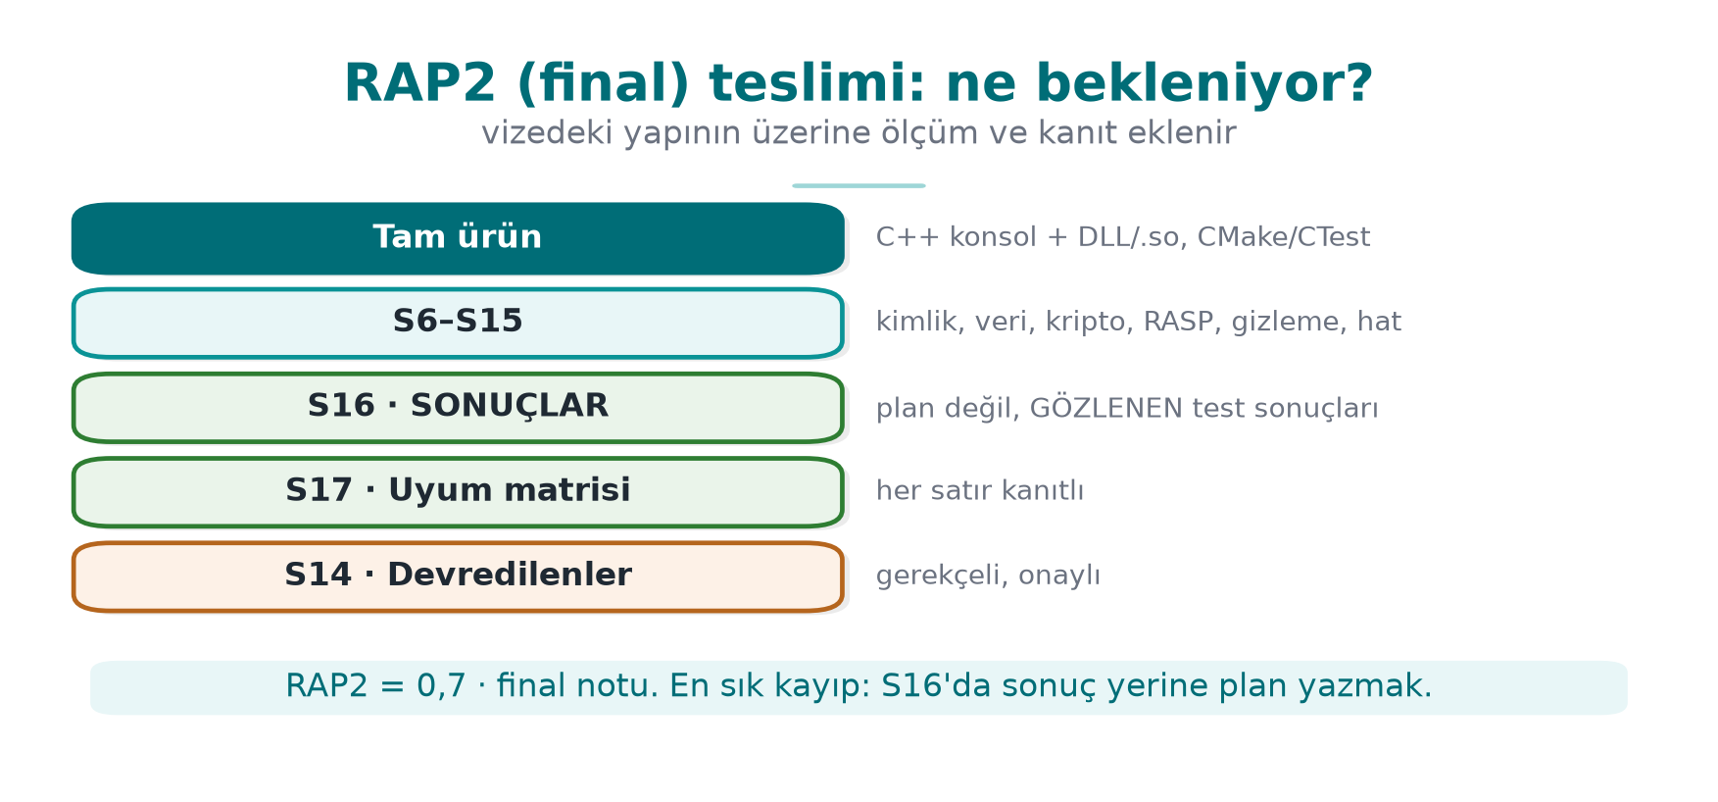
CEN429 Secure Programming · Week 15
RAP2 Submission — Diagram
RTEU Computer Engineering · 2026-2027 Fall
6

Slide 7
CEN429 Secure Programming · Week 15
Preparation Checklist
Week | What you should be able to show
9, 14 | Obfuscated functions and justification · cost table · obfuscation and signing in the build pipeline
10 | Algorithm inventory · key lifecycle · TLS/pinning · signature verification
11 | Protection method or justification for a sensitive asset
12 | Test plan + results · unit tests · CI · finding–action list
13 | Compliance matrix · assumptions and deferred requirements
RTEU Computer Engineering · 2026-2027 Fall
7

Slide 8
CEN429 Secure Programming · Week 15
Suggested Demonstration Flow
1. Summary: product, architecture, the three most critical assets
2. Since the midterm: finding–action list
3. Live demonstration: cryptography, secure communication, a protection layer working live
4. Evidence: tests, protection table, SBOM, compliance matrix
5. Remaining risk: what was deliberately scoped out, and why
RTEU Computer Engineering · 2026-2027 Fall
8

Slide 9
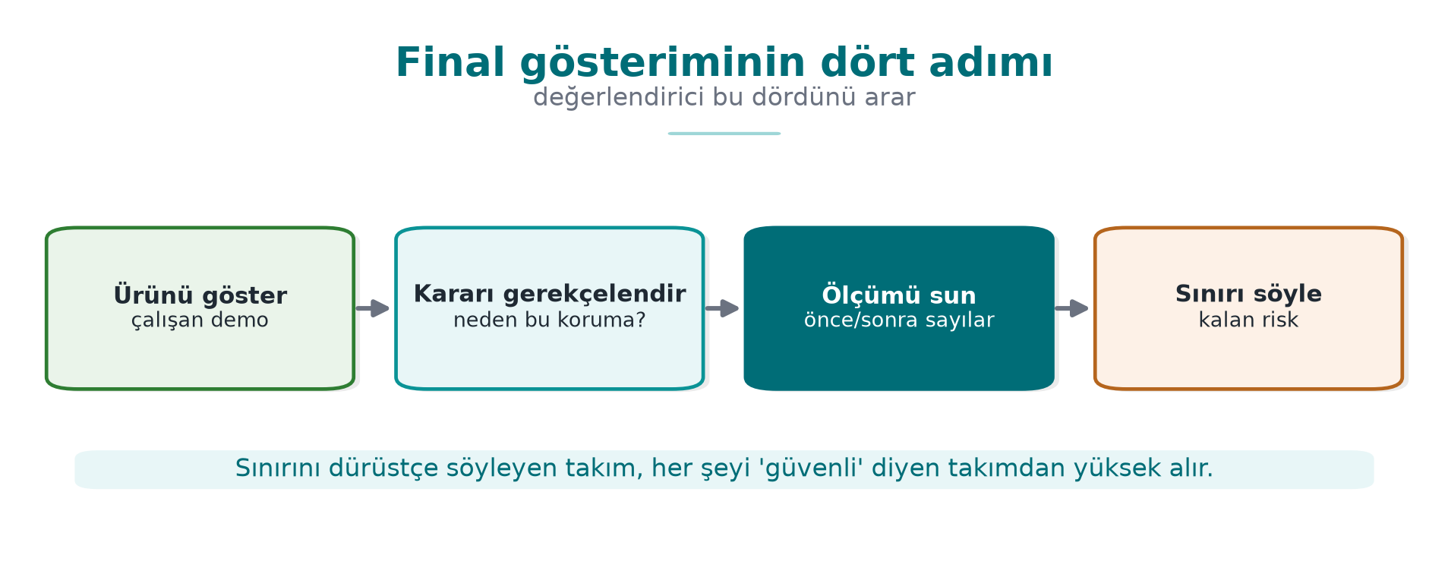
CEN429 Secure Programming · Week 15
Final Demonstration — Diagram
RTEU Computer Engineering · 2026-2027 Fall
9

Slide 10
CEN429 Secure Programming · Week 15
Sample Questions
• Which key is this key derived from, where does it live, when is it deleted?
• Where are chain and hostname verification performed?
• What happens if signature verification fails? Can an old but validly signed version still be installed?
• Did you measure the cost of obfuscation?
• Where is the evidence for this row marked "met"?
• Which requirement did you defer, and how will the other party meet it?
RTEU Computer Engineering · 2026-2027 Fall
10

Slide 11
CEN429 Secure Programming · Week 15
Common Mistakes
Mistake | Why is it a problem?
A test plan exists, but no results | At the final, results are expected
"Met" without evidence | Counted as unmet
Guide and code version differ | The assessed product becomes ambiguous
Empty remaining-risk section | Incomplete analysis
Midterm feedback was ignored | The finding–action loop is part of the process
Real secret / personal data in the repo | Values must be synthetic
RTEU Computer Engineering · 2026-2027 Fall
11

Slide 12
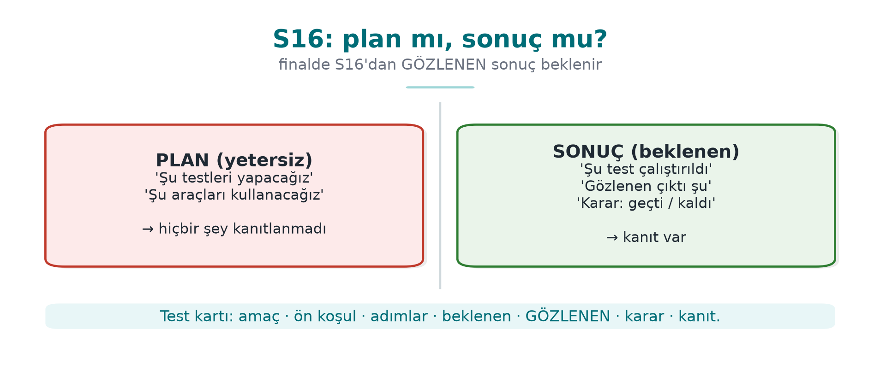
CEN429 Secure Programming · Week 15
S16: Results, Not a Plan — Diagram
RTEU Computer Engineering · 2026-2027 Fall
12

Slide 13
CEN429 Secure Programming · Week 15
At the End of the Term
• Your guide = a small model of certification documents → portfolio (make sure it contains no confidential information)
• Every submitted line must be explainable; any team member may be asked a question
RTEU Computer Engineering · 2026-2027 Fall
13

Slide 14
CEN429 Secure Programming · Week 15
Final Exam Period
Week 16 — Quiz-2
• Scope: weeks 9–14
• Study guide: Week 16 page
RTEU Computer Engineering · 2026-2027 Fall
14

Slide 15
CEN429 Secure Programming · Week 15
Appendix · Final Rubric Item by Item
RTEU Computer Engineering · 2026-2027 Fall
15
Notes:
Speaker note: At the final demonstration (RAP2), every section is expected to be complete; we explain what evidence each item expects.

Slide 16
CEN429 Secure Programming · Week 15
What Does the Final Measure?
The final demonstration measures the entirety of your project:
• cryptography, secure communication
• asset management (complete)
• advanced binary protections
• test results, standards
RTEU Computer Engineering · 2026-2027 Fall
16

Slide 17
CEN429 Secure Programming · Week 15
Item · Cryptography
• Algorithm inventory, key lifecycle.
• Evidence: S8 + tests.
RTEU Computer Engineering · 2026-2027 Fall
17

Slide 18
CEN429 Secure Programming · Week 15
Item · Secure Communication
• TLS, pinning, message level.
• Evidence: S6, S11 + tests.
RTEU Computer Engineering · 2026-2027 Fall
18

Slide 19
CEN429 Secure Programming · Week 15
Item · Advanced Binary Protections
• Obfuscation (S9 advanced), build pipeline (S15).
• Evidence: measurement table + signing.
RTEU Computer Engineering · 2026-2027 Fall
19

Slide 20
CEN429 Secure Programming · Week 15
Item · Testing and Verification
• Test results (not a plan).
• Evidence: S16.
RTEU Computer Engineering · 2026-2027 Fall
20

Slide 21
CEN429 Secure Programming · Week 15
Item · Standards and Compliance
• Compliance matrix (S17), deferred requirements (S14).
• Evidence: S14, S17.
RTEU Computer Engineering · 2026-2027 Fall
21

Slide 22
CEN429 Secure Programming · Week 15
Appendix · From Midterm to Final
RTEU Computer Engineering · 2026-2027 Fall
22

Slide 23
CEN429 Secure Programming · Week 15
New Sections
• S6 identity/binding
• S8 cryptography/keys
• S11 secure communication
• S14 assumptions/deferred requirements
• S15 build/deployment pipeline
RTEU Computer Engineering · 2026-2027 Fall
23

Slide 24
CEN429 Secure Programming · Week 15
To Be Completed
• S5 assets (complete)
• S9 hardening (advanced)
• S12 reporting (complete)
• S16 results
• S17 complete matrix
RTEU Computer Engineering · 2026-2027 Fall
24

Slide 25
CEN429 Secure Programming · Week 15
Finding–Action (from the Midterm)
• Midterm feedback into one table:
  – finding → action → closure.
• The assessor looks for this loop.
RTEU Computer Engineering · 2026-2027 Fall
25

Slide 26
CEN429 Secure Programming · Week 15
Appendix · Demonstration Flow
RTEU Computer Engineering · 2026-2027 Fall
26

Slide 27
CEN429 Secure Programming · Week 15
Flow · Summary + Since the Midterm
• Product, architecture, the three most critical assets.
• Finding–action list.
RTEU Computer Engineering · 2026-2027 Fall
27

Slide 28
CEN429 Secure Programming · Week 15
Flow · Live Demonstration
• Cryptography, secure communication and a protection layer working live.
• E.g., a tampered file being rejected.
RTEU Computer Engineering · 2026-2027 Fall
28

Slide 29
CEN429 Secure Programming · Week 15
Flow · Evidence + Remaining Risk
• Tests, protection table, SBOM, compliance matrix.
• Remaining risk: what was deliberately scoped out.
RTEU Computer Engineering · 2026-2027 Fall
29

Slide 30
CEN429 Secure Programming · Week 15
Appendix · Sample Questions
RTEU Computer Engineering · 2026-2027 Fall
30

Slide 31
CEN429 Secure Programming · Week 15
Question 1
Which key is this key derived from, where does it live, when is it deleted?
RTEU Computer Engineering · 2026-2027 Fall
31

Slide 32
CEN429 Secure Programming · Week 15
Question 2
Where is certificate chain and hostname verification performed?
RTEU Computer Engineering · 2026-2027 Fall
32

Slide 33
CEN429 Secure Programming · Week 15
Question 3
What happens if signature verification fails? Can an old but validly signed version still be installed?
RTEU Computer Engineering · 2026-2027 Fall
33

Slide 34
CEN429 Secure Programming · Week 15
Question 4
Did you measure the cost of obfuscation? Which function did you obfuscate, and why?
RTEU Computer Engineering · 2026-2027 Fall
34

Slide 35
CEN429 Secure Programming · Week 15
Question 5
Where is the evidence for this row marked "met" in the compliance matrix?
RTEU Computer Engineering · 2026-2027 Fall
35

Slide 36
CEN429 Secure Programming · Week 15
Appendix · Common Mistakes
RTEU Computer Engineering · 2026-2027 Fall
36

Slide 37
CEN429 Secure Programming · Week 15
Mistake List
• Test plan exists, no results.
• "Met" without evidence.
• Guide and code version differ.
• Remaining risk is empty.
• Midterm feedback was ignored.
• Real secret/personal data in the repo.
RTEU Computer Engineering · 2026-2027 Fall
37

Slide 38
CEN429 Secure Programming · Week 15
Final Word (RAP2)
At the final, results are expected: every protection is shown working, every requirement is tied to evidence.
Your guide is a small model of certification documents; it is a portfolio item.
RTEU Computer Engineering · 2026-2027 Fall
38

