Slide 1

CEN429 Secure Programming · Week 14
Tigress and Diversification
CEN429 Secure Programming — Week 14
Asst. Prof. Dr. Uğur CORUH · 18.12.2026
RTEU Computer Engineering · 2026-2027 Fall
Notes:
Speaker note: This week Tigress automates week 9's manual obfuscation rules using source-to-source obfuscation and diversification. Main rule: obfuscation does not grant unbreakability, it raises cost; combine transforms, diversify, measure. Tigress is applied only to your own code; it is not distributed in class.

Slide 2
CEN429 Secure Programming · Week 14
Today's Plan (3 Hours)
Hour | Section | Topic
1 | 0–1 | Basic concepts · source-to-source obfuscation · Tigress · license · basic flow
2 | 2 | Transform families · week 9 mapping · transform pipeline · step-by-step example
3 | 3–4 | Diversification · measurement · in-class flow · build pipeline (S15) · project
RTEU Computer Engineering · 2026-2027 Fall
2
Notes:
Speaker note: This week we automate week 9's manual obfuscation rules with a tool (Tigress). The main message is the same: obfuscation does not grant unbreakability, it raises cost; combine, diversify, measure.

Slide 3
CEN429 Secure Programming · Week 14
A Brief History — Source-to-Source Obfuscation and Diversification
• 1993 — Cohen: the idea of diversification (same function, different binary)
• 1997 — Collberg et al.'s obfuscation taxonomy (the foundation of week 9)
• 2013 — Obfuscator-LLVM: compiler-based obfuscation
• 2010s — Tigress: source-to-source + virtualisation + diversification for C
• 2016–17 — Banescu et al. measure resilience with Tigress+KLEE
Main rule: resilience ↔ cost; protection is chosen in proportion to the value of the asset.
RTEU Computer Engineering · 2026-2027 Fall
3

Slide 4
CEN429 Secure Programming · Week 14
Where Does This Week Fit?
• Week 9: we learned obfuscation rules by hand
• Week 11: whitebox for the key
• This week (14): applying the same rules with a tool, automatically, and diversified → Tigress
All three form a whole; today is the automation step.
RTEU Computer Engineering · 2026-2027 Fall
4

Slide 5
CEN429 Secure Programming · Week 14
Learning Outcome
This week is about LO.3 (binary application protections).
By the end, you will be able to:
• Explain source-to-source obfuscation
• Describe how to set up a transform pipeline
• Diversify and measure obfuscation
• Put obfuscation into the build pipeline (S15)
RTEU Computer Engineering · 2026-2027 Fall
5

Slide 6
CEN429 Secure Programming · Week 14
A Reminder from the Start
Week 9's main rule still applies this week:
Obfuscation does not grant unbreakability, it raises cost.
Tigress is not magic; it automates what we did by hand and makes diversification easier.
RTEU Computer Engineering · 2026-2027 Fall
6

Slide 7
CEN429 Secure Programming · Week 14
0. Basic Concepts (From Scratch)
RTEU Computer Engineering · 2026-2027 Fall
7
Notes:
Speaker note: We assume no prior knowledge; we briefly remind ourselves of week 9's terms and add new ones.

Slide 8
CEN429 Secure Programming · Week 14
Why This Section?
Today terms such as "source-to-source," "transform," "seed," and "build pipeline" will come up.
Let's first define all of them one by one.
RTEU Computer Engineering · 2026-2027 Fall
8

Slide 9
CEN429 Secure Programming · Week 14
Reminder · Source, Compiler, Binary
• Source code: the program text a human writes (a C file).
• Compiler: the program that translates source into machine code (gcc/clang).
• Binary file: the resulting executable.
RTEU Computer Engineering · 2026-2027 Fall
9

Slide 10
CEN429 Secure Programming · Week 14
Reminder · Obfuscation
• Code obfuscation: making code hard to understand without changing its behaviour.
• Goal: raise the cost for the attacker (week 9).
RTEU Computer Engineering · 2026-2027 Fall
10

Slide 11
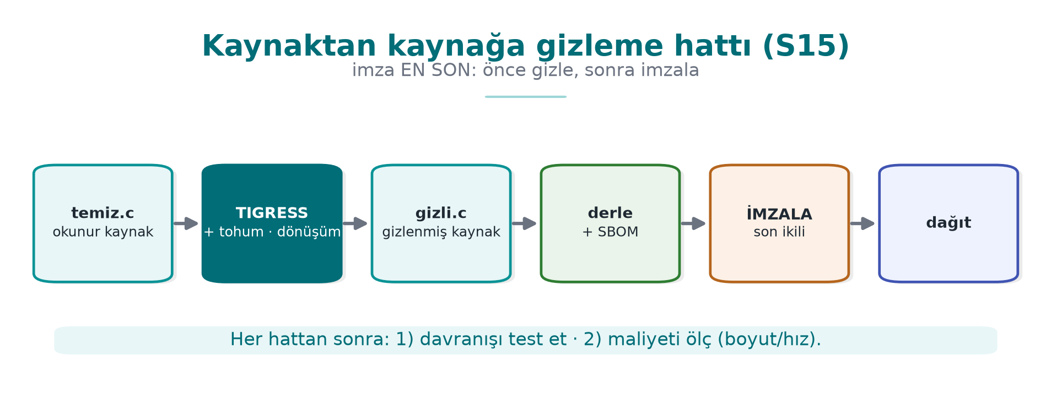
CEN429 Secure Programming · Week 14
Source-to-Source
• Input: C source. Output: C source again — but obfuscated.
• It is then compiled with your normal compiler.
RTEU Computer Engineering · 2026-2027 Fall
11

Slide 12
CEN429 Secure Programming · Week 14
What Is a Transform?
• Transform: a single obfuscation operation applied to the source (e.g., flattening).
• The tool offers many transforms; you choose which one, and where.
RTEU Computer Engineering · 2026-2027 Fall
12

Slide 13
CEN429 Secure Programming · Week 14
Transform Pipeline
• Pipeline: applying several transforms in sequence.
• Each transform is applied to the output of the previous one.
• Order matters.
RTEU Computer Engineering · 2026-2027 Fall
13

Slide 14
CEN429 Secure Programming · Week 14
What Is a Seed?
• Seed: a starting number that governs randomness.
• Same transform + different seed = different obfuscated output.
• This is the key to diversification.
RTEU Computer Engineering · 2026-2027 Fall
14

Slide 15
CEN429 Secure Programming · Week 14
Diversification
• Diversification: producing behaviourally equivalent, structurally different binaries from the same source.
• An attack written against one copy does not work on another (week 9 Rule 2).
RTEU Computer Engineering · 2026-2027 Fall
15

Slide 16
CEN429 Secure Programming · Week 14
What Is a CLI (Command Line)?
• CLI (Command-Line Interface): an interface where you run things by typing commands.
• Tigress is a CLI tool: tigress --Transform=... dosya.c.
RTEU Computer Engineering · 2026-2027 Fall
16

Slide 17
CEN429 Secure Programming · Week 14
Unit Test
• Unit test: a small test that automatically checks that a function works correctly.
• The same tests must pass after obfuscation (behaviour must be preserved).
RTEU Computer Engineering · 2026-2027 Fall
17

Slide 18
CEN429 Secure Programming · Week 14
CFG Reminder
• CFG (Control Flow Graph): a diagram that turns basic blocks into nodes and transitions into edges.
• We measure the potency of obfuscation by the number of nodes/edges (week 9).
RTEU Computer Engineering · 2026-2027 Fall
18

Slide 19
CEN429 Secure Programming · Week 14
Symbolic Execution (Briefly)
• Symbolic execution: automated analysis that solves program paths as mathematical constraints (e.g., KLEE).
• It is a deobfuscation method against obfuscation; we test resilience with it.
RTEU Computer Engineering · 2026-2027 Fall
19

Slide 20
CEN429 Secure Programming · Week 14
Now We're Ready
Terms:
source-to-source · transform · pipeline · seed · diversification · CLI · unit test · CFG · symbolic execution
Now: what is Tigress and how does it work?
RTEU Computer Engineering · 2026-2027 Fall
20

Slide 21
CEN429 Secure Programming · Week 14
1. Source-to-Source Obfuscation and Tigress
RTEU Computer Engineering · 2026-2027 Fall
21

Slide 22
CEN429 Secure Programming · Week 14
Three Problems with Manual Obfuscation
In week 9 we applied the rules by hand. It was instructive, but:
1. Error-prone — can break behaviour
2. Hard to maintain — the source becomes unreadable
3. Cannot be diversified — you cannot differentiate every copy by hand
RTEU Computer Engineering · 2026-2027 Fall
22

Slide 23
CEN429 Secure Programming · Week 14
The Solution: Let a Tool Do It
• Let a tool do the obfuscation.
• You keep the readable source.
• Obfuscation becomes an automatic step in the build pipeline.
RTEU Computer Engineering · 2026-2027 Fall
23

Slide 24
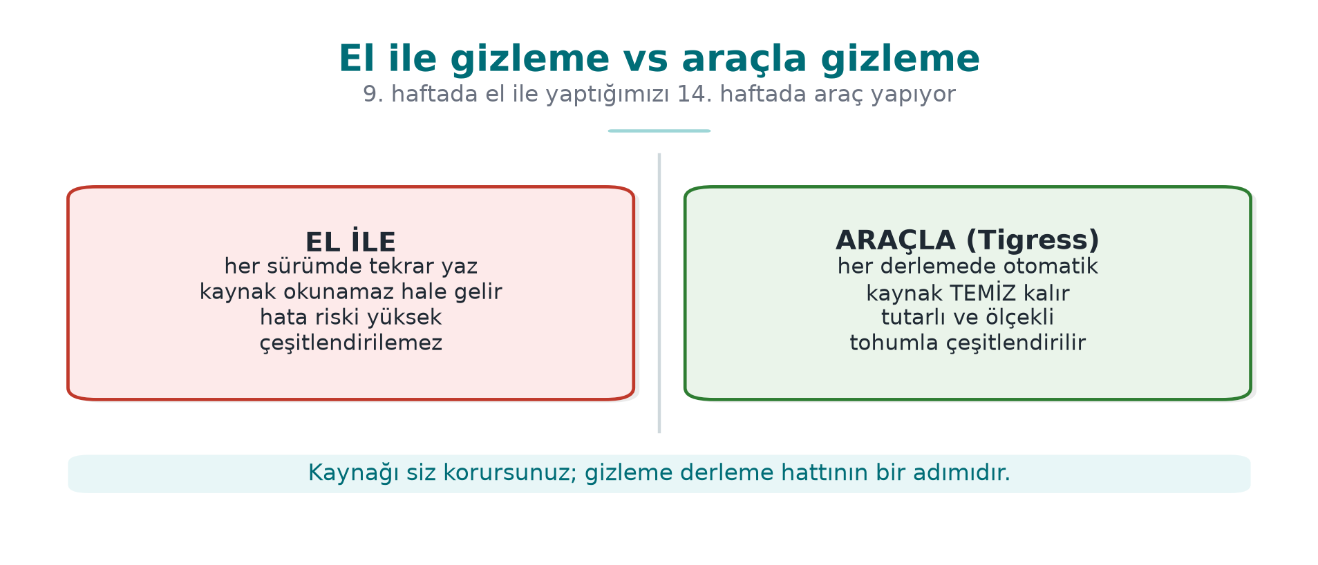
CEN429 Secure Programming · Week 14
The Source-to-Source Idea
The maintenance cost stays with the readable source; the distributed source is obfuscated.
RTEU Computer Engineering · 2026-2027 Fall
24

Slide 25
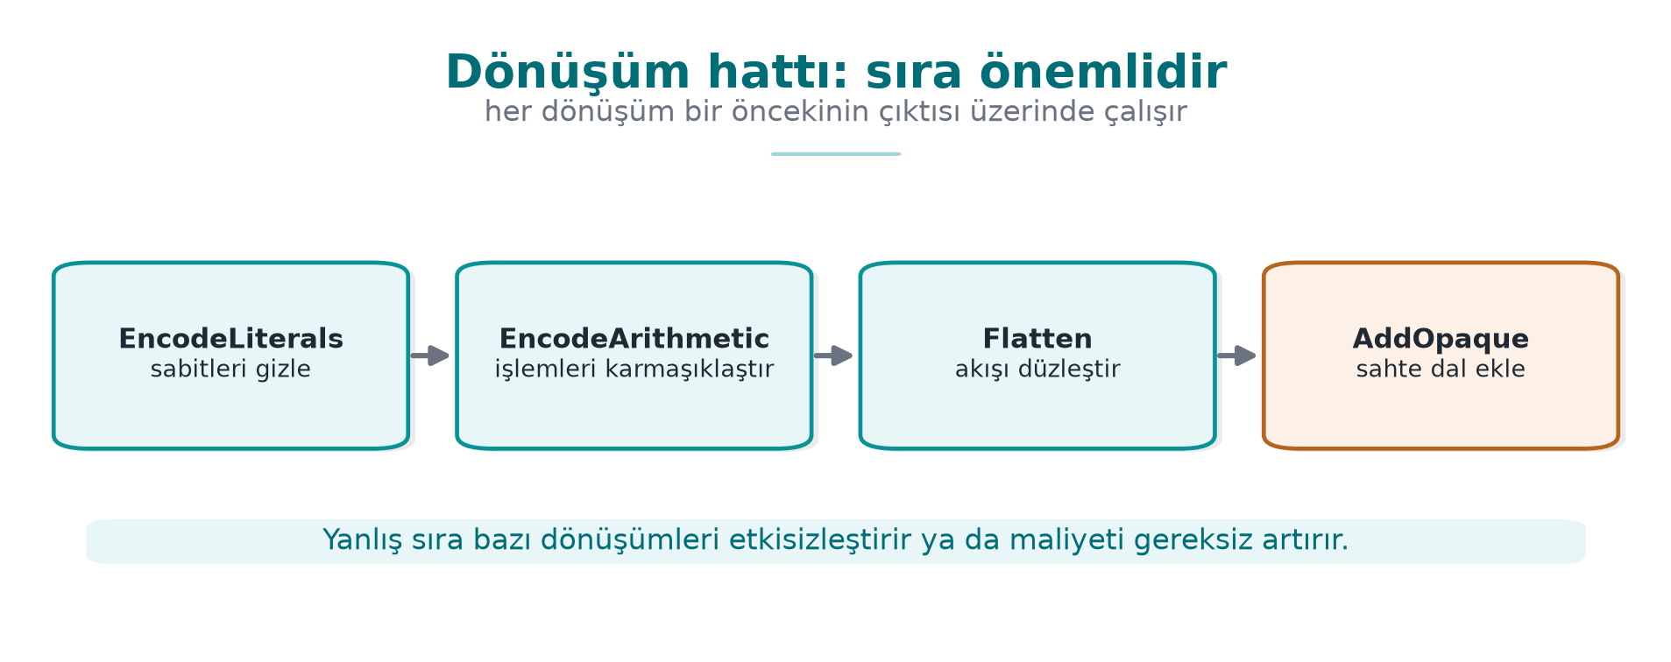
CEN429 Secure Programming · Week 14
Transform Pipeline — Diagram
RTEU Computer Engineering · 2026-2027 Fall
25

Slide 26
CEN429 Secure Programming · Week 14
What Is Tigress?
• A source-to-source C obfuscator/diversifier developed by Collberg and his team at the University of Arizona.
• The automatic counterpart of week 9's manual rules.
RTEU Computer Engineering · 2026-2027 Fall
26

Slide 27
CEN429 Secure Programming · Week 14
Tigress · Features
• Cross-platform: Linux, macOS, Windows, Android
• Architectures: Intel, ARM, WebAssembly
• Compilers: GCC, Clang, MSVC
• Current version: v4
RTEU Computer Engineering · 2026-2027 Fall
27

Slide 28
CEN429 Secure Programming · Week 14
⚠️ License (Important)
• Non-profit (academic/research) use: free.
• Commercial use: requires a license from the University of Arizona.
• The source code is not open; researchers may request access to an encrypted source.
RTEU Computer Engineering · 2026-2027 Fall
28

Slide 29
CEN429 Secure Programming · Week 14
⚠️ Rule for Use in Class
• The Tigress binary or an old version is not distributed in class.
• Students download the current version themselves from the official site (tigress.wtf).
• They verify the license terms there.
• You apply it only to your own code, on your own machine.
RTEU Computer Engineering · 2026-2027 Fall
29

Slide 30
CEN429 Secure Programming · Week 14
Why a Tool, Not by Hand? (1)
By Hand (Week 9) | With a Tool (Tigress)
Instructive | Scales
Error-prone | Preserves behaviour (tested)
Source becomes unreadable | Readable source stays with you
RTEU Computer Engineering · 2026-2027 Fall
30

Slide 31
CEN429 Secure Programming · Week 14
Why a Tool, Not by Hand? (2)
By Hand | With a Tool
Diversification isn't feasible by hand | Automatic via seed
Uniform, recognisable | Varies with transform+seed
RTEU Computer Engineering · 2026-2027 Fall
31

Slide 32
CEN429 Secure Programming · Week 14
But a Tool Is Not Magic Either
• Tigress also does not grant unbreakability, it raises cost.
• The patterns of a well-known tool can become recognisable over time.
• That's why diversification and layered defence (RASP, server) are still essential.
RTEU Computer Engineering · 2026-2027 Fall
32

Slide 33
CEN429 Secure Programming · Week 14
Basic Flow · a Single Transform
# girdi: temiz.c → çıktı: gizli.c
tigress --Transform=Flatten --Functions=erisim_ver \
--out=gizli.c temiz.c
cc -o program gizli.c
RTEU Computer Engineering · 2026-2027 Fall
33

Slide 34
CEN429 Secure Programming · Week 14
Basic Flow · Three Ideas
1. `--Transform=...` which transform (Flatten = flattening, week 9 K-04)
2. `--Functions=...` which functions (only the sensitive ones — the cost rule)
3. The output is C again; you compile it with your own compiler
RTEU Computer Engineering · 2026-2027 Fall
34

Slide 35
CEN429 Secure Programming · Week 14
Why Do We Target with --Functions?
• If obfuscation is applied to every function, the program slows down/bloats a lot.
• We target only sensitive functions (license, key derivation, integrity).
• This is the tool's version of week 9's "cost rule."
RTEU Computer Engineering · 2026-2027 Fall
35

Slide 36
CEN429 Secure Programming · Week 14
Section 1 — Quick Check
1. What is source-to-source obfuscation?
2. Three advantages over manual obfuscation?
3. Why isn't Tigress distributed in class?
RTEU Computer Engineering · 2026-2027 Fall
36
Notes:
Speaker note: Next, transform families.

Slide 37
CEN429 Secure Programming · Week 14
Section 1 — Answers
1. A transform is applied to the source code, producing new source (still C), which is then compiled normally. Tigress takes C, gives obfuscated C.
2. Repeatable/automatic (every build), consistent and scalable (many functions), the original source stays clean + diversification via seed.
3. License/terms of use; everyone downloads it themselves. If Tigress isn't available, demos work with a clean derivative/fallback.
RTEU Computer Engineering · 2026-2027 Fall
37

Slide 38
CEN429 Secure Programming · Week 14
2. Transform Families and Pipeline
RTEU Computer Engineering · 2026-2027 Fall
38
Notes:
Speaker note: Transform names can change slightly with the version; verify against the official documentation. We tie the concept to week 9's rules.

Slide 39
CEN429 Secure Programming · Week 14
Transforms = Week 9's Rules
Tigress transforms correspond to week 9's obfuscation families.
Let's look at them group by group; we'll tie each one to a K-rule.
RTEU Computer Engineering · 2026-2027 Fall
39

Slide 40
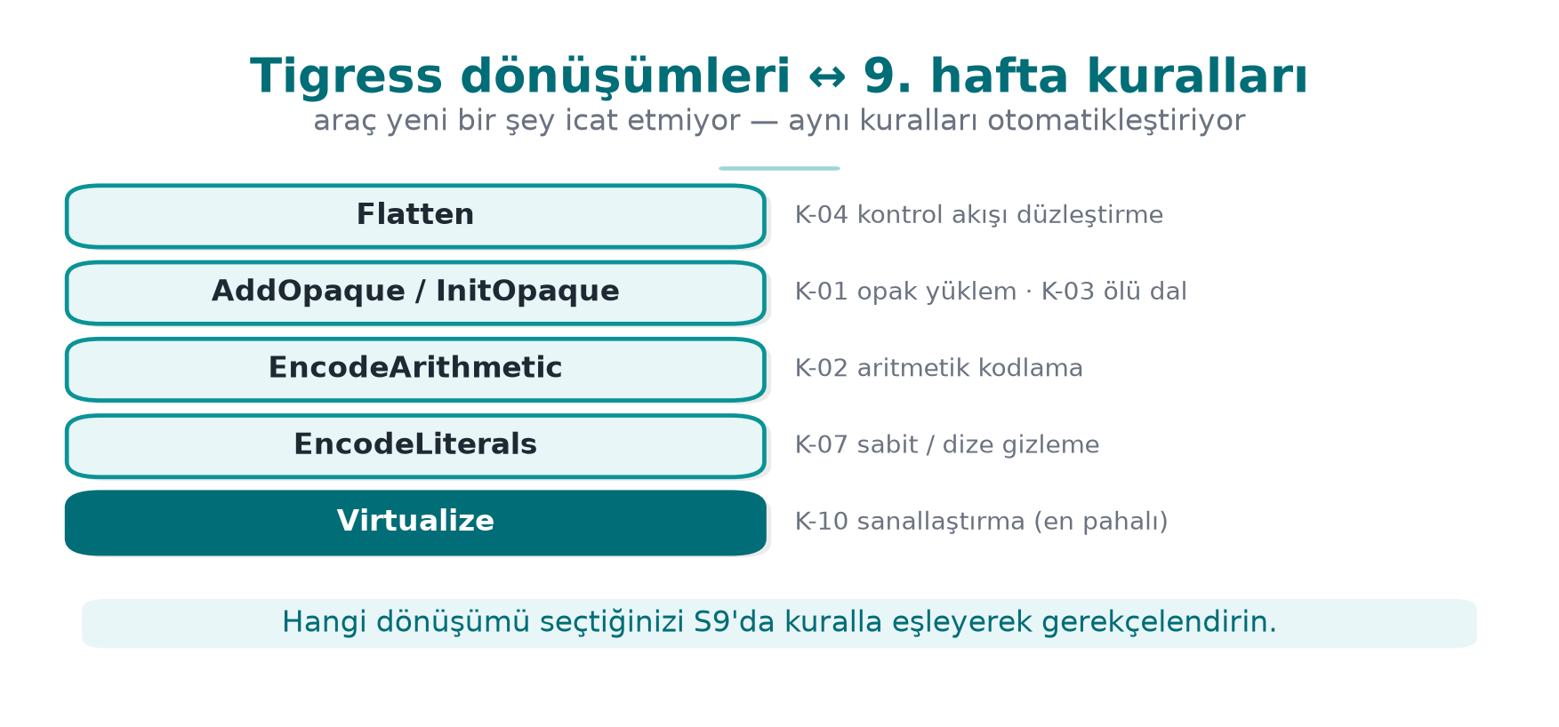
CEN429 Secure Programming · Week 14
Transform ↔ Rule Mapping — Diagram
RTEU Computer Engineering · 2026-2027 Fall
40

Slide 41
CEN429 Secure Programming · Week 14
Control-Flow Transforms
• Flatten: flattens control flow → K-04
• InitOpaque / AddOpaque / UpdateOpaque: opaque predicate + bogus branch → K-01, K-03
RTEU Computer Engineering · 2026-2027 Fall
41

Slide 42
CEN429 Secure Programming · Week 14
Data Transforms
• EncodeArithmetic: arithmetic into an equivalent complex expression (MBA) → K-02
• EncodeLiterals: encodes constants and strings → K-07, K-08
• EncodeData: encodes variable representation → K-09
RTEU Computer Engineering · 2026-2027 Fall
42

Slide 43
CEN429 Secure Programming · Week 14
Function Transforms
• Split / Merge: splits/merges functions → K-06
• Virtualize: turns the function into custom VM bytecode → K-10
• Jit: generates code at run time → K-12 (dynamic)
RTEU Computer Engineering · 2026-2027 Fall
43

Slide 44
CEN429 Secure Programming · Week 14
Anti-Analysis Transforms
• AntiBranchAnalysis / AntiAliasAnalysis / AntiTaintAnalysis: make static analysis techniques harder → preventive family
RTEU Computer Engineering · 2026-2027 Fall
44

Slide 45
CEN429 Secure Programming · Week 14
Diversification Transforms
• RandomFuns: random bogus functions
• RndArgs: bogus parameters
• Combined with a seed, every build differs → diversification, K-06
RTEU Computer Engineering · 2026-2027 Fall
45

Slide 46
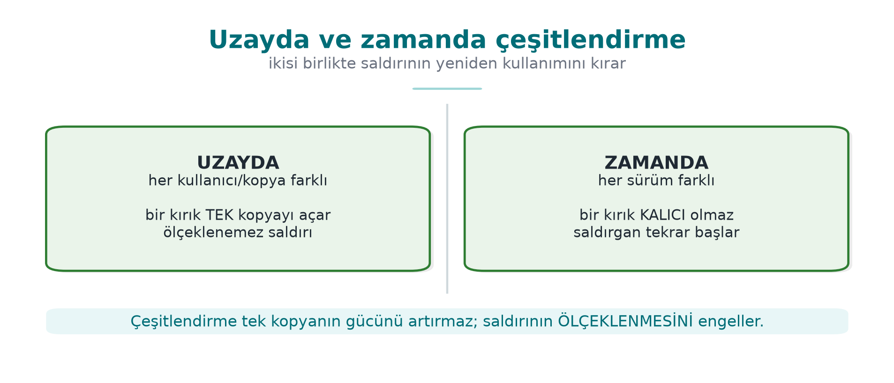
CEN429 Secure Programming · Week 14
Diversification in Space/Time — Diagram
RTEU Computer Engineering · 2026-2027 Fall
46

Slide 47
CEN429 Secure Programming · Week 14
Transform ↔ Rule · Table
Tigress | What It Does | Week 9
Flatten | Flattening | K-04
AddOpaque | Opaque predicate/bogus | K-01, K-03
EncodeArithmetic | Arithmetic encoding | K-02
EncodeLiterals | Constant/string | K-07, K-08
Virtualize | Virtualisation | K-10
RandomFuns/RndArgs | Diversification | K-06
RTEU Computer Engineering · 2026-2027 Fall
47

Slide 48
CEN429 Secure Programming · Week 14
Families and Cost
• Cheap: EncodeArithmetic, EncodeLiterals
• Moderate: Flatten, opaque predicates
• Expensive: Virtualize (tens of times slower)
That's why Virtualize is targeted only at small, critical functions; via --Functions.
RTEU Computer Engineering · 2026-2027 Fall
48

Slide 49
CEN429 Secure Programming · Week 14
Transform Pipeline
RTEU Computer Engineering · 2026-2027 Fall
49

Slide 50
CEN429 Secure Programming · Week 14
"Not One Technique, Together"
Week 9's most important rule.
In Tigress, this means applying transforms in sequence.
RTEU Computer Engineering · 2026-2027 Fall
50

Slide 51
CEN429 Secure Programming · Week 14
Conceptual Pipeline
tigress \
--Transform=EncodeLiterals --Functions=erisim_ver \
--Transform=EncodeArithmetic --Functions=erisim_ver \
--Transform=Flatten --Functions=erisim_ver \
--Transform=AddOpaque --Functions=erisim_ver \
--out=gizli.c temiz.c
RTEU Computer Engineering · 2026-2027 Fall
51

Slide 52
CEN429 Secure Programming · Week 14
What Does the Pipeline Do?
The single check (erisim_ver):
1. Encode constants/strings
2. Encode its arithmetic
3. Flatten
4. Strengthen with opaque predicates
= the automatic version of what week 9's K-04 called "strengthened flattening."
RTEU Computer Engineering · 2026-2027 Fall
52

Slide 53
CEN429 Secure Programming · Week 14
⚠️ Order and Testing Rule
• Transform order affects the result; some orders needlessly hurt performance.
• Rule: after every pipeline, run the unit tests (was behaviour preserved?) and measure size/speed.
• Obfuscation must never change behaviour; if it does, the pipeline is wrong.
This connects to week 12's "S16 results."
RTEU Computer Engineering · 2026-2027 Fall
53

Slide 54
CEN429 Secure Programming · Week 14
Step-by-Step Example
RTEU Computer Engineering · 2026-2027 Fall
54

Slide 55
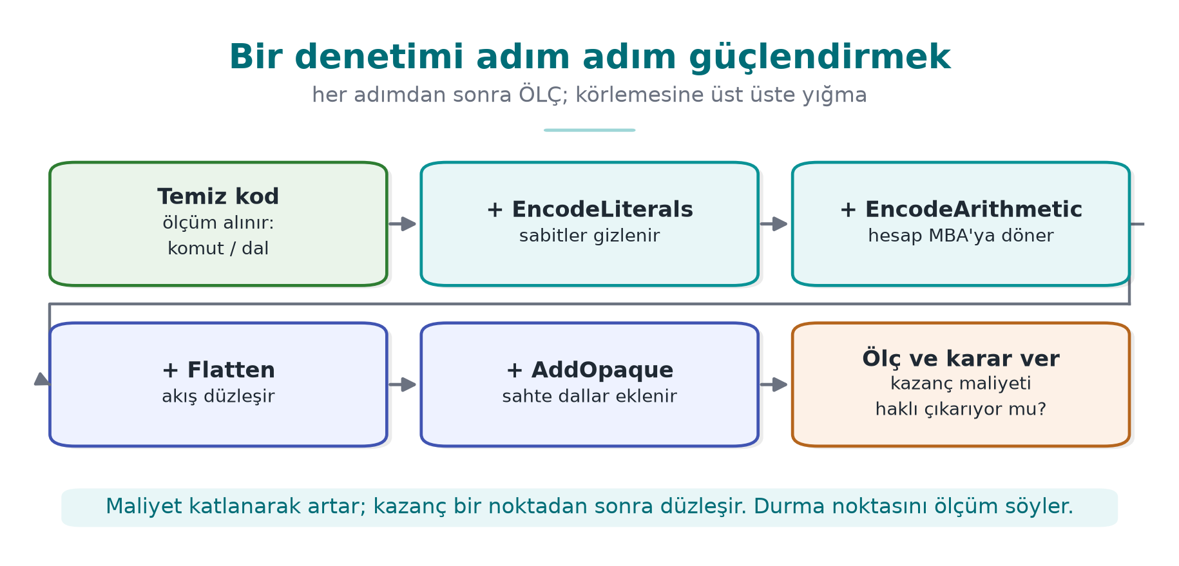
CEN429 Secure Programming · Week 14
Step-by-Step Strengthening — Diagram
RTEU Computer Engineering · 2026-2027 Fall
55

Slide 56
CEN429 Secure Programming · Week 14
Starting Point · temiz.c
int erisim_ver(const char *jeton) {
if (jeton_gecerli(jeton)) return IZIN; /* tek dal */
return RED;
}
Unprotected: a single branch, bypassed with strings and a single-byte patch.
RTEU Computer Engineering · 2026-2027 Fall
56

Slide 57
CEN429 Secure Programming · Week 14
Step 0 · The Attacker
• strings → IZIN/RED
• Reverse-compile → a single if
• Turn the failure branch into success
Time: minutes.
RTEU Computer Engineering · 2026-2027 Fall
57

Slide 58
CEN429 Secure Programming · Week 14
Layer by Layer
Step | Transform | What Changes | Cost
0 | — | Bypassed with a single-byte patch | —
1 | EncodeLiterals | IZIN/RED no longer plain | Very low
2 | EncodeArithmetic | Comparison complex | Low
3 | Flatten | Single branch not visible | Moderate
4 | AddOpaque | Bogus branches | Moderate
5 | Virtualize (if needed) | VM bytecode | High
RTEU Computer Engineering · 2026-2027 Fall
58

Slide 59
CEN429 Secure Programming · Week 14
Takeaway
• Every step makes the attack a bit more expensive.
• Every step adds a cost.
• Where you stop: asset value + the cost you measured.
Step 5 (Virtualize) is unnecessary for most checks.
RTEU Computer Engineering · 2026-2027 Fall
59

Slide 60
CEN429 Secure Programming · Week 14
This Table → S9 Itself
This "step / transform / what changes / cost" table
is the direct counterpart of your project's S9 protection table.
RTEU Computer Engineering · 2026-2027 Fall
60

Slide 61
CEN429 Secure Programming · Week 14
Section 2 — Quick Check
1. Which K-rules do Flatten, EncodeArithmetic, Virtualize correspond to?
2. Why do you target with --Functions?
3. Two things you must always do after every pipeline?
RTEU Computer Engineering · 2026-2027 Fall
61
Notes:
Speaker note: After the break, diversification and measurement.

Slide 62
CEN429 Secure Programming · Week 14
Section 2 — Answers
1. Flatten = control-flow flattening; EncodeArithmetic = arithmetic/data obfuscation; Virtualize = virtualisation (strongest, most expensive).
2. Obfuscating every function blows up cost/performance; targeting only sensitive functions concentrates resilience there.
3. (1) Test behaviour (unit tests must pass), (2) measure cost (size/speed/instruction count, before-after).
RTEU Computer Engineering · 2026-2027 Fall
62

Slide 63
CEN429 Secure Programming · Week 14
3. Diversification and Measurement
RTEU Computer Engineering · 2026-2027 Fall
63

Slide 64
CEN429 Secure Programming · Week 14
Recall Rule 2
An attack that works on one copy should not work on all copies.
If an attacker can crack one copy and distribute the patch to everyone, one crack opens every door.
RTEU Computer Engineering · 2026-2027 Fall
64

Slide 65
CEN429 Secure Programming · Week 14
What Is Diversification?
Behaviourally equivalent, structurally different binaries from the same source.
Tigress does this with a seed:
• Same transforms + a different seed → opaque predicates, bogus branches, state values change.
RTEU Computer Engineering · 2026-2027 Fall
65

Slide 66
CEN429 Secure Programming · Week 14
Two Seeds, Two Different Binaries
tigress --Seed=1001 --Transform=Flatten --Transform=AddOpaque \
--Functions=erisim_ver --out=gizli_a.c temiz.c
tigress --Seed=2002 --Transform=Flatten --Transform=AddOpaque \
--Functions=erisim_ver --out=gizli_b.c temiz.c
gizli_a and gizli_b do the same job; their machine code is different.
RTEU Computer Engineering · 2026-2027 Fall
66

Slide 67
CEN429 Secure Programming · Week 14
Two Types of Diversification
• In space: a differently seeded copy for each user/device → one copy's attack doesn't work on another.
• In time: each version gets a new seed → an old attack breaks on the new version.
Works together with week 10's key/version renewal.
RTEU Computer Engineering · 2026-2027 Fall
67

Slide 68
CEN429 Secure Programming · Week 14
What Does Diversification Prevent?
• It does not increase the strength of obfuscation (cracking one copy is still possible).
• But it prevents it from scaling.
RandomFuns, RndArgs also change structure when combined with a seed.
RTEU Computer Engineering · 2026-2027 Fall
68

Slide 69
CEN429 Secure Programming · Week 14
Diversification Effectiveness · Metric
• Compile the same source with two seeds.
• Measure the byte difference of the protected functions.
• The higher the difference, the lower the chance that one attack works on the other.
Write the metric into S9.
RTEU Computer Engineering · 2026-2027 Fall
69

Slide 70
CEN429 Secure Programming · Week 14
Measuring Obfuscation
RTEU Computer Engineering · 2026-2027 Fall
70

Slide 71
CEN429 Secure Programming · Week 14
Tigress's Teaching Value
In week 9 we learned to measure obfuscation on four dimensions (potency, resilience, stealth, cost).
Tigress lets you make these measurements concrete: obfuscate the same program, measure before/after.
RTEU Computer Engineering · 2026-2027 Fall
71

Slide 72
CEN429 Secure Programming · Week 14
Cost Measurement (Easy, Mandatory)
Measure for every pipeline and write it into S9/S15:
Metric | How
Binary size | size / ls -l
Running time | Same input, N times, average
CFG complexity | Basic block count in the decompiler
RTEU Computer Engineering · 2026-2027 Fall
72

Slide 73
CEN429 Secure Programming · Week 14
Cost Measurement · Command
size ./program_temiz ./program_gizli # boyut farkı
# süre: aynı girdiyle N kez çalıştır, ortalamayı karşılaştır
Simple, but it produces evidence.
RTEU Computer Engineering · 2026-2027 Fall
73

Slide 74
CEN429 Secure Programming · Week 14
Cost · Example Table
Metric | Before | After
Size | 100 KB | 130 KB
Time | 1.0× | 1.8×
Basic blocks (target fn.) | 5 | 40
The figures are an example; you write your own measurements.
RTEU Computer Engineering · 2026-2027 Fall
74

Slide 75
CEN429 Secure Programming · Week 14
Resilience Measurement (Advanced, Concept)
• Resilience = resistance to an automated tool (symbolic execution).
• Week 9: "not a claim, a measured quantity."
• Tigress is at the centre of this research.
RTEU Computer Engineering · 2026-2027 Fall
75

Slide 76
CEN429 Secure Programming · Week 14
Banescu et al. · Tigress + KLEE
A study measuring how much Tigress transforms resist symbolic execution. Findings:
• A single transform (Flatten alone) → usually unwound.
• Combining transforms + growing the state space → forces the solver exponentially.
• But cost also increases.
RTEU Computer Engineering · 2026-2027 Fall
76

Slide 77
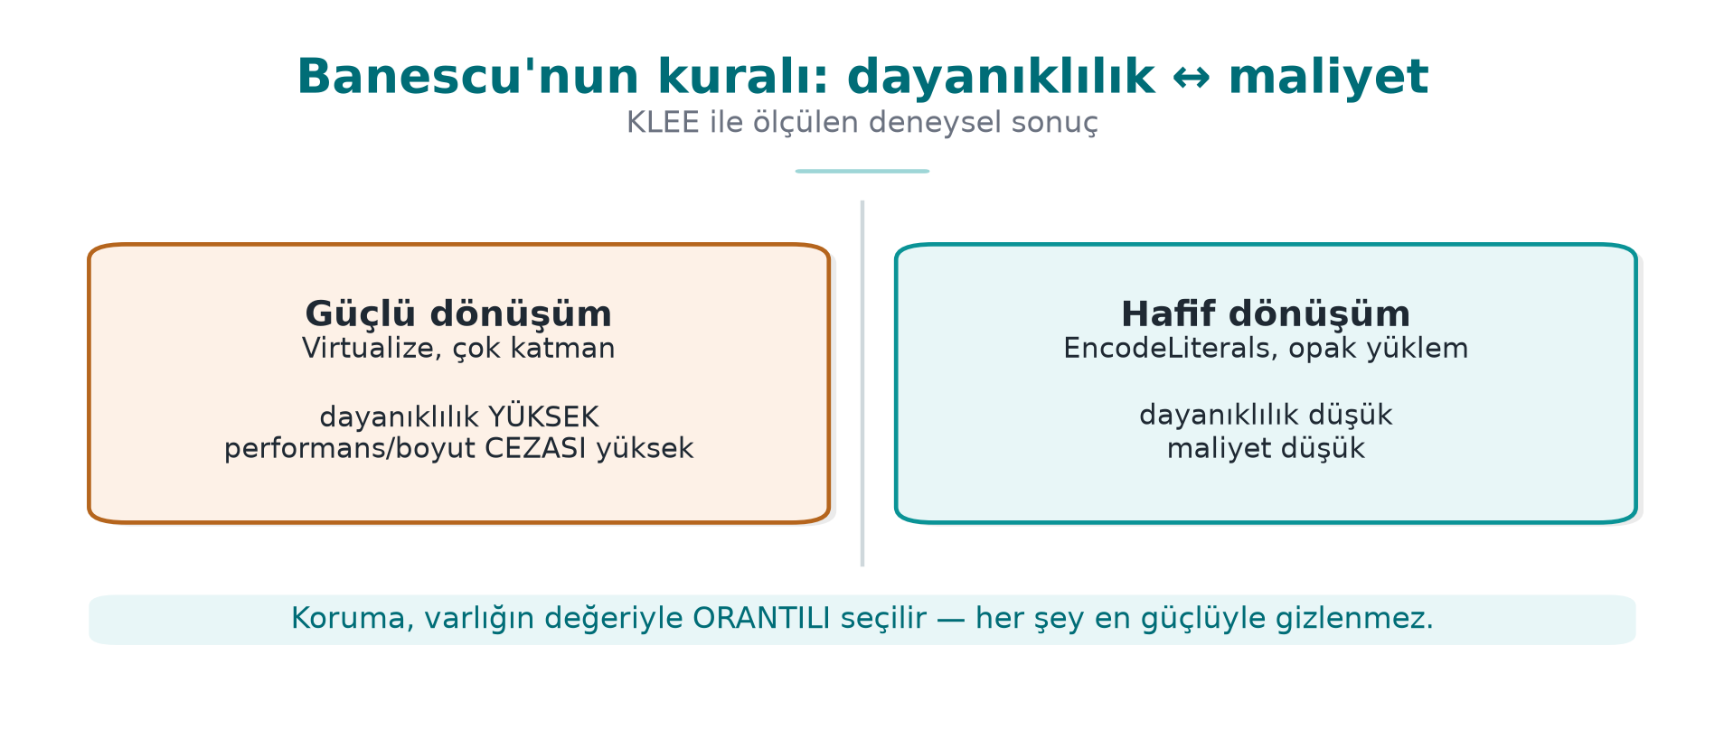
CEN429 Secure Programming · Week 14
Resilience ↔ Cost — Diagram
RTEU Computer Engineering · 2026-2027 Fall
77

Slide 78
CEN429 Secure Programming · Week 14
Takeaway for the Course
Resilience and cost are a trade-off (like week 9).
Don't say "strong"; say "it didn't let this tool solve a problem of this size within this time."
RTEU Computer Engineering · 2026-2027 Fall
78

Slide 79
CEN429 Secure Programming · Week 14
Measurement Rule (S9/S15)
Defend an obfuscation decision with measurements:
"The Flatten + AddOpaque pipeline grew the size by 30%, slowed the process by 1.8×; the target function's basic block count grew 8-fold."
Unmeasured obfuscation = a claim for the evaluator (week 12).
RTEU Computer Engineering · 2026-2027 Fall
79

Slide 80
CEN429 Secure Programming · Week 14
Section 3 — Quick Check
1. How does a seed provide diversification?
2. Difference between diversification in space and in time?
3. Banescu et al.'s main rule? (resilience ↔ cost)
RTEU Computer Engineering · 2026-2027 Fall
80
Notes:
Speaker note: Next, in-class flow, S15, project.

Slide 81
CEN429 Secure Programming · Week 14
Section 3 — Answers
1. Obfuscating the same source with a different seed makes the tool make different random choices → every build is a different binary (same behaviour).
2. In space: different copies/users differ (one crack doesn't crack everyone). In time: it changes across versions (a crack doesn't stay valid).
3. Stronger obfuscation means more resilience but more cost; protection is chosen in proportion to the value of the asset.
RTEU Computer Engineering · 2026-2027 Fall
81

Slide 82
CEN429 Secure Programming · Week 14
4. In-Class Flow (Step by Step)
RTEU Computer Engineering · 2026-2027 Fall
82
Notes:
Speaker note: Students download Tigress themselves and apply it to their own small program. Purely defensive; protecting and measuring your own code.

Slide 83
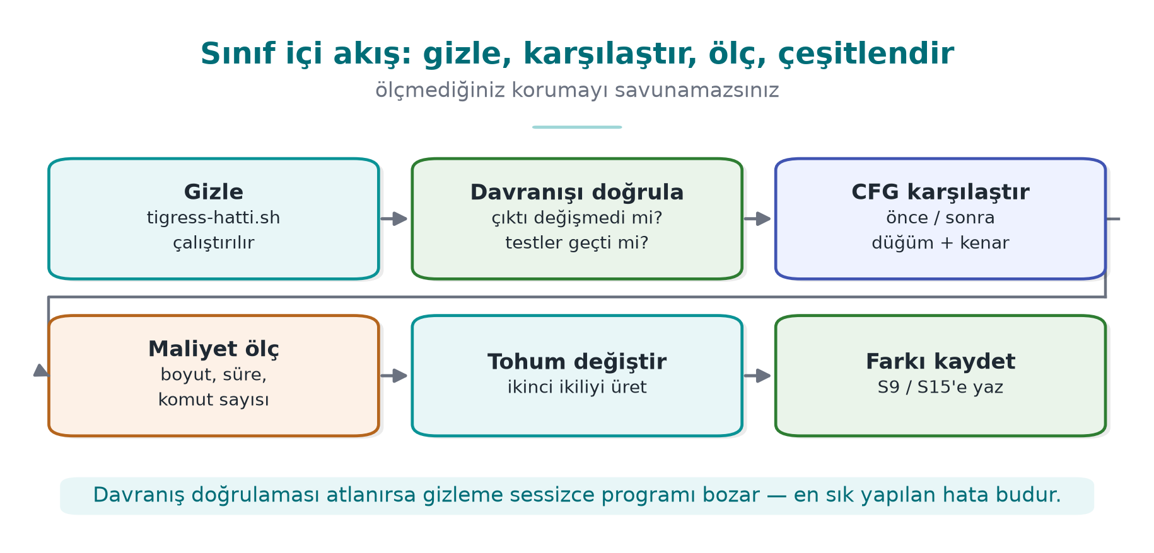
CEN429 Secure Programming · Week 14
In-Class Flow — Diagram
RTEU Computer Engineering · 2026-2027 Fall
83

Slide 84
CEN429 Secure Programming · Week 14
What Will We Do?
Take your own small, synthetic program:
obfuscate → verify behaviour → compare → measure → diversify → report
Let's go step by step.
RTEU Computer Engineering · 2026-2027 Fall
84

Slide 85
CEN429 Secure Programming · Week 14
Step 1 · Preparation
• Write a small, synthetic program (e.g., erisim_ver).
• Show with unit tests that it works correctly.
• This is your "clean" baseline.
RTEU Computer Engineering · 2026-2027 Fall
85

Slide 86
CEN429 Secure Programming · Week 14
Step 2 · Obfuscate
tigress --Transform=EncodeLiterals --Transform=EncodeArithmetic \
--Transform=Flatten --Transform=AddOpaque \
--Functions=erisim_ver --out=gizli.c temiz.c
cc -o program_gizli gizli.c
Apply a transform pipeline.
RTEU Computer Engineering · 2026-2027 Fall
86

Slide 87
CEN429 Secure Programming · Week 14
Step 3 · Verify Behaviour
• Run the same unit tests on the obfuscated version.
• The result must be exactly the same.
• If different: the pipeline is wrong → fix it.
Obfuscation never changes behaviour.
RTEU Computer Engineering · 2026-2027 Fall
87

Slide 88
CEN429 Secure Programming · Week 14
Step 4 · Compare
• Open the clean and obfuscated versions in a decompiler (Ghidra/objdump).
• Compare the control flow.
• Note the increase in basic block count.
RTEU Computer Engineering · 2026-2027 Fall
88

Slide 89
CEN429 Secure Programming · Week 14
Step 5 · Measure
size ./program_temiz ./program_gizli
# süre: aynı girdiyle N kez çalıştır, ortalamayı karşılaştır
Write down the size and time difference.
RTEU Computer Engineering · 2026-2027 Fall
89

Slide 90
CEN429 Secure Programming · Week 14
Step 6 · Diversify
• Run the same pipeline with two different seeds.
• Show that the two binaries are different (byte difference).
tigress --Seed=1001 ... --out=gizli_a.c temiz.c
tigress --Seed=2002 ... --out=gizli_b.c temiz.c
RTEU Computer Engineering · 2026-2027 Fall
90

Slide 91
CEN429 Secure Programming · Week 14
Step 7 · Report
Put your findings into a table:
Transform | Size | Time | Blocks | Seed Difference
… | … | … | … | …
This table goes directly into S9/S15.
RTEU Computer Engineering · 2026-2027 Fall
91

Slide 92
CEN429 Secure Programming · Week 14
⚠️ Ethical and Safe Use
• Tigress only on your own code.
• The example program does not harm the computer: it does not change system settings, does not touch the network.
• All values are synthetic.
RTEU Computer Engineering · 2026-2027 Fall
92

Slide 93
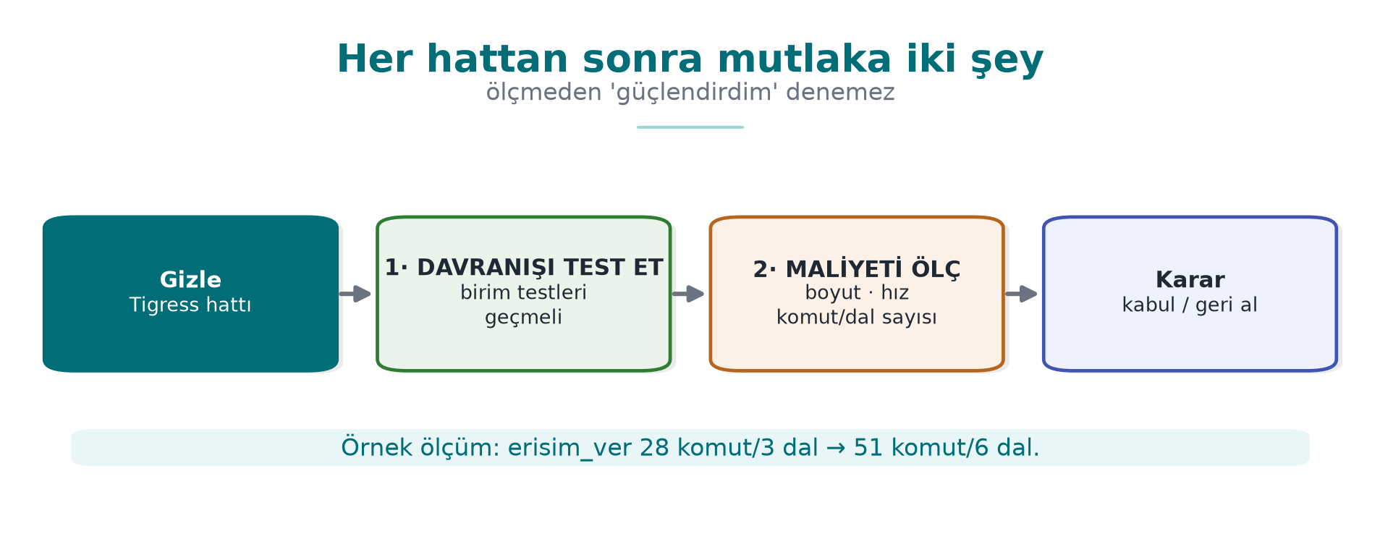
CEN429 Secure Programming · Week 14
In-Class · Summary Flow
RTEU Computer Engineering · 2026-2027 Fall
93

Slide 94
CEN429 Secure Programming · Week 14
Step-by-Step Flow · Why This Order?
• First behaviour (tests) — make sure nothing broke.
• Then evidence (CFG, measurement) — show the gain.
• Then diversification — break scalability.
Don't say "strong" without measuring.
RTEU Computer Engineering · 2026-2027 Fall
94

Slide 95
CEN429 Secure Programming · Week 14
Section 4 — Quick Check
1. The first thing you must always do after obfuscating?
2. How do you show diversification?
3. Which project sections does the report table go into?
RTEU Computer Engineering · 2026-2027 Fall
95
Notes:
Speaker note: Next, the build pipeline (S15) and the project.

Slide 96
CEN429 Secure Programming · Week 14
Section 4 — Answers
1. Test that behaviour hasn't changed (unit tests must pass); obfuscation must not break function.
2. Produce with two different seeds; compare the binaries (hash/size/instructions differ) but same input → same output (diff/objdump).
3. S9 (code hardening) and S15 (build/deployment pipeline); before/after measurement as evidence.
RTEU Computer Engineering · 2026-2027 Fall
96

Slide 97
CEN429 Secure Programming · Week 14
5. Build Pipeline (S15) and Project
RTEU Computer Engineering · 2026-2027 Fall
97

Slide 98
CEN429 Secure Programming · Week 14
Obfuscation Is Not "By Hand at the End"
Obfuscation should be a step in the build pipeline.
Your project's S15 section, after the midterm, documents exactly this.
RTEU Computer Engineering · 2026-2027 Fall
98

Slide 99
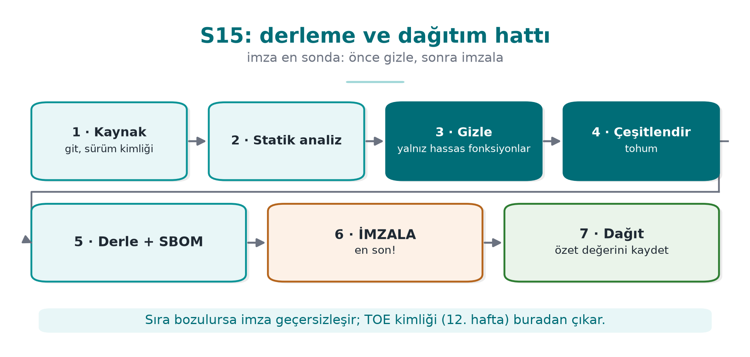
CEN429 Secure Programming · Week 14
Build Pipeline — Diagram
RTEU Computer Engineering · 2026-2027 Fall
99

Slide 100
CEN429 Secure Programming · Week 14
Pipeline Rule 1 · Sensitive Functions Only
• Obfuscate only sensitive functions with --Functions.
• Write down the rationale (which function, why).
• The cost rule (week 9).
RTEU Computer Engineering · 2026-2027 Fall
100

Slide 101
CEN429 Secure Programming · Week 14
Pipeline Rule 2 · Every Version Is Diversified
• Every version is diversified with a seed.
• The seed and build identity are recorded.
• Diversification in time (section 3).
RTEU Computer Engineering · 2026-2027 Fall
101

Slide 102
CEN429 Secure Programming · Week 14
Pipeline Rule 3 · Signing After Obfuscation
• First obfuscate, then sign.
• The build identity and hash values (week 12's TOE) must be consistent.
• Why afterwards? The signature must cover the final distributed binary.
RTEU Computer Engineering · 2026-2027 Fall
102

Slide 103
CEN429 Secure Programming · Week 14
Pipeline Rule 4 · Automatic in CI
• The pipeline runs in continuous integration (CI).
• Every version: unit tests + size/speed measurement automatic.
• If behaviour breaks, the build stops.
RTEU Computer Engineering · 2026-2027 Fall
103

Slide 104
CEN429 Secure Programming · Week 14
9, 11, 14 Together
• 9: obfuscation rules (code)
• 11: whitebox (key)
• 14: automation + diversification (this week)
Common rule: protection = delay; strength comes from layers and measurement.
RTEU Computer Engineering · 2026-2027 Fall
104

Slide 105
CEN429 Secure Programming · Week 14
Project · S9 Extended + S15 Pipeline — 1
1. Transform pipeline (S9): which functions, which transforms, in what order, why.
RTEU Computer Engineering · 2026-2027 Fall
105

Slide 106
CEN429 Secure Programming · Week 14
Project · S9 + S15 — 2
2. Measurement table: size, time, (if available) block count — before/after.
RTEU Computer Engineering · 2026-2027 Fall
106

Slide 107
CEN429 Secure Programming · Week 14
Project · S9 + S15 — 3
3. Diversification: production with two seeds + a difference metric; if you won't apply it, a rationale.
RTEU Computer Engineering · 2026-2027 Fall
107

Slide 108
CEN429 Secure Programming · Week 14
Project · S9 + S15 — 4, 5
4. S15 pipeline: document the obfuscation + signing + build identity steps with a diagram.
5. Behaviour evidence: show that the obfuscated version passes the unit tests (the S16 link).
RTEU Computer Engineering · 2026-2027 Fall
108

Slide 109
CEN429 Secure Programming · Week 14
Through the Evaluator's Eyes
• Not "I used a lot of transforms."
• A rationale and a measurement for every transform.
• Unmeasured obfuscation = a claim (week 12).
RTEU Computer Engineering · 2026-2027 Fall
109

Slide 110
CEN429 Secure Programming · Week 14
Section 5 — Quick Check
1. Why is signing after obfuscation?
2. The rationale for the "sensitive functions only" rule?
3. The steps of the S15 pipeline?
RTEU Computer Engineering · 2026-2027 Fall
110
Notes:
Speaker note: Next, the solved self-check.

Slide 111
CEN429 Secure Programming · Week 14
Section 5 — Answers
1. The signature protects the final binary; if you sign first and obfuscate afterwards, the binary changes → the signature becomes invalid. Order: build → obfuscate → sign.
2. Obfuscating everything blows up performance/size and most code isn't sensitive; concentrate protection on critical functions → low cost, high impact.
3. Source → (static analysis) → build → obfuscate → diversify (seed) → package/SBOM → sign → deploy (all recorded in CI).
RTEU Computer Engineering · 2026-2027 Fall
111

Slide 112
CEN429 Secure Programming · Week 14
Solved Self-Check
RTEU Computer Engineering · 2026-2027 Fall
112
Notes:
Speaker note: Have the students answer first, then reveal the answer.

Slide 113
CEN429 Secure Programming · Week 14
Question 1
What is source-to-source obfuscation? Three advantages over manual obfuscation?
Answer: A tool takes C source and produces obfuscated C source. Advantages: preserves behaviour (error-resistant), the readable source stays with you, easy diversification via seed.
RTEU Computer Engineering · 2026-2027 Fall
113

Slide 114
CEN429 Secure Programming · Week 14
Question 2
Tigress's place in the course; which license, why isn't it distributed in class?
Answer: The automatic form of week 9's rules. Non-profit use is free, commercial needs an Arizona license. The source is closed → its binary is not distributed in class; students download it from the official site.
RTEU Computer Engineering · 2026-2027 Fall
114

Slide 115
CEN429 Secure Programming · Week 14
Question 3
Map these transforms to week 9's rules: Flatten, EncodeArithmetic, EncodeLiterals, Virtualize, AddOpaque.
Answer: Flatten→K-04, EncodeArithmetic→K-02, EncodeLiterals→K-07/K-08, Virtualize→K-10, AddOpaque→K-01/K-03.
RTEU Computer Engineering · 2026-2027 Fall
115

Slide 116
CEN429 Secure Programming · Week 14
Question 4
Why is a transform pipeline stronger than a single transform? Why does order matter?
Answer: Layers strengthen each other (week 9's "together"). Order affects the result and performance; some orders needlessly slow things down or give a weak result.
RTEU Computer Engineering · 2026-2027 Fall
116

Slide 117
CEN429 Secure Programming · Week 14
Question 5
Which two things do you always do after every transform pipeline?
Answer: (1) Run the unit tests (was behaviour preserved?), (2) measure size/speed (cost).
RTEU Computer Engineering · 2026-2027 Fall
117

Slide 118
CEN429 Secure Programming · Week 14
Question 6
Why is Virtualize applied only to small and critical functions?
Answer: Its cost is very high (tens of times slower, size). The benefit only justifies the cost for the most valuable, small functions.
RTEU Computer Engineering · 2026-2027 Fall
118

Slide 119
CEN429 Secure Programming · Week 14
Question 7
How does the seed (`--Seed`) provide diversification? Difference in space/time?
Answer: A different seed → different opaque predicate/bogus branch/state. In space: different copies at the same time. In time: each version gets a new seed.
RTEU Computer Engineering · 2026-2027 Fall
119

Slide 120
CEN429 Secure Programming · Week 14
Question 8
Does diversification prevent the strength of obfuscation, or its scalability?
Answer: It does not increase strength (one copy can still be cracked); it prevents scalability — one crack doesn't open every door.
RTEU Computer Engineering · 2026-2027 Fall
120

Slide 121
CEN429 Secure Programming · Week 14
Question 9
The main rule for the course from the Banescu et al. study?
Answer: Resilience is a measured quantity. Combining transforms forces symbolic execution exponentially; but cost also increases → resilience ↔ cost trade-off.
RTEU Computer Engineering · 2026-2027 Fall
121

Slide 122
CEN429 Secure Programming · Week 14
Question 10
When putting obfuscation into the build pipeline, why does signing come after obfuscation?
Answer: The signature must cover the final distributed binary. It's obfuscated first, then signed; the build identity/hash stays consistent.
RTEU Computer Engineering · 2026-2027 Fall
122

Slide 123
CEN429 Secure Programming · Week 14
Question 11
The rationale for S15's "only sensitive functions are obfuscated" rule?
Answer: Obfuscating every function slows down/bloats the program a lot. It makes sense to take on the cost only for valuable functions.
RTEU Computer Engineering · 2026-2027 Fall
123

Slide 124
CEN429 Secure Programming · Week 14
Question 12
Write the common rule of weeks 9, 11, and 14 in one sentence.
Answer: Protection provides not unbreakability but delay; its strength comes from combining layers, from diversification, and from being measured.
RTEU Computer Engineering · 2026-2027 Fall
124

Slide 125
CEN429 Secure Programming · Week 14
Closing · Three Weeks
• 9: obfuscation rules (by hand)
• 11: whitebox (key)
• 14: automation + diversification
All one framework: cost + layers + measurement.
RTEU Computer Engineering · 2026-2027 Fall
125

Slide 126
CEN429 Secure Programming · Week 14
Appendix A · A Worked Measurement
RTEU Computer Engineering · 2026-2027 Fall
126
Notes:
Speaker note: A measurement pass with concrete, synthetic numbers; can be done on the board.

Slide 127
CEN429 Secure Programming · Week 14
Scenario
Let's obfuscate the erisim_ver function with two pipelines and measure:
• Pipeline A: EncodeLiterals + EncodeArithmetic (light)
• Pipeline B: Pipeline A + Flatten + AddOpaque (heavy)
RTEU Computer Engineering · 2026-2027 Fall
127

Slide 128
CEN429 Secure Programming · Week 14
Before · Baseline
program_temiz:
boyut: 100 KB
işlem süresi: 1.00× (referans)
erisim_ver temel blok: 5
RTEU Computer Engineering · 2026-2027 Fall
128

Slide 129
CEN429 Secure Programming · Week 14
Pipeline A · Measurement (Example)
boyut: 103 KB (+%3)
süre: 1.05×
blok: 7
strings hassas dize: 0 (öncesi 3)
Cheap; string obfuscation gives a big return.
RTEU Computer Engineering · 2026-2027 Fall
129

Slide 130
CEN429 Secure Programming · Week 14
Pipeline B · Measurement (Example)
boyut: 131 KB (+%31)
süre: 1.80×
blok: 40
Potency increased (blocks 5→40); cost increased too.
RTEU Computer Engineering · 2026-2027 Fall
130

Slide 131
CEN429 Secure Programming · Week 14
Comparison Table
Metric | Clean | Pipeline A | Pipeline B
Size | 100 KB | 103 KB | 131 KB
Time | 1.00× | 1.05× | 1.80×
Blocks | 5 | 7 | 40
Sensitive strings | 3 | 0 | 0
RTEU Computer Engineering · 2026-2027 Fall
131

Slide 132
CEN429 Secure Programming · Week 14
Decision
• Asset value low → Pipeline A is enough.
• Asset value high → Pipeline B (accept the cost) + diversification.
The decision rests on numbers, not a feeling.
RTEU Computer Engineering · 2026-2027 Fall
132

Slide 133
CEN429 Secure Programming · Week 14
Diversification Measurement (Example)
• Produce Pipeline B with seed 1001 and 2002.
• Byte difference of the protected function: 92%.
• Comment: a patch written for one copy most likely won't work on the other.
RTEU Computer Engineering · 2026-2027 Fall
133

Slide 134
CEN429 Secure Programming · Week 14
Appendix B · Mini Case
RTEU Computer Engineering · 2026-2027 Fall
134

Slide 135
CEN429 Secure Programming · Week 14
Case · Setup
A synthetic application has a license check and a key derivation function.
Should we heavily obfuscate both?
RTEU Computer Engineering · 2026-2027 Fall
135

Slide 136
CEN429 Secure Programming · Week 14
Case · Decision
• License check: medium value → Pipeline B (Flatten + AddOpaque).
• Key derivation: high value → Pipeline B + Virtualize (acceptable cost because it's small).
• The rest: not obfuscated (unnecessary cost).
RTEU Computer Engineering · 2026-2027 Fall
136

Slide 137
CEN429 Secure Programming · Week 14
Case · Diversification + Pipeline
• Each version, a different seed.
• Build pipeline: obfuscate → sign → build identity.
• Unit tests + measurement automatic in CI.
RTEU Computer Engineering · 2026-2027 Fall
137

Slide 138
CEN429 Secure Programming · Week 14
Case · S9/S15 Output
Function | Pipeline | Size/Time | Rationale
lisans_dogrula | B | +31% / 1.8× | medium value
anahtar_turet | B+Virtualize | +60% / 3× | high value, small fn.
RTEU Computer Engineering · 2026-2027 Fall
138

Slide 139
CEN429 Secure Programming · Week 14
Case · Residual Risk
• A sufficiently determined attacker can still solve a single copy.
• Mitigation: diversification + a short-lived key + server-side checking.
• Written down explicitly.
RTEU Computer Engineering · 2026-2027 Fall
139

Slide 140
CEN429 Secure Programming · Week 14
Appendix C · Alternatives and Limits
RTEU Computer Engineering · 2026-2027 Fall
140

Slide 141
CEN429 Secure Programming · Week 14
O-LLVM (Compiler-Based)
• Obfuscator-LLVM: applies transforms at compile time.
• Not source-to-source; on top of the LLVM intermediate representation.
• Week 9 K-11. An alternative to Tigress.
RTEU Computer Engineering · 2026-2027 Fall
141

Slide 142
CEN429 Secure Programming · Week 14
Tigress or O-LLVM?
 | Tigress | O-LLVM
Where | Source (C→C) | Compiler (IR)
Visibility | You can see the obfuscated source | A build step
Transform richness | Many (including Virtualize) | More limited
RTEU Computer Engineering · 2026-2027 Fall
142

Slide 143
CEN429 Secure Programming · Week 14
Shared Limit
• Both are well known → their patterns can become recognisable.
• Both require diversification and layered defence.
• Neither one grants unbreakability.
RTEU Computer Engineering · 2026-2027 Fall
143

Slide 144
CEN429 Secure Programming · Week 14
Glossary
Term | Meaning
Source-to-source | Obfuscation that takes C in and gives obfuscated C out
Transform | A single obfuscation operation
Pipeline | The ordered whole of the transforms
Seed | A number that governs randomness (diversification)
Symbolic execution | Path-solving automated analysis (KLEE)
RTEU Computer Engineering · 2026-2027 Fall
144

Slide 145
CEN429 Secure Programming · Week 14
Sources
• The Tigress official site/worksheets (tigress.wtf) — transforms, syntax, v4, license
• Collberg & Nagra, Surreptitious Software — taxonomy, measurement
• Banescu et al. — Tigress + KLEE resilience measurement
• Obfuscator-LLVM — a compiler-based alternative
RTEU Computer Engineering · 2026-2027 Fall
145

Slide 146
CEN429 Secure Programming · Week 14
Summary: This Week in One Sentence
Tigress applies week 9's obfuscation rules automatically and diversified; but the rule is the same: obfuscation is not unbreakability but delay; combine, diversify, measure.
RTEU Computer Engineering · 2026-2027 Fall
146

Slide 147
CEN429 Secure Programming · Week 14
Next Week
Week 15 — Final Project Demonstrations (RAP2)
The semester's content is complete. The final report is expected to include this week's pipeline (S15) and measurements (S9). Week 16: Quiz-2.
RTEU Computer Engineering · 2026-2027 Fall
147

Slide 148
CEN429 Secure Programming · Week 14
Appendix D · Transform by Transform
RTEU Computer Engineering · 2026-2027 Fall
148
Notes:
Speaker note: We go through the most-used transforms one by one, with what it does/when/cost.

Slide 149
CEN429 Secure Programming · Week 14
Why One by One?
When building a pipeline, you need to know which transform, and why.
For every transform: what it does · when · cost.
RTEU Computer Engineering · 2026-2027 Fall
149

Slide 150
CEN429 Secure Programming · Week 14
Flatten
• What it does: moves control flow into a single switch (K-04).
• When: to hide the algorithm's structure; in most pipelines.
• Cost: moderate.
RTEU Computer Engineering · 2026-2027 Fall
150

Slide 151
CEN429 Secure Programming · Week 14
AddOpaque / InitOpaque
• What it does: adds opaque predicates and bogus branches (K-01, K-03).
• When: to strengthen Flatten.
• Cost: moderate.
RTEU Computer Engineering · 2026-2027 Fall
151

Slide 152
CEN429 Secure Programming · Week 14
EncodeArithmetic
• What it does: replaces arithmetic with an equivalent complex expression (K-02).
• When: in functions with calculations/comparisons.
• Cost: low.
RTEU Computer Engineering · 2026-2027 Fall
152

Slide 153
CEN429 Secure Programming · Week 14
EncodeLiterals
• What it does: encodes constants and strings (K-07, K-08).
• When: almost always (cheap, high return).
• Cost: very low.
RTEU Computer Engineering · 2026-2027 Fall
153

Slide 154
CEN429 Secure Programming · Week 14
EncodeData
• What it does: encodes the representation of variables (K-09).
• When: to hide sensitive variables.
• Cost: low–moderate.
RTEU Computer Engineering · 2026-2027 Fall
154

Slide 155
CEN429 Secure Programming · Week 14
Split / Merge
• What it does: splits/merges functions; blurs structure (K-06).
• When: to hide function boundaries.
• Cost: low–moderate.
RTEU Computer Engineering · 2026-2027 Fall
155

Slide 156
CEN429 Secure Programming · Week 14
Virtualize
• What it does: turns the function into custom VM bytecode (K-10).
• When: only the most critical, small functions.
• Cost: high (tens of times slower).
RTEU Computer Engineering · 2026-2027 Fall
156

Slide 157
CEN429 Secure Programming · Week 14
Jit
• What it does: generates code at run time (dynamic, K-12).
• When: very selective; advanced use.
• Cost: high; take care with OS protections.
RTEU Computer Engineering · 2026-2027 Fall
157

Slide 158
CEN429 Secure Programming · Week 14
AntiBranchAnalysis / AntiAliasAnalysis / AntiTaintAnalysis
• What it does: makes the corresponding static analysis technique harder (preventive family).
• When: against a specific analysis threat.
• Cost: variable.
RTEU Computer Engineering · 2026-2027 Fall
158

Slide 159
CEN429 Secure Programming · Week 14
RandomFuns / RndArgs
• What it does: adds random bogus functions/parameters.
• When: to strengthen diversification (with a seed).
• Cost: low–moderate.
RTEU Computer Engineering · 2026-2027 Fall
159

Slide 160
CEN429 Secure Programming · Week 14
Which Transform First?
Typical order (conceptual):
1. EncodeLiterals (cheap cleanup)
2. EncodeArithmetic
3. Flatten
4. AddOpaque
5. (if needed) Virtualize
6. RandomFuns/RndArgs (diversification)
RTEU Computer Engineering · 2026-2027 Fall
160

Slide 161
CEN429 Secure Programming · Week 14
Appendix E · Obfuscation Decision Flow
RTEU Computer Engineering · 2026-2027 Fall
161

Slide 162
CEN429 Secure Programming · Week 14
"Should I Obfuscate This Function?" — 1
Question 1: Is this function sensitive? (license, key, integrity, check)
• No → don't obfuscate; don't waste the cost.
• Yes → continue.
RTEU Computer Engineering · 2026-2027 Fall
162

Slide 163
CEN429 Secure Programming · Week 14
"Should I Obfuscate This Function?" — 2
Question 2: Is its value high?
• Medium → EncodeLiterals + EncodeArithmetic + Flatten + AddOpaque.
• High and small → the above + Virtualize.
RTEU Computer Engineering · 2026-2027 Fall
163

Slide 164
CEN429 Secure Programming · Week 14
"Should I Obfuscate This Function?" — 3
Question 3: In every case:
• Diversify (seed)
• Measure (size, time, blocks)
• Verify behaviour with unit tests
• Write it into S9/S15
RTEU Computer Engineering · 2026-2027 Fall
164

Slide 165
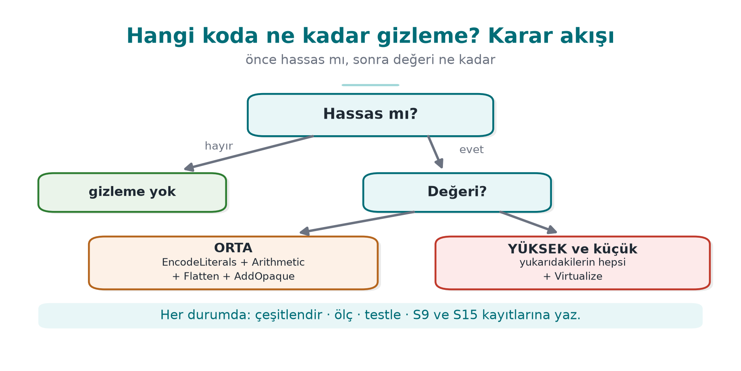
CEN429 Secure Programming · Week 14
Decision Flow · At a Glance
RTEU Computer Engineering · 2026-2027 Fall
165

Slide 166
CEN429 Secure Programming · Week 14
Appendix F · Common Mistakes
RTEU Computer Engineering · 2026-2027 Fall
166

Slide 167
CEN429 Secure Programming · Week 14
Mistake · Obfuscating Everything
• Obfuscating all functions slows down/bloats the program a lot.
• Only sensitive and valuable functions.
RTEU Computer Engineering · 2026-2027 Fall
167

Slide 168
CEN429 Secure Programming · Week 14
Mistake · Obfuscating Without Tests
• If unit tests aren't run after obfuscation, broken behaviour goes unnoticed.
• Testing after every pipeline is mandatory.
RTEU Computer Engineering · 2026-2027 Fall
168

Slide 169
CEN429 Secure Programming · Week 14
Mistake · Saying "Strong" Without Measuring
• Without measurement, the evaluator (week 12) treats it as a claim.
• Write down size/time/block numbers.
RTEU Computer Engineering · 2026-2027 Fall
169

Slide 170
CEN429 Secure Programming · Week 14
Mistake · Skipping Diversification
• Uniform obfuscation → one crack opens every copy.
• A different seed for every version/deployment.
RTEU Computer Engineering · 2026-2027 Fall
170

Slide 171
CEN429 Secure Programming · Week 14
Mistake · Signing Before Obfuscating
• The signature must cover the final distributed binary.
• Obfuscate first, then sign.
RTEU Computer Engineering · 2026-2027 Fall
171

Slide 172
CEN429 Secure Programming · Week 14
Mistake · Using an Old/Distributed Tigress
• The binary isn't distributed in class; download the current version from the official site.
• Verify the license terms.
RTEU Computer Engineering · 2026-2027 Fall
172

Slide 173
CEN429 Secure Programming · Week 14
Appendix · Closing Note
These appendices gave you a concrete template for building your own pipeline:
• transform-by-transform selection
• decision flow
• mistakes to avoid
The right tool + the right measurement + diversification = a defensible S9/S15.
RTEU Computer Engineering · 2026-2027 Fall
173

Slide 174
CEN429 Secure Programming · Week 14
Appendix G · A Second Worked Pipeline
RTEU Computer Engineering · 2026-2027 Fall
174
Notes:
Speaker note: We reinforce the pipeline with a second synthetic example; a different kind of function.

Slide 175
CEN429 Secure Programming · Week 14
New Example · Integrity Check
int dosya_saglam(const uint8_t *veri, size_t n,
const uint8_t *beklenen) {
uint8_t ozet[32];
ozet_hesapla(veri, n, ozet); /* SHA-256 benzeri */
return sabit_zamanli_esit(ozet, beklenen, 32);
}
A synthetic function that checks version integrity.
RTEU Computer Engineering · 2026-2027 Fall
175

Slide 176
CEN429 Secure Programming · Week 14
Why Obfuscate This?
• An attacker wants to find this check and bypass it (to get a tampered file to pass).
• The check's return point and comparison are the target.
• Week 9: opaque boolean + random exit are critical here.
RTEU Computer Engineering · 2026-2027 Fall
176

Slide 177
CEN429 Secure Programming · Week 14
Pipeline Choice
tigress \
--Transform=EncodeLiterals \
--Transform=EncodeArithmetic \
--Transform=Flatten \
--Transform=AddOpaque \
--Functions=dosya_saglam \
--out=gizli.c temiz.c
RTEU Computer Engineering · 2026-2027 Fall
177

Slide 178
CEN429 Secure Programming · Week 14
Step by Step · What Happens?
• EncodeLiterals: 32 and any strings are no longer plain.
• EncodeArithmetic: the comparison becomes complex.
• Flatten: the single return point is not visible.
• AddOpaque: bogus branches; the "success" branch isn't in one place.
RTEU Computer Engineering · 2026-2027 Fall
178

Slide 179
CEN429 Secure Programming · Week 14
Behaviour Verification (Mandatory)
• A file with the correct hash → passes.
• A file with a corrupted hash → rejected.
• The obfuscated version gives the same result → pipeline correct.
RTEU Computer Engineering · 2026-2027 Fall
179

Slide 180
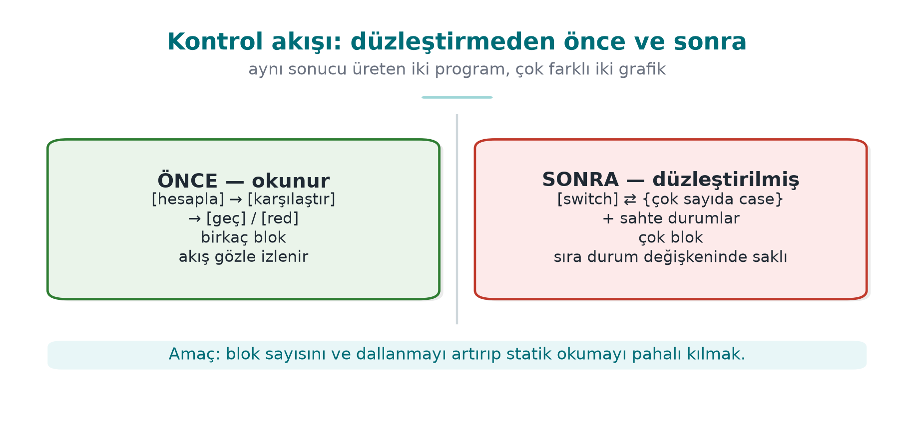
CEN429 Secure Programming · Week 14
CFG Before/After (Concept)
Where the check passes/fails can no longer be read from the flow.
RTEU Computer Engineering · 2026-2027 Fall
180

Slide 181
CEN429 Secure Programming · Week 14
⚠️ Constant-Time Behaviour Must Be Preserved
• Even obfuscated, sabit_zamanli_esit must stay constant time.
• If an early exit is added for the sake of obfuscation, a side channel opens (week 3).
• Test that the transforms don't break this.
RTEU Computer Engineering · 2026-2027 Fall
181

Slide 182
CEN429 Secure Programming · Week 14
Measurement (Example)
Metric | Before | After
Size | 100 KB | 128 KB
Time | 1.0× | 1.7×
Blocks (dosya_saglam) | 4 | 33
RTEU Computer Engineering · 2026-2027 Fall
182

Slide 183
CEN429 Secure Programming · Week 14
Diversification
• Produce with two seeds → two different binaries.
• A "skip the integrity check" patch that works on one copy won't work on the other, even if it succeeds once.
RTEU Computer Engineering · 2026-2027 Fall
183

Slide 184
CEN429 Secure Programming · Week 14
Second Example · Takeaway
• Obfuscation is valuable on functions that are a bypass target, like integrity checks.
• But the real strength: obfuscation + RASP (week 6) + server-side checking.
• Obfuscation alone delays bypass, it doesn't prevent it.
RTEU Computer Engineering · 2026-2027 Fall
184

Slide 185
CEN429 Secure Programming · Week 14
Appendix H · Quick Reference
RTEU Computer Engineering · 2026-2027 Fall
185

Slide 186
CEN429 Secure Programming · Week 14
Transform Selection Guide
You Want | Transform
Hide a string/constant | EncodeLiterals
Hide a calculation | EncodeArithmetic
Hide the structure | Flatten
Add bogus/opaque | AddOpaque
Hide machine code | Virtualize (expensive)
Diversify | --Seed, RandomFuns
RTEU Computer Engineering · 2026-2027 Fall
186

Slide 187
CEN429 Secure Programming · Week 14
Checklist
• --Functions)
•
•
•
•
•
•
RTEU Computer Engineering · 2026-2027 Fall
187

Slide 188
CEN429 Secure Programming · Week 14
Final Word (Week 14)
The tool is powerful, but the decision is yours: what, why, at what cost are you obfuscating?
Measure, diversify, layer. Obfuscation is not unbreakability, it is time bought.
RTEU Computer Engineering · 2026-2027 Fall
188

