Slide 1

CEN429 Secure Programming · Week 1
Introduction to Secure Programming and the Application Protection Plan
CEN429 Secure Programming — Week 1
Asst. Prof. Dr. Uğur CORUH · 18.09.2026
RTEU Computer Engineering · 2026-2027 Fall
Notes:
Speaker note: Introduce yourself and the course. This course is about "learning defence by seeing the attack." There will be working demos every week.

Slide 2
CEN429 Secure Programming · Week 1
0. Basic concepts (from scratch)
RTEU Computer Engineering · 2026-2027 Fall
2
Notes:
Speaker note: This section assumes no prior knowledge; since it's the first day of the course, we define every basic term here. We will use them in the sections that follow.

Slide 3
CEN429 Secure Programming · Week 1
Why this section?
This course is full of terms like "security," "vulnerability," "threat model."
We assume you know none of them.
Let's define every one of them one at a time first.
RTEU Computer Engineering · 2026-2027 Fall
3

Slide 4
CEN429 Secure Programming · Week 1
What is security?
• Security: protecting a system against someone who wants to harm it.
• An ordinary bug: happens by accident.
• Security: there is a deliberate attacker.
RTEU Computer Engineering · 2026-2027 Fall
4

Slide 5
CEN429 Secure Programming · Week 1
What is an asset?
• Asset: anything worth protecting (data, a key, a function).
• Example: a password, a credit card, a license, user data.
• Security begins with "what are we protecting?"
RTEU Computer Engineering · 2026-2027 Fall
5

Slide 6
CEN429 Secure Programming · Week 1
Threat and vulnerability
• Threat: a bad event that could happen (data being stolen).
• Vulnerability: the weak point that makes it possible (unvalidated input).
• Threat + vulnerability + attacker = risk.
RTEU Computer Engineering · 2026-2027 Fall
6

Slide 7
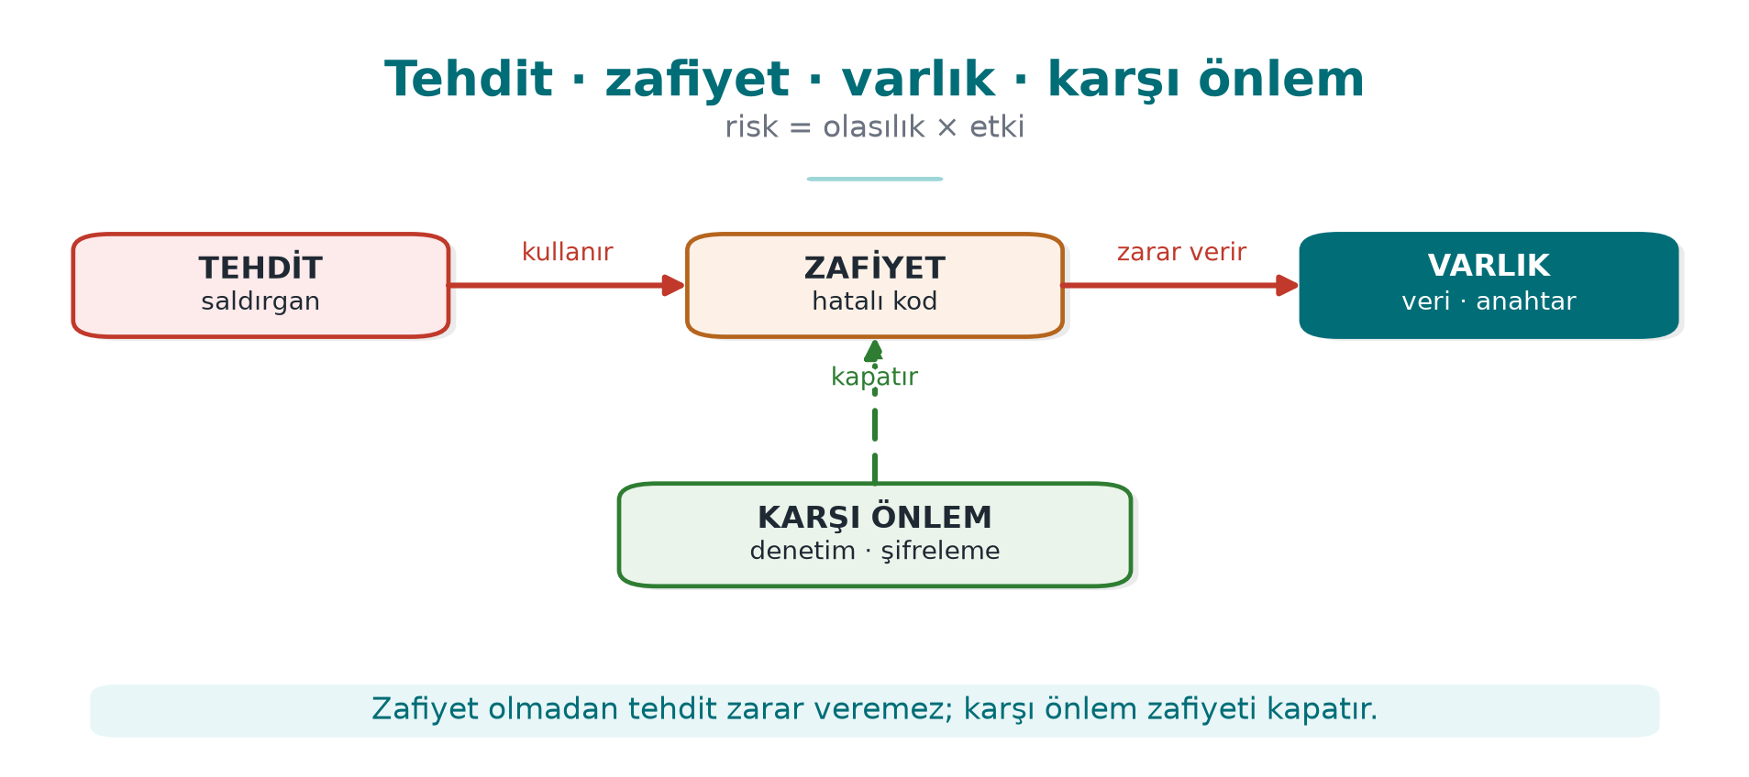
CEN429 Secure Programming · Week 1
Threat · vulnerability · asset — diagram
RTEU Computer Engineering · 2026-2027 Fall
7

Slide 8
CEN429 Secure Programming · Week 1
The CIA triad
The three core goals of security:
• Confidentiality (C): only authorized parties can see it.
• Integrity (I): cannot be changed without authorization.
• Availability (A): works when it needs to.
RTEU Computer Engineering · 2026-2027 Fall
8

Slide 9
CEN429 Secure Programming · Week 1
Attacker model
• Attacker model: "what can the attacker see/do?"
• Are they connecting over the network, or do they own the device?
• We design the defence accordingly.
RTEU Computer Engineering · 2026-2027 Fall
9

Slide 10
CEN429 Secure Programming · Week 1
White-box / MATE
• MATE (Man-At-The-End): an attacker who owns the program.
• Reads the code, sees the memory, modifies it.
• The real situation for mobile/desktop applications (this course's main theme).
RTEU Computer Engineering · 2026-2027 Fall
10

Slide 11
CEN429 Secure Programming · Week 1
Threat modelling
• Threat modelling: systematically answering "what will we protect, against whom, and how?"
• It lists assets, threats, and countermeasures.
• Today we'll do it with STRIDE and attack trees.
RTEU Computer Engineering · 2026-2027 Fall
11

Slide 12
CEN429 Secure Programming · Week 1
STRIDE
• A method that classifies threats with six letters:
• Spoofing, Tampering, Repudiation, Information disclosure, Denial of service, Elevation of privilege.
• It asks "which threat?" for every element.
RTEU Computer Engineering · 2026-2027 Fall
12

Slide 13
CEN429 Secure Programming · Week 1
Attack tree
• Attack tree: a tree that breaks a goal (e.g. "steal the key") into sub-steps.
• Root: the attacker's goal.
• Branches: the ways to achieve it.
RTEU Computer Engineering · 2026-2027 Fall
13

Slide 14
CEN429 Secure Programming · Week 1
Data flow diagram (DFD)
• DFD: a diagram showing how data flows through the system.
• Process, data store, external entity, flow, trust boundary.
• A map for finding threats.
RTEU Computer Engineering · 2026-2027 Fall
14

Slide 15
CEN429 Secure Programming · Week 1
Defence in depth
• Defence in depth: not a single countermeasure, but many.
• If one is bypassed, another stops it.
• A "security shell" is the combination of these layers.
RTEU Computer Engineering · 2026-2027 Fall
15

Slide 16
CEN429 Secure Programming · Week 1
Secure design principles
• Saltzer & Schroeder (1975): least privilege, secure default, economy, open design…
• Still valid today.
• The backbone of this course.
RTEU Computer Engineering · 2026-2027 Fall
16

Slide 17
CEN429 Secure Programming · Week 1
Trade-off
• Every protection carries a cost: speed, complexity, expense.
• Security is not "infinite protection," it is balanced protection.
• We write the remaining risk down explicitly.
RTEU Computer Engineering · 2026-2027 Fall
17

Slide 18
CEN429 Secure Programming · Week 1
Now we're ready
Terms:
security · asset · threat/vulnerability · CIA · attacker model · MATE · threat modelling · STRIDE · attack tree · DFD · defence in depth · design principles · trade-off
Now: what security is, in depth.
RTEU Computer Engineering · 2026-2027 Fall
18

Slide 19
CEN429 Secure Programming · Week 1
Today's plan (3 hours)
Hour | Topic
1 | Course introduction · What is security? · The attacker · Principles · Overview of application protection
2 | Protection plan · STRIDE and risk score · Attack tree · Worked example "Vault" · Class exercise
3 | Demo 1–2 · Secure start-up · Overflows · Demo 3–4 · Memory management · Partitioning · Secure process · Project
Demos: code/week-01 — Windows .demo.ps1 · WSL / Linux sh demo.sh · Visual Studio: Open Folder → code
RTEU Computer Engineering · 2026-2027 Fall
19
Notes:
Speaker note: Build the demos once beforehand (Windows: `.\build.ps1` inside code, WSL: `./build.sh`), so there's no waiting in class. Show students that both environments give the same result; in Visual Studio, Open Folder on the `code` folder is enough.

Slide 20
CEN429 Secure Programming · Week 1
A short history — the idea of secure programming
• 1975 — Saltzer & Schroeder: the 8 principles of secure design (least privilege, defence in depth…)
• 1970s–80s — the CIA triad becomes a common language
• 1998–99 — STRIDE at Microsoft; Schneier introduces attack trees
• 2001–03 — Building Secure Software and the Secure Programming Cookbook (the course's main source)
Today's tools (CIA · attacker model · STRIDE · attack tree) are products of this lineage.
RTEU Computer Engineering · 2026-2027 Fall
20

Slide 21
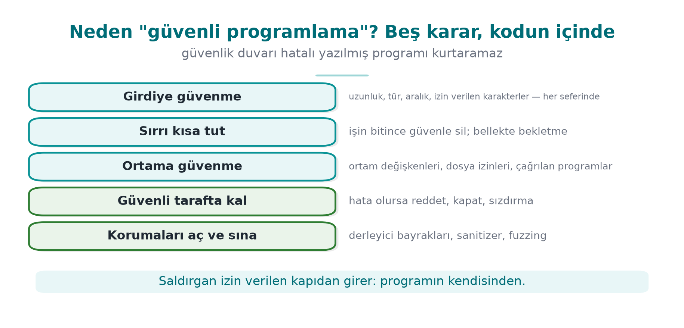
CEN429 Secure Programming · Week 1
The five decisions of secure programming — diagram
RTEU Computer Engineering · 2026-2027 Fall
21

Slide 22
CEN429 Secure Programming · Week 1
How the course runs
• One term project: a C/C++ application + a security guide written "as if it were going through certification"
  – Midterm check: week 7 demo · Final check: week 15 demo
• Two quizzes: week 8 (1–6) · week 16 (9–14)
• Grade: Midterm = 0.6·Project1 + 0.4·Quiz1 · Final = 0.7·Project2 + 0.3·Quiz2
• Every week: buggy code → attack → fix
⚠️ Ethics: Only try these techniques on your own computer and on the demos provided.
RTEU Computer Engineering · 2026-2027 Fall
22

Slide 23
CEN429 Secure Programming · Week 1
1. What is security?
RTEU Computer Engineering · 2026-2027 Fall
23

Slide 24
CEN429 Secure Programming · Week 1
The Vault analogy
Concept | Vault | Software
Asset | Money | Password, payment key
Threat | Thief | Someone who wants to steal the password
Vulnerability | Faulty lock | An unchecked strcpy
Attack | Picking the lock | Becoming administrator with a long username
Countermeasure | A new lock | Length checking
Risk | Probability × impact | "If it's found, every account is gone"
RTEU Computer Engineering · 2026-2027 Fall
24
Notes:
Speaker note: Ask students for their own examples: "For your Instagram account, what are the asset, the threat, the vulnerability?"

Slide 25
CEN429 Secure Programming · Week 1
Security's three goals: CIA
 | Question | If broken
Confidentiality | Can only authorized parties see it? | Passwords leak
Integrity | Can it be changed without authorization? | A balance, a grade changes
Availability | Does it work when needed? | The system crashes
+ Authentication · Authorization · Non-repudiation
Question: A banking app writes the balance unencrypted → ? · The recipient IBAN changes in transit → ? · It crashes on a holiday night → ?
RTEU Computer Engineering · 2026-2027 Fall
25

Slide 26
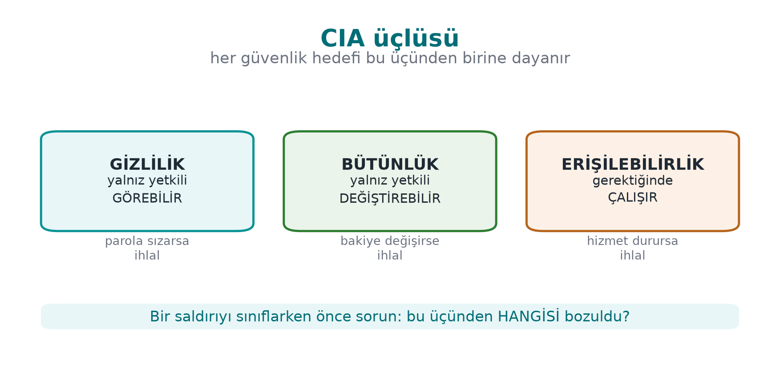
CEN429 Secure Programming · Week 1
The CIA triad — diagram
Answer to the question: balance unencrypted → C; IBAN changes in transit → I; crashes on a holiday night → A.
RTEU Computer Engineering · 2026-2027 Fall
26

Slide 27
CEN429 Secure Programming · Week 1
The CIA triad — typical countermeasures and related concepts
Goal | Typical countermeasure
Confidentiality | Encryption, access control
Integrity | Hash, MAC, digital signature
Availability | Redundancy, resource limiting
+ Authentication: are you really who you say you are? · Authorization: do you have permission to do this? · Non-repudiation: who did this, and can they deny it afterward?
RTEU Computer Engineering · 2026-2027 Fall
27

Slide 28
CEN429 Secure Programming · Week 1
Bug ≠ vulnerability, but…
A very large share of security vulnerabilities are ordinary software bugs.
Heartbleed (2014, CVE-2014-0160)
• Client: "Send me 64 KB back" — but sends only a few bytes
• The server never checks the length → sends back neighboring memory (passwords, keys)
• A single missing length check → a significant part of the internet was affected
RTEU Computer Engineering · 2026-2027 Fall
28
Notes:
Speaker note: In Demo 4 we'll see a bug from the same family (a length check) with our own hands.

Slide 29
CEN429 Secure Programming · Week 1
Who is the attacker, what can they reach?
Attacker | Access | Defence
Remote | Only network messages | Input validation, TLS
Local user | Files, environment variables | Permissions, secure start-up
Insider | Source code, server | Privilege separation, audit logging
Device owner (white-box) | Memory, debugger, binary | RASP, obfuscation, white-box
What's different about this course: what do we do if the program runs on the attacker's device?
RTEU Computer Engineering · 2026-2027 Fall
29
Notes:
Speaker note: Examples: mobile payment, DRM, game cheats, license checks. "Just hide the key" isn't enough; the attacker can read memory.

Slide 30
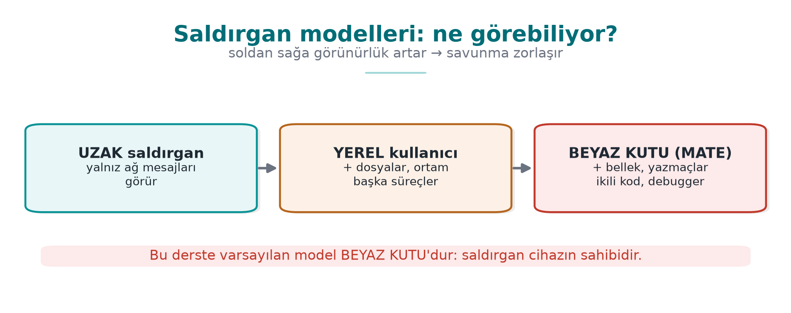
CEN429 Secure Programming · Week 1
Attacker models — diagram
RTEU Computer Engineering · 2026-2027 Fall
30

Slide 31
CEN429 Secure Programming · Week 1
Attackers — real-world examples
Attacker | Example
Remote | Someone attacking a web server
Local user | Another student on a shared server
Insider | An employee abusing their role
Device owner (white-box) | Someone trying to crack a mobile payment app on their own phone
Apply each row to your own project: which one is your attacker?
RTEU Computer Engineering · 2026-2027 Fall
31

Slide 32
CEN429 Secure Programming · Week 1
Secure design principles (Saltzer & Schroeder, 1975)
Principle | One sentence
Least privilege | Run with only the privilege needed
Secure default | The default is "no permission"
Complete mediation | Check every access, every time
Open design | Security rests on the secrecy of the key, not the algorithm
Economy of mechanism | Simple = fewer bugs
Separation of privilege | Two conditions for a critical operation
Least common mechanism | Reduce shared resources
Acceptability | Unusable security gets bypassed
+ Defence in depth: don't rely on one countermeasure, build layers.
RTEU Computer Engineering · 2026-2027 Fall
32

Slide 33
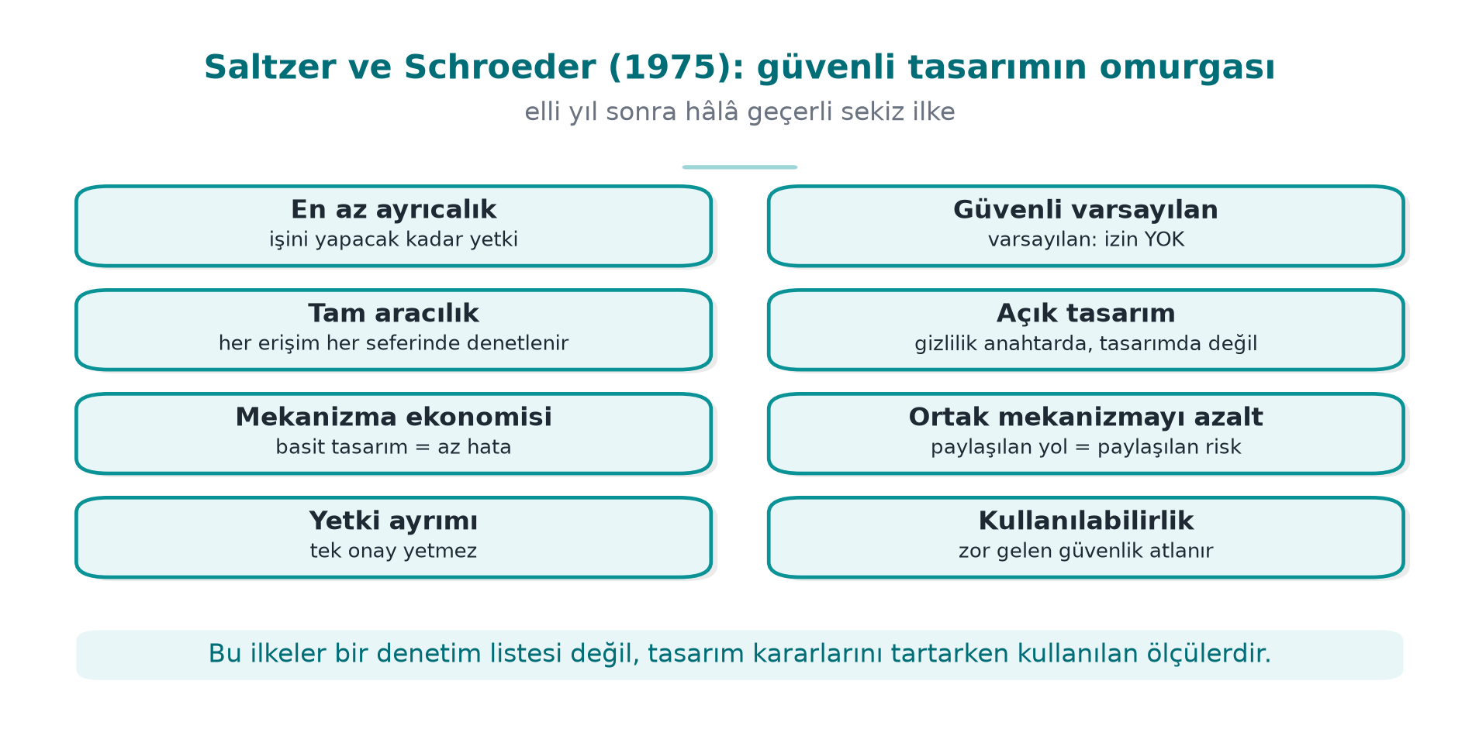
CEN429 Secure Programming · Week 1
Saltzer and Schroeder's principles — diagram
RTEU Computer Engineering · 2026-2027 Fall
33

Slide 34
CEN429 Secure Programming · Week 1
Secure design principles — examples (1/2)
Principle | Example
Least privilege | The reporting program runs as an ordinary user, not administrator
Secure default | A new user's yonetici (admin) field starts at 0
Complete mediation | Permission is not checked once and then cached
Open design | You do not write your own encryption algorithm
No principle is abstract; each one shows up as a concrete decision in code.
RTEU Computer Engineering · 2026-2027 Fall
34

Slide 35
CEN429 Secure Programming · Week 1
Secure design principles — examples (2/2)
Principle | Example
Economy of mechanism | A clear 20-line check beats a "clever" 500-line one
Separation of privilege | Both a password and an SMS code for a money transfer
Least common mechanism | Every session gets its own temporary file
Psychological acceptability | Asking for a password every 5 minutes leads to it being written on paper
Unusable security is bypassed security.
RTEU Computer Engineering · 2026-2027 Fall
35

Slide 36
CEN429 Secure Programming · Week 1
2. Overview of application protection
RTEU Computer Engineering · 2026-2027 Fall
36

Slide 37
CEN429 Secure Programming · Week 1
Why a single countermeasure is not enough
Countermeasure | What it doesn't solve
Bug-free code | The attacker opens the binary and reads the logic
Obfuscated code | Stops it with a debugger and reads the memory
Memory protected against monitoring | The key sits in code as plain text → a single string scan is enough
Hidden key | Changes a single check and bypasses the protection
➡️ Each layer closes the previous one's gap; the attacker must defeat all of them at once
RTEU Computer Engineering · 2026-2027 Fall
37
Notes:
Speaker note: Building analogy: good lock, open window, key under the doormat, safe with no combination. Ask students "who would do this?" for each row.

Slide 38
CEN429 Secure Programming · Week 1
Seven layers: inside out
# | Layer | Question | Week
1 | Secure design | What, against whom? | 1–2
2 | Secure coding | Is my code bug-free? | 1, 4, 5
3 | Compiler/OS protections | If a bug slips through, is exploitation hard? | 4
4 | Obfuscation | Can someone reading the code understand it? | 4, 5, 9, 14
5 | RASP | Does it notice it's under attack? | 6
6 | Cryptography | Even if captured, is the data meaningless? | 3, 10, 11
7 | Assurance | How do we prove it works? | 12–13
RTEU Computer Engineering · 2026-2027 Fall
38
Notes:
Speaker note: The inner layers are "write it correctly," the outer layers are "what happens when the code is in the attacker's hands." This table is the term's roadmap.

Slide 39
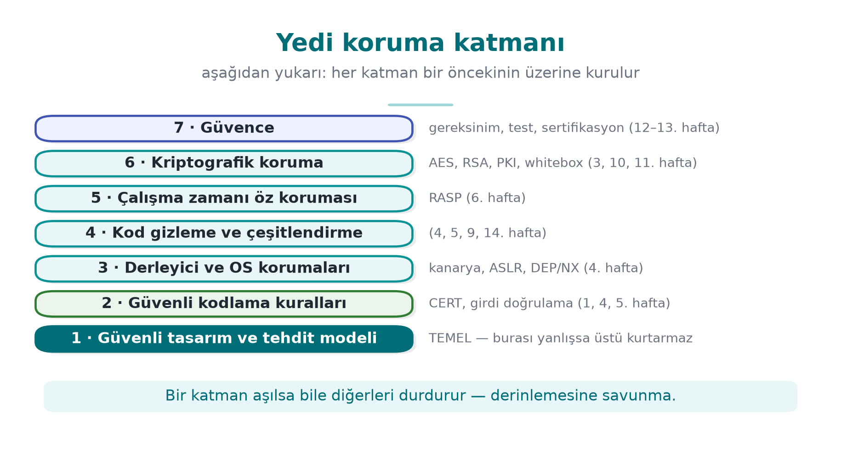
CEN429 Secure Programming · Week 1
Seven layers — diagram (inside out)
Even if a bug slips past the outer layers, the next layer tries to stop it (defence in depth).
RTEU Computer Engineering · 2026-2027 Fall
39

Slide 40
CEN429 Secure Programming · Week 1
Seven layers — typical techniques and the attacker they stop
# | Layer | Typical techniques | Attacker it stops
1 | Design | Threat model, asset/interface tables, least privilege | Anyone looking for a design flaw
2 | Coding | Input validation, bounds checking, SEI CERT rules | An attacker sending input remotely
3 | Compiler/OS | Canary, ASLR, DEP/NX, CFI, _FORTIFY_SOURCE | An attacker exploiting a memory bug
4 | Obfuscation | Control-flow flattening, opaque predicates, virtualisation | A reverse-engineering analyst
5 | RASP | Debugger/hook/root detection, integrity checking | An attacker inspecting the running program
6 | Cryptography | Authenticated encryption, key hierarchy, white-box | An attacker who captures the data
7 | Assurance | Code review, fuzzing, penetration testing, certification | Auditors and evaluators
RTEU Computer Engineering · 2026-2027 Fall
40

Slide 41
CEN429 Secure Programming · Week 1
The security shell: where the layers meet
A sensitive key is carried inside several layers at once:
1. Stays encrypted on disk
2. Decrypted only at the moment it's needed, only as much as needed
3. The code section where it is decrypted is obfuscated and integrity-checked
4. The process has debugger detection running
➡️ In week 3 we'll build a four-shell design step by step
RTEU Computer Engineering · 2026-2027 Fall
41

Slide 42
CEN429 Secure Programming · Week 1
Which layer, when? By attacker model
Application | Where is the attacker? | Priority
Server-side web service | On the network; no access to code or server | 1, 2, 3, 6, 7
Desktop business app | On the user's computer; the user is not the attacker | 1, 2, 3, 6
Mobile payment | The device may be in the attacker's hands | All; especially 4, 5, 6
Game, licensed software | The user is the attacker | 4, 5
Embedded device | Physical access | 2, 3, 6 + hardware
White-box attacker: owns the program itself — copies it, opens it, modifies it, re-runs it
RTEU Computer Engineering · 2026-2027 Fall
42

Slide 43
CEN429 Secure Programming · Week 1
⚠️ Obfuscation is not a substitute for correct code
• Obfuscation slows the attacker down, it does not fix the bug
• An obfuscated overflow is still an overflow
• Outer layers only make sense once the inner layers are solid
The server never trusts the client. Even an obfuscated client can send inconsistent data to the server.
RTEU Computer Engineering · 2026-2027 Fall
43
Notes:
Speaker note: A game cheat example: the client is obfuscated, but the server accepts "100 meters in one second" movement.

Slide 44
CEN429 Secure Programming · Week 1
The white-box attacker's six paths (1/2)
A six-row attack table for a sensitive library running on the client side:
# | Attacker's path | Example | Layer that answers
1 | Bypassing platform controls | A rooted device, an emulator, a modified OS | 5 (RASP)
2 | Reverse-engineering the code | Reading logic/keys with a decompiler | 4 (obfuscation), 6
3 | Modifying the code | Flipping an if check and repackaging | 5 (integrity), 4
RTEU Computer Engineering · 2026-2027 Fall
44

Slide 45
CEN429 Secure Programming · Week 1
The white-box attacker's six paths (2/2)
# | Attacker's path | Example | Layer that answers
4 | Abusing interfaces | Calling the library from your own program | 1 (design), 5, 6
5 | Extracting assets at runtime | Memory dump, debugger, hook | 2 (erasure), 5, 6 (white-box)
6 | Redirecting control flow at runtime | Skipping a branch, changing a return value | 5 (flow counter), 4
This table is the starting point for the threats section of a protection plan.
RTEU Computer Engineering · 2026-2027 Fall
45

Slide 46
CEN429 Secure Programming · Week 1
The cost of protection
Cost | Example
Performance | Control-flow flattening can slow a function several times over
Size | Virtualisation, white-box tables make the binary bigger
Maintenance | Crash reports from obfuscated code are unreadable
False positive | An overly sensitive root check punishes a legitimate user
➡️ Every countermeasure is written with its justification: this asset, against this attacker, at this cost
RTEU Computer Engineering · 2026-2027 Fall
46

Slide 47
CEN429 Secure Programming · Week 1
An evaluator reads the table backward
1. String scan → is a key, URL, error message visible?
2. Opening the binary → is the logic readable?
3. Attaching a debugger → does the program notice?
4. Modifying the code → does the integrity check catch it?
5. Memory dump → is a secret found?
Every step that isn't stopped becomes a finding in the report
RTEU Computer Engineering · 2026-2027 Fall
47
Notes:
Speaker note: The project's security guide will answer, for every layer, "which countermeasure did I take, how did I test it?"

Slide 48
CEN429 Secure Programming · Week 1
Try it yourself (3 min)
1. What is the attacker model for an offline password manager? Which layers matter?
2. "It runs on the server, no need to obfuscate" — when is this true, when is it false?
3. In a game that uses only obfuscation, which attack path stays open?
RTEU Computer Engineering · 2026-2027 Fall
48
Notes:
Speaker note: ask first, then open this slide.

Slide 49
CEN429 Secure Programming · Week 1
Try it yourself — answers
1. Offline password manager: the attacker owns the device/file (white-box). Layers that matter: cryptography (a KDF from the password + AEAD), secure coding, some obfuscation/RASP.
2. "Runs on the server": true if no sensitive logic/key is sent to the client; false if code/a key runs on the client (white-box).
3. Obfuscation only: if there's no server-side validation, a patched-client cheat stays open — obfuscation doesn't fix the logic.
RTEU Computer Engineering · 2026-2027 Fall
49

Slide 50
CEN429 Secure Programming · Week 1
3. The application protection plan and threat modelling
RTEU Computer Engineering · 2026-2027 Fall
50

Slide 51
CEN429 Secure Programming · Week 1
Application protection plan: 7 steps
1. Scope — What are we protecting? Which binary, which version, which hash?
2. Architecture and interfaces — Who talks to whom, over which channel?
3. Assets — Where does it live, when is it erased, C or I?
4. Threats — Who is the attacker, by which path do they reach the asset?
5. Countermeasures — Which layer, which countermeasure?
6. Verification — How is it proven that it works?
7. Residual risk — What was accepted, and why
→ In certification this plan becomes a security guide hundreds of pages long. You will write a 20–30 page version of it for the project.
RTEU Computer Engineering · 2026-2027 Fall
51

Slide 52
CEN429 Secure Programming · Week 1
Step 1 detail: Scope
Question: What are we evaluating?
• Saying "version 2.1" alone is not enough
• Which binary, which source code, which hash value?
• In certification this is called the target of evaluation
RTEU Computer Engineering · 2026-2027 Fall
52

Slide 53
CEN429 Secure Programming · Week 1
Step 2 detail: Architecture and interfaces
Question: What are the components, how do they talk?
• What are the components?
• Which channel do they talk to each other over?
• How is identity verified on each channel?
RTEU Computer Engineering · 2026-2027 Fall
53

Slide 54
CEN429 Secure Programming · Week 1
Step 3 detail: Assets
Question: Where and when is the protected data?
• Every piece of data to be protected is listed one by one
• Where does it live, when is it created, when is it erased?
• Does it need confidentiality (C) or integrity (I)?
RTEU Computer Engineering · 2026-2027 Fall
54

Slide 55
CEN429 Secure Programming · Week 1
Step 4 detail: Threats
Question: Who is the attacker, how do they reach it?
• Who is the attacker? (see attacker models)
• By which path can they reach each asset?
• STRIDE and the attack tree come in here
RTEU Computer Engineering · 2026-2027 Fall
55

Slide 56
CEN429 Secure Programming · Week 1
Step 5 detail: Countermeasures
Question: Which countermeasure, in which layer?
• One countermeasure is chosen for each threat
• Which of the seven layers does the countermeasure belong to?
• An unjustified countermeasure is in the wrong place or unnecessary
RTEU Computer Engineering · 2026-2027 Fall
56

Slide 57
CEN429 Secure Programming · Week 1
Step 6 detail: Verification
Question: How is it proven that it works?
• A test is written for each countermeasure
• A unit test, or a bypass attempt?
• A countermeasure with no test does not exist in an evaluator's eyes
RTEU Computer Engineering · 2026-2027 Fall
57

Slide 58
CEN429 Secure Programming · Week 1
Step 7 detail: Residual risk
Question: What did we knowingly accept?
• Risks that can't be closed, or are knowingly accepted
• The reason for each (e.g. performance, usability)
• The plan never ends: as the product changes, step 1 is revisited and it is updated
RTEU Computer Engineering · 2026-2027 Fall
58

Slide 59
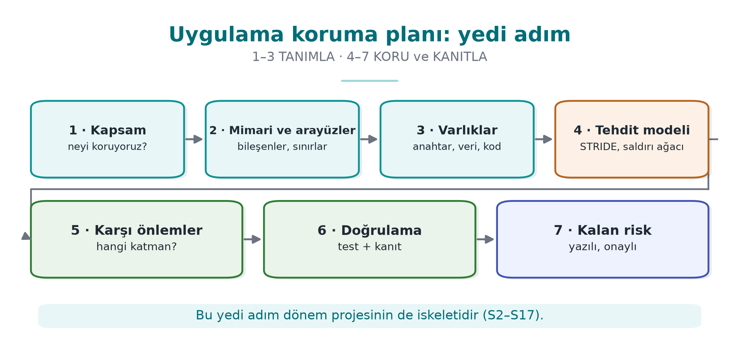
CEN429 Secure Programming · Week 1
The protection plan — diagram
RTEU Computer Engineering · 2026-2027 Fall
59

Slide 60
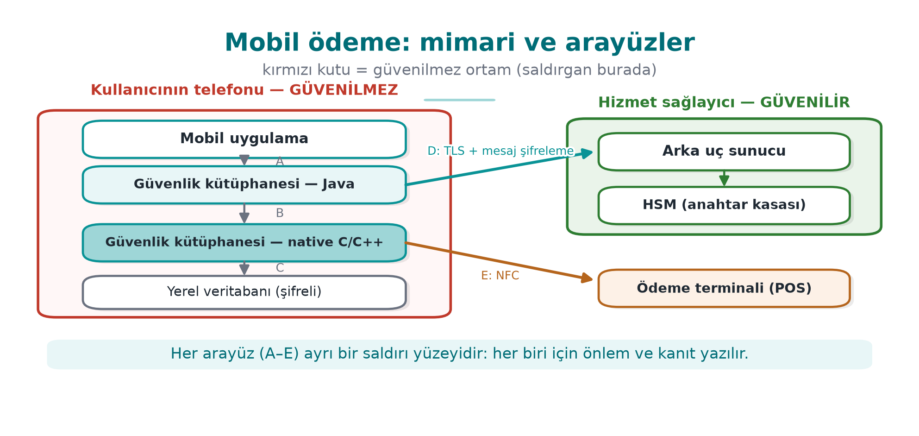
CEN429 Secure Programming · Week 1
Example architecture: a mobile payment app
• The phone may be in the attacker's hands: root, debugger, memory dump
• The most sensitive work runs in the native C/C++ layer
RTEU Computer Engineering · 2026-2027 Fall
60
Notes:
Speaker note: This architecture is only for showing the method. We'll use the interface and asset table method all term; the methods that protect the table's assets are opened up one at a time in the coming weeks (3: security shells, 4 and 9: native hardening, 6: RASP, 10: key hierarchy, 11: white-box).

Slide 61
CEN429 Secure Programming · Week 1
Interface and asset tables
Interface | Ends | Authentication | Confidentiality / integrity
C | native – database | — | Encryption + MAC, key bound to the device
D | SDK – server | Certificate pinning | TLS + message-level encryption on top
Asset | Where | Lifetime | Protection
One-time payment key | DB (encrypted), memory | One payment | C, I
Session key | Memory only | Session | C, I
Transaction counter | DB | Persistent | I
An asset not on the list is an asset that's not protected.
RTEU Computer Engineering · 2026-2027 Fall
61

Slide 62
CEN429 Secure Programming · Week 1
Interface table — full list (mobile payment)
Interface | Ends | Authentication | Confidentiality / integrity
A | App – Library (Java) | The caller's signature is verified | Same process; no sensitive data crosses
B | Library (Java) – native | Mutual integrity check | Crosses encrypted and masked
C | native – local database | — | Encryption + MAC, key bound to the device
D | Library – back-end server | Certificate pinning + server verification | TLS + message-level encryption on top
E | Library – payment terminal | Payment protocol | One-time payment key
RTEU Computer Engineering · 2026-2027 Fall
62

Slide 63
CEN429 Secure Programming · Week 1
Asset table — full list (mobile payment)
Asset | Where | Creation → deletion | Protection
One-time payment key | DB (encrypted), memory | Downloaded from server → used → erased | C, I
Device fingerprint | Memory, two separate pieces | Computed at start-up | I
Session key | Memory only | Derived → erased at session end | C, I
Transaction counter | Database | Increments on every payment | I
Server public key | Embedded in the app | At build time | I
RTEU Computer Engineering · 2026-2027 Fall
63

Slide 64
CEN429 Secure Programming · Week 1
STRIDE
 | Threat | Breaks | Example
S | Spoofing | Authentication | A fake app calling the SDK
T | Tampering | Integrity | A native check altered in the binary
R | Repudiation | Non-repudiation | "I didn't make this payment"
I | Information disclosure | Confidentiality | Key read from a memory dump
D | Denial of service | Availability | Thousands of fake registration requests
E | Elevation of privilege | Authorization | Ordinary user → administrator
Draw the data flow diagram → ask the six letters for every arrow that crosses a trust boundary.
RTEU Computer Engineering · 2026-2027 Fall
64

Slide 65
CEN429 Secure Programming · Week 1
Attack tree: "Capture the payment key"
GOAL: Payment key — OR (one is enough)
1. Break the database — AND (all required): gain root privilege + find the database key
2. Read from memory — OR: attach a debugger | take a memory dump | hook a function
3. Eavesdrop on the traffic — AND: break TLS + break message-level encryption
RTEU Computer Engineering · 2026-2027 Fall
65

Slide 66
CEN429 Secure Programming · Week 1
Attack tree — the "Break the database" branch
AND node (all required):
1. Gain root privilege
2. AND find the database key
This path is expensive because both are needed.
This is proof that defence in depth works.
RTEU Computer Engineering · 2026-2027 Fall
66

Slide 67
CEN429 Secure Programming · Week 1
Attack tree — the "Read from memory" branch
OR node (one is enough): three alternatives
1. Attach a debugger
2. OR take a memory dump
3. OR hook a function
Three alternatives = the weakest point: the key in memory.
→ This week's Demo 2 · Week 6 runtime protection · Week 11 white-box
RTEU Computer Engineering · 2026-2027 Fall
67

Slide 68
CEN429 Secure Programming · Week 1
Attack tree — the "Eavesdrop on traffic" branch
AND node (all required):
1. Break TLS
2. AND break message-level encryption
Both layers must be broken at once → an expensive path.
The defender's goal: force the attacker into as many AND nodes as possible.
RTEU Computer Engineering · 2026-2027 Fall
68

Slide 69
CEN429 Secure Programming · Week 1
Conclusions from the attack tree
• The "eavesdrop on traffic" path requires breaking two layers at once → expensive → defence in depth is working
• The "read from memory" path has three alternatives → the weakest point is the key in memory
  – This week: Demo 2 (a secret left in memory)
  – Week 6: runtime protection (debugger, hook detection)
  – Week 11: white-box cryptography (the key is never exposed in memory)
• The defender's goal: force the attacker into AND nodes
RTEU Computer Engineering · 2026-2027 Fall
69

Slide 70
CEN429 Secure Programming · Week 1
Data flow diagram: five symbols
Symbol | Name | Example
▭ Rectangle | External entity | User, payment terminal
◯ Circle | Process | Login module, crypto library
═ Two lines | Data store | Database, config file
→ Arrow | Data flow | HTTP request, function call
┄ Dashed line | Trust boundary | Internet ↔ server, app ↔ OS
➡️ Color every arrow that crosses a trust boundary red: start your review there
RTEU Computer Engineering · 2026-2027 Fall
70

Slide 71
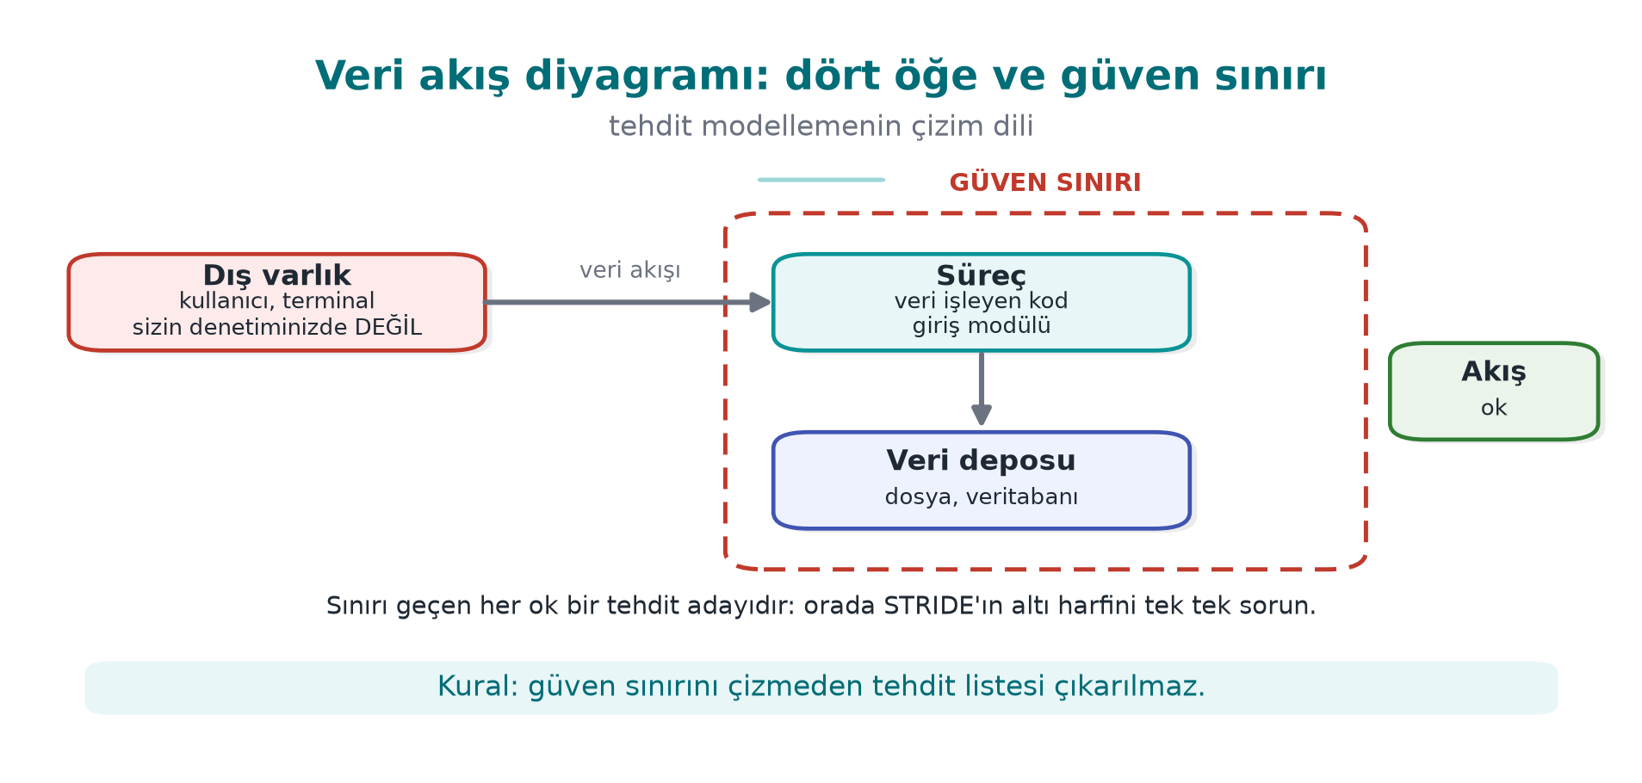
CEN429 Secure Programming · Week 1
Data flow diagram and trust boundary — diagram
RTEU Computer Engineering · 2026-2027 Fall
71

Slide 72
CEN429 Secure Programming · Week 1
Which letter for which element?
Element | S | T | R | I | D | E
--- | :-: | :-: | :-: | :-: | :-: | :-:
External entity | ✔ |  | ✔
Process | ✔ | ✔ | ✔ | ✔ | ✔ | ✔
Data store |  | ✔ | ✔¹ | ✔ | ✔
Data flow |  | ✔ |  | ✔ | ✔
¹ If it's an audit log · A data flow has no "identity" → S is not asked
RTEU Computer Engineering · 2026-2027 Fall
72
Notes:
Speaker note: A process is exposed to all six threats: it can be impersonated, its code altered, its memory read, it can be crashed, its privilege abused.

Slide 73
CEN429 Secure Programming · Week 1
Question and countermeasure for each letter
Letter | Ask yourself | Typical countermeasure
S | Is the other party really who they claim to be? | Authentication, signature, certificate pinning
T | Would I notice if it were changed? | MAC/HMAC, signature, integrity check
R | If they say "I didn't do it," do I have proof? | Tamper-resistant log, signed transaction
I | Does it leak on disk, network, memory, or in a log? | Encryption, memory wiping, masking
D | Can it be crashed, exhausted? | Input limits, rate limiting, quotas
E | Can a low-privileged actor get a high-privileged one's work done? | Least privilege, complete mediation, memory safety
An overflow = D (crashes) + E (control flow hijacked) + I (adjacent secret is read)
RTEU Computer Engineering · 2026-2027 Fall
73

Slide 74
CEN429 Secure Programming · Week 1
Risk score: likelihood × impact
 | Impact 1 | Impact 2 | Impact 3
--- | :-: | :-: | :-:
Likelihood 3 | 3 | 6 | 9 critical
Likelihood 2 | 2 | 4 | 6
Likelihood 1 | 1 | 2 | 3
• Likelihood: physical access, or over the internet? Expertise needed? Can it be automated?
• Impact: which asset, how many users, financial/legal consequence?
• More detailed: CVSS (week 2), attack potential (week 13)
RTEU Computer Engineering · 2026-2027 Fall
74

Slide 75
CEN429 Secure Programming · Week 1
Four responses to a threat
1. Mitigate — add a countermeasure (most common)
2. Eliminate — never write the feature at all (strongest) If there's no "remember my password" feature, there's no disk-password threat either
3. Transfer — don't store card data, leave it to the payment provider
4. Accept — write it into the residual risk list, with a reason
⚠️ A risk not written into the plan is not accepted, it has been overlooked
RTEU Computer Engineering · 2026-2027 Fall
75

Slide 76
CEN429 Secure Programming · Week 1
4. Worked example: the "Vault" password vault
RTEU Computer Engineering · 2026-2027 Fall
76

Slide 77
CEN429 Secure Programming · Week 1
Step 0–1: Application and scope
Vault: a C++ desktop password vault
• Master password → derived key → records encrypted in a single file
• Copy to clipboard · optional cloud backup · auto-update
Field | Value
Target of evaluation | kasa 1.0 + kasa_cekirdek + configuration
Out of scope | The backup server itself, the operating system
Security objective | Unreadable and undetectably unmodifiable to anyone who doesn't know the master password
RTEU Computer Engineering · 2026-2027 Fall
77

Slide 78
CEN429 Secure Programming · Week 1
Step 2: Architecture and interfaces
Interface | Ends | Authentication | Confidentiality / integrity
A | User → Interface | Master password | Never shown on screen
B | Interface → Core | Same process | Password erased after the call
C | Core → Vault file | — | AES-GCM, key from the password
D | Core → Clipboard | — | Cleared after 30 s
E | Core → Backup server | Certificate + token | TLS + already-encrypted file
F | Interface → Update | Package signature | TLS; the real assurance is the signature
RTEU Computer Engineering · 2026-2027 Fall
78
Notes:
Speaker note: Draw the diagram on the board; E and F are the arrows that cross the trust boundary.

Slide 79
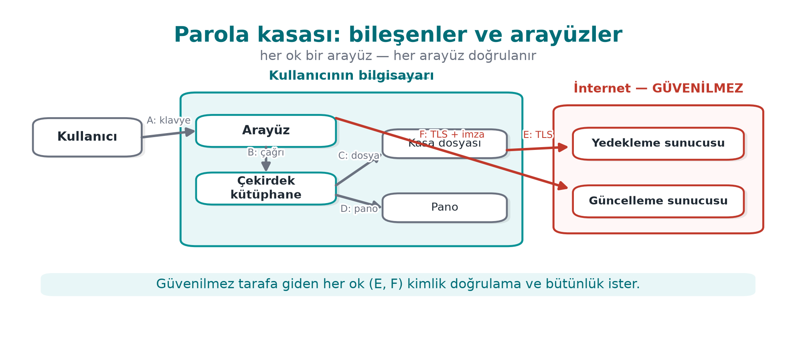
CEN429 Secure Programming · Week 1
Vault architecture — diagram
RTEU Computer Engineering · 2026-2027 Fall
79

Slide 80
CEN429 Secure Programming · Week 1
Step 3: Assets
# | Asset | Where | Creation → deletion | Protection
V1 | Master password | Memory only | Typed → derived → erased immediately | C
V2 | Vault key | Memory only | Derived → erased on lock | C, I
V3 | Decrypted record | Memory | Displayed → erased on close | C
V4 | Vault file | Disk, backup | Persistent | C, I
V5 | Salt, derivation parameter | File header | At creation | I
V6 | Update public key | Embedded in the app | At build time | I
Protection classes: C confidentiality · I integrity · I+ integrity + accountability · N none
RTEU Computer Engineering · 2026-2027 Fall
80

Slide 81
CEN429 Secure Programming · Week 1
Step 4: Threats
# | Where | Letter | Threat | Risk
--- | --- | :-: | --- | :-:
T1 | C / V4 | I | Stolen file, weak password brute-forced offline | 9
T2 | B / V1-2 | I | Password/key stays in memory → dump, swap | 6
T3 | D / V3 | I | Clipboard password read by another app | 6
T5 | C / V5 | T | Iteration count dropped to 1 | 3
T6 | F / V6 | T, E | A fake update is installed | 6
T8 | Process | T | A memory bug in the vault parser | 6
RTEU Computer Engineering · 2026-2027 Fall
81

Slide 82
CEN429 Secure Programming · Week 1
Step 3-4 (continued): remaining assets and threats
# | Asset/Threat | Detail | Value
V7 | Backup token | Disk (OS key store); created on connect → deleted on revoke | C
T4 | C / V4, T | Vault file is modified; a corrupted record is used without notice | Risk 4
T7 | E, S | A fake backup server steals the token | Risk 4
T9 | A, S | Master password read off the screen (shoulder surfing) | Risk 3
All nine threats must be in the table; a skipped threat is a threat that isn't closed.
RTEU Computer Engineering · 2026-2027 Fall
82

Slide 83
CEN429 Secure Programming · Week 1
Step 5: Countermeasures
Threat | Countermeasure | Layer
T1 | Slow derivation (Argon2id / high-iteration PBKDF2) + password strength requirement | 6, 2
T2 | Secure erase, mlock, disable dumps | 2
T3 | Clipboard cleared after 30 s | 1
T4-5 | Authenticated encryption; header = AAD; minimum iteration count hard-coded | 6, 2
T6 | Never run without verifying the signature; reject downgrades | 6
T8 | Length validation + fuzzing + compiler protections | 2, 3, 7
RTEU Computer Engineering · 2026-2027 Fall
83

Slide 84
CEN429 Secure Programming · Week 1
Step 5 (continued): T7 and T9 countermeasures
Threat | Countermeasure | Layer
T7 | Certificate validation + hostname check, optional certificate pinning | 6
T9 | Accept: mask the password on screen; physical observation is out of scope | —
The T9 example matters: not every threat needs a countermeasure added, sometimes accepting it is the right call.
RTEU Computer Engineering · 2026-2027 Fall
84

Slide 85
CEN429 Secure Programming · Week 1
Step 6–7: Verification and residual risk
Countermeasure | Test | Expected
Derivation | Time it | ≥ 250 ms
Erasure | Search a memory dump after lock for the password | Not found
Integrity | Modify one byte of the file | Says "corrupted," refuses to open, doesn't crash
Signature | A package with a broken signature | Rejected, logged
Residual risk: malware running with the same user while the vault is open · shoulder surfing · a very weak password
⚠️ A countermeasure with no test doesn't exist in an evaluator's eyes
RTEU Computer Engineering · 2026-2027 Fall
85

Slide 86
CEN429 Secure Programming · Week 1
Step 6 (continued): T5 and T8 tests
Countermeasure | Test | Expected
T5 parameter | Iteration count in the header set to 1 | The app rejects the file
T8 parser | 24 hours of fuzzing (week 4) | No crashes; no sanitizer findings
RTEU Computer Engineering · 2026-2027 Fall
86

Slide 87
CEN429 Secure Programming · Week 1
Step 7 (continued): residual risk — full table
Risk | Why accepted? | Re-evaluation
Memory can be read if malware runs while the vault is open | Full protection against same-user malware isn't possible; the lock timeout was kept short | Every release
Shoulder surfing (T9) | The physical environment is out of scope | —
Very weak master password | The user is warned but not forcibly blocked | Based on user feedback
RTEU Computer Engineering · 2026-2027 Fall
87

Slide 88
CEN429 Secure Programming · Week 1
Common mistakes
• Forgetting assets: keys, tokens, counters, configuration, the code itself
• Drawing the trust boundary wrong: treating your own client as "trusted"
• Not matching a countermeasure to a threat: "we use TLS" — which threat does it close, which doesn't it?
• A countermeasure with no test: saying "we erase it" without noticing the compiler removed the erasure (Demo 2)
RTEU Computer Engineering · 2026-2027 Fall
88
Notes:
Speaker note: These seven steps are the skeleton of the term project's security guide. This week, steps 0-4 are expected.

Slide 89
CEN429 Secure Programming · Week 1
Class exercise (15 min)
Student grading system: the instructor enters grades, the student sees them, the data lives on a server.
1. Data flow diagram + trust boundaries
2. One threat from each STRIDE letter
3. Attack tree for "raise my grade from 45 to 85" — which is the cheapest path?
RTEU Computer Engineering · 2026-2027 Fall
89
Notes:
Speaker note: Groups of 3-4 people. 10 minutes of work, 5 minutes for two groups to present. Hint: for E, a direct URL to a grade-entry page; for R, no record of the change.

Slide 90
CEN429 Secure Programming · Week 1
5. Program start-up and secrets left in memory
RTEU Computer Engineering · 2026-2027 Fall
90

Slide 91
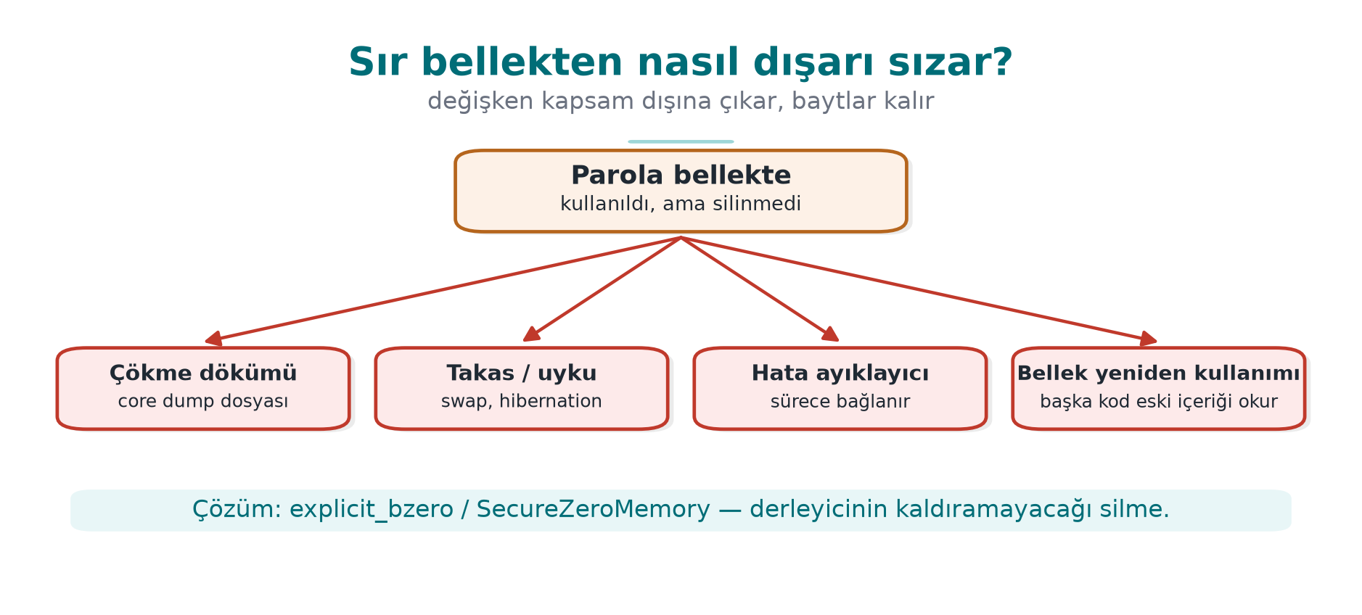
CEN429 Secure Programming · Week 1
How a secret leaks from memory — diagram
RTEU Computer Engineering · 2026-2027 Fall
91

Slide 92
CEN429 Secure Programming · Week 1
A program doesn't start with a blank page
What it inherits from whoever launched it:
• Environment variables: PATH, LD_PRELOAD, IFS…
• Open file descriptors, working directory, umask
• Resource limits, crash dump settings
If the program trusts these, whoever controls them controls the program. Book: Viega & Messier, Recipes 1.1–1.9
RTEU Computer Engineering · 2026-2027 Fall
92

Slide 93
CEN429 Secure Programming · Week 1
Demo 1 — Fooling via PATH (CWE-426)
int durum = system(KOMUT); /* Linux: "date" Windows: "hostname" */
/* HANGİSİ çalışacak? */
.demo.ps1 (Windows) · sh demo.sh (WSL / Linux)
ADIM 2 — PATH="$PWD/sahte:$PATH" ./bin/linux/rapor
Rapor tarihi:
!!! SAHTE 'date' calisti !!!
ADIM 3 — ./bin/linux/rapor_guvenli -> Rapor tarihi: Sat Sep 19 ...
RTEU Computer Engineering · 2026-2027 Fall
93
Notes:
Speaker note: First show the fake/date file (sahte\hostname.bat on Windows): it only prints a message. On Windows, cmd.exe searches the working directory before PATH too. Ask: "what would a real attacker do here?"

Slide 94
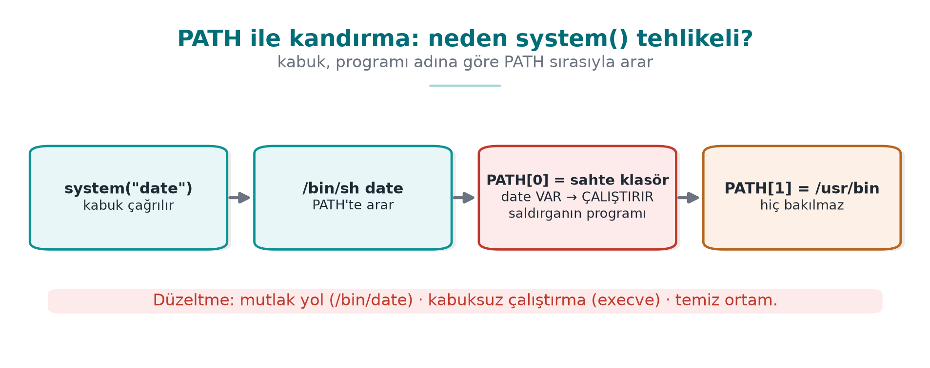
CEN429 Secure Programming · Week 1
Fooling via PATH — diagram
RTEU Computer Engineering · 2026-2027 Fall
94

Slide 95
CEN429 Secure Programming · Week 1
Fix: three rules
char *const arguman[] = { "date", NULL };
char *const temiz_ortam[] = { "PATH=/usr/bin:/bin", "LANG=C", NULL };
posix_spawn(&pid, "/bin/date", NULL, NULL, arguman, temiz_ortam);
1. Absolute path → no PATH search
2. No shell (posix_spawn / execve) → no special characters, no IFS
3. Clean environment → a known, small environment
Windows: CreateProcessW + System32hostname.exe + only SystemRoot
Best: avoid needing another program at all → strftime(), GetComputerNameW()
RTEU Computer Engineering · 2026-2027 Fall
95

Slide 96
CEN429 Secure Programming · Week 1
Secure start-up: what is inherited?
Inherited | Danger | Recipe
Environment variables | PATH, LD_PRELOAD change the program/library that loads | 1.1
Open file descriptors | The parent's hidden file leaks; if 0–2 are closed, the first file becomes "stdout" | 1.5
umask | 000 → world-writable files | 2.7
Resource limits | Core dump enabled → memory to disk | 1.9
Identity and privileges | setuid: more privilege than needed | 1.3
Rule: trust nothing you didn't set up yourself
RTEU Computer Engineering · 2026-2027 Fall
96

Slide 97
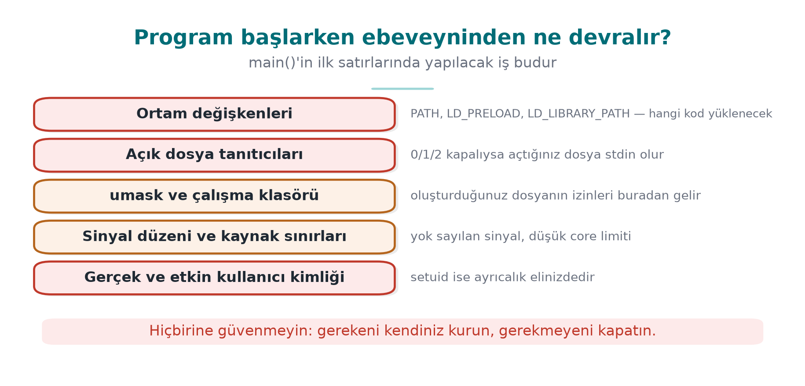
CEN429 Secure Programming · Week 1
What a program inherits — diagram
RTEU Computer Engineering · 2026-2027 Fall
97

Slide 98
CEN429 Secure Programming · Week 1
Other inherited risks: working directory, signals, dlopen
• Working directory: relative paths (./ayar.ini) can point into a folder the attacker chose
• Signal settings: signals the parent ignores are also ignored in the child
• `dlopen("lib.so")`: affected by LD_LIBRARY_PATH and search paths → use the full path; LD_* should already be cleaned in Step 1
Same rule: trust nothing the program itself did not set up.
RTEU Computer Engineering · 2026-2027 Fall
98

Slide 99
CEN429 Secure Programming · Week 1
Steps 1–2: Environment and descriptors
/* Ortam: kara liste değil BEYAZ liste */
clearenv(); /* önce korunacakları kopyala! */
setenv("PATH", "/usr/bin:/bin", 1);
/* 0-2 kapalıysa /dev/null'a bağla, gerisini kapat */
for (int fd = 0; fd <= 2; fd++)
if (fcntl(fd, F_GETFD) == -1 && open("/dev/null", O_RDWR) != fd) abort();
close_range(3, ~0U, 0); /* Linux 5.9+ */
• The getenv pointer becomes invalid after clearenv
• Always use O_CLOEXEC on your own files
RTEU Computer Engineering · 2026-2027 Fall
99

Slide 100
CEN429 Secure Programming · Week 1
Steps 3–4: Permissions and crash dumps
umask(077); /* rw------- */
int fd = open(yol, O_WRONLY | O_CREAT | O_EXCL, 0600);
struct rlimit r = { 0, 0 };
setrlimit(RLIMIT_CORE, &r); /* döküm boyutu 0 */
prctl(PR_SET_DUMPABLE, 0, 0, 0, 0); /* + ptrace ile bağlanılamaz */
• Windows: SetErrorMode(SEM_FAILCRITICALERRORS | SEM_NOGPFAULTERRORBOX)
• The real defence: even if a dump is taken, no secret should be left inside it
RTEU Computer Engineering · 2026-2027 Fall
100
Notes:
Speaker note: Highlight PR_SET_DUMPABLE's second effect: even a debugger from the same user can't attach. A bridge to week 6.

Slide 101
CEN429 Secure Programming · Week 1
Step 5: Drop privilege permanently and verify
if (setresgid(g, g, g) != 0) abort(); /* 1. önce GRUP */
if (setresuid(u, u, u) != 0) abort(); /* 2. sonra kullanıcı: r/e/s üçü de */
getresuid(&r, &e, &s);
if (r != u || e != u || s != u) abort(); /* 3. DOĞRULA */
• seteuid() is temporary: the saved identity stays privileged (week 2 Demo 13)
• Windows: a restricted token (CreateRestrictedToken)
• Better: privilege separation — a small privileged process + a large unprivileged one (Recipe 1.4)
RTEU Computer Engineering · 2026-2027 Fall
101

Slide 102
CEN429 Secure Programming · Week 1
Step 6: Loading programs and libraries
❌ Wrong | ✅ Correct
system("convert " + dosya) | execve("/usr/bin/convert", argv, temiz_ortam)
execvp("convert", ...) | execve with a full path
CreateProcess(NULL, "C:Program Files...") | lpApplicationName = full path, quoted command line
LoadLibrary("yardimci.dll") | SetDefaultDllDirectories(LOAD_LIBRARY_SEARCH_DEFAULT_DIRS) + full path
The Windows DLL search order = the twin of the PATH problem (CWE-427)
RTEU Computer Engineering · 2026-2027 Fall
102

Slide 103
CEN429 Secure Programming · Week 1
All together: guvenli_baslat()
int main(int argc, char **argv)
{
tanitici_duzenle(); /* 1. tanıtıcılar */
ortami_temizle(); /* 2. ortam */
umask(077); /* 3. izinler */
dokumu_kapat(); /* 4. döküm */
yetkiyi_birak(); /* 5. yetki */
/* ... asıl iş ... */
}
Order matters: before doing anything else
RTEU Computer Engineering · 2026-2027 Fall
103
Notes:
Speaker note: An evaluator starts the program with stdout closed, a poisoned PATH/LD_PRELOAD, and umask 000. In the field, the native layer tests whether getenv is hooked with a setenv/getenv round-trip.

Slide 104
CEN429 Secure Programming · Week 1
Demo 2 — Password left in memory (CWE-14)
char parola[64];
n = dosya_oku(fd, parola, sizeof(parola) - 1);
anahtar = anahtar_turet(parola, n);
memset(parola, 0, sizeof(parola)); /* sürüm 2 */
explicit_bzero(parola, sizeof(parola)); /* sürüm 3, Linux */
SecureZeroMemory(parola, sizeof(parola)); /* sürüm 3, Windows */
Hiç silmeyen -> parola dökümde BULUNDU
memset (-O2) -> parola dökümde BULUNDU ← !!!
explicit_bzero -> parola dökümde bulunamadı
RTEU Computer Engineering · 2026-2027 Fall
104
Notes:
Speaker note: On Linux the demo stops the program with gdb and dumps memory with gcore; on Windows the program writes its own memory with MiniDumpWriteDump. This is a safe simulation of a crash dump or debugger attack. MSVC /O2 also removes the memset. Machine code: objdump -d on Linux, the Disassembly window in Visual Studio.

Slide 105
CEN429 Secure Programming · Week 1
Why did the memset disappear?
The compiler's reasoning:
"parola is never read after this point. Writing zeros into it doesn't change the result. Redundant — I'll remove it."
Dead store elimination: good for speed, a disaster for secrets.
Platform | Erasure that can't be removed
Linux (glibc) | explicit_bzero
Windows | SecureZeroMemory
C11 Annex K | memset_s
OpenSSL | OPENSSL_cleanse
+ setrlimit(RLIMIT_CORE, 0) · mlock · keep the secret short-lived, don't copy it
RTEU Computer Engineering · 2026-2027 Fall
105

Slide 106
CEN429 Secure Programming · Week 1
6. Process memory and overflows
RTEU Computer Engineering · 2026-2027 Fall
106

Slide 107
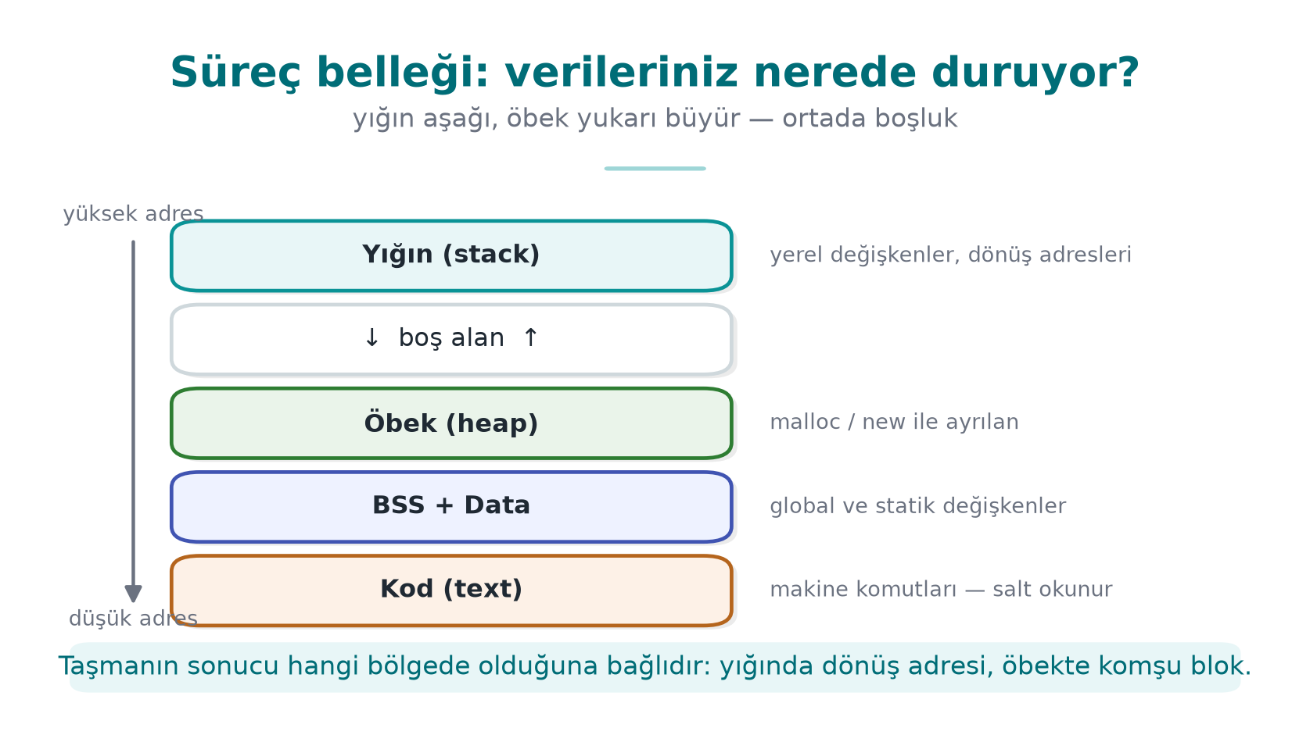
CEN429 Secure Programming · Week 1
Process memory
C does not check the end of an array. A 17th byte into ad[16] → overwrites the next variable.
RTEU Computer Engineering · 2026-2027 Fall
107

Slide 108
CEN429 Secure Programming · Week 1
The structure in memory
struct oturum { char ad[16]; int yonetici; };
ofset: 0 ............................ 15 | 16 17 18 19
[ a y s e \0 . . . . . . ][ 00 00 00 00 ] yonetici = 0
"AAAAAAAAAAAAAAAAB" (17 karakter) kopyalanınca:
[ A A A A A A A A A A A ][ 42 00 00 00 ] yonetici = 66 (!)
'B' '\0'
Little-endian: the lowest byte sits at the lowest address.
RTEU Computer Engineering · 2026-2027 Fall
108

Slide 109
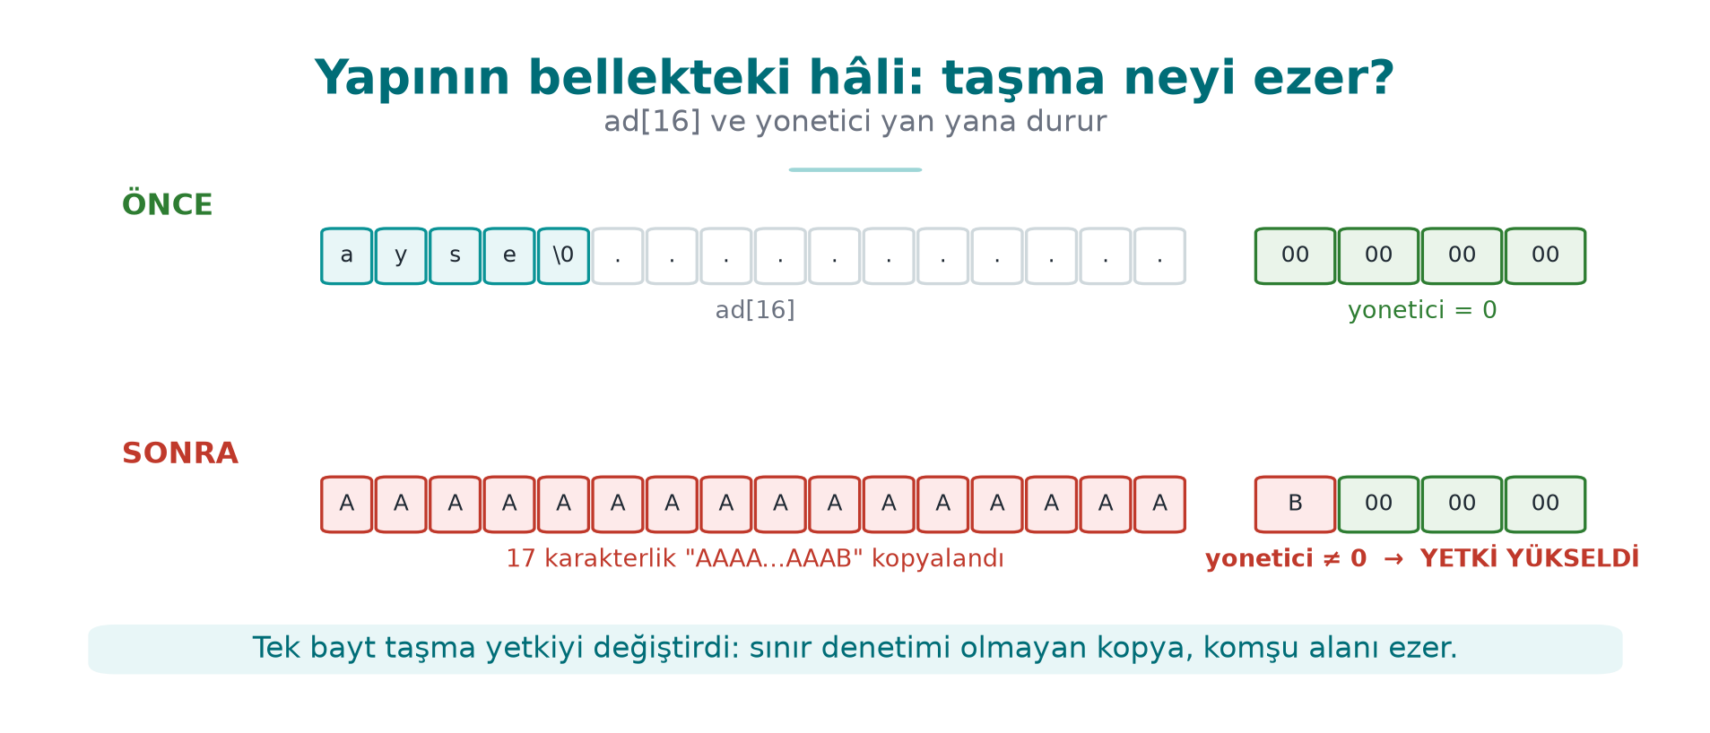
CEN429 Secure Programming · Week 1
Structure in memory and overflow — diagram
RTEU Computer Engineering · 2026-2027 Fall
109

Slide 110
CEN429 Secure Programming · Week 1
What is a buffer overflow?
Writing more data than allocated into an array → the overflowing bytes land over neighboring variables
Why does C overflow so easily?
1. An array doesn't know its own size
2. Only the starting address goes to the function
3. A string = an array ending in '0'; strcpy never asks the target's size
4. The compiler adds no bounds checking
CWE-787 "out-of-bounds write": always near the top of the CWE Top 25
RTEU Computer Engineering · 2026-2027 Fall
110

Slide 111
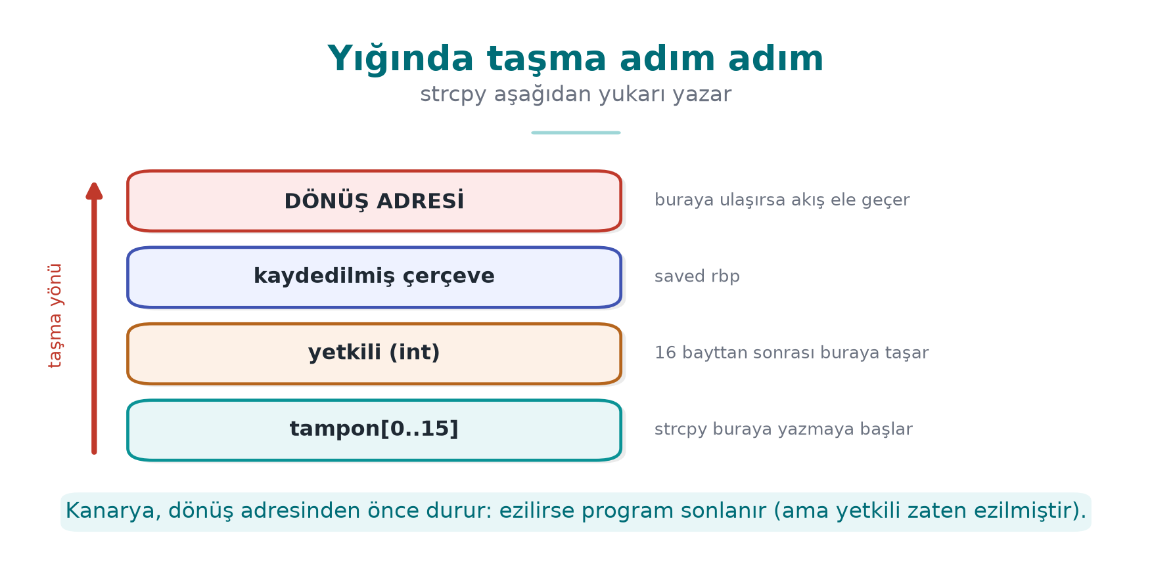
CEN429 Secure Programming · Week 1
A stack overflow
void selamla(const char *ad) {
int yetkili = 0;
char tampon[16];
strcpy(tampon, ad); /* ad > 15 karakter? */
}
RTEU Computer Engineering · 2026-2027 Fall
111
Notes:
Speaker note: The real layout varies by compiler. In this course we focus on how the bug happens, is found, and is prevented — not on the exploitation technique.

Slide 112
CEN429 Secure Programming · Week 1
Types of overflow
Type | Typical cause | CWE
Stack overflow | strcpy, gets, unbounded scanf("%s") | 121
Heap overflow | A memcpy with the wrong length | 122
Off-by-one | <= instead of <; no room for '0' | 193
Out-of-bounds read | Trusting a length the other party reports | 125
Integer-driven | n * size overflows → small block, large copy | 190 → 787
RTEU Computer Engineering · 2026-2027 Fall
112

Slide 113
CEN429 Secure Programming · Week 1
Heartbleed (2014): nothing was written
• Client: "I'm sending 1 byte, but reporting 64 KB"
• Server: sent 64 KB back without checking the declared length
• Leaked: passwords, sessions, even the server's private key
• CVE-2014-0160 · CWE-125 · Fix: a single length check
➡️ An out-of-bounds read is as dangerous as a write; it doesn't crash, leaves no trace
RTEU Computer Engineering · 2026-2027 Fall
113

Slide 114
CEN429 Secure Programming · Week 1
The off-by-one bug
char ad[8];
for (int i = 0; i <= 8; i++) /* 9 kez: ad[8] dışarıda */
ad[i] = kaynak[i];
strncpy(ad, kaynak, sizeof ad); /* kaynak >= 8 → '\0' YOK */
printf("%s\n", ad); /* dizinin sonundan okumaya devam */
• strncpy is not a safe strcpy
• Even a single-byte overflow changes the low byte of a neighboring variable
RTEU Computer Engineering · 2026-2027 Fall
114

Slide 115
CEN429 Secure Programming · Week 1
Dangerous functions → use instead
❌ | ✅
gets(s) | fgets(s, sizeof s, stdin) — gets removed in C11
strcpy(d, s) | Length check + memcpy, snprintf, strlcpy (glibc 2.38+)
strcat(d, s) | Compute remaining room; snprintf, strlcat
sprintf(d, ...) | snprintf(d, sizeof d, ...) + check the return value
scanf("%s", s) | scanf("%15s", s)
memcpy(d, s, n) | First check n <= sizeof d
char a[n] (VLA), alloca | A fixed upper bound, or malloc
Today's Recipe 3.3–3.4: snprintf/strlcpy, MSVC strcpy_s, C++ std::string/span
RTEU Computer Engineering · 2026-2027 Fall
115

Slide 116
CEN429 Secure Programming · Week 1
The right pattern: validate first, then copy with a bound
int selamla(const char *ad)
{
char tampon[16];
size_t n = strnlen(ad, sizeof tampon); /* en fazla 16 bayt oku */
if (n == sizeof tampon) /* uzunsa REDDET */
return -1;
memcpy(tampon, ad, n);
tampon[n] = '\0'; /* sonlandırıcı her zaman */
printf("Merhaba %s\n", tampon);
return 0;
}
Why reject instead of truncate? /home/ayse/gizli_rapor.txt → /home/ayse/gizli
RTEU Computer Engineering · 2026-2027 Fall
116

Slide 117
CEN429 Secure Programming · Week 1
C++: the type carries the size — but be careful
void selamla(const std::string &ad) {
if (ad.size() > 15) throw std::invalid_argument("ad cok uzun");
std::cout << "Merhaba " << ad << '\n';
}
• vector::operator[] does not check bounds → at() does
• Writing through a pointer taken with c_str() → all of C's problems come back
RTEU Computer Engineering · 2026-2027 Fall
117

Slide 118
CEN429 Secure Programming · Week 1
Who catches the overflow?
Layer | Tool | When?
Code | Bounds checking, safe API | Always
Warning | -Wall -Wextra -Wformat-security · /W4 /sdl | Development
Static analysis | clang --analyze, cppcheck, /analyze | CI
Sanitizer | -fsanitize=address · /fsanitize=address | Testing
Fuzzing | libFuzzer, AFL++ | Testing (week 4)
Compiler | Canary -fstack-protector-strong · /GS, _FORTIFY_SOURCE | Release
OS / hardware | DEP/NX, ASLR · Intel CET, ARM PAC | Release
⚠️ Protection makes exploitation harder, it doesn't fix the bug — a canary terminates the program = denial of service
RTEU Computer Engineering · 2026-2027 Fall
118

Slide 119
CEN429 Secure Programming · Week 1
Reading an ASan report
ERROR: AddressSanitizer: stack-buffer-overflow
WRITE of size 21 at 0x7ffd... thread T0
#0 in strcpy
#1 in selamla ornek.c:7
#2 in main ornek.c:15
This frame has 1 object(s):
[32, 48) 'tampon' <== Memory access at offset 48 overflows this variable
1. What? a stack overflow, a 21-byte write
2. Where? ornek.c:7, strcpy
3. Which variable? tampon (16 bytes), the access is right past the bound
Roughly 2× slower → only in test builds
RTEU Computer Engineering · 2026-2027 Fall
119
Notes:
Speaker note: An evaluator first greps for dangerous functions, then checks whether every externally supplied length field is validated; checks protections with checksec / dumpbin.

Slide 120
CEN429 Secure Programming · Week 1
Demo 3 — Privilege escalation via overflow (CWE-121)
.demo.ps1 (Windows) · sh demo.sh (WSL / Linux)
Version | 17-character attack
giris (unprotected) | ❌ ADMIN access granted
giris_asan (ASan) | ❌ stayed silent — overflow inside the struct
giris_asan + 40 characters | ✅ stack-buffer-overflow caught
giris_denetimli (_FORTIFY_SOURCE=2 / strcpy_s) | ✅ program stopped
giris_guvenli | ✅ Rejected
RTEU Computer Engineering · 2026-2027 Fall
120
Notes:
Speaker note: The real point: a single byte is enough; tools have limits; the real fix is in the code.

Slide 121
CEN429 Secure Programming · Week 1
Fix: validate, then copy with a bound
/* İzin listesi: 1–15 karakter, harf/rakam/_/- */
static int ad_gecerli_mi(const char *s)
{
size_t n = strnlen(s, 16);
if (n == 0 || n >= 16) return 0;
for (size_t i = 0; i < n; i++) {
unsigned char c = (unsigned char)s[i];
if (!isalnum(c) && c != '_' && c != '-') return 0;
}
return 1;
}
struct oturum o = { .yonetici = 0 }; /* güvenli varsayılan */
snprintf(o.ad, sizeof(o.ad), "%s", argv[1]); /* boyutu bilen kopya */
Canary, NX, ASLR (week 4) make exploitation harder, they don't fix the bug.
RTEU Computer Engineering · 2026-2027 Fall
121

Slide 122
CEN429 Secure Programming · Week 1
Integers: when does -1 become huge?
int is signed · size_t is unsigned · negatives are two's complement
int -1 = 0xFFFFFFFFFFFFFFFF
size_t = 18 446 744 073 709 551 615
if (uzunluk > 16) return -1; /* -1 bu denetimi GEÇER */
memcpy(hedef, kaynak, uzunluk); /* int -> size_t */
RTEU Computer Engineering · 2026-2027 Fall
122

Slide 123
CEN429 Secure Programming · Week 1
Demo 4 — Signed length (CWE-195)
ADIM 0 GCC -Wall -Wextra: sessiz · -Wsign-conversion: uyarı
MSVC (C): sessiz · aynı kod C++ olarak: C4365
ADIM 1 kopya 8 -> Kopyalandi: ORNEK-KA
ADIM 2 kopya 100 -> Reddedildi
ADIM 3 kopya -1 -> Linux: SIGSEGV (139) · Windows: 0xC0000409
ADIM 4 ASan -> negative-size-param: (size=-1)
ADIM 5 kopya_guvenli -1 / 12abc -> Reddedildi
Rule: sizes in size_t · lower and upper bound · strtol · turn on warnings
RTEU Computer Engineering · 2026-2027 Fall
123

Slide 124
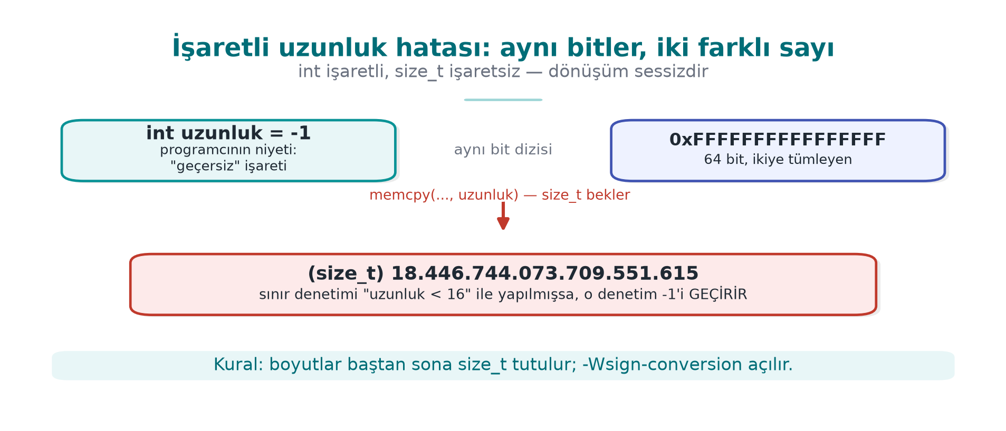
CEN429 Secure Programming · Week 1
The signed length bug — diagram
RTEU Computer Engineering · 2026-2027 Fall
124

Slide 125
CEN429 Secure Programming · Week 1
7. Memory management, partitioning, and secure processing
RTEU Computer Engineering · 2026-2027 Fall
125

Slide 126
CEN429 Secure Programming · Week 1
The lifecycle of dynamic memory
Allocate → validate → use → erase secret → free once → forget the pointer
Step | If forgotten | CWE
Validate | malloc returns NULL, unchecked → crash | 476
Use | Out-of-bounds write | 787
Erase secret | The block goes to another piece of code on the next malloc | 226
Free once | Double free | 415
Forget the pointer | Use-after-free (UAF) | 416
Never free | Leak → denial of service | 401
RTEU Computer Engineering · 2026-2027 Fall
126

Slide 127
CEN429 Secure Programming · Week 1
The four lifetimes of memory
Lifetime | How created? | When does it end? | Typical bug
Static | Global variable, static local | When the program ends | Multiple threads writing at once
Automatic | Local variable inside a function | On return | Returning the address of a local variable
Dynamic | malloc/calloc/new | On free/delete | Leak, double free, UAF
Thread | _Thread_local / thread_local | When the thread ends | —
This week's overflow and UAF examples all relate to the dynamic lifetime; knowing that alone isn't enough.
RTEU Computer Engineering · 2026-2027 Fall
127

Slide 128
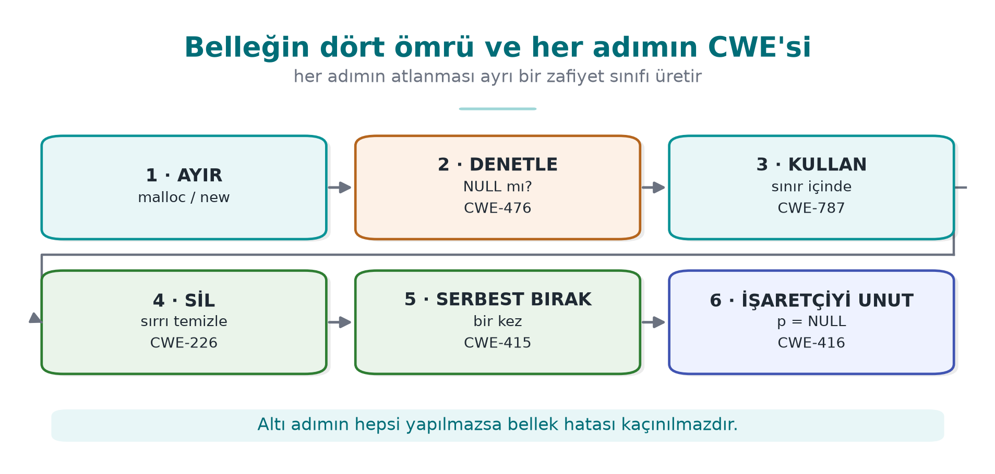
CEN429 Secure Programming · Week 1
The lifetime of memory and its CWEs — diagram
RTEU Computer Engineering · 2026-2027 Fall
128

Slide 129
CEN429 Secure Programming · Week 1
UAF: why is it so dangerous?
Kullanici *aktif = malloc(sizeof *aktif);
Kullanici *onbellek = aktif; /* ikinci sahip */
free(aktif); aktif = NULL; /* onbellek hâlâ eski adreste */
char *not = malloc(sizeof(Kullanici)); /* aynı blok geri verilebilir */
strcpy(not, "....");
if (onbellek->yetki) { ... } /* 'not'un baytlarını okuyor */
• free doesn't return memory to the OS, it puts it on the free list → the same block gets handed out again
• ✅ Ownership rule: every block has one owner, only that owner frees it
RTEU Computer Engineering · 2026-2027 Fall
129

Slide 130
CEN429 Secure Programming · Week 1
Fixed patterns
Kayit *k = calloc(n, sizeof(Kayit)); /* çarpım taşmasını denetler + sıfırlar */
if (k == NULL) return HATA_BELLEK;
Kayit *yeni = reallocarray(k, n2, sizeof(Kayit));
if (yeni == NULL) { free(k); return HATA_BELLEK; } /* k'yi kaybetme */
k = yeni;
❌ tampon = realloc(tampon, n); → on failure, the old block is lost
❌ realloc on a buffer holding a secret → the moved-away old block isn't zeroed
RTEU Computer Engineering · 2026-2027 Fall
130

Slide 131
CEN429 Secure Programming · Week 1
Erasing secrets (Recipe 13.2)
Platform | Function
Linux, BSD | explicit_bzero(p, n)
Windows | SecureZeroMemory(p, n)
C11 Annex K / C23 | memset_s / memset_explicit
None available | Byte by byte through a volatile pointer
Hidden copies of a secret: structs passed by value · realloc's old block · std::string (SSO, vanishes without erasure) · I/O buffers · swap and hibernation files
RTEU Computer Engineering · 2026-2027 Fall
131
Notes:
Speaker note: In the field, session data is erased with random values the moment the operation ends; even a long run of zeros leaves a "there was a secret here" trace.

Slide 132
CEN429 Secure Programming · Week 1
Keep it off disk (Recipe 13.3) and RAII
mlock(anahtar, sizeof anahtar); /* Windows: VirtualLock */
/* ... kullan ... */
cen429_sil(anahtar, sizeof anahtar);
munlock(anahtar, sizeof anahtar);
class GizliAnahtar { /* yıkıcı otomatik siler */
~GizliAnahtar() { cen429_sil(v_.data(), v_.size()); }
GizliAnahtar(const GizliAnahtar&) = delete; /* kopya = ikinci sır */
};
Locking is at the page level, and limited in amount → only a small key region
RTEU Computer Engineering · 2026-2027 Fall
132

Slide 133
CEN429 Secure Programming · Week 1
Memory-bug hunters
Tool | What it finds | Use
AddressSanitizer | Overflow, UAF, double free | -fsanitize=address · /fsanitize=address
LeakSanitizer | Leaks | With ASan (Linux)
MemorySanitizer | Uninitialized reads | Clang -fsanitize=memory
Valgrind | Everything (slow) | valgrind --leak-check=full ./prog
CRT debug heap | Leaks | MSVC _CrtSetDbgFlag
Evaluator: dumps memory after the process ends, searches for the test password
RTEU Computer Engineering · 2026-2027 Fall
133

Slide 134
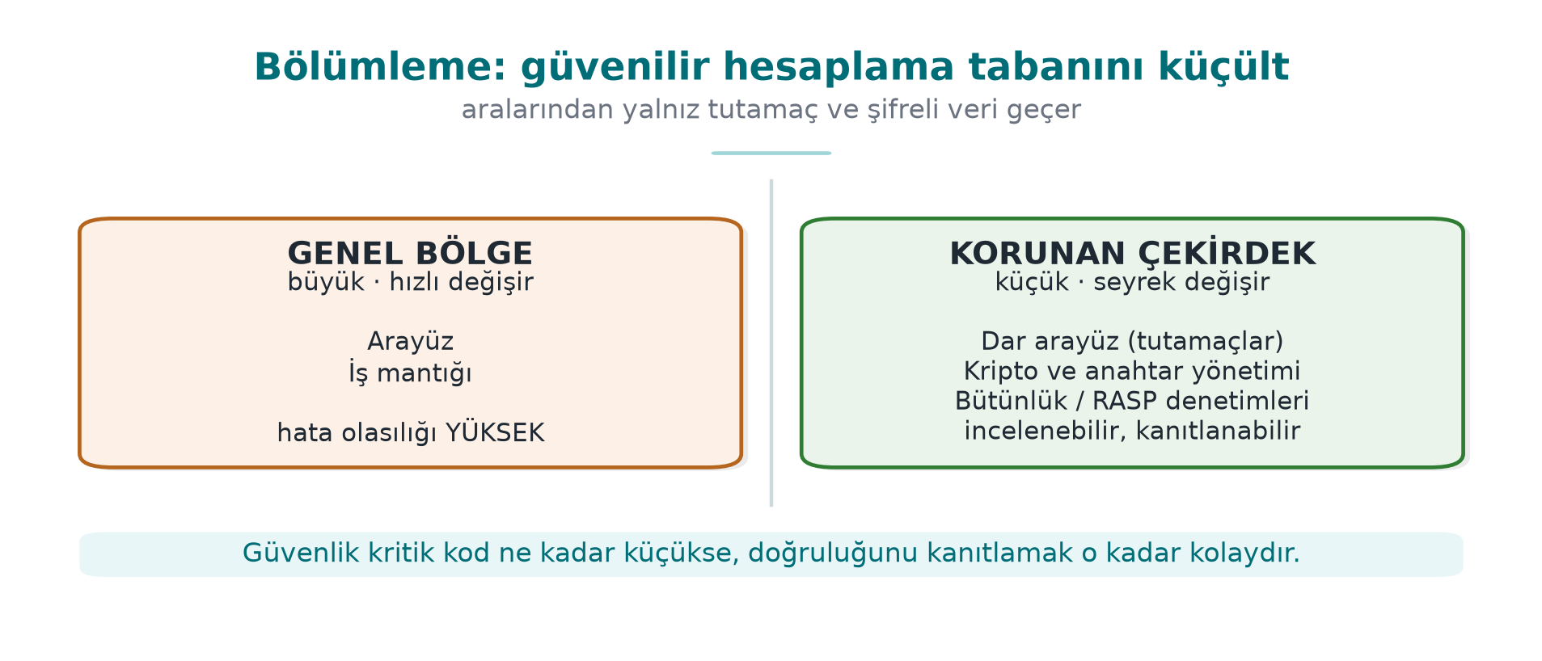
CEN429 Secure Programming · Week 1
Protected code partitioning: shrink the TCB
Trusted Computing Base (TCB): all the code where "if it's buggy, security collapses"
• A 200,000-line application, a 2,000-line protected core
• Review, obfuscation, integrity checking only for the core → cost stays there too
RTEU Computer Engineering · 2026-2027 Fall
134

Slide 135
CEN429 Secure Programming · Week 1
Partitioning options
Option | Isolation | Example
Separate module, same process | Low | A native library in a Java app
Separate process | Medium | Browser sandbox, privileged helper process (Recipe 1.4)
OS service | Medium–high | DPAPI, Keychain, Android Keystore
Hardware | High | Secure element, TPM, TEE
Move to server | Highest | The secret never goes to the client, stays in the HSM
Strongest: remove the secret from the client; failing that, hardware; failing that, software protection (this course's topic)
RTEU Computer Engineering · 2026-2027 Fall
135

Slide 136
CEN429 Secure Programming · Week 1
Interface: narrow, validated, secret-free
typedef struct KasaAnahtari KasaAnahtari; /* opak tür */
int kasa_ac(const char *parola, size_t n, const unsigned char tuz[16],
KasaAnahtari **cikti); /* parolayı siler */
int kasa_coz(KasaAnahtari *a, const unsigned char *sifreli, size_t n,
unsigned char *acik, size_t kapasite, size_t *yazilan);
void kasa_kapat(KasaAnahtari *a); /* anahtarı siler */
1. Don't hand out the secret, do the work (a handle)
2. Validate everything that crosses the boundary
3. Never pass plain data across the boundary
RTEU Computer Engineering · 2026-2027 Fall
136

Slide 137
CEN429 Secure Programming · Week 1
Oracles and code lifting
• Decryption oracle: the attacker calls kasa_coz with their own data — no key needed
• Code lifting: the protected function is copied as-is and run like a black box
Countermeasure | Idea
Bind to device/instance | Wrong result in another environment
Bind to version | Key won't decrypt on an old/modified version
Context checking | The caller's integrity and call order are verified
No shared static key | Breaking one copy doesn't affect others
RTEU Computer Engineering · 2026-2027 Fall
137

Slide 138
CEN429 Secure Programming · Week 1
Secure processing under encryption: the window of exposure
Kötü: [aç] ██████████████████████████████████ [kapat] anahtar hep açık
İyi: [aç] ░░░░░██░░░░░░░░██░░░░░░░░░░░██░░░░ [kapat] yalnız işlem anında
1. Just-in-time decryption → erase before the function returns
2. Masking: key XOR a random mask — two meaningless pieces in memory
3. Splitting: kept in different places, combined only on use
4. Code encryption: function code decrypted at runtime (weeks 4, 9)
5. White-box: the key is never exposed at all (week 11)
RTEU Computer Engineering · 2026-2027 Fall
138
Notes:
Speaker note: In the field, a single static key is split down to the half-byte and spread across dozens of functions; the fingerprint is stored in two places with two different hashes and compared. Masking alone is not a fortress; it gains value combined with the other layers.

Slide 139
CEN429 Secure Programming · Week 1
Masking in memory — code example
typedef struct {
uint8_t maske[32]; /* açılışta rastgele üretilir */
uint8_t ortulu[32]; /* anahtar XOR maske */
} OrtuluAnahtar;
static void anahtari_ac(const OrtuluAnahtar *o, uint8_t gecici[32])
{
for (size_t i = 0; i < 32; i++)
gecici[i] = o->ortulu[i] ^ o->maske[i];
}
What sits in memory is not the key itself, but two meaningless pieces; combined only when used.
RTEU Computer Engineering · 2026-2027 Fall
139

Slide 140
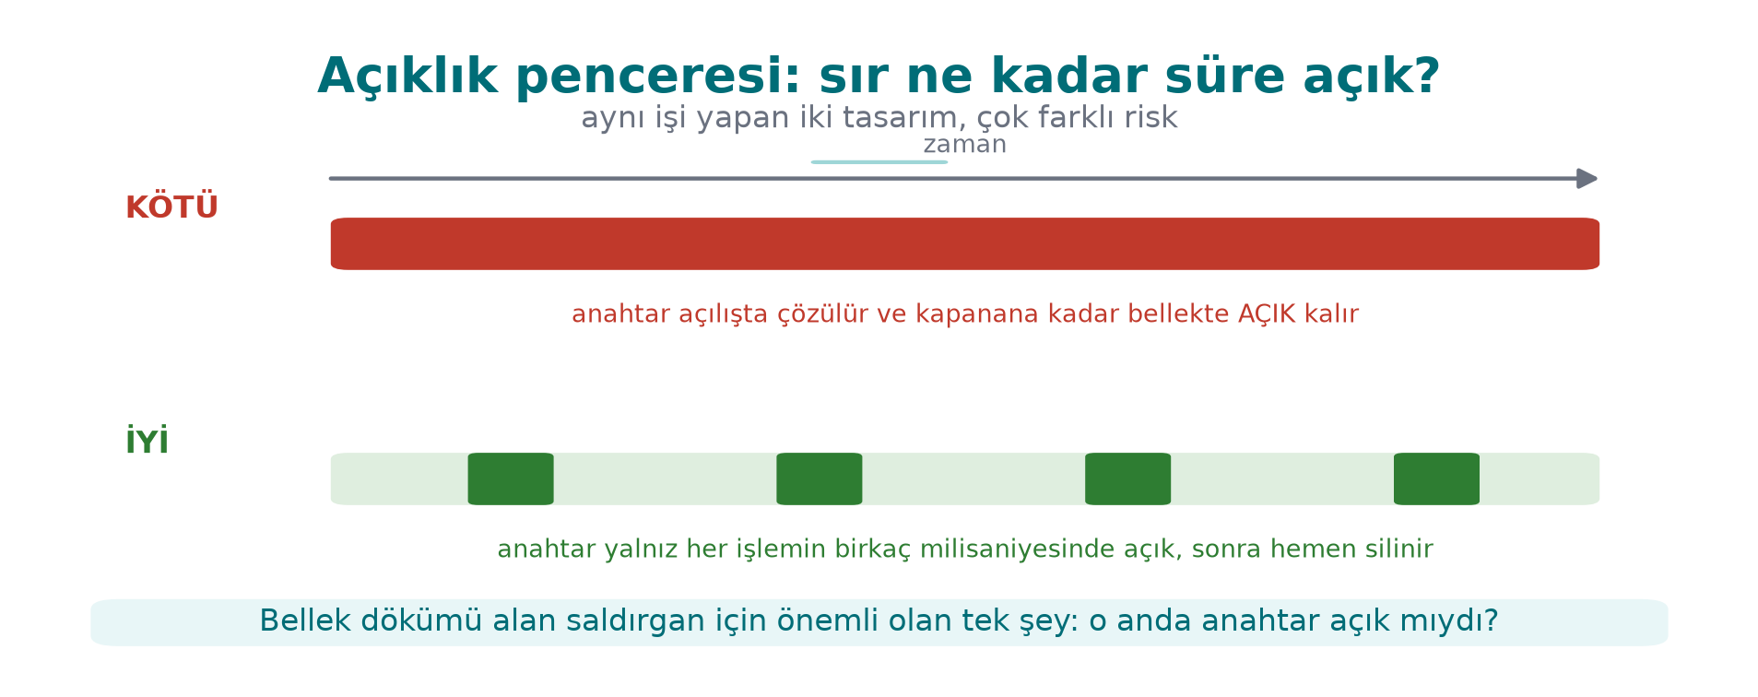
CEN429 Secure Programming · Week 1
Window of exposure — diagram
RTEU Computer Engineering · 2026-2027 Fall
140

Slide 141
CEN429 Secure Programming · Week 1
The secure development lifecycle
Stage | Activity | Week
Requirement | Security requirements from standards | 13
Design | Threat model, protection plan | 1–2
Implementation | Coding rules, banned functions, static analysis | 4–5
Verification | Sanitizer, fuzzing, penetration testing | 4, 12
Release | Signed build, unique version identity | 1, 10
Response | Vulnerability disclosure, emergency update | 12
Microsoft SDL · NIST SSDF (SP 800-218)
RTEU Computer Engineering · 2026-2027 Fall
141

Slide 142
CEN429 Secure Programming · Week 1
Unique version identity
Is what was reviewed the same as what was shipped? → 1.4.2 + git id + the binary's SHA-256
execute_process(COMMAND git rev-parse --short=12 HEAD
OUTPUT_VARIABLE GIT_KIMLIK OUTPUT_STRIP_TRAILING_WHITESPACE)
target_compile_definitions(kasa PRIVATE SURUM="1.4.2" GIT_KIMLIK="${GIT_KIMLIK}")
Get-FileHash .kasa.exe -Algorithm SHA256 · sha256sum ./kasa
In the field, the version also feeds into key derivation → a version-rollback attack won't work
RTEU Computer Engineering · 2026-2027 Fall
142

Slide 143
CEN429 Secure Programming · Week 1
Change management: seven steps
1. Baseline → 2. Change request → 3. Classification → 4. Approval and planning → 5. Development and testing → 6. Release → 7. Verification
• Between 3 and 4, a security impact analysis: which asset, interface, threat, countermeasure?
• Reviewing only the changed part = delta assessment (week 13)
• Repository: protected branches · at least one reviewer · signed tag · MFA
RTEU Computer Engineering · 2026-2027 Fall
143

Slide 144
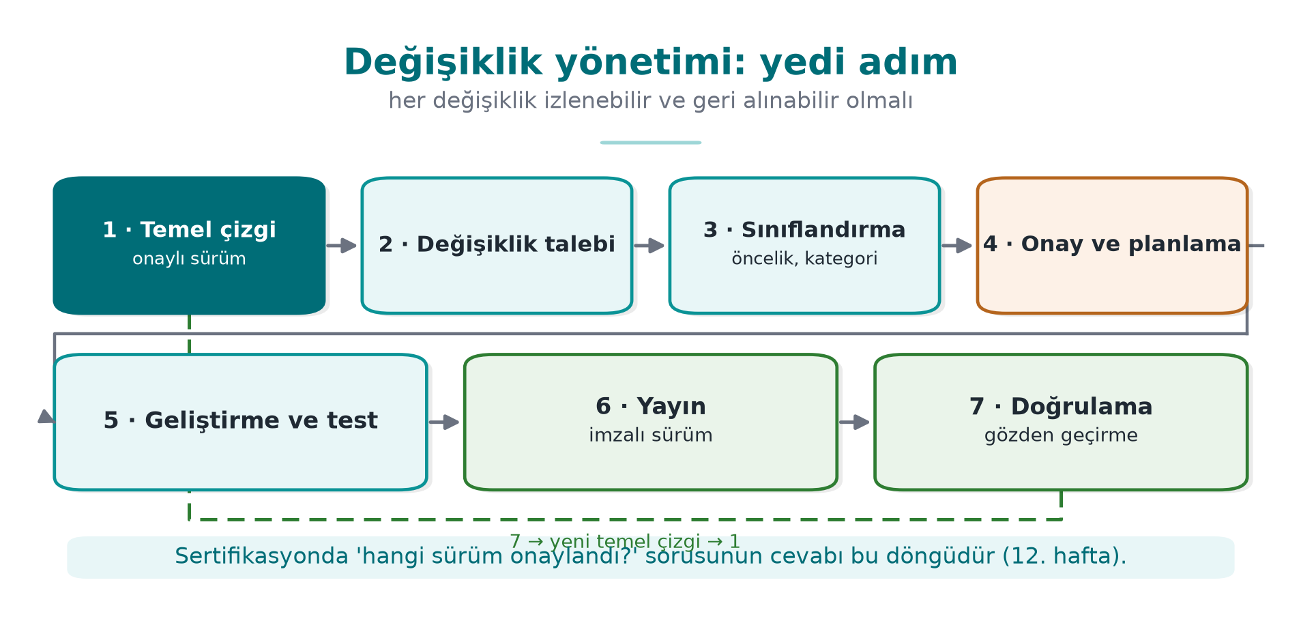
CEN429 Secure Programming · Week 1
Change management — diagram
RTEU Computer Engineering · 2026-2027 Fall
144

Slide 145
CEN429 Secure Programming · Week 1
Trade-off log
Decision | Chosen | Reason | Residual risk
Logging in release | Fully removed by a build macro | Silenced code remains as strings | Hard to diagnose in the field
Error codes | Only success/failure (opaque) | Detail gives the attacker a hint | A separate diagnostic channel
Native "debuggable" flag | On (justified exception) | Integrity checking needs to read its own memory | Compensated with debugger detection
Password derivation time | 250 ms | Balance between wait time and brute force | A very weak password
An unwritten trade-off is an error in an evaluator's eyes
RTEU Computer Engineering · 2026-2027 Fall
145
Notes:
Speaker note: Countermeasures like integrity checking also change the build pipeline: a hash is embedded, then rebuilt; a five-pass signed build in the field. The cost of protections is also measured: running the critical operation 20 times for the shortest, longest, average time.

Slide 146
CEN429 Secure Programming · Week 1
This week's toolbox
Task | Linux / GCC | Windows / MSVC
Suspicious-code warnings | -Wall -Wextra -Wsign-conversion | /W4
Library size checking | -D_FORTIFY_SOURCE=2 -O2 | _s functions like strcpy_s
Catching memory bugs | -fsanitize=address | /fsanitize=address
Memory dump | gdb + gcore | MiniDumpWriteDump
Machine code | objdump -d | VS Disassembly
Erasure that can't be removed | explicit_bzero | SecureZeroMemory
Running a program safely | posix_spawn + absolute path | CreateProcessW + full path
RTEU Computer Engineering · 2026-2027 Fall
146

Slide 147
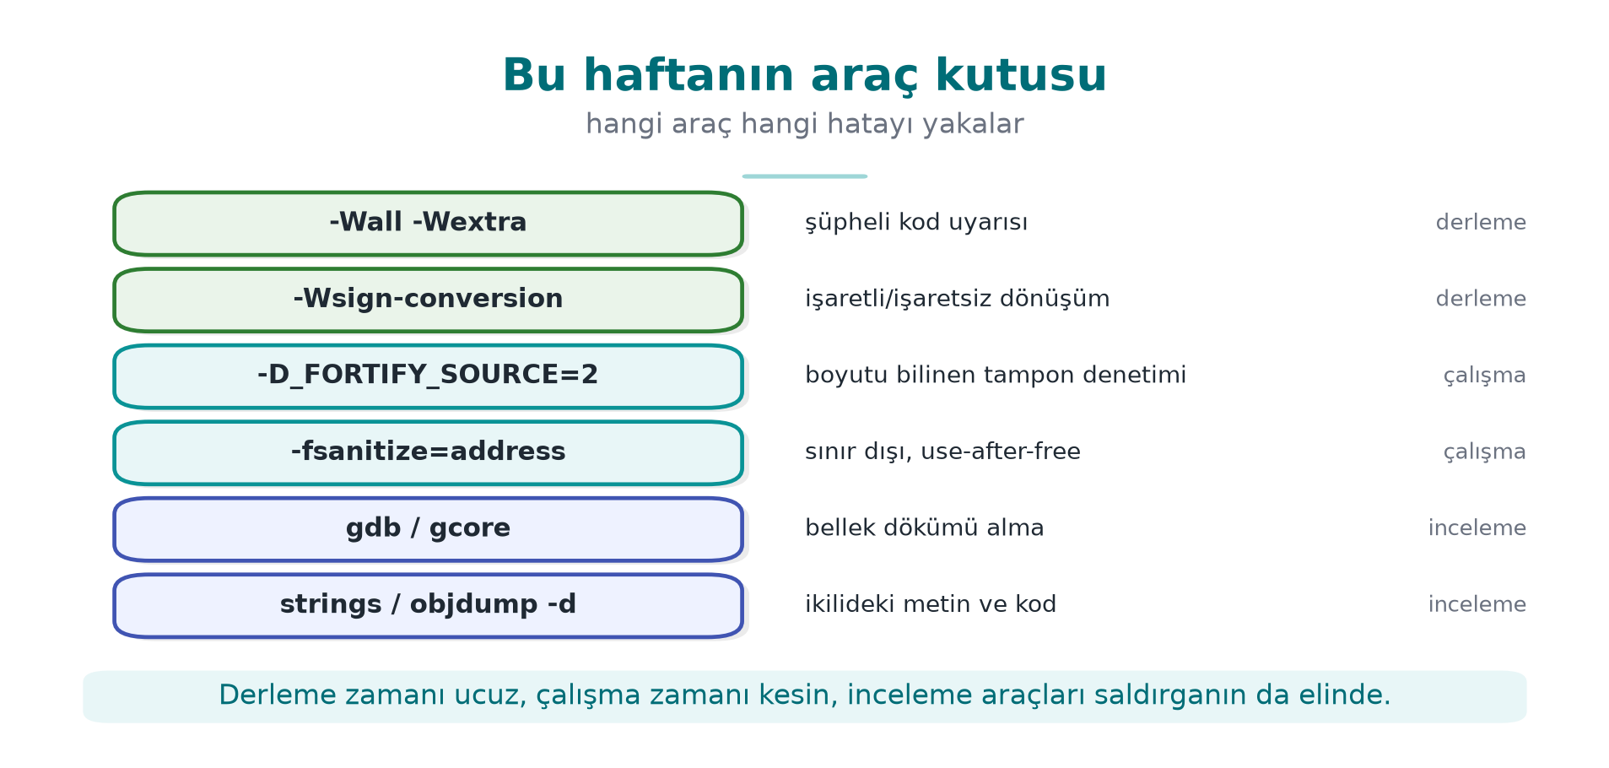
CEN429 Secure Programming · Week 1
This week's toolbox — diagram
RTEU Computer Engineering · 2026-2027 Fall
147

Slide 148
CEN429 Secure Programming · Week 1
8. Project and wrap-up
RTEU Computer Engineering · 2026-2027 Fall
148

Slide 149
CEN429 Secure Programming · Week 1
Project: this week's tasks
1. Team (individual or up to 4 people) and topic
2. GitHub repository + project plan (work packages, timeline) → get it approved
3. Security guide draft:
  – S0 cover and version history · S2 product overview
  – S3 architecture and interface table
  – S4 attacker model · STRIDE · attack tree
RTEU Computer Engineering · 2026-2027 Fall
149

Slide 150
CEN429 Secure Programming · Week 1
Try it yourself (not graded)
1. The PATH trap: repeat with ls (Linux) / whoami (Windows), fix with a full path
2. In Demo 2, MOD optimize → MOD korumasiz: does memset work now?
3. In Demo 3, 16, 17, 18, 19, 20 characters: a table of yonetici values
4. Add bakiye to struct oturum: push it above 1000 with an overflow, then prevent it
5. A STRIDE table for your own project (≥ 8 threats + countermeasures)
6. Read the Heartbleed report: which check was missing? Which CWE?
Details and hints: course site → Week 1 → "Try it yourself"
RTEU Computer Engineering · 2026-2027 Fall
150

Slide 151
CEN429 Secure Programming · Week 1
Self-check
1. Difference between asset, threat, vulnerability?
2. The recipient IBAN changing in transit — which CIA property?
3. What does a white-box attacker do differently?
4. STRIDE "E" — which demo?
5. AND / OR node — which is good for defence?
6. Why is system("date") dangerous? Three fixes?
7. Why did memset disappear?
8. Why didn't ASan catch the 17 characters?
9. What happens when -1 reaches memcpy?
10. Defence in depth — an example from the mobile payment architecture?
RTEU Computer Engineering · 2026-2027 Fall
151
Notes:
ask first, then open the answer slide; full solutions in the appendix

Slide 152
CEN429 Secure Programming · Week 1
Self-check — answers (1–10)
1. Asset is a valuable thing to protect; threat is a possible harmful event/actor; vulnerability is the flaw a threat can exploit.
2. Integrity — an IBAN changing in transit is a data integrity violation.
3. White-box (MATE) owns the program (reads memory/key, modifies code); a network attacker only connects from outside.
4. E = Elevation of Privilege → the privilege-dropping / setuid demo.
5. AND is good for defence: the goal needs all sub-steps, cutting one stops the attack. OR is convenient for the attacker.
6. system interprets a shell → command injection/PATH hijacking. Fix: call directly with execvp (no shell), a full path, an input allowlist.
7. The compiler removed it as a dead store (never read afterward). Use memset_s/explicit_bzero/volatile.
8. The overflow didn't reach the redzone / that code path wasn't run; ASan only sees the instrumented region.
9. -1 becomes SIZE_MAX in a size_t → a huge copy → overflow/crash.
10. Payment: TLS+pinning (transit) · AEAD (at rest) · RASP/anti-debug · white-box/HSM key · server checks — layers.
RTEU Computer Engineering · 2026-2027 Fall
152

Slide 153
CEN429 Secure Programming · Week 1
Self-check (continued)
1. Why is S never asked of a data flow?
2. What are the four responses to a threat? Give an example of "eliminate"
3. Why is the group dropped first in a setuid program?
4. Why isn't strncpy a safe strcpy?
5. Why did Heartbleed leak data without anything crashing?
RTEU Computer Engineering · 2026-2027 Fall
153
Notes:
ask first, then open the answer slide

Slide 154
CEN429 Secure Programming · Week 1
Self-check — answers (continued 1–5)
1. S is not asked of a data flow: a flow has no identity (spoofing is asked of endpoints/assets).
2. Mitigate · eliminate · transfer · accept. "Eliminate" example: never offering a "remember my password" feature at all.
3. In setuid, the group is dropped first; if the user is dropped first, there's no privilege left to change the group.
4. strncpy doesn't add a terminator on a long source → an unterminated string.
5. Heartbleed only read; the memory it read was the process's own valid memory → it leaked without crashing.
RTEU Computer Engineering · 2026-2027 Fall
154

Slide 155
CEN429 Secure Programming · Week 1
Self-check (continued)
1. What does a canary do when it catches an overflow? Why is it still a problem?
2. What does free(p); p = NULL; prevent, and not prevent?
3. What does mlock prevent, and not prevent?
4. What is a "decryption oracle"? A countermeasure?
5. The three components of unique version identity?
RTEU Computer Engineering · 2026-2027 Fall
155
Notes:
ask first, then open

Slide 156
CEN429 Secure Programming · Week 1
Self-check — answers (continued 6–10)
1. When a canary is corrupted it terminates the program (denial of service); it does not see the overflow into the neighboring variable.
2. free(p); p=NULL; prevents double free/UAF; it does not protect against aliases (another pointer to the same address).
3. mlock prevents memory from being written to swap; it does not prevent it from being read, or a secret from staying unerased.
4. Decryption oracle: the ability to decrypt without the key. Countermeasure: context/integrity checking, a call limit, binding to the device.
5. Unique version: semantic version + git id + binary SHA-256.
RTEU Computer Engineering · 2026-2027 Fall
156

Slide 157
CEN429 Secure Programming · Week 1
Next week
Week 2 — Computer Viruses and Security Models
Malware types · Bell–LaPadula, Biba, Clark–Wilson · CWE, OWASP, CVSS
Source: Viega & Messier, Recipes 1, 3, 12.1, 13.2–13.3
RTEU Computer Engineering · 2026-2027 Fall
157

Slide 158
CEN429 Secure Programming · Week 1
Appendix · Applying STRIDE step by step
RTEU Computer Engineering · 2026-2027 Fall
158
Notes:
Speaker note: We apply every letter of STRIDE to a synthetic example, one at a time.

Slide 159
CEN429 Secure Programming · Week 1
Example system
A mobile banking application:
• user login
• balance display
• money transfer
Let's apply every STRIDE letter to this system.
RTEU Computer Engineering · 2026-2027 Fall
159

Slide 160
CEN429 Secure Programming · Week 1
S · Spoofing
• Threat: acting as someone else (a fake user/server).
• Example: a fake server, a stolen session.
• Countermeasure: strong authentication, TLS + certificate checking.
RTEU Computer Engineering · 2026-2027 Fall
160

Slide 161
CEN429 Secure Programming · Week 1
T · Tampering
• Threat: modifying data/code without authorization.
• Example: changing the transfer amount.
• Countermeasure: integrity (MAC/signature), integrity checking (RASP).
RTEU Computer Engineering · 2026-2027 Fall
161

Slide 162
CEN429 Secure Programming · Week 1
R · Repudiation
• Threat: denying what you did.
• Example: "I didn't make that transfer."
• Countermeasure: secure log, signature, audit trail.
RTEU Computer Engineering · 2026-2027 Fall
162

Slide 163
CEN429 Secure Programming · Week 1
I · Information disclosure
• Threat: confidential data leaking.
• Example: a balance/password leak.
• Countermeasure: encryption, least privilege, leak-free error messages.
RTEU Computer Engineering · 2026-2027 Fall
163

Slide 164
CEN429 Secure Programming · Week 1
D · Denial of service
• Threat: making the service unavailable.
• Example: excessive requests, resource exhaustion.
• Countermeasure: rate limiting, resource quotas, input limits.
RTEU Computer Engineering · 2026-2027 Fall
164

Slide 165
CEN429 Secure Programming · Week 1
E · Elevation of privilege
• Threat: gaining unauthorized privilege.
• Example: an ordinary user becomes administrator.
• Countermeasure: least privilege, privilege checking, secure default.
RTEU Computer Engineering · 2026-2027 Fall
165

Slide 166
CEN429 Secure Programming · Week 1
STRIDE · summary application
Letter | Countermeasure in this system
S | TLS + authentication
T | MAC/signature + RASP
R | Secure log
I | Encryption + least privilege
D | Rate limiting
E | Privilege checking
RTEU Computer Engineering · 2026-2027 Fall
166

Slide 167
CEN429 Secure Programming · Week 1
Appendix · Attack tree step by step
RTEU Computer Engineering · 2026-2027 Fall
167

Slide 168
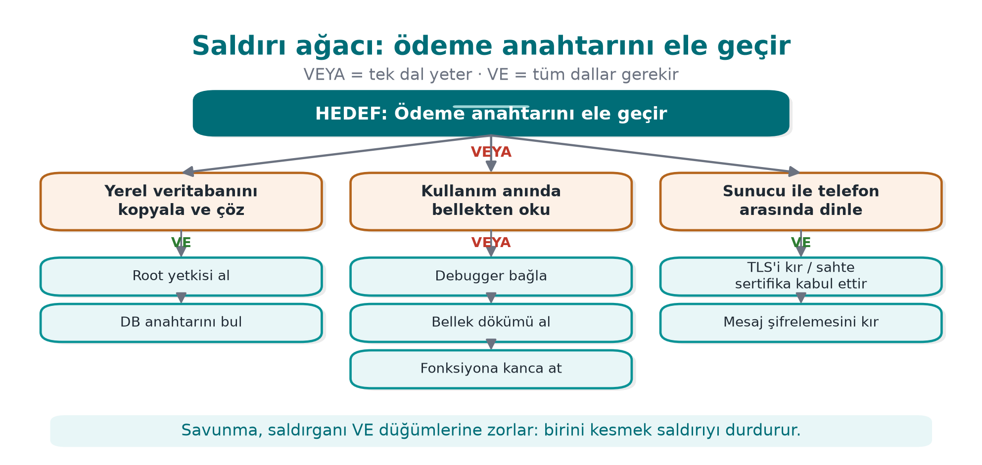
CEN429 Secure Programming · Week 1
Root · goal
The attacker's ultimate goal. Now let's break down the paths.
RTEU Computer Engineering · 2026-2027 Fall
168

Slide 169
CEN429 Secure Programming · Week 1
Branches · how?
The question to ask after the root: "By which paths is this goal reached?"
• Every branch is one way to reach the goal
• AND: all of the branch is needed · OR: one is enough
• Next step: break the most likely branch into sub-branches
RTEU Computer Engineering · 2026-2027 Fall
169

Slide 170
CEN429 Secure Programming · Week 1
Sub-branches · read from memory
Read from memory — three ways:
• Attach a debugger
• Take a memory dump
• Catch it with a hook
Every leaf is one attack step.
RTEU Computer Engineering · 2026-2027 Fall
170

Slide 171
CEN429 Secure Programming · Week 1
Prioritising from the tree
• The easiest leaf is the biggest risk.
• Close it first (e.g. RASP + short lifetime).
• The tree shows the defence priority.
RTEU Computer Engineering · 2026-2027 Fall
171

Slide 172
CEN429 Secure Programming · Week 1
Mapping the tree to countermeasures
Leaf | Countermeasure
Debugger | Anti-debug (6)
Memory dump | Short lifetime + protection (6, 10)
Extract from binary | Obfuscation + white-box (9, 11)
Leak over the network | TLS + pinning (10)
RTEU Computer Engineering · 2026-2027 Fall
172

Slide 173
CEN429 Secure Programming · Week 1
Appendix · Going deeper on secure design principles
RTEU Computer Engineering · 2026-2027 Fall
173

Slide 174
CEN429 Secure Programming · Week 1
Least privilege
• Every component can only do what's needed.
• Excess privilege = a larger attack surface.
• Example: a DB user with only SELECT.
RTEU Computer Engineering · 2026-2027 Fall
174

Slide 175
CEN429 Secure Programming · Week 1
Secure default (fail-safe)
• If something goes wrong, fall to the safe side.
• Error → access is denied (fail-closed).
• Default: closed, restricted.
RTEU Computer Engineering · 2026-2027 Fall
175

Slide 176
CEN429 Secure Programming · Week 1
Economy and open design
• Economy: a simple design, fewer bugs.
• Open design: security rests on the key, not secrecy (Kerckhoffs).
• Complexity is the enemy.
RTEU Computer Engineering · 2026-2027 Fall
176

Slide 177
CEN429 Secure Programming · Week 1
Complete mediation and separation of privilege
• Complete mediation: every access is checked (don't skip it by trusting a cache).
• Separation of privilege: more than one condition for a critical operation.
• The foundation of defence in depth.
RTEU Computer Engineering · 2026-2027 Fall
177

Slide 178
CEN429 Secure Programming · Week 1
Principles → this course
• These principles will repeat every week this term.
• Code, crypto, RASP, requirements — all rest on them.
• The principles don't change; the techniques do.
RTEU Computer Engineering · 2026-2027 Fall
178

Slide 179
CEN429 Secure Programming · Week 1
Appendix · summary
• STRIDE asks six questions of every element.
• An attack tree breaks the goal into paths and prioritizes them.
• Design principles are the compass for every decision.
Model the threat, then protect it with layers.
RTEU Computer Engineering · 2026-2027 Fall
179

Slide 180
CEN429 Secure Programming · Week 1
Appendix · Solved self-check
RTEU Computer Engineering · 2026-2027 Fall
180
Notes:
Speaker note: Ask the students first, then reveal the answer.

Slide 181
CEN429 Secure Programming · Week 1
Question 1
Explain the CIA triad with an example.
Answer: Confidentiality: only the owner sees the password. Integrity: a bank balance can't be changed without authorization. Availability: the app works when needed.
RTEU Computer Engineering · 2026-2027 Fall
181

Slide 182
CEN429 Secure Programming · Week 1
Question 2
What is the difference between a bug and a vulnerability?
Answer: Every vulnerability is a bug, but not every bug is a vulnerability. A vulnerability is a bug an attacker can exploit.
RTEU Computer Engineering · 2026-2027 Fall
182

Slide 183
CEN429 Secure Programming · Week 1
Question 3
How does a MATE (white-box) attacker differ from a network attacker?
Answer: MATE owns the program: reads the code, sees the memory, modifies it. A network attacker only connects from outside.
RTEU Computer Engineering · 2026-2027 Fall
183

Slide 184
CEN429 Secure Programming · Week 1
Question 4
What does STRIDE provide?
Answer: A systematic search for threats in six classes: spoofing, tampering, repudiation, information disclosure, denial of service, elevation of privilege.
RTEU Computer Engineering · 2026-2027 Fall
184

Slide 185
CEN429 Secure Programming · Week 1
Question 5
What is an attack tree for?
Answer: It breaks an attack goal into sub-steps; it shows the easiest/most likely path and helps prioritise.
RTEU Computer Engineering · 2026-2027 Fall
185

Slide 186
CEN429 Secure Programming · Week 1
Question 6
Why isn't a single countermeasure enough?
Answer: Every countermeasure can be bypassed; in layered defence, if one is bypassed, another stops it. Strength comes from combination.
RTEU Computer Engineering · 2026-2027 Fall
186

Slide 187
CEN429 Secure Programming · Week 1
Question 7
"Does obfuscation replace correct code?"
Answer: No. Obfuscation makes reading harder but doesn't fix the bug. Secure code first, then obfuscation.
RTEU Computer Engineering · 2026-2027 Fall
187

Slide 188
CEN429 Secure Programming · Week 1
Question 8
What is the principle of least privilege?
Answer: Every component should have only the necessary privilege; more than that enlarges the attack surface.
RTEU Computer Engineering · 2026-2027 Fall
188

Slide 189
CEN429 Secure Programming · Week 1
Question 9
What is a trust boundary?
Answer: The place where trusted and untrusted zones are separated; input validation is done here at the earliest point.
RTEU Computer Engineering · 2026-2027 Fall
189

Slide 190
CEN429 Secure Programming · Week 1
Question 10
Why is residual risk written down?
Answer: No system is 100% secure; known, accepted risks are documented explicitly.
RTEU Computer Engineering · 2026-2027 Fall
190

Slide 191
CEN429 Secure Programming · Week 1
Appendix · A worked mini threat model
RTEU Computer Engineering · 2026-2027 Fall
191

Slide 192
CEN429 Secure Programming · Week 1
Product · synthetic
A "password vault" application:
• stores passwords locally
• opens with a master password
Let's build a quick threat model.
RTEU Computer Engineering · 2026-2027 Fall
192

Slide 193
CEN429 Secure Programming · Week 1
Step · assets
• Master password (C/I)
• Stored passwords (C/I)
• Encryption key (C/I)
RTEU Computer Engineering · 2026-2027 Fall
193

Slide 194
CEN429 Secure Programming · Week 1
Step · threats (STRIDE)
• I (information disclosure): if the device is stolen, passwords can be read.
• T (tampering): the vault file is modified.
• E (privilege): memory access on a rooted device.
RTEU Computer Engineering · 2026-2027 Fall
194

Slide 195
CEN429 Secure Programming · Week 1
Step · countermeasures
• Passwords encrypted with AEAD (I → C).
• A key from the master password via KDF.
• An integrity tag (T).
• Short-lived memory + RASP (E).
RTEU Computer Engineering · 2026-2027 Fall
195

Slide 196
CEN429 Secure Programming · Week 1
Step · residual risk
• While the master password is being typed on a rooted device, it may be exposed in memory.
• Mitigation: fast erasure, device binding.
• Written down explicitly.
RTEU Computer Engineering · 2026-2027 Fall
196

Slide 197
CEN429 Secure Programming · Week 1
Glossary
Term | Meaning
CIA | Confidentiality/integrity/availability
MATE | An attacker who owns the program
STRIDE | Six threat classes
Attack tree | Breaking a goal into sub-steps
DFD | Data flow diagram
Defence in depth | Many countermeasures together
RTEU Computer Engineering · 2026-2027 Fall
197

Slide 198
CEN429 Secure Programming · Week 1
From this week to the project
• S2–S5: product, architecture, asset list, threat model.
• S1: scope, sources.
• Every asset labelled C/I/I+; a countermeasure for every threat.
RTEU Computer Engineering · 2026-2027 Fall
198

Slide 199
CEN429 Secure Programming · Week 1
Final word (week 1)
Security is not a "feeling," it's a process: know the asset, model the threat, protect with layers, write down the residual risk.
We'll use this framework all term.
RTEU Computer Engineering · 2026-2027 Fall
199

