Slide 1
Database and Fundamental Concepts
Instructor: Yıldıran Yılmaz
Email: yildiran.yilmaz@erdogan.edu.tr
Office Hours: Thursday
Teaching Assistant:

Slide 2
Why we use the database?
The purpose of the database;
  helping people and organizations keep track of things.

Slide 3
Why we use the database?
Lists are used to keep track of things without using a database.
  Shopping list,
  to-do list,
  List of paid invoices

Slide 4
Why we use the database?
Lists;
Customer Name | Job | Company | Address | Price
Ahmet | mimar | A | Çanakkale Cad. 43/5 | 1000 TL
Sema | öğretmen | B | Kayabaşı mah. A Blok 8/4 | 250 TL
Serdar | mühendis | C | Gazi Mah 6/7 | 350 TL
Zerrin | emekli | B | Kayabaşı mah. A Blok 8/4 | 700 TL
Mehmet | Öğretim elemanı | B | Kayabaşı mah. A Blok 8/4 | 1200 TL
Defne | Doktor | D | Gazi Mah 6/7 | 100 TL
Elif | avukat | A | Çanakkale Cad. 43/5 | 150 TL

Slide 5
Why we use the database?
Problems with lists;
    For example, the address of company B has changed.
    Address information in 3 lines should also change
    If it is missing, information inconsistency occurs.
    It can cause both a waste of time and an error.

Slide 6
Why we use the database?
Problems with lists;
    For example, company A no longer works with your company,
    If you delete the record related to company A from the list, you will lose information such as customer information and company address where the product was sold.

Slide 7
Why we use the database?
    Problems with shared data;
    For example, different departments of your company need to display company information;
      Communication department: company, address
      Marketing department: company, price
      Customer service: customer name, job, company

Slide 8
Why we use the database?
Problems with shared data;
  Sharing all of this information with all departments is inconvenient for different reasons.
    Security
    customer privacy
    etc.

Slide 9
Why we use the database?
The biggest drawback for lists is that it combines different types of information into a table.

Slide 10
Why we use the database?
For DMS, the process of placing different types of information in different tables is called normalisation.
For the previous list;
    customers
    Worked companies
    sales information

Slide 11
Why we use the database?
  Customers
Customer Name | Job
Ahmet | mimar
Sema | öğretmen
Serdar | mühendis
Zerrin | emekli
Mehmet | Öğretim elemanı
Defne | Doktor
Elif | avukat

Slide 12
Why we use the database?
  Worked Companies
Company | Address
A | Çanakkale Cad. 43/5
B | Kayabaşı mah. A Blok 8/4
C | Gazi Mah 6/7
D | Gazi Mah 6/7

Slide 13
Why we use the database?
  Sales Information
Customer Name | Price
Ahmet | 1000 TL
Sema | 250 TL
Serdar | 350 TL
Zerrin | 700 TL
Mehmet | 1200 TL
Defne | 100 TL
Elif | 150 TL

Slide 14
Why we use the database?
When different types of information are placed in different tables, most of the problems related to the following works are eliminated;
    changing information
    deleted information
    with shared information.

Slide 15
Why we use the database?
When different types of data are in different tables;
  Relationships need to be established in order to answer questions such as which customer bought the product from which company ?

Slide 16
Why we use the database?
Relations
Customer No | Company No | Price
1 | 1 | 1000 TL
2 | 2 | 250 TL
3 | 3 | 350 TL
4 | 2 | 700 TL
5 | 2 | 1200 TL
6 | 4 | 100 TL
7 | 1 | 150 TL
Customer No | Customer Name | Job
1 | Ahmet | mimar
2 | Sema | öğretmen
3 | Serdar | mühendis
4 | Zerrin | emekli
5 | Mehmet | Öğretim elemanı
6 | Defne | Doktor
7 | Elif | avukat
Company No | Company | Address
1 | A | Çanakkale Cad. 43/5
2 | B | Kayabaşı mah. A Blok 8/4
3 | C | Gazi Mah 6/7
4 | D | Gazi Mah 6/7

Slide 17
Why we use the database?
Relations
Foreign
Key
Foreign
Key
Müşteri No | Firma No | Fiyat
1 | 1 | 1000 YTL
2 | 2 | 250 YTL
3 | 3 | 350 YTL
4 | 2 | 700 YTL
5 | 2 | 1200 YTL
6 | 4 | 100 YTL
7 | 1 | 150 YTL
Primary
Key
Primary
Key
Müşteri No | Müsteri adı | Mesleği
1 | Ahmet | mimar
2 | Sema | öğretmen
3 | Serdar | mühendis
4 | Zerrin | emekli
5 | Mehmet | Öğretim elemanı
6 | Defne | Doktor
7 | Elif | avukat
Firma No | Firma | Adres
1 | A | Çanakkale Cad. 43/5
2 | B | Kayabaşı mah. A Blok 8/4
3 | C | Gazi Mah 6/7
4 | D | Gazi Mah 6/7

Slide 18
Why we use the database?
Joining tables
    So what is done to get the initial holistic list?
    SQL language is used.

Slide 19
What is database management system?
Components of the database system;
Database
application
Database
Management
System
Database
User

Slide 20
What is database management system?
The user does the following:
    It uses the database to perform its work,
    Adds new data
    Modify existing data,
    deletes data,
    Reads data through queries or reports

Slide 21
What is database management system?
Database Application:
    It is one or more computer programs that provide communication between the database management system and the user.
    Creates queries and reports,
    Receives data from the user or sends the data to the user,

Slide 22
What is database management system?
Database Management System:
  It receives requests from the application and performs them by reading or writing data on database files,
  It reads SQL statements and converts these statements into instructions for the computer's operating system to read or write data on database files.

Slide 23
What is database management system?
  Functions of Database Application
  Functions of Database Management System

Slide 24
What is database management system?
Database Application:
  Creates and processes forms,
  Creates queries and forwards queries,
  Creates and operates reports,
  Performs application logic,
  Controls the application.

Slide 25
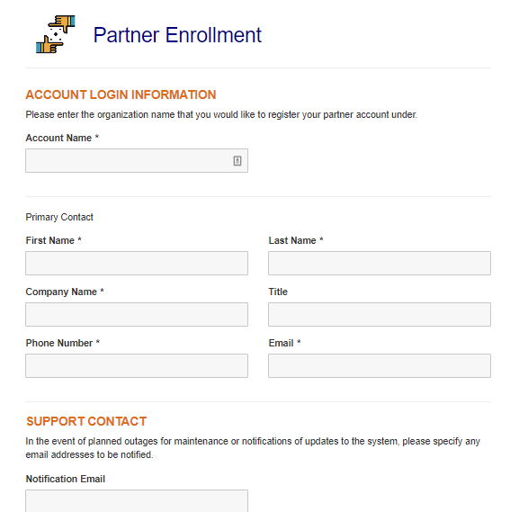
What is database management system?
Database Application:
Creates and processes forms, for example, in a web-based application;
  Creates HTML and other web formats to be displayed on the user's computer,
  When the user fills out the forms and sends the data back, it sends the DBMS requests for the necessary adjustments.
  If an error occurs in the process, it displays the necessary message to the user and/or performs the necessary actions.

Slide 26
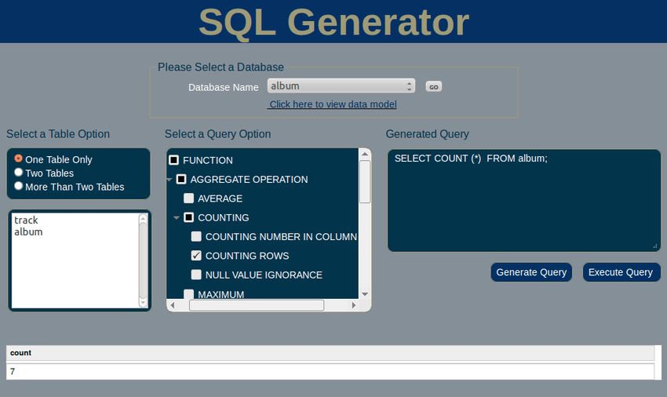
What is database management system?
Database Application:
Creates queries and forwards queries,
  Generates the query to be transmitted to DBMS,
  These requests are usually expressed in SQL,
  When the query is executed, the results are formatted and transmitted to the user,

Slide 27
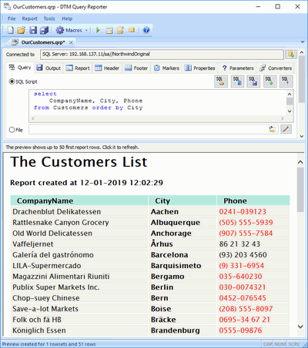
What is database management system?
Database Application:
Creates and operates reports,
  Data is requested from DBMS through queries and query results are presented in the form of reports,

Slide 28
What is database management system?
Database Application:
Performs application logic,
    For example, the user made a request for 10 units, but 8 units were found in stock,
    What happens depends on the logic of the program,
    It is the task of the application program to implement the appropriate logic.

Slide 29
What is database management system?
Database Application:
  Controls the application

Slide 30
What is database management system?
The Database Management System does the following:
  Creating the database, creating the tables,
  Reading data from the database and updating the data,
  Realizing the limitations on data values,
  It prevents one user's process from interfering with the other user's process.
  Allowing users to take action within the limits of their authority,
  Backing up data in the database.

Slide 31
Database
Database is data stores that consist of following related records.
    Metadata (metadata)
    index
    stored procedure
    trigger
    data integrity (referential integrity)

Slide 32
Database
  Data about the structure of the database is called metadata.
      Table names
      column names
      Properties of tables and columns etc.

Slide 33
Database
  Metadata example:
Tabloeno | Table name | Column number | Row number
1 | Müşteriler | 3 | 7
2 | Firmalar | 3 | 4
3 | Satışlar | 3 | 7
Column no | Column name | Data type | Length | Table no
1 | id | int | 4 | 1
2 | Mus_adi | char | 50 | 1
3 | meslegi | char | 50 | 1

Slide 34
Database
  Some databases contain application metadata.
  This metadata defines application components such as forms and reports.
  DBMS has several tools to show the structure of the database.

Slide 35
Database
  At the same time, there are indexes used in databases to improve the performance of the database.
  Indexes are tools that show which records are in which tables.

Slide 36
Database
  Stored procedures are compiled SQL statements.
  Because they are database objects, they are directly included in the database manager program.
  For example, stored procedures can be created for the purpose of taking a backup of data in a table or remove a backup of data that has passed more than a year.

Slide 37
Database
  Stored procedures are codes for doing a specific duty defined in a database.
  These codes are optimized because they are compiled at the same time as they are written, and they are the fastest ready-to-run codes.

Slide 38
Database
  A trigger is a special type of stored procedure that automatically runs when an event occurs in the database server.
  The events that trigger the triggers on the table are insert, update, delete events.

Slide 39
Database
  For example, it is a typical use of triggers to decrease or increase the amount of stock as a result of stock movements.

Slide 40
Database
  Since both triggers and stored procedures are codes on the database, they run on the database server.
  It is one of the powerful components of the Client & Server architecture.
  There are databases in client & server architecture as follows.
      Oracle, Sybase, MS SQL, Interbase, FireBird etc.

Slide 41
Database
  Because they work on the server where the data is located, the data does not go back and forth between the client and the server.
  Therefore minimal data is sent from the server to the client side.

Slide 42
Database
  In a relational database
  Let's assume that the department information of the person in the PERSONNEL table is kept in the SECTION_NO variable and
  the name of the department is in the SECTION table.

Slide 43
Database
  If the section numbered as 1 is used by any personnel, the record with SECTION_NO value of 1 from the SECTION table must not be deleted.
  Protecting data integrity by making such controls is called referential integrity.

Slide 44
Database
  The use of triggers is highly preferred in order to ensure data integrity.

Slide 45
Database
There can be 3 types of database systems:
  used by a single person,
  used by small businesses,
  Used by large international companies

Slide 46
Database
used by a single person,
  Painter
  Whose house was painted, when and how much?
  What was painted in the painting, what colors and styles were used?
  Who referenced others? Who are the referrals?

Slide 47
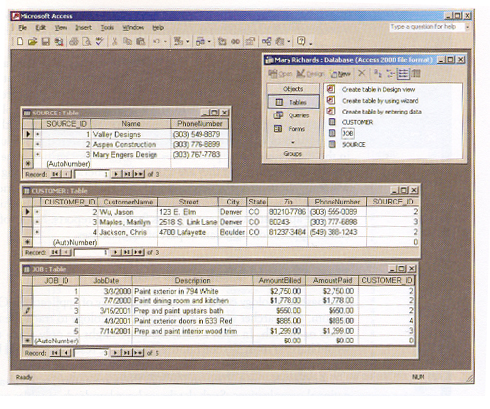
Database Systems
used by a single person,

Slide 48
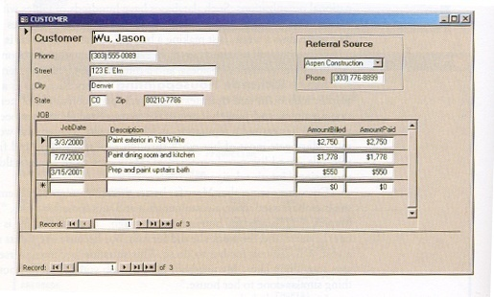
Database Systems
used by a single person,

Slide 49
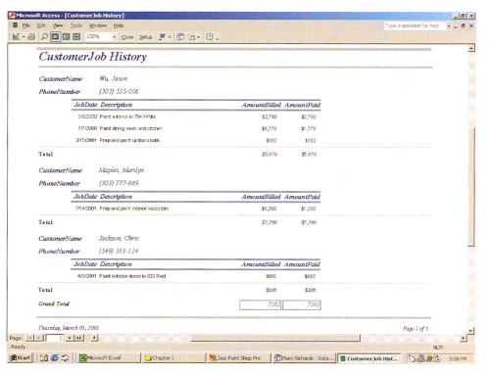
Database Systems
used by a single person,

Slide 50
Database Systems
used by small businesses,
  What are the rented musical instruments? How much is it rented?
  Which musical instruments are rented the most?
  Who made the lease? (multi-user database)
  The same instrument cannot be selected by two different dealers at the same time!

Slide 51
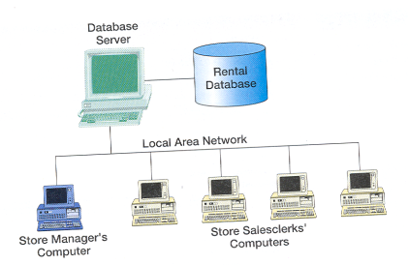
Database Systems
used by small businesses,

Slide 52
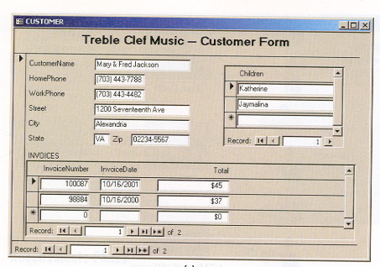
Database Systems
used by small businesses,

Slide 53
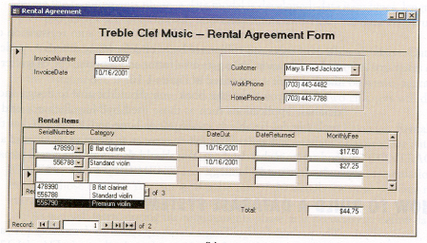
Database Systems
used by small businesses,

Slide 54
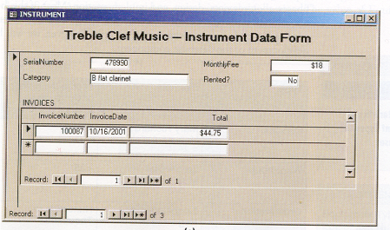
Database Systems
used by small businesses,

Slide 55
Database Systems
Used by large international companies,
  Driver licensing and auto registration office
  It has 52 different centers
  Accidents of people, traffic violations are kept,
  Is the license renewable, are there any limitations?
  Database is used by 100s of people
    Licensing and registration staff
    Those who follow law enforcement
    Finance department staff
  Reachable 24 hours a day, 7 days a week

Slide 56
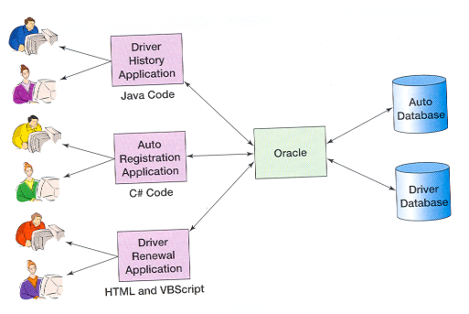
Database Systems
Used by large international companies,

Slide 57
References
Kroenke, D. M. (2006). Database Processing:Fundamentals, Design, and Implementation.Pearson Education International. Singapore,Canada,Japan.
http://www.delphiturkiye.com/trigger.htm

