Slide 1

CEN207 Data Structures · Week 9
Week 9
Order · Weights · Cycles · Backtracking
RTEU Computer Engineering · Fall 2026–2027
Notes:
Welcome back after the midterm week. This week extends every Week 5 graph tool with order, weight, and cycle awareness, and closes with backtracking.

Slide 2
CEN207 Data Structures · Week 9
Today's map
• Order: topological sort (2 ways), cycle detection
• Track groups: union-find
• Cheapest connections: Kruskal, Prim (MST)
• Cheapest paths: Dijkstra, Bellman-Ford, Floyd-Warshall
• Reachability: strongly connected components, bipartite
• Beyond paths: max flow, backtracking
RTEU Computer Engineering · Fall 2026–2027
2
Notes:
Eleven algorithms, ten sections — some sections pair two algorithms that solve the same problem two ways.

Slide 3
CEN207 Data Structures · Week 9
Before we start: what you know
• Week 5: adjacency list, alphabetical neighbours
• BFS: queue, fewest edges
• DFS: recursion or explicit stack
• Connected components: BFS/DFS from every unvisited vertex
RTEU Computer Engineering · Fall 2026–2027
3
Notes:
Every algorithm this week extends BFS or DFS with one or two extra arrays. Nothing here replaces Week 5 — it builds on it directly.

Slide 4
CEN207 Data Structures · Week 9
The one new ingredient: weights
• 6 of today's algorithms attach a number to every edge
• A distance, a cost, a capacity
• The question changes from "reachable?" to "cheapest?"
RTEU Computer Engineering · Fall 2026–2027
4
Notes:
Kruskal, Prim, Dijkstra, Bellman-Ford, Floyd-Warshall, Edmonds-Karp all need weights. The other five stay unweighted.

Slide 5
CEN207 Data Structures · Week 9
What this week reuses from Week 5
Week 5 tool | Reused by
Adjacency list, alphabetical order | Every algorithm this week
BFS queue | Bipartite check, max-flow's augmenting path
DFS recursion | Topo-sort, cycle detection, SCC, backtracking
Circle layout | Every animation's graph drawing
RTEU Computer Engineering · Fall 2026–2027
5
Notes:
Nothing about the graph representation changes -- only what we compute over it.

Slide 6
CEN207 Data Structures · Week 9
1. Topological Sort
RTEU Computer Engineering · Fall 2026–2027
6

Slide 7
CEN207 Data Structures · Week 9
A question to start
Socks before shoes. Shirt before jacket. No order between socks and shirt.
Is there always one order obeying every rule?
RTEU Computer Engineering · Fall 2026–2027
7
Notes:
This is exactly the build-system / package-manager dependency problem.

Slide 8
CEN207 Data Structures · Week 9
A short history
• A. B. Kahn, 1962 — in-degree + queue
• Build systems, package installers use this daily
• The DFS-based alternative falls out of Tarjan's 1970s DFS framework
RTEU Computer Engineering · Fall 2026–2027
8
Notes:
Kahn's paper is literally titled "Topological sorting of large networks".

Slide 9
CEN207 Data Structures · Week 9
Kahn's idea
• A vertex with in-degree 0 has no unmet prerequisite
• Place it now; this removes its outgoing edges
• Every neighbour's in-degree drops by one
• Newly-zero neighbours become eligible — enqueue them
RTEU Computer Engineering · Fall 2026–2027
9
Notes:
The queue holds every vertex currently eligible to be placed, all at once.

Slide 10
CEN207 Data Structures · Week 9
Kahn's code (C) — part 1/2
int topo_sort_kahn(Graph *g) {
for (int i=0;i<g->vertex_count;i++) indeg[i]=0;
for (int u=0;u<g->vertex_count;u++)
for (AdjNode *n=g->adj[u]; n; n=n->next)
indeg[n->to]++;
front=rear=0; order_len=0;
for (int v=0;v<g->vertex_count;v++)
if (indeg[v]==0) enqueue(v);
RTEU Computer Engineering · Fall 2026–2027
10
Notes:
Count in-degrees, then seed the queue with every vertex that already has in-degree 0.

Slide 11
CEN207 Data Structures · Week 9
Kahn's code (C) — part 2/2
while (front<rear) {
int u=dequeue();
order[order_len++]=u;
for (AdjNode *n=g->adj[u]; n; n=n->next) {
indeg[n->to]--;
if (indeg[n->to]==0) enqueue(n->to);
}
}
return order_len==g->vertex_count;
}
RTEU Computer Engineering · Fall 2026–2027
11
Notes:
Relax every dequeued vertex's neighbours, enqueueing any that newly reach in-degree 0.

Slide 12
CEN207 Data Structures · Week 9
Kahn's code (Java) — part 1/2
static boolean topoSortKahn(Graph g) {
for (int i=0;i<g.vertexCount;i++) indeg[i]=0;
for (int u=0;u<g.vertexCount;u++)
for (AdjNode n=g.adj[u]; n!=null; n=n.next)
indeg[n.to]++;
front=rear=0; orderLen=0;
for (int v=0;v<g.vertexCount;v++)
if (indeg[v]==0) enqueue(v);
RTEU Computer Engineering · Fall 2026–2027
12
Notes:
Identical shape to the C version so far.

Slide 13
CEN207 Data Structures · Week 9
Kahn's code (Java) — part 2/2
while (front<rear) {
int u=dequeue();
order[orderLen]=u; orderLen++;
for (AdjNode n=g.adj[u]; n!=null; n=n.next) {
indeg[n.to]--;
if (indeg[n.to]==0) enqueue(n.to);
}
}
return orderLen==g.vertexCount;
}
RTEU Computer Engineering · Fall 2026–2027
13
Notes:
Same shape as the C version, line for line -- that parity is why the code panel's line numbers stay meaningful in both languages.

Slide 14
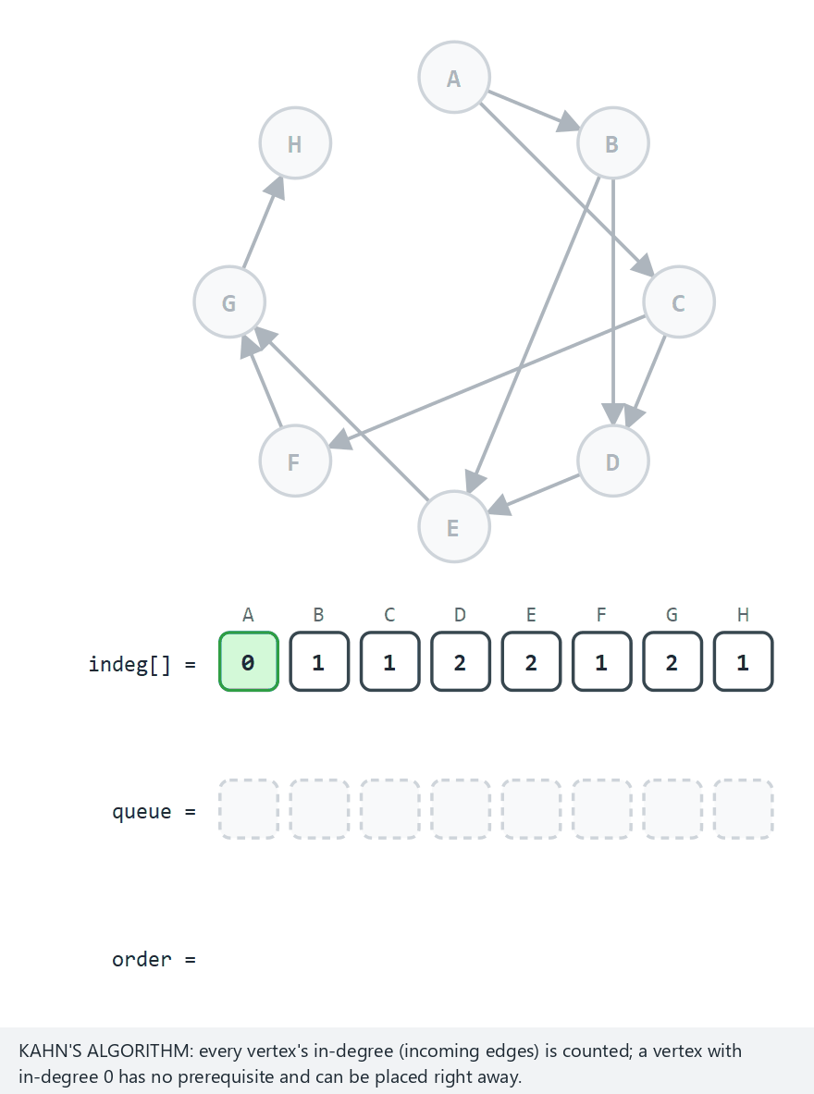
CEN207 Data Structures · Week 9
Kahn's algorithm
RTEU Computer Engineering · Fall 2026–2027
14
Notes:
Watch the queue and the order row fill together. Try the cycle edge case next.

Slide 15
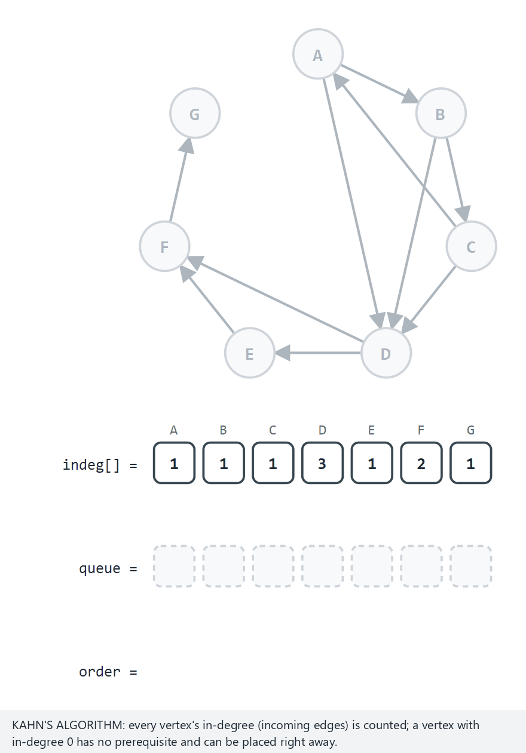
CEN207 Data Structures · Week 9
Edge case: a cycle
RTEU Computer Engineering · Fall 2026–2027
15
Notes:
The queue empties early — the leftover vertices are locked in a cycle with each other.

Slide 16
CEN207 Data Structures · Week 9
Real output: Kahn's algorithm
-- normal: 8 vertices, 10 edges, a valid DAG --
order: A B C D F E G H
all 8 vertices placed: a valid topological order
-- edge: 10 edges but a cycle exists, no full order --
order:
only 0 of 7 vertices placed -- a cycle exists
RTEU Computer Engineering · Fall 2026–2027
16
Notes:
Real captured output from the compiled C program, byte-identical to the Java program's output.

Slide 17
CEN207 Data Structures · Week 9
The DFS idea
• Run recursive DFS (Week 5's DFS, one array added)
• Record every vertex's finish time
• Read finish times largest to smallest
• A vertex finishes only after everything it points to
RTEU Computer Engineering · Fall 2026–2027
17
Notes:
A back edge to a still-open (grey) vertex means a cycle — caught for free.

Slide 18
CEN207 Data Structures · Week 9
DFS topo-sort code (C) — dfs_visit
void dfs_visit(int u) {
color_of[u]=1;
for (AdjNode *n=cur_g->adj[u]; n; n=n->next) {
if (color_of[n->to]==0) dfs_visit(n->to);
else if (color_of[n->to]==1) has_cycle=1;
}
color_of[u]=2;
finish[finish_len++]=u;
}
RTEU Computer Engineering · Fall 2026–2027
18
Notes:
The finish[] array fills bottom-up; the caller reads it back to front for the topological order.

Slide 19
CEN207 Data Structures · Week 9
DFS topo-sort code (C) — the driver
void topo_sort_dfs(Graph *g) {
cur_g=g;
for (int i=0;i<g->vertex_count;i++) color_of[i]=0;
finish_len=0; has_cycle=0;
for (int v=0;v<g->vertex_count;v++)
if (color_of[v]==0) dfs_visit(v);
}
RTEU Computer Engineering · Fall 2026–2027
19
Notes:
One dfs_visit call per unvisited vertex -- this is what covers a disconnected DAG.

Slide 20
CEN207 Data Structures · Week 9
DFS topo-sort code (Java) — dfsVisit
static void dfsVisit(int u) {
colorOf[u]=1;
for (AdjNode n=curG.adj[u]; n!=null; n=n.next) {
if (colorOf[n.to]==0) dfsVisit(n.to);
else if (colorOf[n.to]==1) hasCycle=true;
}
colorOf[u]=2;
finish[finishLen]=u; finishLen++;
}
RTEU Computer Engineering · Fall 2026–2027
20
Notes:
hasCycle is set the moment a back edge is seen, but the loop keeps going to finish every vertex.

Slide 21
CEN207 Data Structures · Week 9
DFS topo-sort code (Java) — the driver
static void topoSortDfs(Graph g) {
curG=g;
for (int i=0;i<g.vertexCount;i++) colorOf[i]=0;
finishLen=0; hasCycle=false;
for (int v=0;v<g.vertexCount;v++)
if (colorOf[v]==0) dfsVisit(v);
}
RTEU Computer Engineering · Fall 2026–2027
21
Notes:
Same shape as the C driver, line for line.

Slide 22
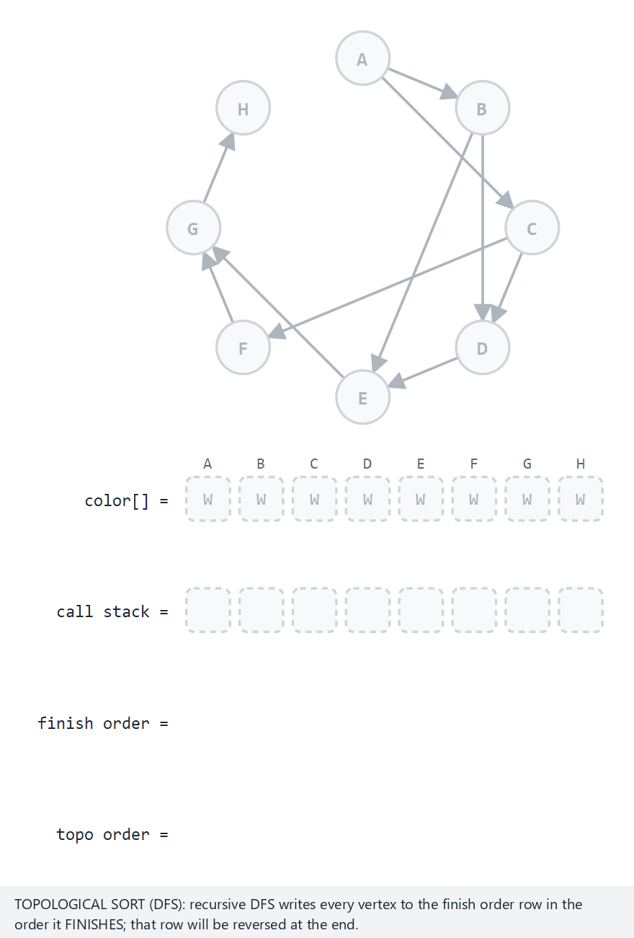
CEN207 Data Structures · Week 9
DFS topological sort
RTEU Computer Engineering · Fall 2026–2027
22
Notes:
Same graph as Kahn's — compare the two valid orders.

Slide 23
CEN207 Data Structures · Week 9
Complexity & mistake
• O(V + E) — both algorithms, one pass
• Mistake: a topological order is not unique
• Compare positions, never hard-code the exact sequence
RTEU Computer Engineering · Fall 2026–2027
23
Notes:
Two correct algorithms on the same DAG can (and do) disagree on the exact order.

Slide 24
CEN207 Data Structures · Week 9
Mini question
Why does Kahn's algorithm use a queue, not just one recursive call?
(answer on the next slide)
RTEU Computer Engineering · Fall 2026–2027
24
Notes:
Give the audience 20 seconds.

Slide 25
CEN207 Data Structures · Week 9
Answer
A DAG can have several independent sources at once.
The queue lets the algorithm interleave them in one pass, instead of finishing one branch before starting another.
RTEU Computer Engineering · Fall 2026–2027
25
Notes:
This is also why more than one valid order usually exists.

Slide 26
CEN207 Data Structures · Week 9
2. Cycle Detection (Directed)
RTEU Computer Engineering · Fall 2026–2027
26

Slide 27
CEN207 Data Structures · Week 9
A question to start
Section 1's DFS detects that a cycle exists (a back edge).
Which vertices form it, in what order?
RTEU Computer Engineering · Fall 2026–2027
27
Notes:
Kahn's algorithm can't answer this at all — only "some vertices never reach 0".

Slide 28
CEN207 Data Structures · Week 9
3-colour DFS with a path
• White / gray (on the path) / black (finished)
• Keep the current path in on_path[]
• A back edge to a gray vertex: that vertex is an open ancestor
• The path slice from there to here IS the cycle
RTEU Computer Engineering · Fall 2026–2027
28
Notes:
We can read the cycle directly off the path array.

Slide 29
CEN207 Data Structures · Week 9
Cycle detection code (C) — part 1/2
int dfs_cycle(int u) {
color_of[u]=1;
on_path[path_top++]=u;
for (AdjNode *n=cur_g->adj[u]; n; n=n->next) {
if (color_of[n->to]==0) {
if (dfs_cycle(n->to)) return 1;
} else if (color_of[n->to]==1) {
RTEU Computer Engineering · Fall 2026–2027
29
Notes:
A white neighbour recurses; a grey neighbour is an ancestor -- the cycle-found branch continues next slide.

Slide 30
CEN207 Data Structures · Week 9
Cycle detection code (C) — part 2/2
int i=path_top-1;
while (on_path[i]!=n->to) i--;
cycle_len=0;
for (; i<path_top; i++)
cycle[cycle_len++]=on_path[i];
return 1;
}
}
path_top--; color_of[u]=2;
return 0;
}
RTEU Computer Engineering · Fall 2026–2027
30
Notes:
The extraction loop walks back from the top of the path to the grey ancestor.

Slide 31
CEN207 Data Structures · Week 9
Cycle detection code (Java) — part 1/2
static boolean dfsCycle(int u) {
colorOf[u]=1;
onPath[pathTop]=u; pathTop++;
for (AdjNode n=curG.adj[u]; n!=null; n=n.next) {
if (colorOf[n.to]==0) {
if (dfsCycle(n.to)) return true;
} else if (colorOf[n.to]==1) {
RTEU Computer Engineering · Fall 2026–2027
31
Notes:
Same shape as the C version so far.

Slide 32
CEN207 Data Structures · Week 9
Cycle detection code (Java) — part 2/2
int i=pathTop-1;
while (onPath[i]!=n.to) i--;
cycleLen=0;
for (; i<pathTop; i++) {
cycle[cycleLen]=onPath[i]; cycleLen++;
}
return true;
}
}
pathTop--; colorOf[u]=2;
return false;
}
RTEU Computer Engineering · Fall 2026–2027
32
Notes:
onPath[] is a plain array used as a stack -- push on entry, pop on the way back out.

Slide 33
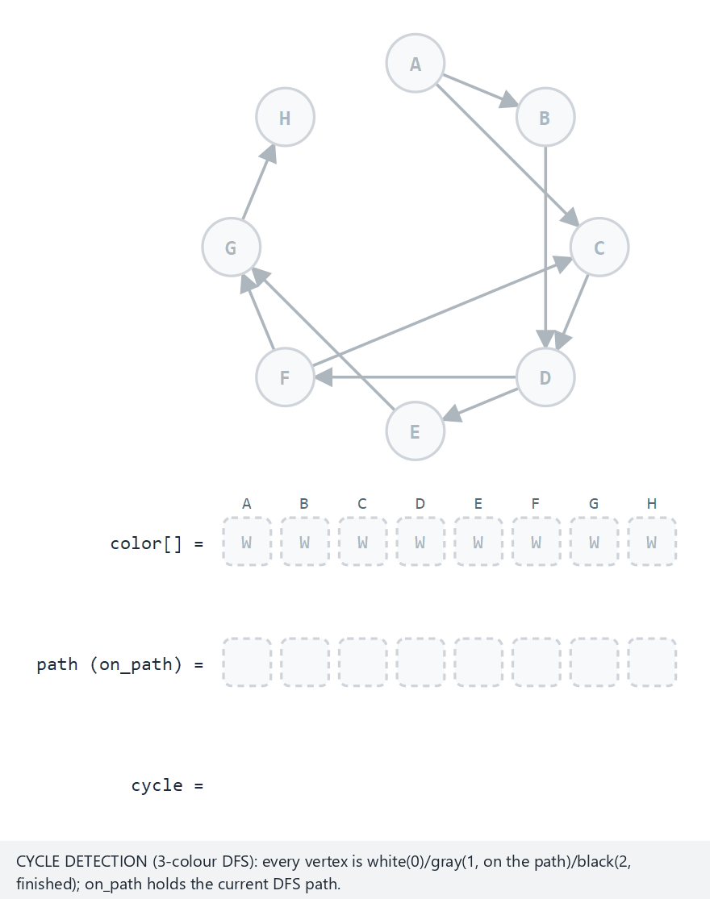
CEN207 Data Structures · Week 9
Cycle detection, directed graph
RTEU Computer Engineering · Fall 2026–2027
33
Notes:
Watch the cycle vertices turn red and get boxed below the graph.

Slide 34
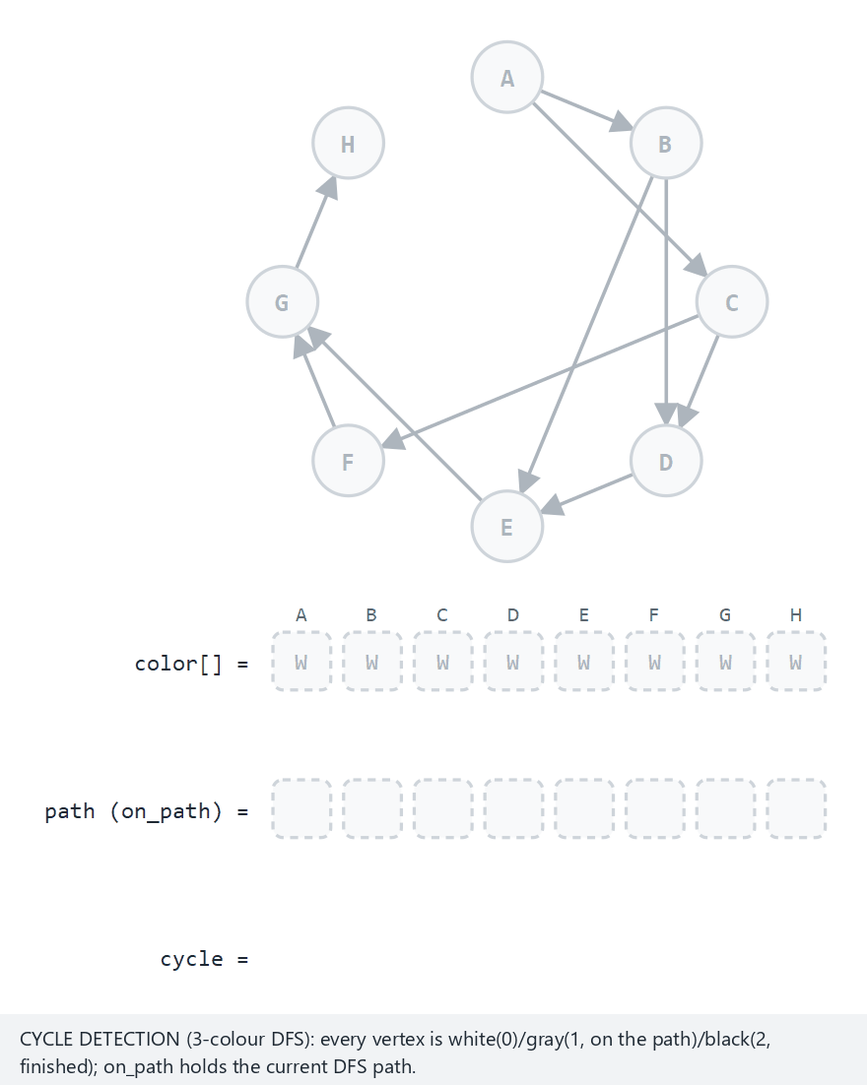
CEN207 Data Structures · Week 9
Edge case: no cycle at all
RTEU Computer Engineering · Fall 2026–2027
34
Notes:
Every vertex turns black, no back edge is ever found.

Slide 35
CEN207 Data Structures · Week 9
Real output: cycle detection
-- normal: 8 vertices, 10 edges, one cycle: C-D-F-C --
cycle found: D F C -> D
-- edge: 10 edges, entirely cycle-free (a DAG) --
no cycle found
-- edge: the smallest cycle, A-B-A (2 edges) --
cycle found: A B -> A
RTEU Computer Engineering · Fall 2026–2027
35
Notes:
A 2-vertex cycle is the smallest possible directed cycle -- a single edge can never be one.

Slide 36
CEN207 Data Structures · Week 9
Complexity & mistake
• O(V + E) — one DFS, plus O(V) to extract a found cycle
• Mistake: checking "not white" instead of "gray"
• A black neighbour is finished and safe — not a cycle
RTEU Computer Engineering · Fall 2026–2027
36
Notes:
This is the same trap as Section 1's forward/cross edges.

Slide 37
CEN207 Data Structures · Week 9
Mini question
Section 1's DFS topo-sort just sets has_cycle = 1. Why does THIS algorithm need the extra on_path[] stack at all?
(answer on the next slide)
RTEU Computer Engineering · Fall 2026–2027
37

Slide 38
CEN207 Data Structures · Week 9
Answer
Knowing a cycle exists is not the same as knowing which vertices form it.
on_path[] keeps the current root-to-here chain available, so the moment a back edge is found, the cycle can be read straight off it.
RTEU Computer Engineering · Fall 2026–2027
38
Notes:
This trade-off — a bit more bookkeeping for a lot more information — recurs all week.

Slide 39
CEN207 Data Structures · Week 9
3. Union-Find
RTEU Computer Engineering · Fall 2026–2027
39

Slide 40
CEN207 Data Structures · Week 9
A question to start
Kruskal's algorithm (coming up) must ask, over and over:
"Are these two vertices already connected by edges I picked?"
A fresh BFS every time would be correct — but slow.
RTEU Computer Engineering · Fall 2026–2027
40
Notes:
We need a structure built specifically for "same group?" queries.

Slide 41
CEN207 Data Structures · Week 9
A forest of parent pointers
• find(v) walks parent pointers up to the root
• Same root = same group
• union(a, b) merges two groups: root points to root
RTEU Computer Engineering · Fall 2026–2027
41
Notes:
Each group is a tiny tree; the root IS the group's identity.

Slide 42
CEN207 Data Structures · Week 9
Two tricks
• Union by rank: shorter tree hangs under the taller
• Path compression: find re-points every visited node straight at the root
• Together: O(α(n)) per operation — for all practical n, this is O(1)
RTEU Computer Engineering · Fall 2026–2027
42
Notes:
α is the inverse Ackermann function — under 5 for any n you could ever build.

Slide 43
CEN207 Data Structures · Week 9
Union-find code (C) — find
int find(int v) {
int root=v;
while (parent_of[root]!=root) root=parent_of[root];
while (parent_of[v]!=root) {
int next=parent_of[v];
parent_of[v]=root;
v=next;
}
return root;
}
RTEU Computer Engineering · Fall 2026–2027
43
Notes:
The second while loop is the path compression step -- it re-points every visited node at the root.

Slide 44
CEN207 Data Structures · Week 9
Union-find code (C) — union_sets
void union_sets(int a, int b) {
int ra=find(a), rb=find(b);
if (ra==rb) return;
if (rank_of[ra]<rank_of[rb]) parent_of[ra]=rb;
else if (rank_of[ra]>rank_of[rb]) parent_of[rb]=ra;
else { parent_of[rb]=ra; rank_of[ra]++; }
}
RTEU Computer Engineering · Fall 2026–2027
44
Notes:
Merging by ROOT, never by the raw a/b arguments, is the one rule that must never be broken here.

Slide 45
CEN207 Data Structures · Week 9
Union-find code (Java) — find
static int find(int v) {
int root=v;
while (parentOf[root]!=root) root=parentOf[root];
while (parentOf[v]!=root) {
int next=parentOf[v];
parentOf[v]=root;
v=next;
}
return root;
}
RTEU Computer Engineering · Fall 2026–2027
45
Notes:
Identical shape to the C version -- union-find translates almost line for line between languages.

Slide 46
CEN207 Data Structures · Week 9
Union-find code (Java) — unionSets
static void unionSets(int a, int b) {
int ra=find(a), rb=find(b);
if (ra==rb) return;
if (rankOf[ra]<rankOf[rb]) parentOf[ra]=rb;
else if (rankOf[ra]>rankOf[rb]) parentOf[rb]=ra;
else { parentOf[rb]=ra; rankOf[ra]++; }
}
RTEU Computer Engineering · Fall 2026–2027
46
Notes:
Same rank-comparison ladder as the C version.

Slide 47
CEN207 Data Structures · Week 9
Real output: union-find
union(A, B): merged, new root = A
union(C, D): merged, new root = C
union(A, C): merged, new root = A
find(D) = A
union(B, H): already the same set (A)
final sets: A->A B->A C->A D->A E->A F->A G->A H->A
RTEU Computer Engineering · Fall 2026–2027
47
Notes:
"already the same set" is not an error -- union() on an already-merged pair is always safe, a no-op.

Slide 48
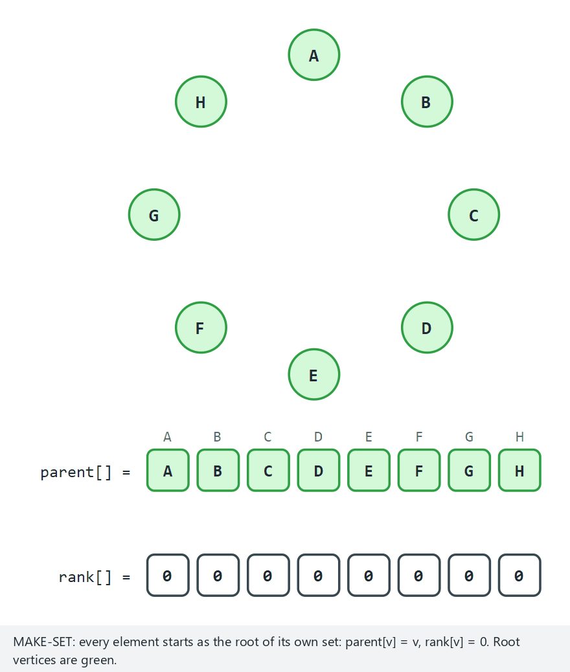
CEN207 Data Structures · Week 9
Union-find: rank + path compression
RTEU Computer Engineering · Fall 2026–2027
48
Notes:
Watch a genuine depth-2 chain flatten to depth 1 in one find() call.

Slide 49
CEN207 Data Structures · Week 9
Complexity & mistake
• ~O(1) amortised per operation, with both tricks
• Mistake: union(a, b) comparing a, b directly
• Must merge roots — find(a), find(b) — never raw arguments
RTEU Computer Engineering · Fall 2026–2027
49
Notes:
Merging raw arguments can create a node with two parents.

Slide 50
CEN207 Data Structures · Week 9
Mini question
Rank counts height, not the number of elements in a set. Why not just track set size instead?
(answer on the next slide)
RTEU Computer Engineering · Fall 2026–2027
50

Slide 51
CEN207 Data Structures · Week 9
Answer
Size works too, and is a common alternative — "union by size" hangs the smaller set under the larger one.
Both give the same O(α(n)) guarantee; rank is the classical presentation because it directly bounds tree height, which is what find actually pays for.
RTEU Computer Engineering · Fall 2026–2027
51
Notes:
Some textbooks use "union by size" exclusively — both are correct, this course picks rank for the height argument.

Slide 52
CEN207 Data Structures · Week 9
4. Minimum Spanning Trees
RTEU Computer Engineering · Fall 2026–2027
52

Slide 53
CEN207 Data Structures · Week 9
A question to start
Connect n towns with power lines. Any pair could link directly, at a cost.
What is the cheapest set of lines that still connects everything?
RTEU Computer Engineering · Fall 2026–2027
53
Notes:
Not every pair needs a direct line — just everyone reachable from everyone.

Slide 54
CEN207 Data Structures · Week 9
A short history
• Joseph Kruskal, 1956
• Robert Prim, 1957 (rediscovering Jarník, 1930)
• Same problem, two structurally different greedy solutions
• Both provably safe: the cut property
RTEU Computer Engineering · Fall 2026–2027
54
Notes:
The cheapest edge crossing any partition of the vertices must belong to some MST.

Slide 55
CEN207 Data Structures · Week 9
Kruskal's idea
• Sort all edges by weight, once
• Scan cheapest-first; add an edge unless it closes a cycle
• Cycle check: union-find, near O(1)
• Disconnected graph → a spanning forest
RTEU Computer Engineering · Fall 2026–2027
55
Notes:
Kruskal doesn't care where the tree "is" — it just avoids cycles globally.

Slide 56
CEN207 Data Structures · Week 9
Prim's idea
• Grow one tree from a start vertex
• Add the cheapest edge from inside to outside
• key[v] = cheapest edge connecting v to the tree so far
• Never reaches a different component: key stays "infinite"
RTEU Computer Engineering · Fall 2026–2027
56
Notes:
This is the same "priority queue as a row" idea we'll reuse for Dijkstra.

Slide 57
CEN207 Data Structures · Week 9
Kruskal's code (C) — part 1/2
int kruskal_mst(Edge *sorted, int edge_count,
Edge *mst_out, int *total_out) {
for (int v=0;v<vertex_count;v++)
{ parent_of[v]=v; rank_of[v]=0; }
qsort(sorted, edge_count, sizeof(Edge), cmp_weight);
int mst_len=0, total=0;
RTEU Computer Engineering · Fall 2026–2027
57
Notes:
A fresh union-find, then one global sort by weight -- exactly as described a slide ago.

Slide 58
CEN207 Data Structures · Week 9
Kruskal's code (C) — part 2/2
for (int i=0;i<edge_count;i++) {
if (find(sorted[i].a)==find(sorted[i].b))
continue;
union_sets(sorted[i].a, sorted[i].b);
mst_out[mst_len++]=sorted[i];
total+=sorted[i].w;
}
*total_out=total;
return mst_len;
}
RTEU Computer Engineering · Fall 2026–2027
58
Notes:
find and union_sets are exactly Section 3's union-find, unchanged.

Slide 59
CEN207 Data Structures · Week 9
Kruskal's code (Java) — part 1/2
static int kruskalMst(Edge[] sorted,
Edge[] mstOut, int[] totalOut) {
for (int v=0;v<vertexCount;v++)
{ parentOf[v]=v; rankOf[v]=0; }
Arrays.sort(sorted, Comparator.comparingInt(
(Edge e) -> e.w).thenComparingInt(e -> e.idx));
int mstLen=0, total=0;
RTEU Computer Engineering · Fall 2026–2027
59
Notes:
Java's Comparator chain replaces C's qsort + comparator function -- same tie-break, different syntax.

Slide 60
CEN207 Data Structures · Week 9
Kruskal's code (Java) — part 2/2
for (Edge e : sorted) {
if (find(e.a)==find(e.b)) continue;
unionSets(e.a, e.b);
mstOut[mstLen]=e; mstLen++;
total+=e.w;
}
totalOut[0]=total;
return mstLen;
}
RTEU Computer Engineering · Fall 2026–2027
60
Notes:
Same loop shape as the C version's second half.

Slide 61
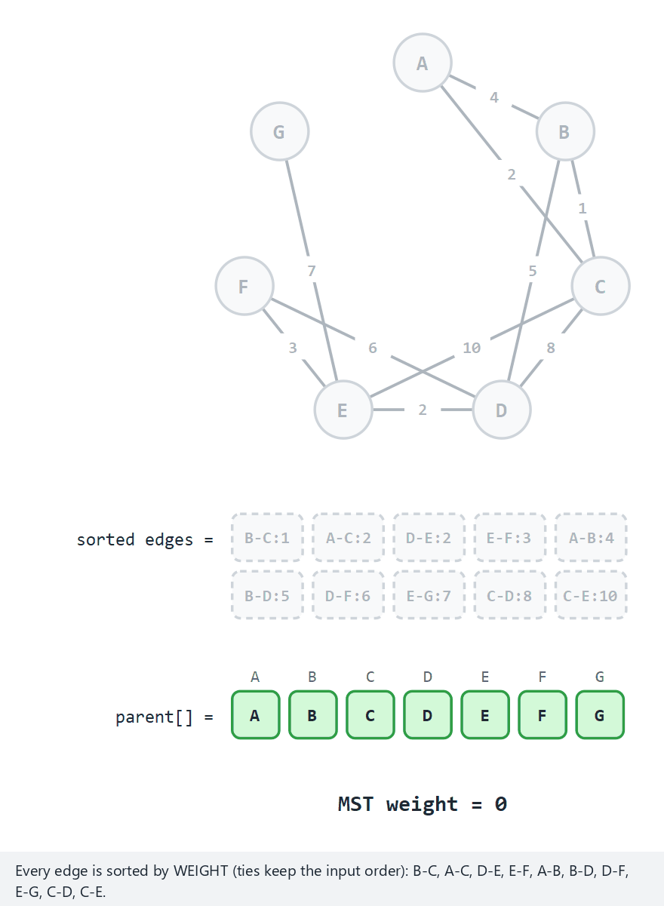
CEN207 Data Structures · Week 9
Kruskal's MST
RTEU Computer Engineering · Fall 2026–2027
61
Notes:
The sorted-edges row and the parent[] row grow together.

Slide 62
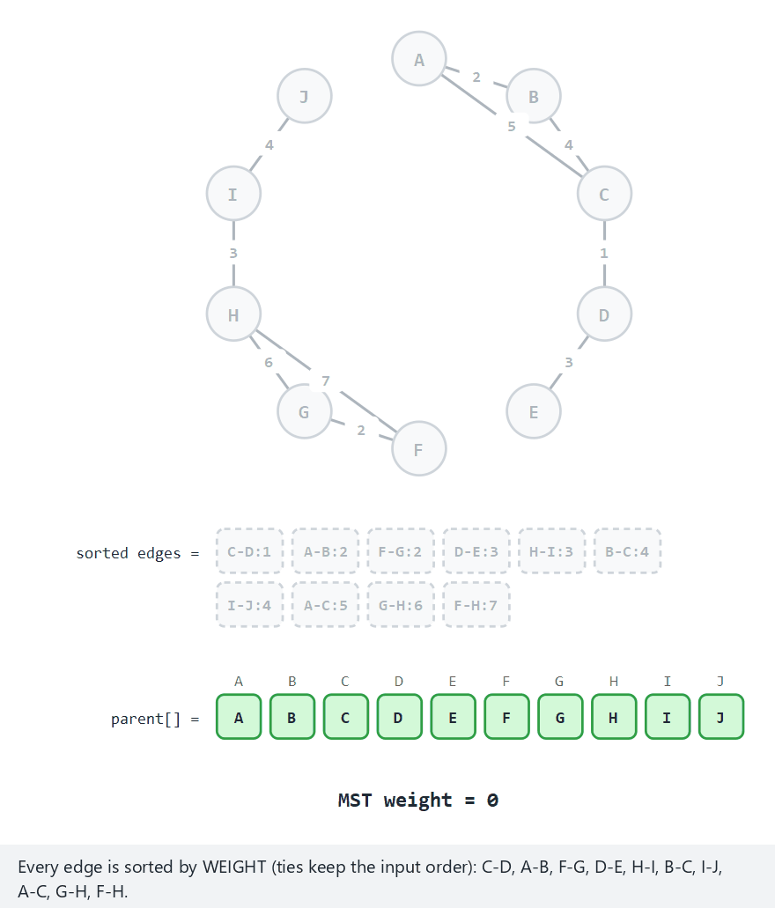
CEN207 Data Structures · Week 9
Edge case: a spanning forest
RTEU Computer Engineering · Fall 2026–2027
62
Notes:
Two components in, two trees out — no error, just a forest.

Slide 63
CEN207 Data Structures · Week 9
Real output: Kruskal's MST
-- normal: 7 vertices, 10 edges, one component --
MST edges: B-C:1 A-C:2 D-E:2 E-F:3 B-D:5 E-G:7
total weight = 20
components = 1
-- edge: 10 edges, 2 components -- a spanning FOREST --
MST edges: C-D:1 A-B:2 F-G:2 D-E:3 H-I:3 B-C:4 I-J:4 G-H:6
total weight = 25
components = 2 (a spanning forest)
RTEU Computer Engineering · Fall 2026–2027
63
Notes:
Two components in, two separate trees out, added together into one edge list.

Slide 64
CEN207 Data Structures · Week 9
Prim's code (C) — part 1/2
int prim_mst(Graph *g, int start,
Edge *mst_out, int *total_out) {
for (int v=0;v<g->vertex_count;v++)
{ key_of[v]=INF; in_mst[v]=0; parent_of[v]=-1; }
key_of[start]=0;
int mst_len=0, total=0;
for (int count=0;count<g->vertex_count;count++) {
int u=min_key_vertex(g->vertex_count);
if (u==-1 || key_of[u]==INF) break;
in_mst[u]=1;
RTEU Computer Engineering · Fall 2026–2027
64
Notes:
key_of[] IS the priority-queue row shown below the graph in the animation.

Slide 65
CEN207 Data Structures · Week 9
Prim's code (C) — part 2/2
if (parent_of[u]!=-1) {
mst_out[mst_len].a=parent_of[u];
mst_out[mst_len].b=u;
mst_out[mst_len].w=key_of[u];
mst_len++; total+=key_of[u];
}
for (AdjNode *n=g->adj[u]; n; n=n->next)
if (!in_mst[n->to] && n->weight<key_of[n->to])
{ key_of[n->to]=n->weight;
parent_of[n->to]=u; }
}
*total_out=total;
return mst_len;
}
RTEU Computer Engineering · Fall 2026–2027
65
Notes:
Record the edge that just brought u into the tree, then relax u's neighbours.

Slide 66
CEN207 Data Structures · Week 9
Prim's code (Java) — part 1/2
static int primMst(Graph g, int start,
Edge[] mstOut, int[] totalOut) {
for (int v=0;v<g.vertexCount;v++)
{ keyOf[v]=INF; inMst[v]=false; parentOf[v]=-1; }
keyOf[start]=0;
int mstLen=0, total=0;
for (int count=0;count<g.vertexCount;count++) {
int u=minKeyVertex(g.vertexCount);
if (u==-1 || keyOf[u]==INF) break;
inMst[u]=true;
RTEU Computer Engineering · Fall 2026–2027
66
Notes:
Same shape as the C version so far.

Slide 67
CEN207 Data Structures · Week 9
Prim's code (Java) — part 2/2
if (parentOf[u]!=-1) {
mstOut[mstLen]=new Edge();
mstOut[mstLen].a=parentOf[u];
mstOut[mstLen].b=u;
mstOut[mstLen].w=keyOf[u];
mstLen++; total+=keyOf[u];
}
for (AdjNode n=g.adj[u]; n!=null; n=n.next)
if (!inMst[n.to] && n.weight<keyOf[n.to])
{ keyOf[n.to]=n.weight; parentOf[n.to]=u; }
}
totalOut[0]=total;
return mstLen;
}
RTEU Computer Engineering · Fall 2026–2027
67
Notes:
Java allocates a new Edge object per MST edge; C fills a pre-allocated array slot -- the only real difference.

Slide 68
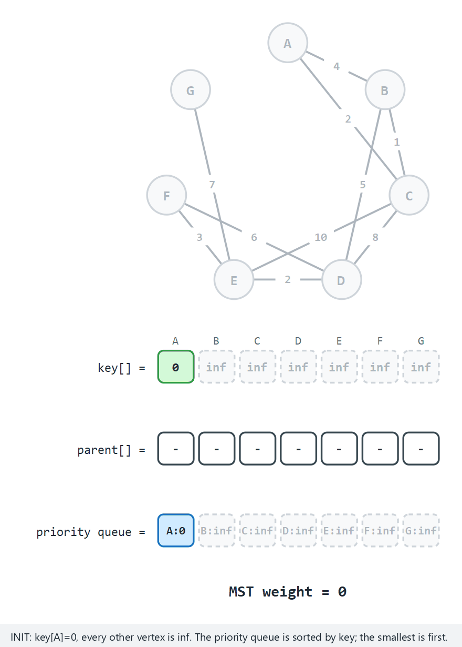
CEN207 Data Structures · Week 9
Prim's MST
RTEU Computer Engineering · Fall 2026–2027
68
Notes:
Same "normal" graph as Kruskal's — compare the two MSTs: same total weight.

Slide 69
CEN207 Data Structures · Week 9
Real output: Prim's MST
-- normal: 7 vertices, 10 edges, starts at A --
MST edges: A-C:2 C-B:1 B-D:5 D-E:2 E-F:3 E-G:7
total weight = 20
-- edge: 2 components, starts at A -- F..J never reached --
MST edges: A-B:2 B-C:4 C-D:1 D-E:3
total weight = 10
unreached: F G H I J
RTEU Computer Engineering · Fall 2026–2027
69
Notes:
total weight = 20, matching Kruskal's on the same normal graph -- a nice cross-check to show live.

Slide 70
CEN207 Data Structures · Week 9
Complexity table
Algorithm | Time | Note
Kruskal | O(E log E) | sort dominates
Prim (array) | O(V^2) | matches Dijkstra's shape
Prim (heap) | O(E log V) | better on dense graphs
RTEU Computer Engineering · Fall 2026–2027
70
Notes:
We use the array version so the priority queue is a visible, simple row.

Slide 71
CEN207 Data Structures · Week 9
Mini question
Could Prim ever pick a more expensive edge than Kruskal, on the same graph?
(answer: no — see next slide)
RTEU Computer Engineering · Fall 2026–2027
71

Slide 72
CEN207 Data Structures · Week 9
Answer
No. Both are provably optimal (cut property).
Every MST of a graph has the same total weight — they can differ only in which edges they pick, when weights tie.
RTEU Computer Engineering · Fall 2026–2027
72
Notes:
Total weight is invariant; the specific edge set is not, under ties.

Slide 73
CEN207 Data Structures · Week 9
5. Single-Source Shortest Paths
RTEU Computer Engineering · Fall 2026–2027
73

Slide 74
CEN207 Data Structures · Week 9
A question to start
A road network, weighted by distance. Starting from one city,
what is the cheapest way to reach every other city?
RTEU Computer Engineering · Fall 2026–2027
74
Notes:
Not "fewest edges" (Week 5's BFS) — cheapest total weight.

Slide 75
CEN207 Data Structures · Week 9
A short history
• Edsger Dijkstra, 1956 (published 1959)
• A 20-minute exercise to demo a new computer
• Still the standard answer when every weight is non-negative
RTEU Computer Engineering · Fall 2026–2027
75
Notes:
Dijkstra later said he designed it without pencil and paper, on a terrace in Amsterdam.

Slide 76
CEN207 Data Structures · Week 9
Dijkstra's idea
• dist[v] = cheapest total path found so far
• Pick the not-yet-finished vertex with smallest dist
• Once picked: final, can never shrink again
• Only true because no edge weight is negative
RTEU Computer Engineering · Fall 2026–2027
76
Notes:
Prim's algorithm with one change: "cheapest edge in" becomes "cheapest path so far".

Slide 77
CEN207 Data Structures · Week 9
Why negative weights break it
A vertex popped "final" early could later be beaten by a path through a very negative edge — discovered after it was already finalised.
RTEU Computer Engineering · Fall 2026–2027
77
Notes:
This is exactly why Dijkstra refuses negative input in our program.

Slide 78
CEN207 Data Structures · Week 9
Dijkstra's code (C) — part 1/2
void dijkstra(Graph *g, int start) {
for (int v=0;v<g->vertex_count;v++)
{ dist_of[v]=INF; done[v]=0; parent_of[v]=-1; }
dist_of[start]=0;
for (int count=0;count<g->vertex_count;count++) {
int u=min_dist_vertex(g->vertex_count);
if (u==-1 || dist_of[u]==INF) break;
done[u]=1;
RTEU Computer Engineering · Fall 2026–2027
78
Notes:
min_dist_vertex is the "priority queue" step, shown as a row in the animation.

Slide 79
CEN207 Data Structures · Week 9
Dijkstra's code (C) — part 2/2
for (AdjNode *n=g->adj[u]; n; n=n->next) {
int cand=dist_of[u]+n->weight;
if (!done[n->to] && cand<dist_of[n->to])
{ dist_of[n->to]=cand; parent_of[n->to]=u; }
}
}
}
RTEU Computer Engineering · Fall 2026–2027
79
Notes:
Relax every not-yet-done neighbour of the just-finalised vertex u.

Slide 80
CEN207 Data Structures · Week 9
Dijkstra's code (Java) — part 1/2
static void dijkstra(Graph g, int start) {
for (int v=0;v<g.vertexCount;v++)
{ distOf[v]=INF; done[v]=false; parentOf[v]=-1; }
distOf[start]=0;
for (int count=0;count<g.vertexCount;count++) {
int u=minDistVertex(g.vertexCount);
if (u==-1 || distOf[u]==INF) break;
done[u]=true;
RTEU Computer Engineering · Fall 2026–2027
80
Notes:
Same shape as the C version so far.

Slide 81
CEN207 Data Structures · Week 9
Dijkstra's code (Java) — part 2/2
for (AdjNode n=g.adj[u]; n!=null; n=n.next) {
int cand=distOf[u]+n.weight;
if (!done[n.to] && cand<distOf[n.to])
{ distOf[n.to]=cand; parentOf[n.to]=u; }
}
}
}
RTEU Computer Engineering · Fall 2026–2027
81
Notes:
minDistVertex is a small linear scan -- the Java and C versions are effectively identical.

Slide 82
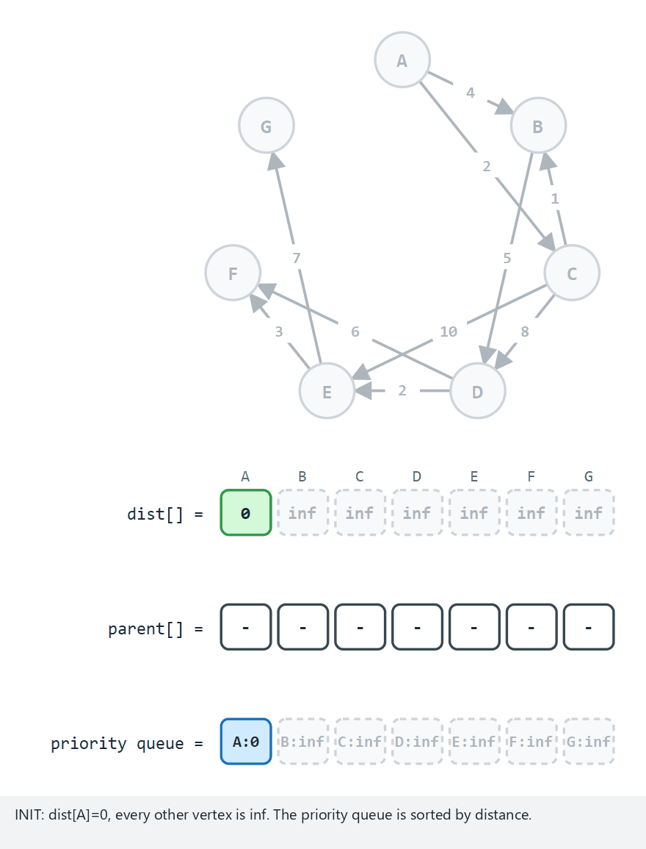
CEN207 Data Structures · Week 9
Dijkstra's shortest path
RTEU Computer Engineering · Fall 2026–2027
82
Notes:
The priority queue row is a plain sorted array, not a heap.

Slide 83
CEN207 Data Structures · Week 9
Real output: Dijkstra
-- normal: 8 vertices, 10 edges, starts at A --
distances: A=0 B=3 C=2 D=8 E=10 F=13 G=17
-- edge: F..J never reachable via the directed edges --
distances: A=0 B=2 C=5 D=6 E=9 F=inf G=inf H=inf I=inf J=inf
RTEU Computer Engineering · Fall 2026–2027
83
Notes:
"inf" prints exactly when a vertex was never reached -- the program's own sentinel, not a crash.

Slide 84
CEN207 Data Structures · Week 9
Bellman-Ford: negative weights OK
• Bellman & Ford, late 1950s
• Give up "pop the minimum" entirely
• Relax every edge, fixed order, up to V - 1 rounds
• A V-th round that still improves = a negative cycle
RTEU Computer Engineering · Fall 2026–2027
84
Notes:
V-1 rounds are exactly enough for the longest possible shortest path to propagate.

Slide 85
CEN207 Data Structures · Week 9
Bellman-Ford's code (C) — part 1/2
int bellman_ford(Graph *g, int start) {
for (int v=0;v<g->vertex_count;v++)
{ dist_of[v]=INF; parent_of[v]=-1; }
dist_of[start]=0;
for (int p=1;p<=g->vertex_count-1;p++) {
int changed=0;
for (int u=0;u<g->vertex_count;u++) {
if (dist_of[u]==INF) continue;
RTEU Computer Engineering · Fall 2026–2027
85
Notes:
Up to V-1 rounds, skipping any vertex not yet reached at all.

Slide 86
CEN207 Data Structures · Week 9
Bellman-Ford's code (C) — part 2/2
for (AdjNode *n=g->adj[u]; n; n=n->next) {
int cand=dist_of[u]+n->weight;
if (cand<dist_of[n->to])
{ dist_of[n->to]=cand;
parent_of[n->to]=u; changed=1; }
}
}
if (!changed) break;
}
/* one more pass detects a negative cycle */
}
RTEU Computer Engineering · Fall 2026–2027
86
Notes:
The early-exit "if (!changed) break" is a common, correct optimisation.

Slide 87
CEN207 Data Structures · Week 9
Bellman-Ford's code (Java) — part 1/2
static boolean bellmanFord(Graph g, int start) {
for (int v=0;v<g.vertexCount;v++)
{ distOf[v]=INF; parentOf[v]=-1; }
distOf[start]=0;
for (int pass=1;pass<=g.vertexCount-1;pass++) {
boolean changed=false;
for (int u=0;u<g.vertexCount;u++) {
if (distOf[u]==INF) continue;
RTEU Computer Engineering · Fall 2026–2027
87
Notes:
Same shape as the C version so far.

Slide 88
CEN207 Data Structures · Week 9
Bellman-Ford's code (Java) — part 2/2
for (AdjNode n=g.adj[u]; n!=null; n=n.next) {
int cand=distOf[u]+n.weight;
if (cand<distOf[n.to])
{ distOf[n.to]=cand;
parentOf[n.to]=u; changed=true; }
}
}
if (!changed) break;
}
/* one more pass detects a negative cycle */
}
RTEU Computer Engineering · Fall 2026–2027
88
Notes:
boolean replaces C's int flag -- otherwise line-for-line identical.

Slide 89
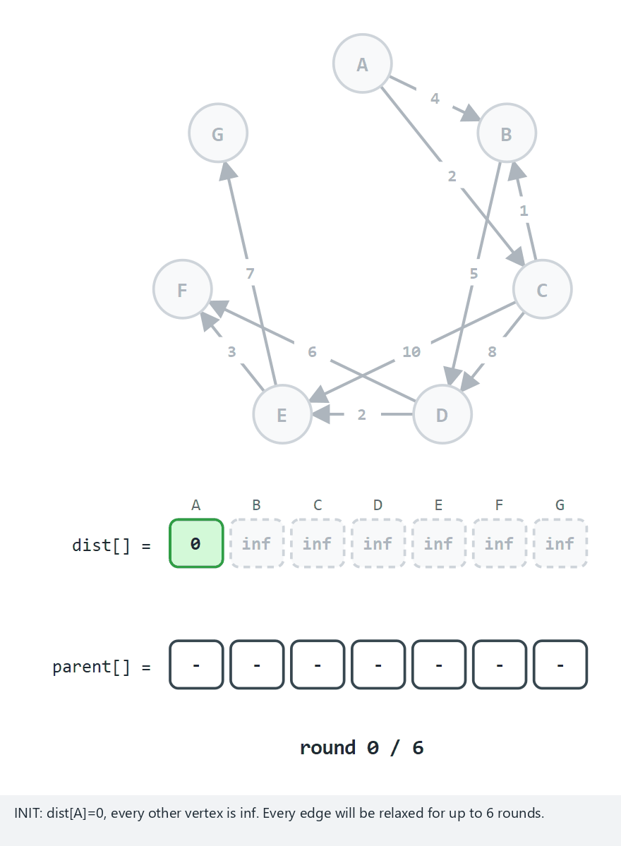
CEN207 Data Structures · Week 9
Bellman-Ford shortest path
RTEU Computer Engineering · Fall 2026–2027
89
Notes:
Watch the round counter and the detection round at the end.

Slide 90
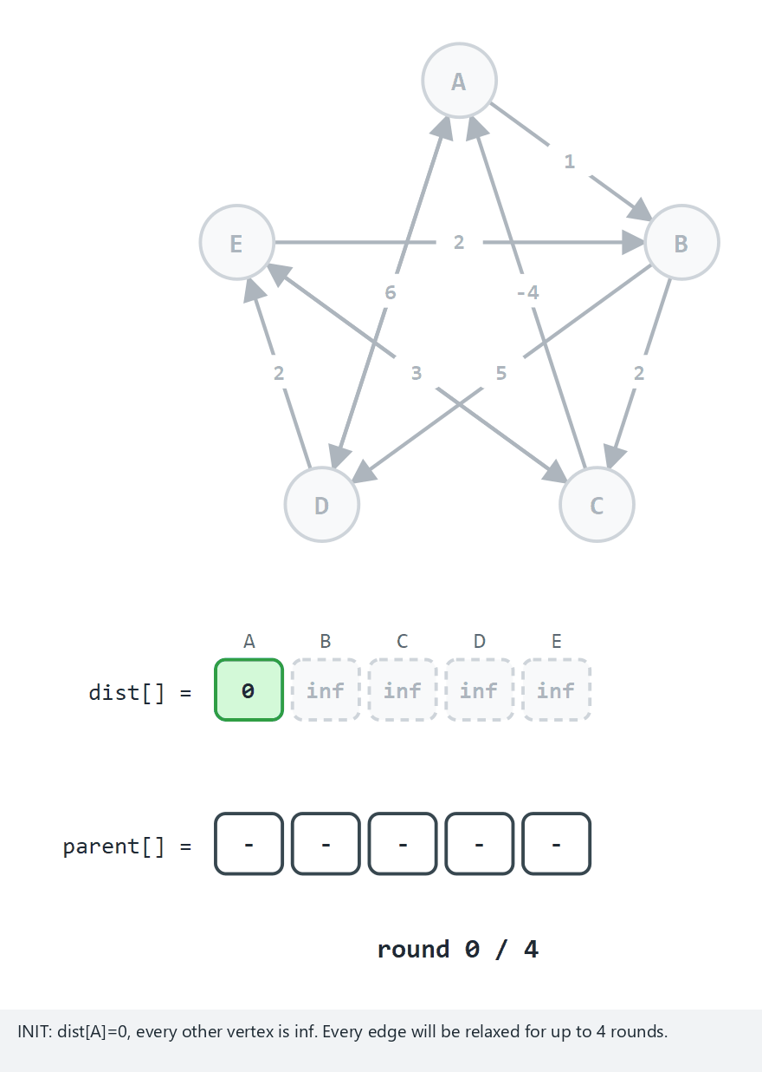
CEN207 Data Structures · Week 9
Required edge case: negative cycle
RTEU Computer Engineering · Fall 2026–2027
90
Notes:
A-B-C-A sums to -1. The detection round finds a still-relaxable edge.

Slide 91
CEN207 Data Structures · Week 9
Real output: Bellman-Ford
-- normal: 7 vertices, all positive, starts at A --
distances: A=0 B=3 C=2 D=8 E=10 F=13 G=17
no negative cycle
-- edge: A-B-C-A is a negative cycle (total -1) --
distances: A=-4 B=-2 C=0 D=0 E=1
negative cycle detected
RTEU Computer Engineering · Fall 2026–2027
91
Notes:
Same starting graph shape as Dijkstra's -- compare the two "distances:" lines side by side.

Slide 92
CEN207 Data Structures · Week 9
Complexity table
Algorithm | Time | Handles negatives?
Dijkstra | O(V^2) | No
Bellman-Ford | O(V*E) | Yes
RTEU Computer Engineering · Fall 2026–2027
92
Notes:
Bellman-Ford's price for tolerating negatives is a much slower worst case.

Slide 93
CEN207 Data Structures · Week 9
Mini question
Why exactly V - 1 rounds for Bellman-Ford, not V or V/2?
(answer on the next slide)
RTEU Computer Engineering · Fall 2026–2027
93

Slide 94
CEN207 Data Structures · Week 9
Answer
A shortest path (no negative cycle) never repeats a vertex — at most V - 1 edges.
Each round extends every path's "confirmed" prefix by one edge. V - 1 rounds confirm the longest possible shortest path.
RTEU Computer Engineering · Fall 2026–2027
94
Notes:
Repeating a vertex means looping through non-negative extra weight — never an improvement.

Slide 95
CEN207 Data Structures · Week 9
6. All-Pairs Shortest Paths
RTEU Computer Engineering · Fall 2026–2027
95

Slide 96
CEN207 Data Structures · Week 9
A question to start
A flight-booking system needs the cheapest fare between every pair of ~20 cities, at once.
Running Dijkstra 20 times works — is there a way to share the work?
RTEU Computer Engineering · Fall 2026–2027
96
Notes:
20 * O(V^2) vs. one shared O(V^3) computation.

Slide 97
CEN207 Data Structures · Week 9
A short history
• Robert Floyd & Stephen Warshall, both 1962
• Independent, closely related matrix algorithms
• Combined algorithm carries both names
RTEU Computer Engineering · Fall 2026–2027
97
Notes:
Warshall's was for reachability; Floyd's for shortest distances.

Slide 98
CEN207 Data Structures · Week 9
The idea
• An N x N matrix dist[i][j]
• For every vertex k: is i -> k -> j shorter than dist[i][j]?
• Try every vertex as an intermediate stop
• Update in place — safe, since dist[i][k]/dist[k][j] never change mid-pass
RTEU Computer Engineering · Fall 2026–2027
98
Notes:
This in-place safety is a rare, pleasant simplification.

Slide 99
CEN207 Data Structures · Week 9
Floyd-Warshall's code (C)
void floyd_warshall(int vertex_cnt) {
for (int k=0;k<vertex_cnt;k++) {
for (int i=0;i<vertex_cnt;i++) {
for (int j=0;j<vertex_cnt;j++) {
if (dist[i][k]==INF || dist[k][j]==INF)
continue;
int through=dist[i][k]+dist[k][j];
if (through<dist[i][j])
dist[i][j]=through;
}
}
}
}
RTEU Computer Engineering · Fall 2026–2027
99
Notes:
k must be the OUTERMOST loop — that's the whole correctness argument.

Slide 100
CEN207 Data Structures · Week 9
Floyd-Warshall's code (Java)
static void floydWarshall(int vertexCnt) {
for (int k=0;k<vertexCnt;k++) {
for (int i=0;i<vertexCnt;i++) {
for (int j=0;j<vertexCnt;j++) {
if (dist[i][k]==INF || dist[k][j]==INF)
continue;
int through=dist[i][k]+dist[k][j];
if (through<dist[i][j])
dist[i][j]=through;
}
}
}
}
RTEU Computer Engineering · Fall 2026–2027
100
Notes:
dist is a Java 2-D array here, vs. C's dist[i][k] on a fixed-size static array -- same access pattern.

Slide 101
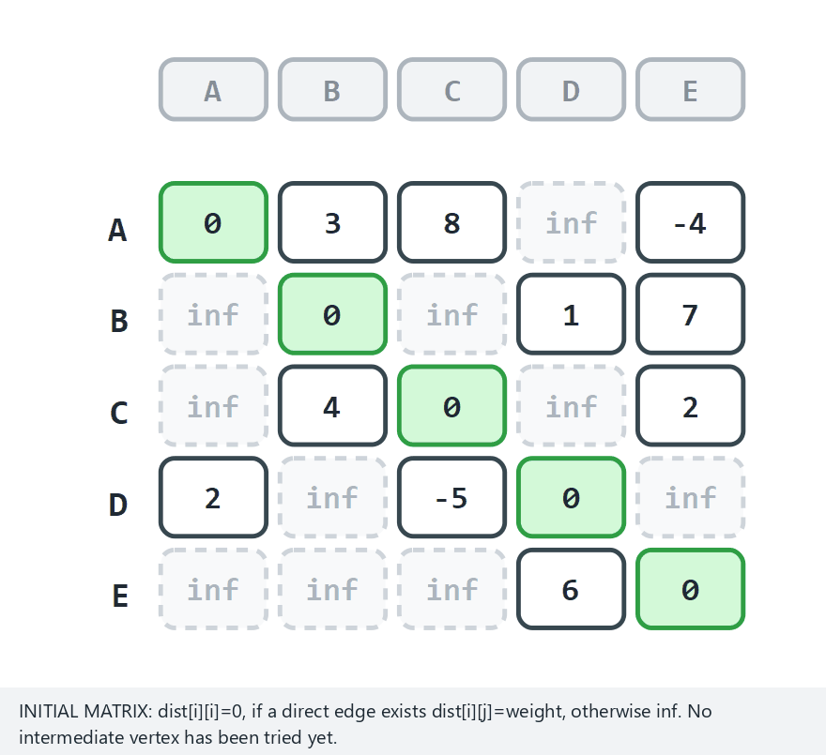
CEN207 Data Structures · Week 9
Floyd-Warshall: the matrix fills in
RTEU Computer Engineering · Fall 2026–2027
101
Notes:
One step per intermediate vertex k — not per (i,j) pair, or this would be far too many steps.

Slide 102
CEN207 Data Structures · Week 9
Real output: Floyd-Warshall
-- normal: 5 vertices, negative edges but no negative cycle --
A B C E D
A 0 1 -3 -4 2
B 3 0 -4 -2 1
C 7 4 0 2 5
no negative cycle
-- edge: A-B-C-A is a negative cycle --
negative cycle at: A B C
RTEU Computer Engineering · Fall 2026–2027
102
Notes:
A negative diagonal entry (dist[A][A] < 0) is exactly what flags a negative cycle through that vertex.

Slide 103
CEN207 Data Structures · Week 9
Complexity & mistake
• O(V^3) time, O(V^2) space
• Practical for a few hundred vertices, not more
• Mistake: k as the innermost loop silently computes garbage
• Mistake: forgetting the == INF guard → integer overflow
RTEU Computer Engineering · Fall 2026–2027
103
Notes:
INF + INF can wrap around to a large negative number without the guard.

Slide 104
CEN207 Data Structures · Week 9
Mini question
Bellman-Ford finds negative cycles reachable from one start. Floyd-Warshall's diagonal check finds them differently — how?
(answer on the next slide)
RTEU Computer Engineering · Fall 2026–2027
104

Slide 105
CEN207 Data Structures · Week 9
Answer
Any dist[v][v] that drops below zero means: a path leaves v and comes back cheaper than staying put.
Since Floyd-Warshall computes every pair, this check runs for every vertex at once — no separate start vertex needed.
RTEU Computer Engineering · Fall 2026–2027
105
Notes:
This is a nice payoff of solving the harder, more general problem: some questions become simpler, not harder.

Slide 106
CEN207 Data Structures · Week 9
7. Strongly Connected Components
RTEU Computer Engineering · Fall 2026–2027
106

Slide 107
CEN207 Data Structures · Week 9
A question to start
Which groups of vertices can reach each other and get back, respecting edge direction?
Web pages linking in a cycle. Mutually-recursive functions.
RTEU Computer Engineering · Fall 2026–2027
107
Notes:
Week 5's connected components ignore direction entirely — this is the directed version.

Slide 108
CEN207 Data Structures · Week 9
Kosaraju's idea
• Sergei Kosaraju, ~1978 (credited via Micali & Vazirani, 1981)
• Phase 1: DFS, record every vertex's finish time
• Phase 2: DFS the transpose (edges reversed)
• Visit roots in decreasing finish-time order
• Each DFS tree in phase 2 = one SCC
RTEU Computer Engineering · Fall 2026–2027
108
Notes:
Chosen over Tarjan's one-pass algorithm because it reuses Section 1's exact DFS + finish time.

Slide 109
CEN207 Data Structures · Week 9
Kosaraju's code (C)
void dfs1(int u) { /* phase 1 */
visited[u]=1;
for (AdjNode *n=cur_g->adj[u]; n; n=n->next)
if (!visited[n->to]) dfs1(n->to);
finish[finish_len++]=u;
}
void dfs2(int u, int id) { /* phase 2, on adjT */
visited[u]=1; comp_of[u]=id;
for (AdjNode *n=cur_g->adjT[u]; n; n=n->next)
if (!visited[n->to]) dfs2(n->to, id);
}
RTEU Computer Engineering · Fall 2026–2027
109
Notes:
dfs1 and dfs2 look almost identical — the only difference is adj vs adjT.

Slide 110
CEN207 Data Structures · Week 9
Kosaraju's code (Java)
static void dfs1(int u) { // phase 1
visited[u]=1;
for (AdjNode n=curG.adj[u]; n!=null; n=n.next)
if (visited[n.to]==0) dfs1(n.to);
finish[finishLen]=u; finishLen++;
}
static void dfs2(int u, int id) { // phase 2, on adjT
visited[u]=1; compOf[u]=id;
for (AdjNode n=curG.adjT[u]; n!=null; n=n.next)
if (visited[n.to]==0) dfs2(n.to, id);
}
RTEU Computer Engineering · Fall 2026–2027
110
Notes:
adjT is the transpose graph, built once alongside adj when the Graph is constructed.

Slide 111
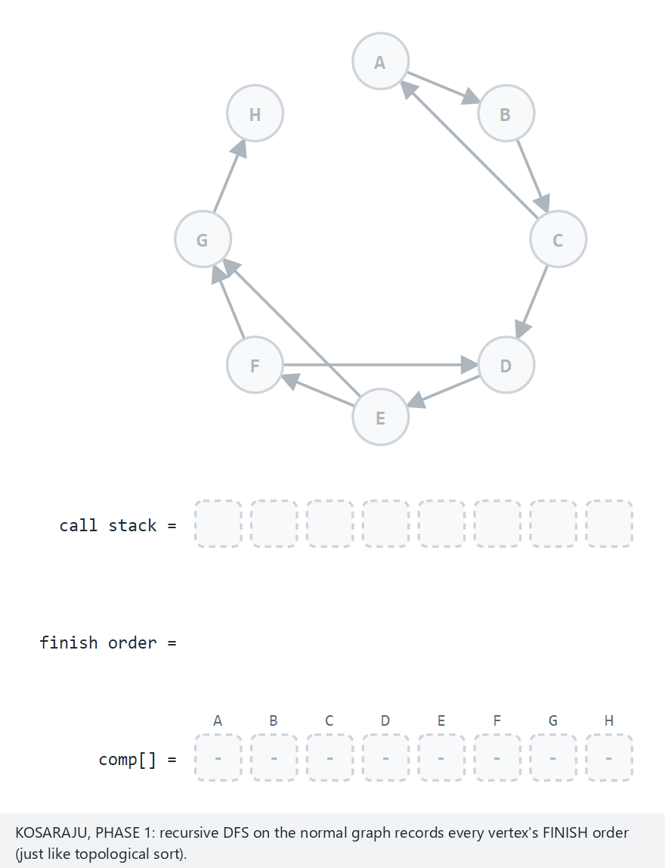
CEN207 Data Structures · Week 9
Strongly connected components
RTEU Computer Engineering · Fall 2026–2027
111
Notes:
Watch phase 1's finish order, then phase 2's transpose-graph DFS trees.

Slide 112
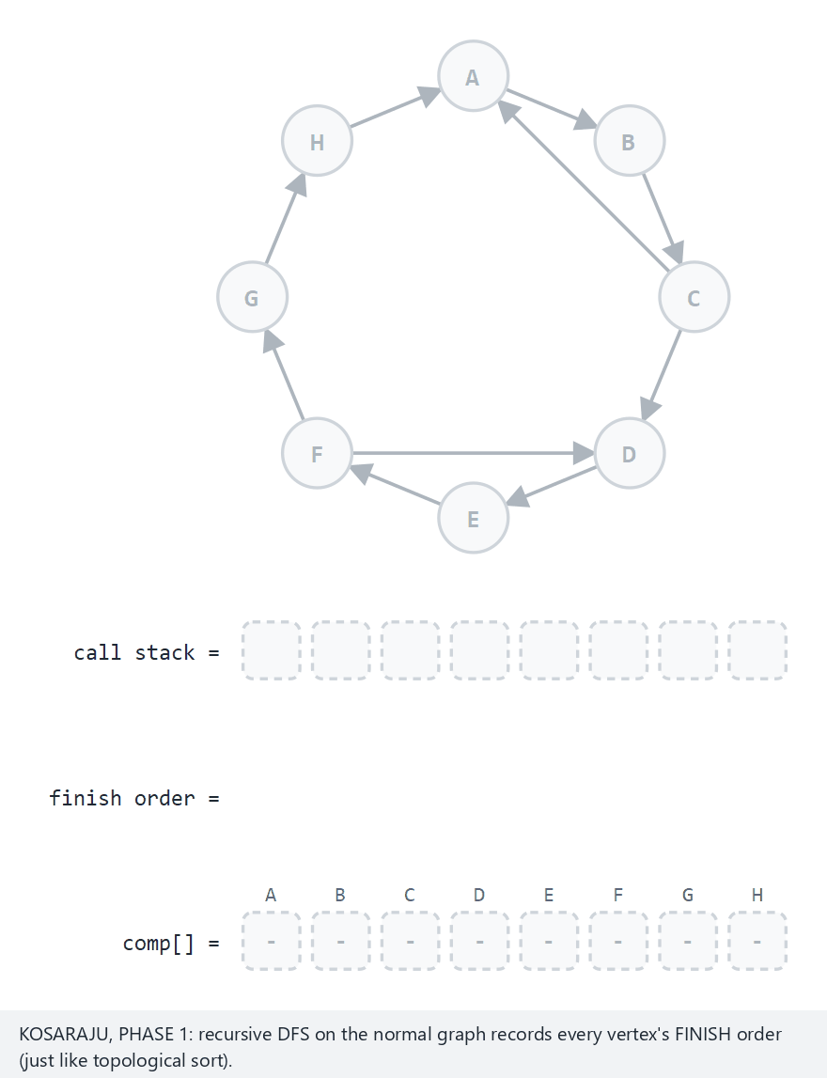
CEN207 Data Structures · Week 9
Edge case: one big cycle
RTEU Computer Engineering · Fall 2026–2027
112
Notes:
When everything can reach everything, there is exactly one SCC.

Slide 113
CEN207 Data Structures · Week 9
Real output: strongly connected components
-- normal: 8 vertices, 2 cyclic components + 2 singletons --
4 components:
A B C
D E F
G
H
-- edge: everything is one big cycle --
1 component:
A B C D E F G H
RTEU Computer Engineering · Fall 2026–2027
113
Notes:
A single vertex with no cycle through it is still a valid SCC -- just a component of size one.

Slide 114
CEN207 Data Structures · Week 9
Complexity & mistake
• O(V + E) — two full DFS passes
• Mistake: running phase 2 in the same order as phase 1
• Must be reversed — the single most common bug here
RTEU Computer Engineering · Fall 2026–2027
114
Notes:
Forgetting to reset visited[] between the two phases is the second most common bug.

Slide 115
CEN207 Data Structures · Week 9
Mini question
On a DAG (no cycles at all), how many strongly connected components does Kosaraju's algorithm find?
(answer on the next slide)
RTEU Computer Engineering · Fall 2026–2027
115

Slide 116
CEN207 Data Structures · Week 9
Answer
Exactly V — one per vertex.
With no cycle anywhere, no vertex can return to itself through any path, so every component is a singleton. This is the last edge case in this week's SCC animation.
RTEU Computer Engineering · Fall 2026–2027
116
Notes:
It's a useful sanity check: SCC count == vertex count if and only if the graph is a DAG.

Slide 117
CEN207 Data Structures · Week 9
8. Bipartite Graphs
RTEU Computer Engineering · Fall 2026–2027
117

Slide 118
CEN207 Data Structures · Week 9
A question to start
Schedule exams so no student has two at once. Courses sharing a student → an edge.
Can this graph be 2-coloured — the simplest possible timetable?
RTEU Computer Engineering · Fall 2026–2027
118
Notes:
A much faster question than general graph colouring (Section 10).

Slide 119
CEN207 Data Structures · Week 9
BFS with two colours
• Colour the start 0; every neighbour the opposite colour
• A same-coloured neighbour already queued? Conflict — not bipartite
• One BFS per component (like Week 5's components loop)
RTEU Computer Engineering · Fall 2026–2027
119

Slide 120
CEN207 Data Structures · Week 9
The odd-cycle equivalence
A graph is bipartite if and only if it has no odd-length cycle.
An even cycle alternates colours perfectly. An odd one cannot close up consistently.
RTEU Computer Engineering · Fall 2026–2027
120
Notes:
This equivalence is provable directly from the BFS coloring argument.

Slide 121
CEN207 Data Structures · Week 9
Bipartite check code (C) — part 1/2
int is_bipartite(Graph *g) {
for (int i=0;i<g->vertex_count;i++) color_of[i]=-1;
for (int s=0;s<g->vertex_count;s++) {
if (color_of[s]!=-1) continue;
color_of[s]=0; front=rear=0; enqueue(s);
while (front<rear) {
int u=dequeue();
RTEU Computer Engineering · Fall 2026–2027
121
Notes:
The outer for-s loop is what makes this correct on a disconnected graph -- reused from components.

Slide 122
CEN207 Data Structures · Week 9
Bipartite check code (C) — part 2/2
for (AdjNode *n=g->adj[u]; n; n=n->next) {
if (color_of[n->to]==-1)
{ color_of[n->to]=1-color_of[u];
enqueue(n->to); }
else if (color_of[n->to]==color_of[u])
return 0;
}
}
}
return 1;
}
RTEU Computer Engineering · Fall 2026–2027
122
Notes:
The colour assignment happens at enqueue time, not dequeue time — deliberately.

Slide 123
CEN207 Data Structures · Week 9
Bipartite check code (Java) — part 1/2
static boolean isBipartite(Graph g) {
for (int i=0;i<g.vertexCount;i++) colorOf[i]=-1;
for (int s=0;s<g.vertexCount;s++) {
if (colorOf[s]!=-1) continue;
colorOf[s]=0; front=rear=0; enqueue(s);
while (front<rear) {
int u=dequeue();
RTEU Computer Engineering · Fall 2026–2027
123
Notes:
Same shape as the C version so far.

Slide 124
CEN207 Data Structures · Week 9
Bipartite check code (Java) — part 2/2
for (AdjNode n=g.adj[u]; n!=null; n=n.next) {
if (colorOf[n.to]==-1)
{ colorOf[n.to]=1-colorOf[u];
enqueue(n.to); }
else if (colorOf[n.to]==colorOf[u])
return false;
}
}
}
return true;
}
RTEU Computer Engineering · Fall 2026–2027
124
Notes:
The outer for-s loop is what makes this correct on a disconnected graph -- Section 3's components idea, reused.

Slide 125
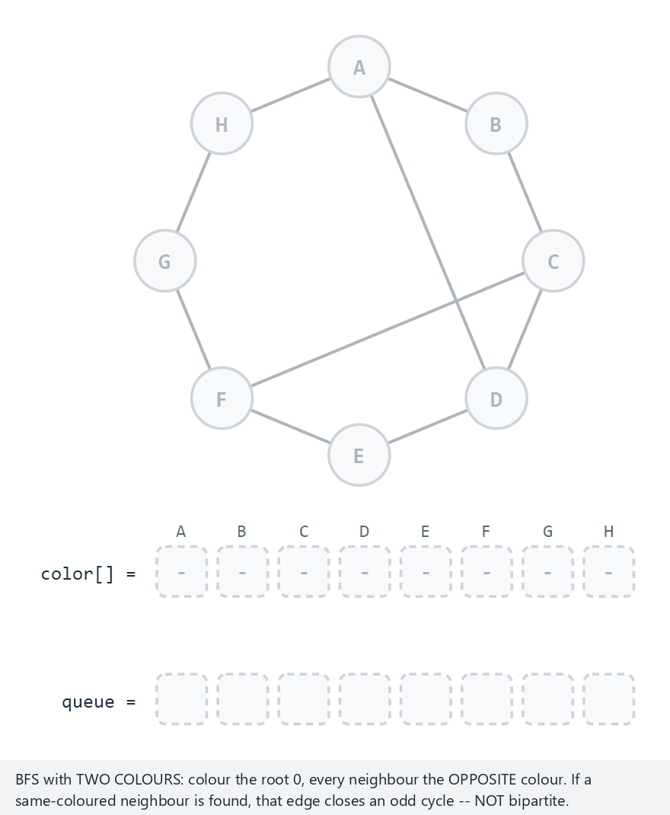
CEN207 Data Structures · Week 9
Bipartite graph check
RTEU Computer Engineering · Fall 2026–2027
125
Notes:
Watch a conflicting edge flash red the moment BFS reaches it.

Slide 126
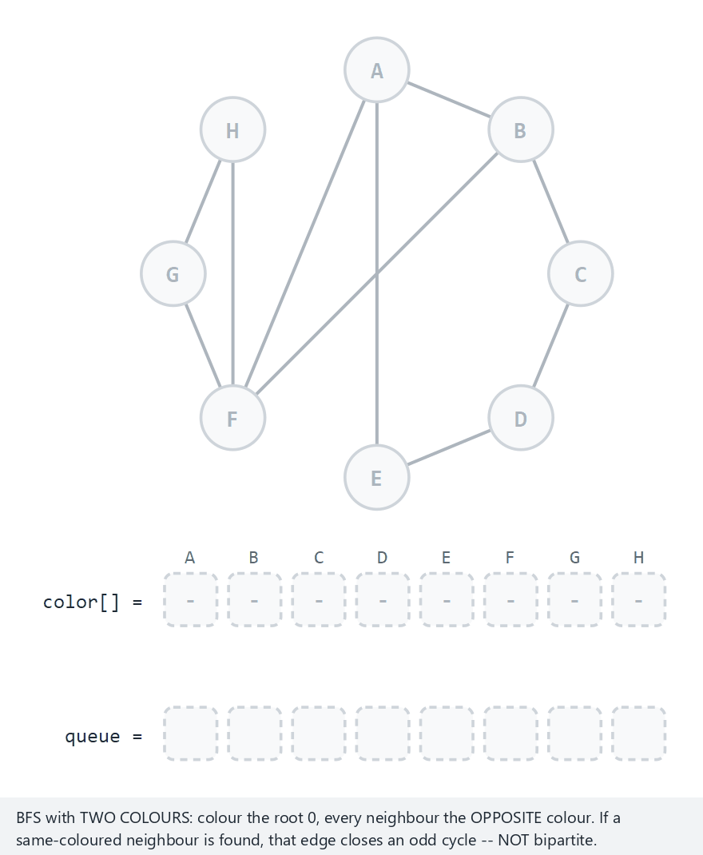
CEN207 Data Structures · Week 9
Edge case: an odd cycle
RTEU Computer Engineering · Fall 2026–2027
126
Notes:
The function returns immediately — later vertices stay uncoloured, and that's expected.

Slide 127
CEN207 Data Structures · Week 9
Real output: bipartite check
-- normal: an even cycle plus 2 safe diagonals --
colors: A=0 B=1 C=0 D=1 E=0 F=1 G=0 H=1
bipartite
-- edge: A-B-C-D-E-A is a 5-cycle (odd) --
colors: A=0 B=1 C=0 D=-1 E=1 F=1 G=-1 H=-1
NOT bipartite
RTEU Computer Engineering · Fall 2026–2027
127
Notes:
color -1 means "never reached by BFS" -- the search stopped the instant it found the conflict.

Slide 128
CEN207 Data Structures · Week 9
Complexity & mistake
• O(V + E) — one BFS
• Mistake: not handling disconnected graphs
• An odd cycle isolated in a second component is invisible without a per-component loop
RTEU Computer Engineering · Fall 2026–2027
128
Notes:
A tree is always bipartite (no cycles at all) — a useful sanity check, not a shortcut.

Slide 129
CEN207 Data Structures · Week 9
Mini question
Why does a conflict edge ("same colour as its neighbour") always exist within one BFS layer or between two adjacent layers — never skip a layer?
(answer on the next slide)
RTEU Computer Engineering · Fall 2026–2027
129

Slide 130
CEN207 Data Structures · Week 9
Answer
BFS colours strictly by distance parity from the source — even distance gets colour 0, odd gets colour 1.
Any edge connects vertices whose BFS distances differ by exactly 0 or 1 (never 2+, or it wouldn't be a direct edge) — so a conflict can only appear exactly there.
RTEU Computer Engineering · Fall 2026–2027
130
Notes:
This is the same distance-parity idea that proves the odd-cycle equivalence two slides back.

Slide 131
CEN207 Data Structures · Week 9
9. Maximum Flow
RTEU Computer Engineering · Fall 2026–2027
131

Slide 132
CEN207 Data Structures · Week 9
A question to start
A water network: source, destination, pipes with capacities.
What is the largest total flow the network can deliver at once?
RTEU Computer Engineering · Fall 2026–2027
132

Slide 133
CEN207 Data Structures · Week 9
A short history
• Ford & Fulkerson, 1956 — the general method
• Edmonds & Karp, 1972 — always use the shortest augmenting path
• Proved: this choice guarantees polynomial time
RTEU Computer Engineering · Fall 2026–2027
133
Notes:
Ford-Fulkerson with an arbitrary path choice can be pathologically slow.

Slide 134
CEN207 Data Structures · Week 9
The idea
• Find any augmenting path, s to t, with spare capacity
• Push the bottleneck (smallest capacity on the path)
• Pushing forward opens a reverse edge — a later path can "undo"
• The graph of "still usable" is the residual graph
RTEU Computer Engineering · Fall 2026–2027
134
Notes:
The reverse edge is what lets Edmonds-Karp beat a naive greedy approach.

Slide 135
CEN207 Data Structures · Week 9
Max-flow min-cut
Max flow equals the cheapest cut — the smallest total capacity separating s from t.
No augmenting path left = BFS's reachable set from s is that cut.
RTEU Computer Engineering · Fall 2026–2027
135
Notes:
This is why running out of augmenting paths proves optimality, not just termination.

Slide 136
CEN207 Data Structures · Week 9
Edmonds-Karp code (C) — part 1/2
int edmonds_karp(int vertex_cnt, int s, int t) {
int max_flow=0;
while (bfs_augmenting_path(vertex_cnt, s, t)) {
int bottleneck=INF;
for (int v=t; v!=s; v=parent_of[v])
if (cap_of[parent_of[v]][v]<bottleneck)
bottleneck=cap_of[parent_of[v]][v];
RTEU Computer Engineering · Fall 2026–2027
136
Notes:
First walk back along parent_of[] from t to s: find the smallest residual capacity on the path.

Slide 137
CEN207 Data Structures · Week 9
Edmonds-Karp code (C) — part 2/2
for (int v=t; v!=s; v=parent_of[v]) {
int u=parent_of[v];
cap_of[u][v]-=bottleneck;
cap_of[v][u]+=bottleneck;
}
max_flow+=bottleneck;
}
return max_flow;
}
RTEU Computer Engineering · Fall 2026–2027
137
Notes:
Second walk: apply the bottleneck, opening a reverse residual edge as it goes.

Slide 138
CEN207 Data Structures · Week 9
Edmonds-Karp code (Java) — part 1/2
static int edmondsKarp(int vertexCnt, int s, int t) {
int maxFlow=0;
while (bfsAugmentingPath(vertexCnt, s, t)) {
int bottleneck=INF;
for (int v=t; v!=s; v=parentOf[v]) {
int u=parentOf[v];
if (capOf[u][v]<bottleneck)
bottleneck=capOf[u][v];
}
RTEU Computer Engineering · Fall 2026–2027
138
Notes:
Same two-walk shape as the C version.

Slide 139
CEN207 Data Structures · Week 9
Edmonds-Karp code (Java) — part 2/2
for (int v=t; v!=s; v=parentOf[v]) {
int u=parentOf[v];
capOf[u][v]-=bottleneck;
capOf[v][u]+=bottleneck;
}
maxFlow+=bottleneck;
}
return maxFlow;
}
RTEU Computer Engineering · Fall 2026–2027
139
Notes:
capOf is a plain int[][] matrix in Java, matching C's 2-D array exactly.

Slide 140
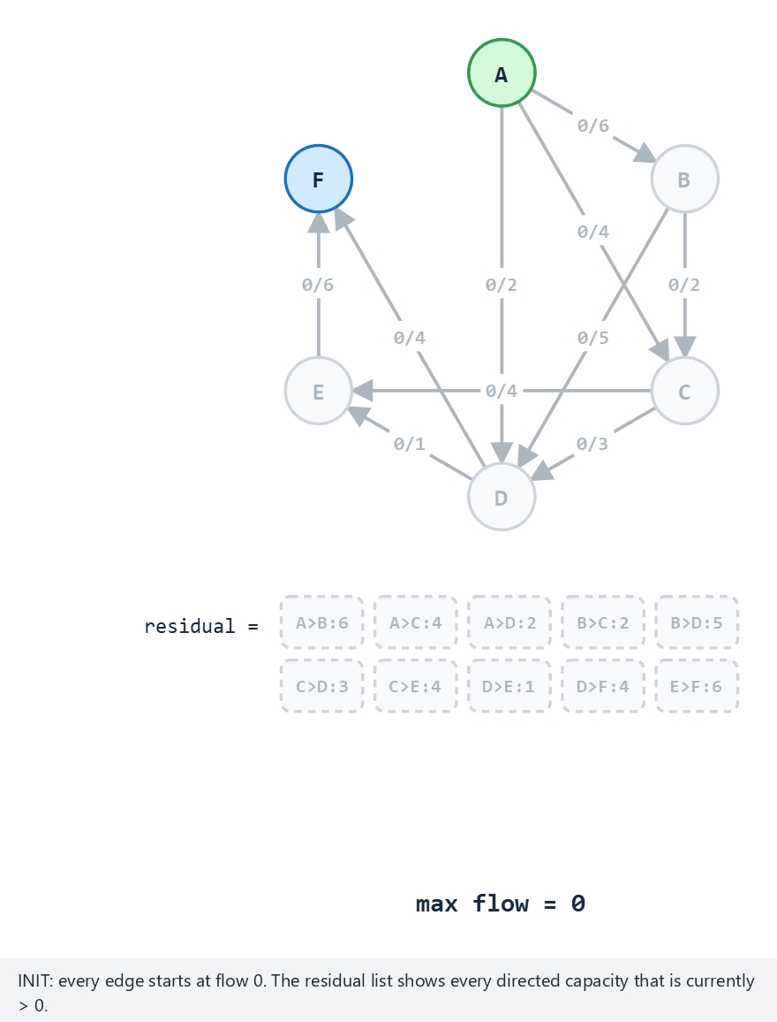
CEN207 Data Structures · Week 9
Edmonds-Karp maximum flow
RTEU Computer Engineering · Fall 2026–2027
140
Notes:
Every edge shows flow/capacity; the residual row lists every positive residual pair.

Slide 141
CEN207 Data Structures · Week 9
Real output: Edmonds-Karp
-- normal: 6 vertices, 10 edges, A to F --
max flow from A to F = 9
-- edge: A and J are in two separate components --
max flow from A to J = 0
RTEU Computer Engineering · Fall 2026–2027
141
Notes:
Max flow 0 is a perfectly valid answer -- it's what "no augmenting path exists at all" looks like.

Slide 142
CEN207 Data Structures · Week 9
Complexity & mistake
• *O(V E^2)** for Edmonds-Karp specifically
• Mistake: forgetting the reverse edge update
• Without it: plain Ford-Fulkerson, can get stuck short of optimal
RTEU Computer Engineering · Fall 2026–2027
142
Notes:
DFS instead of BFS is still correct but loses the polynomial-time guarantee.

Slide 143
CEN207 Data Structures · Week 9
Mini question
Section 3's union-find could answer "0 flow, s and t disconnected" instantly. Why does this section still run a full BFS first?
(answer on the next slide)
RTEU Computer Engineering · Fall 2026–2027
143

Slide 144
CEN207 Data Structures · Week 9
Answer
Union-find only knows reachability, not capacity.
Even when s and t ARE connected, the actual max flow depends on the bottleneck capacities along the way — something union-find's parent pointers never recorded.
RTEU Computer Engineering · Fall 2026–2027
144
Notes:
A nice callback that also previews why max-flow is strictly harder than plain connectivity.

Slide 145
CEN207 Data Structures · Week 9
10. Backtracking
RTEU Computer Engineering · Fall 2026–2027
145

Slide 146
CEN207 Data Structures · Week 9
A question to start
Colour a map so no two neighbours share a colour, with as few colours as possible.
No known formula. How do you search systematically?
RTEU Computer Engineering · Fall 2026–2027
146
Notes:
N-queens, seating charts, and Hamiltonian paths all share this shape.

Slide 147
CEN207 Data Structures · Week 9
The idea: try, recurse, undo
• Extend a partial solution by one decision
• Still consistent? Recurse and keep extending
• Inconsistent, or every extension fails? Undo and try the next option
RTEU Computer Engineering · Fall 2026–2027
147
Notes:
"Backtracking" refers specifically to the undo step.

Slide 148
CEN207 Data Structures · Week 9
Why graph colouring, not Hamiltonian path?
Colouring reuses Section 8's exact color[] row and neighbour-conflict check.
A Hamiltonian path needs an entirely new "path so far" convention — for comparatively little extra insight.
RTEU Computer Engineering · Fall 2026–2027
148

Slide 149
CEN207 Data Structures · Week 9
Backtracking code (C)
int color_graph(int v, int k) {
if (v==cur_g->vertex_count) return 1;
for (int c=1;c<=k;c++) {
if (safe(v,c)) {
color_of[v]=c;
if (color_graph(v+1,k)) return 1;
color_of[v]=0; /* backtrack */
}
}
return 0;
}
RTEU Computer Engineering · Fall 2026–2027
149
Notes:
Four lines carry the whole idea: try, recurse, undo, and the safety check does the pruning.

Slide 150
CEN207 Data Structures · Week 9
Backtracking code (Java)
static boolean colorGraph(int v, int k) {
if (v==curG.vertexCount) return true;
for (int c=1;c<=k;c++) {
if (safe(v,c)) {
colorOf[v]=c;
if (colorGraph(v+1,k)) return true;
colorOf[v]=0; // backtrack
}
}
return false;
}
RTEU Computer Engineering · Fall 2026–2027
150
Notes:
safe(v,c) is a short neighbour scan, the same shape as Section 8's bipartite conflict check.

Slide 151
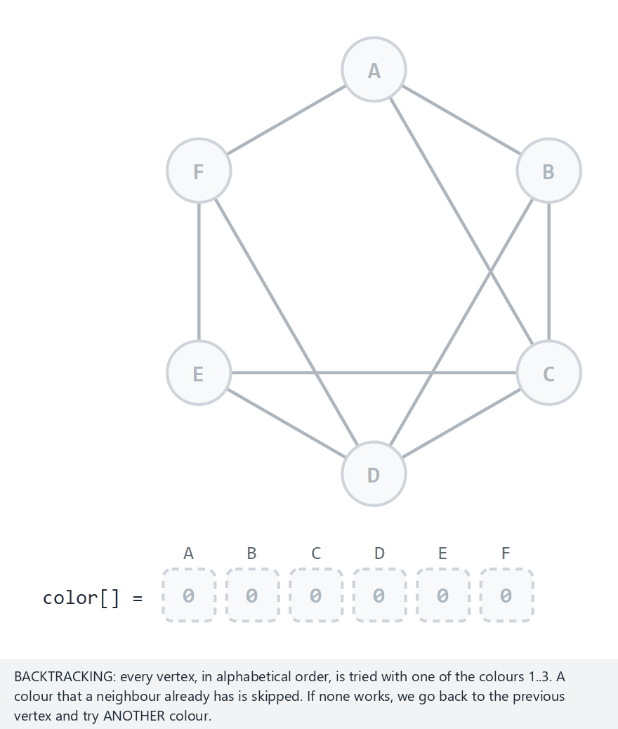
CEN207 Data Structures · Week 9
Backtracking: graph colouring
RTEU Computer Engineering · Fall 2026–2027
151
Notes:
A rejected colour flashes red; an undone colour clears back to empty.

Slide 152
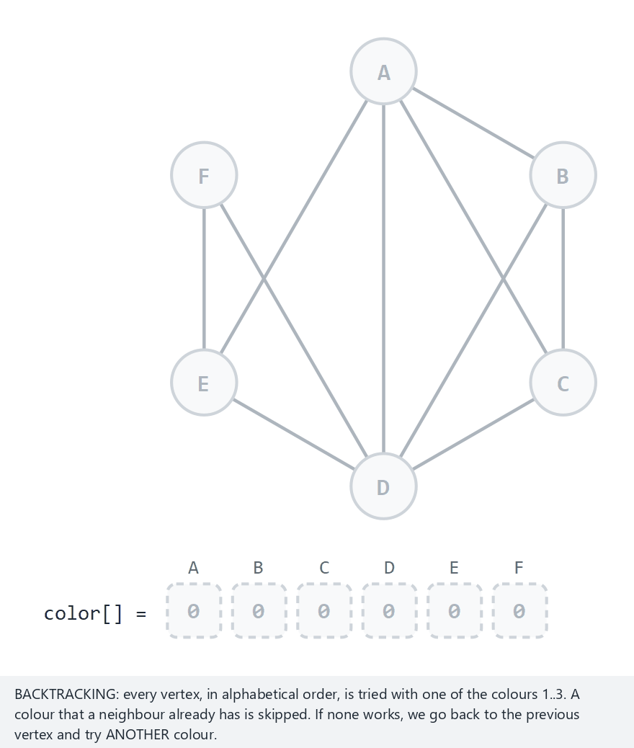
CEN207 Data Structures · Week 9
Required edge case: K4, unsolvable
RTEU Computer Engineering · Fall 2026–2027
152
Notes:
Every combination is tried and found unsafe — proven failure, not a lucky success.

Slide 153
CEN207 Data Structures · Week 9
Real output: backtracking graph colouring
-- normal: 6 vertices, 10 edges, k=3 --
colouring: A=1 B=2 C=3 D=1 E=2 F=3
-- edge: K4 is UNSOLVABLE with k=3 --
no valid colouring with k=3
RTEU Computer Engineering · Fall 2026–2027
153
Notes:
"no valid colouring" only prints after every branch has been tried and undone -- a proven negative.

Slide 154
CEN207 Data Structures · Week 9
Complexity & mistake
• Worst case O(k^V) — a last-resort technique
• safe() prunes huge swaths early — why it's usable at all
• Mistake: forgetting the undo step corrupts later branches
RTEU Computer Engineering · Fall 2026–2027
154
Notes:
This is the whole reason backtracking works despite the exponential bound.

Slide 155
CEN207 Data Structures · Week 9
Mini question
K4 needs 4 colours. How many vertices does the algorithm actually try to colour before reporting "unsolvable" with k=3?
(answer on the next slide)
RTEU Computer Engineering · Fall 2026–2027
155

Slide 156
CEN207 Data Structures · Week 9
Answer
All of them, every time it backtracks past vertex 0 — but the failure is detected at vertex 3, the 4th vertex of K4, since the first 3 already used all 3 available colours between them.
safe() then rejects every colour for vertex 3, forcing a chain of undos all the way back to the start.
RTEU Computer Engineering · Fall 2026–2027
156
Notes:
Worth tracing live on the animation slide if time allows — watching the full backtrack chain is the point of this algorithm.

Slide 157
CEN207 Data Structures · Week 9
How each program was checked
• Every C program compiles with -Wall -Wextra -Werror
• Every Java program compiles with -Xlint:all -Werror
• C and Java output diffed byte-identical, same scenarios
• Every unit test file also rebuilt under AddressSanitizer
RTEU Computer Engineering · Fall 2026–2027
157
Notes:
This is the run_tests.py pipeline used for every program this week, not just a few.

Slide 158
CEN207 Data Structures · Week 9
One sentence per algorithm
• Kahn / DFS topo-sort: order respecting every "before" rule
• Cycle detection: which vertices, not just whether
• Union-find: "same group?" in near-constant time
• Kruskal / Prim: cheapest way to connect everything
• Dijkstra / Bellman-Ford: cheapest path from one start
• Floyd-Warshall: cheapest path between every pair at once
RTEU Computer Engineering · Fall 2026–2027
158
Notes:
First half of the week, one line each.

Slide 159
CEN207 Data Structures · Week 9
One sentence per algorithm (cont.)
• Kosaraju SCC: mutual reachability, directed
• Bipartite check: can this be split into exactly two teams?
• Edmonds-Karp: the largest flow a network can carry
• Backtracking: try, recurse, undo — for problems with no formula
RTEU Computer Engineering · Fall 2026–2027
159
Notes:
Second half. Together, eleven algorithms, ten problems (topo-sort has two solutions).

Slide 160
CEN207 Data Structures · Week 9
Summary table (1/3)
Problem | Algorithm | Time
Order | Kahn / DFS topo-sort | O(V+E)
Cycle? | 3-colour DFS | O(V+E)
Groups | Union-find | ~O(1) amortised
RTEU Computer Engineering · Fall 2026–2027
160
Notes:
This table mirrors the note's summary table exactly, split across three slides to fit.

Slide 161
CEN207 Data Structures · Week 9
Summary table (2/3)
Problem | Algorithm | Time
Cheapest connect | Kruskal / Prim | O(E log E) / O(V^2)
Cheapest path | Dijkstra / Bellman-Ford | O(V^2) / O(V*E)
All-pairs paths | Floyd-Warshall | O(V^3)
RTEU Computer Engineering · Fall 2026–2027
161

Slide 162
CEN207 Data Structures · Week 9
Summary table (3/3)
Problem | Algorithm | Time
Mutual reach | Kosaraju SCC | O(V+E)
2-team split | Bipartite check | O(V+E)
Max flow | Edmonds-Karp | O(V*E^2)
No formula | Backtracking | O(k^V) worst case
RTEU Computer Engineering · Fall 2026–2027
162
Notes:
Four rows here since this closes out the list -- still comfortably within the slide.

Slide 163
CEN207 Data Structures · Week 9
Exercises (pick a few)
• Trace Kahn's algorithm by hand on a 5-edge DAG
• Build a graph with a negative edge but no negative cycle
• Modify SCC to flag trivial (single-vertex) components
• Prove every tree is bipartite
RTEU Computer Engineering · Fall 2026–2027
163
Notes:
Full ten-exercise list is in this week's notes.

Slide 164
CEN207 Data Structures · Week 9
Self-check: 3 quick questions
1. Why does Dijkstra fail on a negative edge?
2. What's the ONE new idea Kosaraju adds over topological-sort DFS?
3. What does a reverse residual edge let a later augmenting path do?
RTEU Computer Engineering · Fall 2026–2027
164
Notes:
Full ten-question quiz, with answers, is in this week's notes.

Slide 165
CEN207 Data Structures · Week 9
Looking ahead
Week 10: Advanced Tree Structures
AVL trees, red-black trees, B-trees — the self-balancing machinery that keeps O(log n) from collapsing to O(n) on unlucky insertions.
RTEU Computer Engineering · Fall 2026–2027
165
Notes:
This week mostly worked on arrays and adjacency lists — Week 10 returns to balanced trees.

Slide 166
CEN207 Data Structures · Week 9
Questions?
CEN207 Data Structures · Week 9 · Graph Algorithms
RTEU Computer Engineering · Fall 2026–2027
166
Notes:
Open floor for questions before the self-check quiz.

