Slide 1

CEN207 Data Structures · Week 2
Arrays, Matrices, and Linked Lists
CEN207 Data Structures — Week 2
Asst. Prof. Dr. Uğur CORUH · Fall 2026–2027
RTEU Computer Engineering · Fall 2026–2027
Notes:
Last week a box held one value, made and destroyed by malloc and free. This week two ideas grow out of that single box: many boxes side by side, reached by arithmetic — the array — and one box pointing at the next — the linked list.

Slide 2
CEN207 Data Structures · Week 2
Today's plan (3 hours)
Hour | Topic
1 | Arrays: insert/delete, dynamic growth Anim 1–2 · 2-D layout, rotation, rearrange Anim 3–5
2 | Sparse matrices Anim 6–8 · lists: node/head/NULL, singly ops Anim 9–12
3 | Doubly, circular, Josephus, XOR, skip list Anim 13–17 · arrays vs. lists
Learning outcomes: LO.1 (explain fundamental data structures) · LO.2 (analyze complexity) · LO.7 (choose the right structure)
RTEU Computer Engineering · Fall 2026–2027
2
Notes:
Seventeen short animations carry the whole lecture; each appears once, exactly where its idea is introduced, and every single one gets a second look at its trickiest edge case.

Slide 3
CEN207 Data Structures · Week 2
This week's concepts — where
Concept | Where
Arrays: shifting, dynamic growth | Section 1
2-D arrays, rotation, rearrangement | Sections 2–3
Sparse matrices | Section 4
Singly/doubly/circular lists | Sections 5–8
XOR list, skip list, arrays vs. lists | Sections 9–11
RTEU Computer Engineering · Fall 2026–2027
3
Notes:
Every term gets a full definition the first time it appears; this table just says where to find it again.

Slide 4
CEN207 Data Structures · Week 2
How the code examples work
• Every idea has a complete C and Java program
• C: gcc -std=c11 -Wall -Wextra -o /tmp/x file.c && /tmp/x
• Java: javac -d /tmp/j File.java && java -cp /tmp/j File
• Sources: code/week-02/c/ and code/week-02/java/
• Each program's expected output is in the week notes
RTEU Computer Engineering · Fall 2026–2027
4
Notes:
Open a terminal now if you want to run these live; every snippet on today's slides compiles and runs exactly as shown.

Slide 5
CEN207 Data Structures · Week 2
Recap — Week 1: memory and pointers
• A variable is a labeled box in memory
• A pointer stores an address — it points at a box
• malloc(n): reserve n bytes, returns an address
• free(p): give the box back; then set p = NULL
• NULL: a pointer that points at nothing
RTEU Computer Engineering · Fall 2026–2027
5
Notes:
Everything today builds on exactly these five facts — nothing new about memory itself gets introduced this week, only new shapes built from it.

Slide 6
CEN207 Data Structures · Week 2
Map of the week — at a glance
Arrays & matrices | Linked lists
Shifting, dynamic growth | Node, head, NULL
Row-major, rotation, rearrange | Singly, doubly, circular
Sparse: triplet, transpose, add | Josephus, XOR, skip list
RTEU Computer Engineering · Fall 2026–2027
6
Notes:
Every box on this map gets its own slides below, most with a short animation and a complete C/Java program.

Slide 7
CEN207 Data Structures · Week 2
1. Arrays in Memory: Insertion, Deletion, Growth
RTEU Computer Engineering · Fall 2026–2027
7
Notes:
Section 1 asks what it costs to change an array's contents, not just read them — and what to do when the array's size was guessed wrong.

Slide 8
CEN207 Data Structures · Week 2
A question to start
An array is n boxes in a row. Insert one value in the middle — what has to move before the new value can even go in?
RTEU Computer Engineering · Fall 2026–2027
8
Notes:
Let the class guess before the next slide answers it: everything after the insertion point.

Slide 9
CEN207 Data Structures · Week 2
Intuition — a row of numbered lockers
• Each box sits at index × box size from the start
• arr[k] is pure arithmetic — no searching needed
• But lockers do not slide apart by themselves
• Making room means moving every locker after it
RTEU Computer Engineering · Fall 2026–2027
9
Notes:
That O(1) index lookup is the array's whole appeal — and its whole cost shows up the moment something has to move.

Slide 10
CEN207 Data Structures · Week 2
size vs. capacity
• A fixed array reserves CAP boxes up front
• size tracks how many boxes are actually used
• insert_at(k, v): make room at index k
• delete_at(k): close the gap at index k
RTEU Computer Engineering · Fall 2026–2027
10
Notes:
CAP never changes in this first version; size is the only thing that moves, and only within 0..CAP.

Slide 11
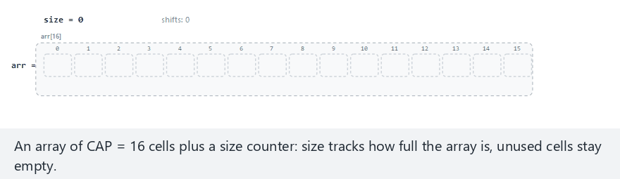
CEN207 Data Structures · Week 2
Array insert and delete, step by step
RTEU Computer Engineering · Fall 2026–2027
11
Notes:
Watch how many cells light up on a front insert versus an append — that difference is the whole lesson.

Slide 12
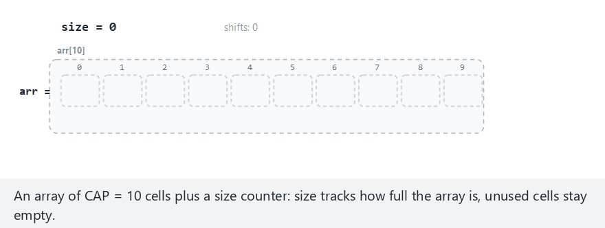
CEN207 Data Structures · Week 2
Edge case — overflow: the array is full
RTEU Computer Engineering · Fall 2026–2027
12
Notes:
A full array rejects the insert outright rather than crash — that check has to come before any shifting starts.

Slide 13
CEN207 Data Structures · Week 2
Code — insert_at()
bool insert_at(int k, int v) {
if (size == CAP)
return false; /* full: overflow */
for (int i = size; i > k; i--)
arr[i] = arr[i - 1]; /* shift right */
arr[k] = v;
size++;
return true;
}
RTEU Computer Engineering · Fall 2026–2027
13
Notes:
The shift loop runs backward, from the end toward k — forward would overwrite values before they are copied.

Slide 14
CEN207 Data Structures · Week 2
Code — delete_at()
bool delete_at(int k) {
if (size == 0)
return false; /* empty: underflow */
for (int i = k; i < size - 1; i++)
arr[i] = arr[i + 1]; /* shift left */
size--;
return true;
}
RTEU Computer Engineering · Fall 2026–2027
14
Notes:
This loop runs forward instead — the mirror image of insert's backward shift, and just as easy to get backward by mistake.

Slide 15
CEN207 Data Structures · Week 2
Complexity and common mistakes
• k = 0: shifts every element — O(n)
• k = size (append): no shift at all — O(1)
• Mistake: forgetting the overflow/underflow check first
• Mistake: shifting in the wrong direction, overwriting data
RTEU Computer Engineering · Fall 2026–2027
15
Notes:
The exact same function costs anywhere from O(1) to O(n), purely depending on which index k the caller picks.

Slide 16
CEN207 Data Structures · Week 2
Mini-quiz
You insert 5 values, always at index 0. How many total element-shifts happen?
RTEU Computer Engineering · Fall 2026–2027
16
Notes:
Let the class add it up before the next slide.

Slide 17
CEN207 Data Structures · Week 2
Answer
0+1+2+3+4 = 10 shifts. Each front-insert shifts every element already there — the classic O(n) worst case, repeated five times.
RTEU Computer Engineering · Fall 2026–2027
17
Notes:
Ten shifts to place five values — inserting at the front is expensive precisely because it repeats the worst case every time.

Slide 18
CEN207 Data Structures · Week 2
But what if the size is unknown?
A fixed array's CAP is a hard ceiling. A dynamic array grows its own capacity on demand, instead of rejecting the insert.
RTEU Computer Engineering · Fall 2026–2027
18
Notes:
This is exactly what Java's ArrayList and C++'s std::vector do under the hood — the same trick, industrial strength.

Slide 19
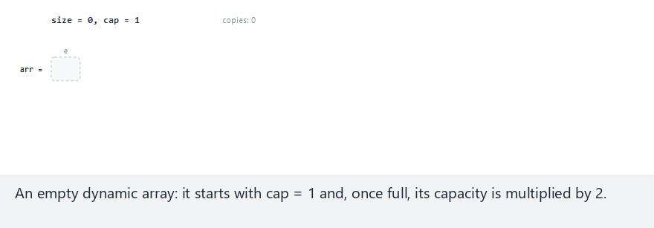
CEN207 Data Structures · Week 2
Dynamic array growth, step by step
RTEU Computer Engineering · Fall 2026–2027
19
Notes:
Watch the temporary row appear below the array each time it grows — that row is the copy, before it slides up to replace the old block.

Slide 20
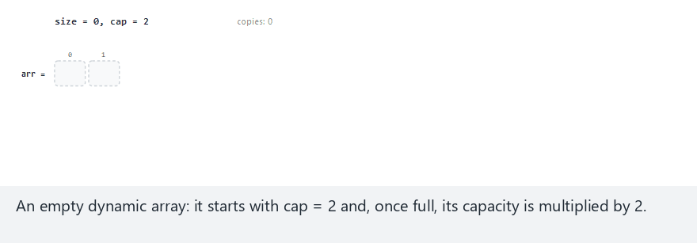
CEN207 Data Structures · Week 2
Edge case — shrinking back down
RTEU Computer Engineering · Fall 2026–2027
20
Notes:
Shrinking is optional and symmetric to growing — capacity halves once usage drops to a quarter full, to give memory back.

Slide 21
CEN207 Data Structures · Week 2
Code — da_resize()
static void da_resize(DynArray *a, int new_cap) {
int *fresh = malloc(new_cap * sizeof(int));
for (int i = 0; i < a->size; i++)
fresh[i] = a->data[i]; /* copy every value */
free(a->data); /* old block freed */
a->data = fresh;
a->cap = new_cap;
}
RTEU Computer Engineering · Fall 2026–2027
21
Notes:
Every single existing value gets copied into the fresh block — that full copy is exactly where the O(n) cost of growing comes from.

Slide 22
CEN207 Data Structures · Week 2
Code — da_append()
void da_append(DynArray *a, int v) {
if (a->size == a->cap) {
int new_cap = a->cap * 2; /* growth factor 2 */
da_resize(a, new_cap);
}
a->data[a->size++] = v;
}
RTEU Computer Engineering · Fall 2026–2027
22
Notes:
The resize only happens when the block is already full — most calls skip straight to the one-line write at the end.

Slide 23
CEN207 Data Structures · Week 2
Complexity and common mistakes
• A growing append copies size elements: O(n)
• Most appends just write one slot: O(1)
• Over n appends, total copies stay under 2n
• So the amortized cost per append is O(1)
• Mistake: treating every single append as O(n)
RTEU Computer Engineering · Fall 2026–2027
23
Notes:
Amortized means averaged over a long run of operations — one append can be expensive, but the average never is.

Slide 24
CEN207 Data Structures · Week 2
Mini-quiz
Starting from cap = 1 and doubling, how many times does the array grow while 100 values are appended one by one?
RTEU Computer Engineering · Fall 2026–2027
24
Notes:
Have the class count the doublings: 1, 2, 4, 8... before the next slide.

Slide 25
CEN207 Data Structures · Week 2
Answer
7 times (1→2→4→8→16→32→64→128). log2(100) ≈ 6.6, rounded up — growth is logarithmic in the final size, not linear.
RTEU Computer Engineering · Fall 2026–2027
25
Notes:
Doubling means the number of growths grows only as the logarithm of the final size — that is exactly why the total copying stays cheap.

Slide 26
CEN207 Data Structures · Week 2
2. 2-D Arrays: Row-Major vs Column-Major
RTEU Computer Engineering · Fall 2026–2027
26
Notes:
Section 2 asks what a "two-dimensional" array actually looks like underneath, in memory that has only ever been one-dimensional.

Slide 27
CEN207 Data Structures · Week 2
A question to start
Memory is one long row of bytes. A matrix looks two-dimensional — rows and columns. How does mat[i][j] become one address?
RTEU Computer Engineering · Fall 2026–2027
27
Notes:
There is no such thing as genuinely 2-D memory — every "2-D" array is really a 1-D array wearing a disguise.

Slide 28
CEN207 Data Structures · Week 2
Intuition — a bookshelf, one shelf at a time
• Picture the matrix's rows laid end to end
• Row 0's cells, then row 1's cells, and so on
• That layout is called row-major order
• Some languages (Fortran, MATLAB) lay out columns first
RTEU Computer Engineering · Fall 2026–2027
28
Notes:
Row-major versus column-major is purely a convention — nothing about "rows" or "columns" is more natural to memory than the other.

Slide 29
CEN207 Data Structures · Week 2
The address formulas
• Row-major: addr(i,j) = i * COLS + j
• Column-major: addr(i,j) = j * ROWS + i
• C and Java: row-major; Fortran, MATLAB: column-major
• The formula is arithmetic — no searching at all
RTEU Computer Engineering · Fall 2026–2027
29
Notes:
Two formulas, and every "2-D array" question this section asks comes down to picking the right one and applying it.

Slide 30
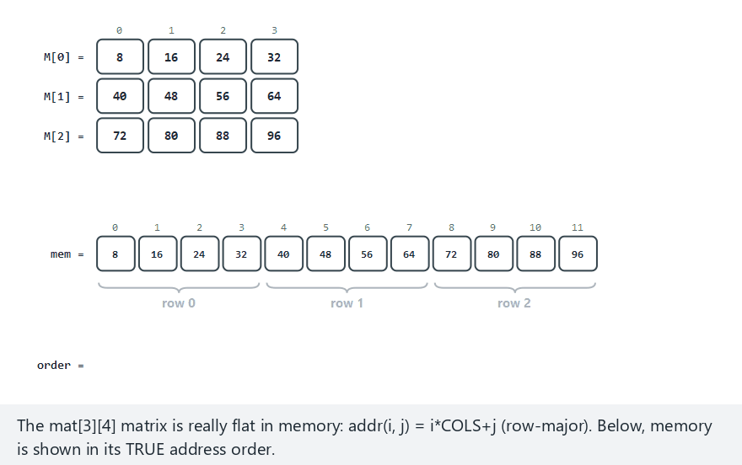
CEN207 Data Structures · Week 2
Matrix in memory, step by step
RTEU Computer Engineering · Fall 2026–2027
30
Notes:
Watch the memory row below the grid — a row-major walk lands on consecutive memory cells, one step at a time.

Slide 31
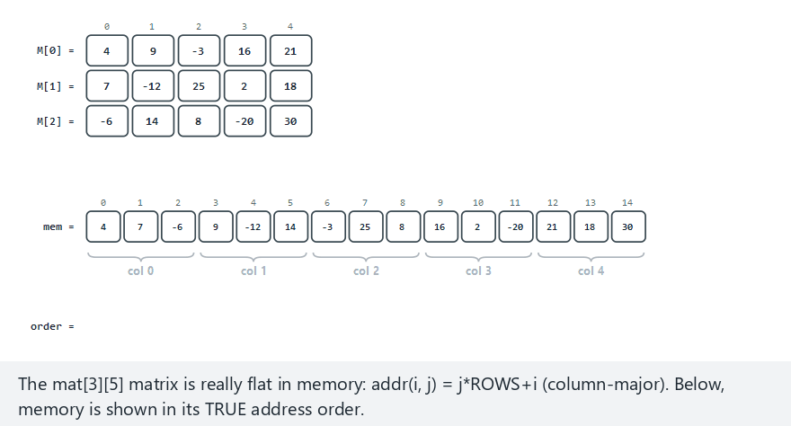
CEN207 Data Structures · Week 2
Edge case — column-major storage, row-by-row walk
RTEU Computer Engineering · Fall 2026–2027
31
Notes:
The traversal order here fights the storage order — every step now jumps across memory instead of landing next door.

Slide 32
CEN207 Data Structures · Week 2
Code — addr() and a row-major walk
int mat[ROWS][COLS];
/* address of mat[i][j], in ints from the start */
int addr(int i, int j) {
return i * COLS + j; /* row-major */
}
void traverse_row_major(int mat[ROWS][COLS]) {
for (int i = 0; i < ROWS; i++)
for (int j = 0; j < COLS; j++)
visit(mat[i][j]);
}
RTEU Computer Engineering · Fall 2026–2027
32
Notes:
The outer loop over i and the inner loop over j exactly retrace the row-major formula, one visit per address in order.

Slide 33
CEN207 Data Structures · Week 2
Complexity and common mistakes
• Address lookup: pure arithmetic — O(1)
• Row-major walk, row-major storage: every step Δ=1
• Wrong layout for the walk: a jump every step
• Mistake: assuming every language is row-major
RTEU Computer Engineering · Fall 2026–2027
33
Notes:
The formula's cost never changes — what changes is how far apart consecutive visits land in real memory, which is what your CPU's cache actually feels.

Slide 34
CEN207 Data Structures · Week 2
Mini-quiz
A row-major matrix has 5 columns. mat[3][2] sits at address 17. What is mat[3][3]'s address?
RTEU Computer Engineering · Fall 2026–2027
34
Notes:
Let the class apply the formula themselves before the next slide.

Slide 35
CEN207 Data Structures · Week 2
Answer
18. Moving one column right adds exactly 1 in row-major order — the next cell is always the very next address.
RTEU Computer Engineering · Fall 2026–2027
35
Notes:
That one-step adjacency is exactly what "row-major" buys you, and exactly what a column-major walk would throw away.

Slide 36
CEN207 Data Structures · Week 2
3. Rotation and Rearrangement: Two Pointers
RTEU Computer Engineering · Fall 2026–2027
36
Notes:
Section 3 covers two array tricks that share one idea — moving values around using only O(1) extra space, never a second array.

Slide 37
CEN207 Data Structures · Week 2
A question to start
Rotate a 12-value array left by 4, using no second array. Where would you even start, with only O(1) extra space allowed?
RTEU Computer Engineering · Fall 2026–2027
37
Notes:
The obvious approach — copy into a new array — is exactly the approach this section rules out.

Slide 38
CEN207 Data Structures · Week 2
Intuition — reversal, three times
• Reverse the first part, reverse the rest
• Then reverse the whole array once more
• Three reversals land every value exactly right
• No second array, no shifting one step at a time
RTEU Computer Engineering · Fall 2026–2027
38
Notes:
This trick feels like magic the first time; watching it on the animation, one reversal at a time, is what makes it click.

Slide 39
CEN207 Data Structures · Week 2
rotate_left: three reversals
• d = d % n — the real rotation amount
• Reverse arr[0..d-1]
• Reverse arr[d..n-1]
• Reverse arr[0..n-1] — done
RTEU Computer Engineering · Fall 2026–2027
39
Notes:
Each reversal on its own looks wrong; only the third one, over the whole array, straightens everything back out.

Slide 40
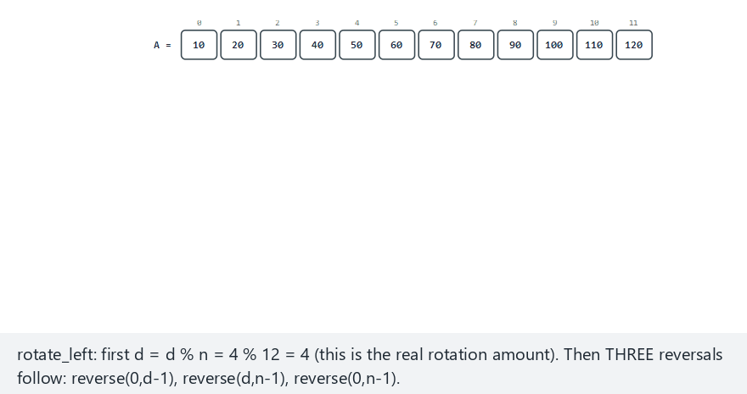
CEN207 Data Structures · Week 2
Array rotation, step by step
RTEU Computer Engineering · Fall 2026–2027
40
Notes:
Each reversal's result is kept as a new row below, so all three phases stay visible at once, side by side.

Slide 41
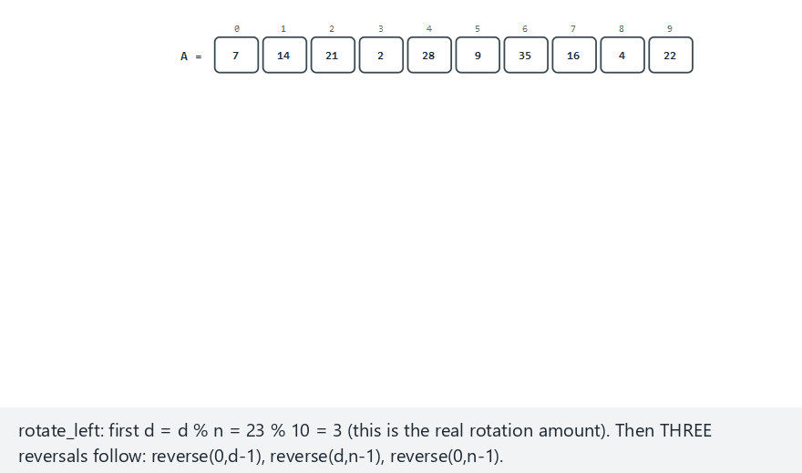
CEN207 Data Structures · Week 2
Edge case — d larger than n
RTEU Computer Engineering · Fall 2026–2027
41
Notes:
d=23 on 10 values still works, because d % n reduces it to 3 before a single reversal even begins.

Slide 42
CEN207 Data Structures · Week 2
Code — reverse()
void reverse(int arr[], int lo, int hi) {
while (lo < hi) {
int tmp = arr[lo];
arr[lo] = arr[hi];
arr[hi] = tmp;
lo++;
hi--;
}
}
RTEU Computer Engineering · Fall 2026–2027
42
Notes:
This one helper function, called three times with three different ranges, is the entire rotation algorithm.

Slide 43
CEN207 Data Structures · Week 2
Code — rotate_left()
void rotate_left(int arr[], int n, int d) {
if (n == 0) return; /* empty: nothing to do */
d = d % n;
reverse(arr, 0, d - 1); /* first d */
reverse(arr, d, n - 1); /* the rest */
reverse(arr, 0, n - 1); /* whole array */
}
RTEU Computer Engineering · Fall 2026–2027
43
Notes:
Three calls, three ranges — nothing else in this function does any work at all.

Slide 44
CEN207 Data Structures · Week 2
Complexity and common mistakes
• Three passes over the array, each O(n) — still O(n)
• O(1) extra space: no second array anywhere
• Mistake: forgetting d = d % n first
• Mistake: off-by-one bounds inside reverse
RTEU Computer Engineering · Fall 2026–2027
44
Notes:
Three passes sounds like it should be three times slower, but three times O(n) is still just O(n).

Slide 45
CEN207 Data Structures · Week 2
Rearranging: two pointers close in
• Goal: negatives left, non-negatives right
• left skips values already negative
• right skips values already non-negative
• When both stop, swap and step inward
RTEU Computer Engineering · Fall 2026–2027
45
Notes:
This is the exact same two-pointer shape as a quicksort partition step — the same idea shows up again next semester.

Slide 46
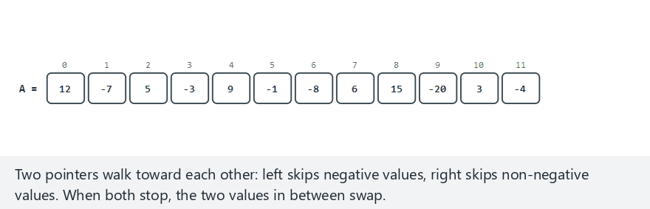
CEN207 Data Structures · Week 2
Array rearrangement, step by step
RTEU Computer Engineering · Fall 2026–2027
46
Notes:
Watch left and right walk toward each other, each skipping values that are already on the correct side.

Slide 47
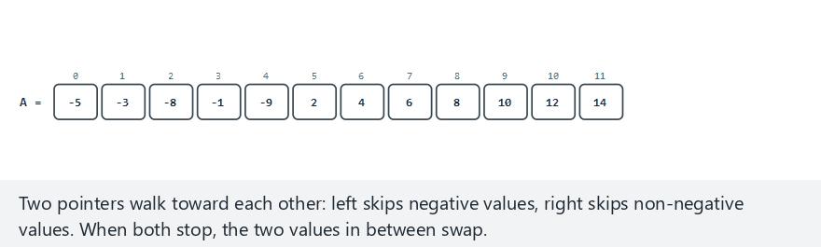
CEN207 Data Structures · Week 2
Edge case — already segregated
RTEU Computer Engineering · Fall 2026–2027
47
Notes:
The pointers still walk the whole array here, even though no swap is ever needed — the check itself still costs O(n).

Slide 48
CEN207 Data Structures · Week 2
Code — segregate()
void segregate(int arr[], int n) {
int left = 0, right = n - 1;
while (left < right) {
while (left<right && arr[left]<0) left++;
while (left<right && arr[right]>=0) right--;
if (left < right) {
int tmp = arr[left];
arr[left] = arr[right];
arr[right] = tmp;
left++; right--;
}
}
}
RTEU Computer Engineering · Fall 2026–2027
48
Notes:
Two inner while-loops skip past values already on the right side; only when both stop does an actual swap happen.

Slide 49
CEN207 Data Structures · Week 2
Complexity and common mistakes
• Both pointers move inward only — O(n) total
• One pass, O(1) extra space
• Mistake: treating 0 as negative — it is not
• Mistake: forgetting the left < right guard inside
RTEU Computer Engineering · Fall 2026–2027
49
Notes:
Every inner loop also checks left < right, or the two pointers could cross and read past each other.

Slide 50
CEN207 Data Structures · Week 2
Mini-quiz
After segregate, is the array sorted within each half, or just split in two?
RTEU Computer Engineering · Fall 2026–2027
50
Notes:
Let the class think about what segregate actually compares.

Slide 51
CEN207 Data Structures · Week 2
Answer
Just split. Negatives end up left of non-negatives, but neither half is sorted — segregate never compares values to order them.
RTEU Computer Engineering · Fall 2026–2027
51
Notes:
Segregating and sorting are different jobs; this algorithm only ever asks "is it negative", never "which is bigger".

Slide 52
CEN207 Data Structures · Week 2
4. Sparse Matrices
RTEU Computer Engineering · Fall 2026–2027
52
Notes:
Section 4 asks what to do when a matrix is mostly zeros — a very common case in real scientific and graph computing.

Slide 53
CEN207 Data Structures · Week 2
A question to start
A 1000×1000 matrix has a million cells. Only 200 are nonzero. Why store the other 999,800 zeros at all?
RTEU Computer Engineering · Fall 2026–2027
53
Notes:
A million ints is 4 MB just for one matrix that is 99.98% empty — the waste is not hypothetical.

Slide 54
CEN207 Data Structures · Week 2
Intuition — a mostly-empty parking lot
• Most spaces sit empty, all day, every day
• A clipboard listing only the occupied spots suffices
• Position + value is all you need to remember
• That clipboard is the triplet representation
RTEU Computer Engineering · Fall 2026–2027
54
Notes:
Nobody photographs every empty parking space to prove it is empty — they just write down where the cars are.

Slide 55
CEN207 Data Structures · Week 2
The triplet: (row, col, value)
• One entry per nonzero cell, nothing else
• Scan row-major, skip every zero found
• A sparse matrix's triplet table can be tiny
• Rebuilding the dense matrix just needs the triplets
RTEU Computer Engineering · Fall 2026–2027
55
Notes:
Three numbers per nonzero cell replace an entire row of mostly zeros — the saving grows with how sparse the matrix is.

Slide 56
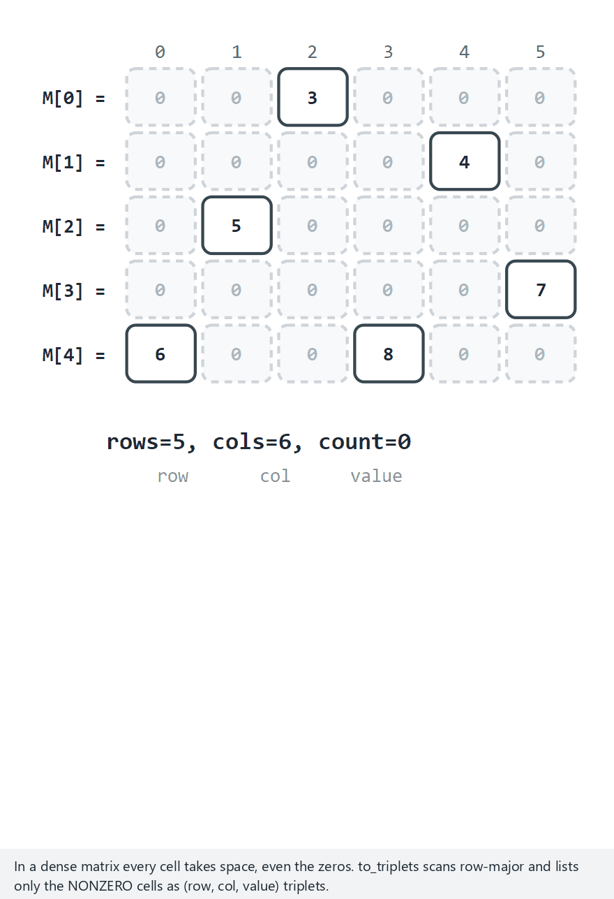
CEN207 Data Structures · Week 2
Sparse matrix as triplets, step by step
RTEU Computer Engineering · Fall 2026–2027
56
Notes:
Watch how many cells get skipped silently — only the handful of nonzero ones ever produce a triplet row.

Slide 57
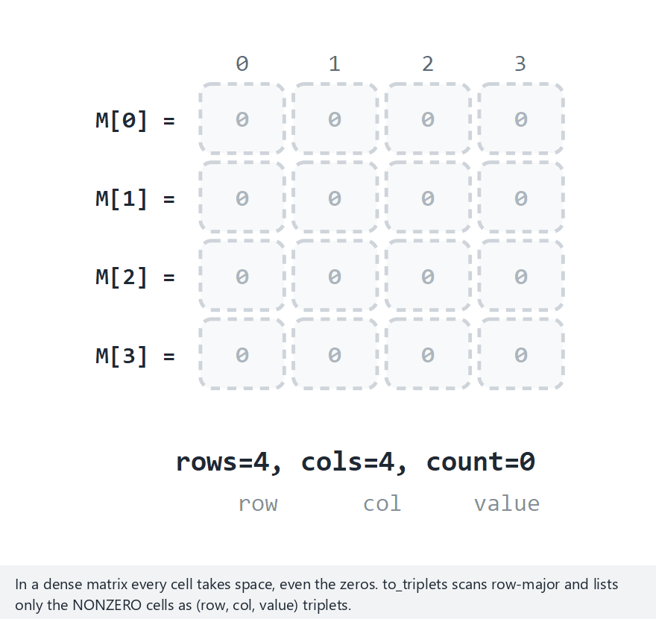
CEN207 Data Structures · Week 2
Edge case — an all-zero matrix
RTEU Computer Engineering · Fall 2026–2027
57
Notes:
Every cell gets scanned and skipped — the triplet table stays completely empty, which is itself a valid, correct result.

Slide 58
CEN207 Data Structures · Week 2
Code — to_triplets()
int to_triplets(int mat[ROWS][COLS], Triplet out[]) {
int k = 0;
for (int i = 0; i < ROWS; i++)
for (int j = 0; j < COLS; j++)
if (mat[i][j] != 0) {
out[k].row = i;
out[k].col = j;
out[k].value = mat[i][j];
k++;
}
return k;
}
RTEU Computer Engineering · Fall 2026–2027
58
Notes:
The nested loops scan every cell regardless, but the if-check means only nonzero cells ever get written into out[].

Slide 59
CEN207 Data Structures · Week 2
Complexity
• Scanning the dense matrix: O(rows × cols)
• Output size equals the nonzero count, never more
• A very sparse matrix: triplets are far smaller
RTEU Computer Engineering · Fall 2026–2027
59
Notes:
The scan itself cannot be cheaper than the full matrix, but everything built from the result afterward benefits from the small output.

Slide 60
CEN207 Data Structures · Week 2
Fast transpose: no re-sorting needed
• Naive transpose: swap (row,col), then sort — O(nnz log nnz)
• Better: count nonzeros per column first
• Turn counts into starting positions (a prefix sum)
• One more pass places every triplet, already sorted
RTEU Computer Engineering · Fall 2026–2027
60
Notes:
This is a genuinely clever trick — knowing in advance exactly where each entry belongs means never needing to sort at all.

Slide 61
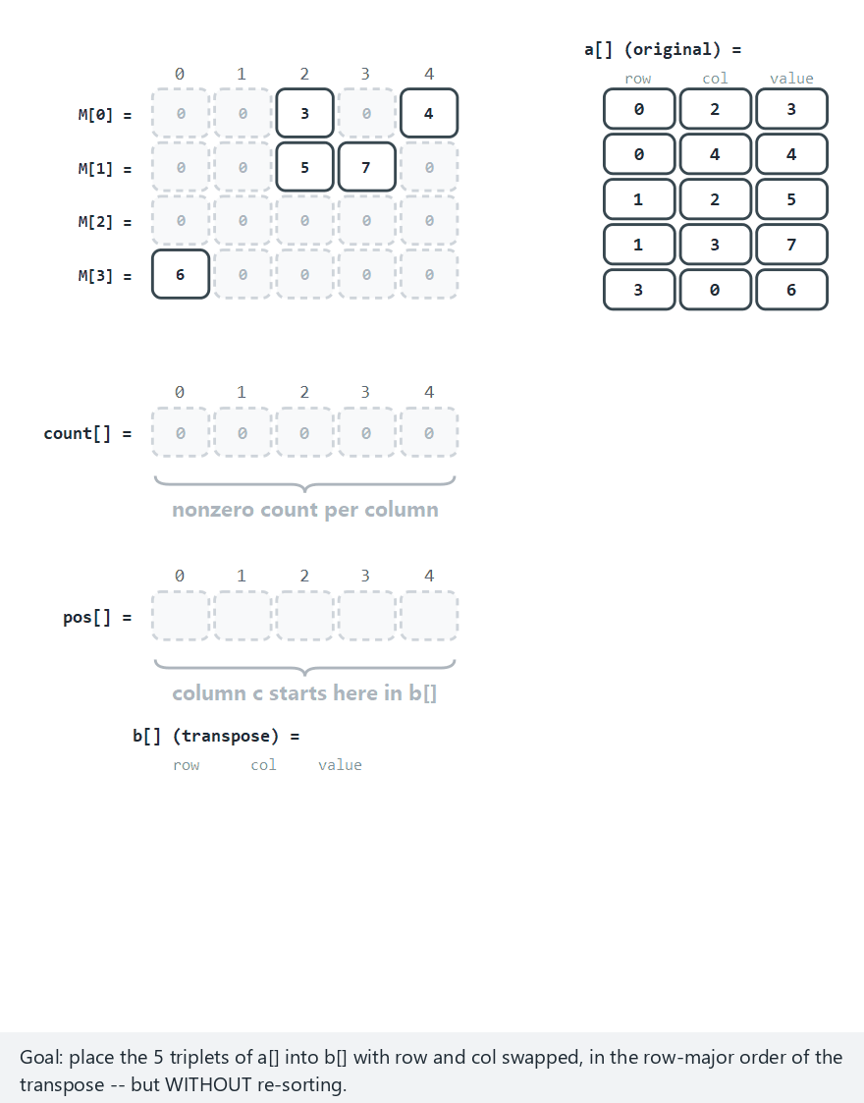
CEN207 Data Structures · Week 2
Fast transpose, step by step
RTEU Computer Engineering · Fall 2026–2027
61
Notes:
Watch count[] fill first, then pos[] turn those counts into starting offsets, before a single output triplet is placed.

Slide 62
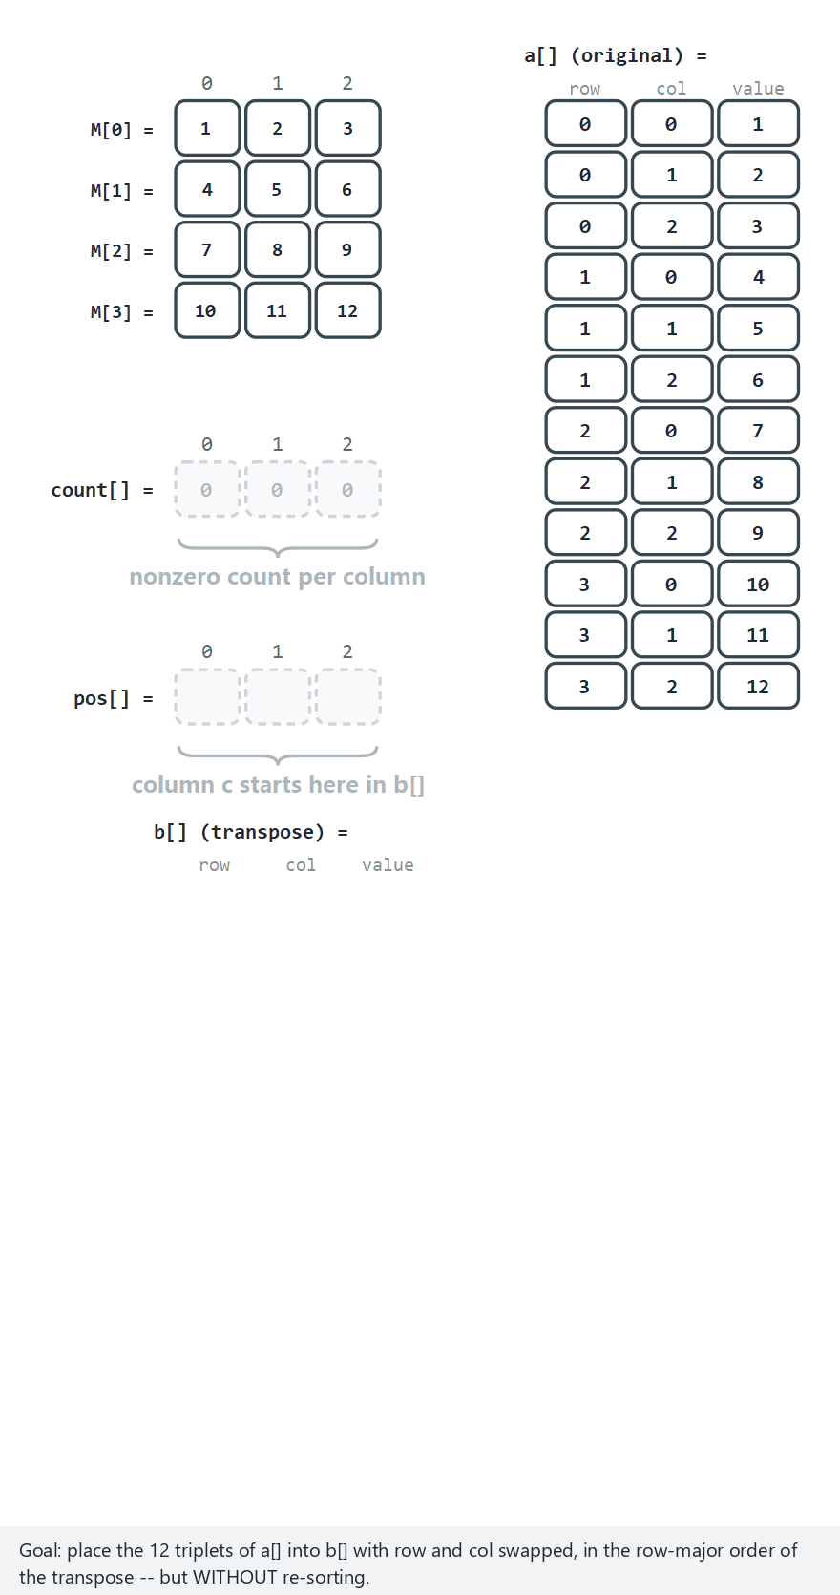
CEN207 Data Structures · Week 2
Edge case — a fully dense matrix
RTEU Computer Engineering · Fall 2026–2027
62
Notes:
With every cell nonzero, fast transpose still works — it just has as many triplets to place as the matrix has cells.

Slide 63
CEN207 Data Structures · Week 2
Code — counting and prefix sums
int count[COLS] = {0};
int pos[COLS];
for (int i = 0; i < nnz; i++)
count[a[i].col]++; /* per column */
pos[0] = 0;
for (int c = 1; c < COLS; c++)
pos[c] = pos[c - 1] + count[c - 1];
RTEU Computer Engineering · Fall 2026–2027
63
Notes:
pos[c] is the running total of every column before c — exactly where column c's triplets should start in the output.

Slide 64
CEN207 Data Structures · Week 2
Code — placing every triplet
for (int i = 0; i < nnz; i++) {
int c = a[i].col;
int p = pos[c]++;
b[p].row = a[i].col; /* row/col swap */
b[p].col = a[i].row;
b[p].value = a[i].value;
}
RTEU Computer Engineering · Fall 2026–2027
64
Notes:
pos[c]++ both reads the next free slot for column c and reserves it for the next triplet that lands there.

Slide 65
CEN207 Data Structures · Week 2
Complexity and common mistakes
• Two passes, O(nnz + COLS) — no sorting at all
• Far faster than a general sort's O(nnz log nnz)
• Mistake: skipping the prefix sum — output lands unsorted
• Mistake: forgetting to swap row and col
RTEU Computer Engineering · Fall 2026–2027
65
Notes:
Skip the prefix-sum step and every triplet still gets placed somewhere — just not in the sorted order the algorithm promises.

Slide 66
CEN207 Data Structures · Week 2
Adding two sparse matrices: a merge
• Both triplet lists already row-major sorted
• Walk both together, like merge sort's merge step
• Earlier (row,col) wins and is copied through
• Same (row,col) in both: add the values
RTEU Computer Engineering · Fall 2026–2027
66
Notes:
Because both inputs are already sorted, addition never needs to search — it only ever needs to compare two current positions.

Slide 67
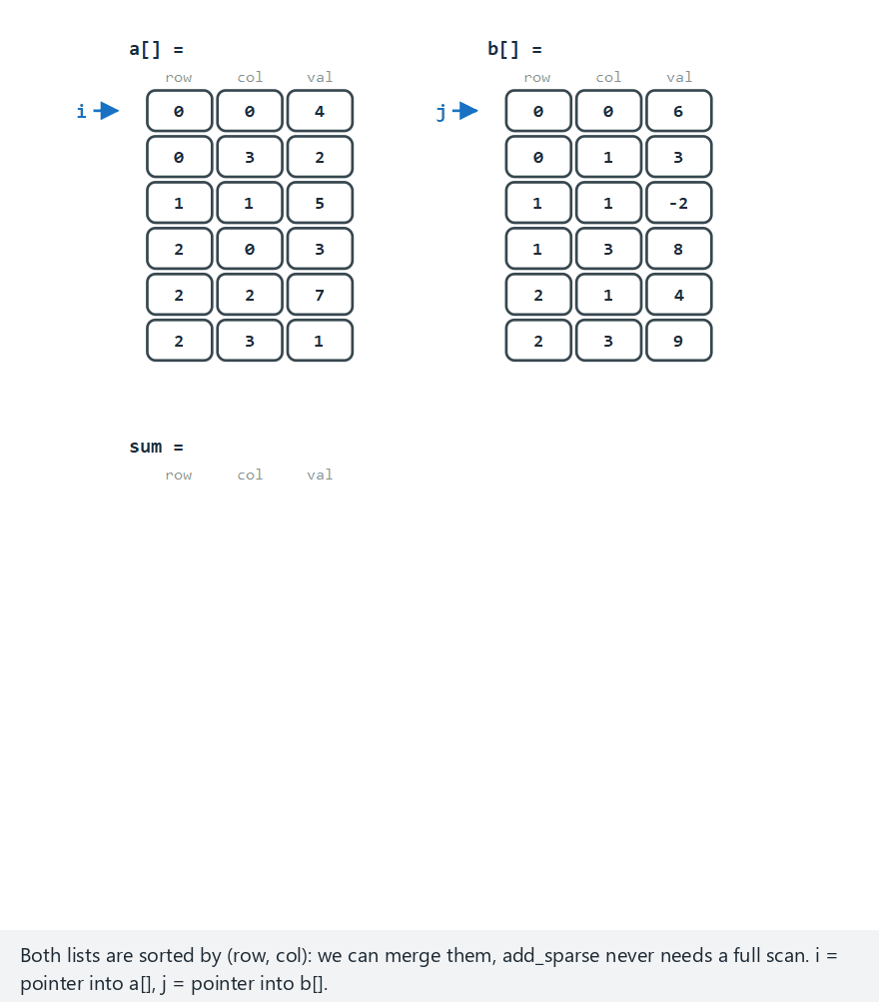
CEN207 Data Structures · Week 2
Sparse matrix addition, step by step
RTEU Computer Engineering · Fall 2026–2027
67
Notes:
Watch pointers i and j advance independently, each stepping only through its own list, exactly like merging two sorted runs.

Slide 68
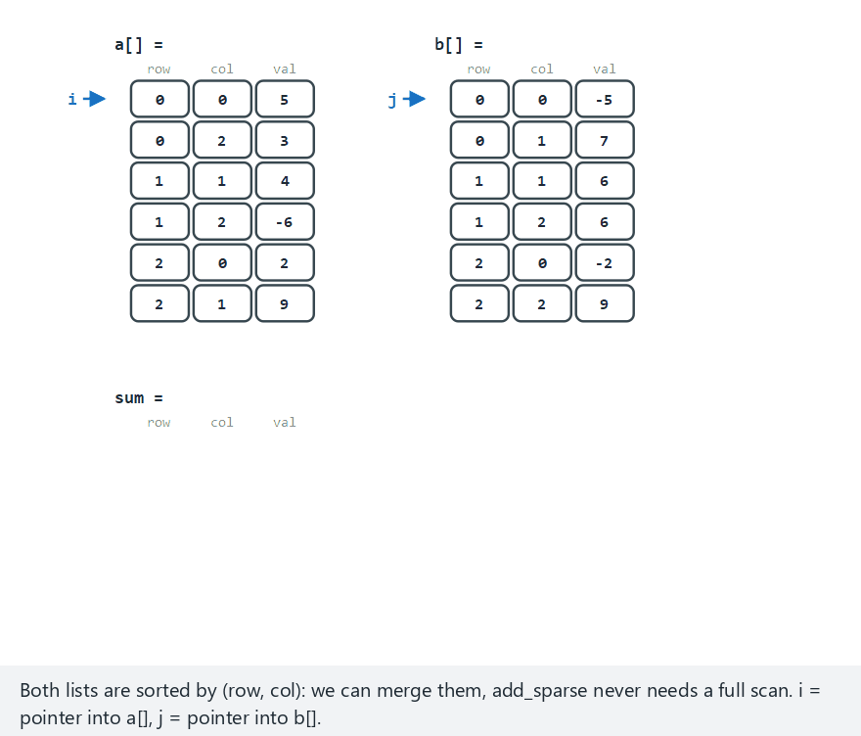
CEN207 Data Structures · Week 2
Edge case — values that cancel to zero
RTEU Computer Engineering · Fall 2026–2027
68
Notes:
A cancelled cell is not written to the output at all — the result stays sparse, never picking up new zero entries.

Slide 69
CEN207 Data Structures · Week 2
Code — the merge loop
while (i < na && j < nb) {
if (/* … a[i]'s (row,col) comes first … */) {
out[k++] = a[i++];
} else if (/* … b[j]'s comes first … */) {
out[k++] = b[j++];
} else {
int sum = a[i].value + b[j].value;
if (sum != 0) /* … out[k++] = sum entry … */;
i++; j++;
}
}
RTEU Computer Engineering · Fall 2026–2027
69
Notes:
Three cases only: a is earlier, b is earlier, or they land on the exact same cell and their values add together.

Slide 70
CEN207 Data Structures · Week 2
Complexity and common mistakes
• One merge pass: O(na + nb), no re-sorting
• Never touches a cell absent from both lists
• Mistake: forgetting to drop a cell when the sum is 0
• Mistake: assuming unsorted triplet lists still merge correctly
RTEU Computer Engineering · Fall 2026–2027
70
Notes:
This whole approach depends on both lists already being sorted — feed it unsorted triplets and the merge silently gives the wrong answer.

Slide 71
CEN207 Data Structures · Week 2
Mini-quiz
Cell (1,2) holds 6 in matrix A and −6 in matrix B. What ends up in the sum's triplet list?
RTEU Computer Engineering · Fall 2026–2027
71
Notes:
Let the class work out the arithmetic before the next slide.

Slide 72
CEN207 Data Structures · Week 2
Answer
Nothing. 6 + (-6) = 0, and a zero-sum cell is dropped entirely — the triplet list only ever holds nonzero values.
RTEU Computer Engineering · Fall 2026–2027
72
Notes:
Keeping a zero-valued triplet around would quietly break the "only nonzero cells" promise the whole representation depends on.

Slide 73
CEN207 Data Structures · Week 2
5. Linked Lists: Node, Head, NULL
RTEU Computer Engineering · Fall 2026–2027
73
Notes:
Section 5 introduces the second major idea of the week — a structure where inserting never has to shift anything else.

Slide 74
CEN207 Data Structures · Week 2
A question to start
Every insert into an array can shift up to n elements. Is there a structure where inserting never moves existing values?
RTEU Computer Engineering · Fall 2026–2027
74
Notes:
Give the class a moment — the answer is exactly what the rest of today builds.

Slide 75
CEN207 Data Structures · Week 2
A short history
• 1956 — John McCarthy, Lisp's cons cell
• A cons cell: a value, plus a pointer to the next
• Six decades later, every language still uses it
• C's struct Node { data; next; } is the same idea
RTEU Computer Engineering · Fall 2026–2027
75
Notes:
McCarthy was building a language for symbolic reasoning, not thinking about "data structures" as a subject — this idea simply turned out to be everywhere.

Slide 76
CEN207 Data Structures · Week 2
Intuition — a treasure hunt
• Each clue tells you where the next clue is
• You never see the whole map at once
• Follow one pointer, arrive, read, follow the next
• The last clue says "nothing here" — NULL
RTEU Computer Engineering · Fall 2026–2027
76
Notes:
An array is a map you hold all at once; a linked list is a trail you can only walk one step at a time.

Slide 77
CEN207 Data Structures · Week 2
The whole idea, one struct
typedef struct Node {
int data;
struct Node *next;
} Node;
• One value, one pointer — that is a linked list
• No shifting: a new node just gets a pointer
RTEU Computer Engineering · Fall 2026–2027
77
Notes:
Every single linked-list program this week and next builds on exactly this five-line struct.

Slide 78
CEN207 Data Structures · Week 2
head and the NULL terminator
• head is the only fixed reference into the list
• Every other node is reached by following next
• The last node's next is NULL — "no more nodes"
• An empty list is just head == NULL
RTEU Computer Engineering · Fall 2026–2027
78
Notes:
Lose head, and every node after it becomes unreachable — head is the single thread the whole list hangs from.

Slide 79
CEN207 Data Structures · Week 2
The "inception": a struct containing itself
• struct Node has a field of type struct Node *
• That is not infinite recursion — it is a pointer
• A pointer's size is fixed, known before Node is complete
• This is why struct Node *next; compiles, but Node next; cannot
RTEU Computer Engineering · Fall 2026–2027
79
Notes:
This self-reference trips up a lot of students the first time — the key is that a pointer is always the same small, fixed size, whatever it points at.

Slide 80
CEN207 Data Structures · Week 2
Common mistakes
• Forgetting to check for NULL before ->next
• Confusing a node (the struct) with a pointer to it
• Writing Node next; where a pointer was needed
RTEU Computer Engineering · Fall 2026–2027
80
Notes:
Dereferencing a NULL pointer is the single most common crash in every linked-list program this semester.

Slide 81
CEN207 Data Structures · Week 2
Mini-quiz
Why must next be declared as struct Node *, never as a plain struct Node?
RTEU Computer Engineering · Fall 2026–2027
81
Notes:
Let the class connect this back to the "inception" slide before the answer.

Slide 82
CEN207 Data Structures · Week 2
Answer
A plain Node field would need the size of Node to already be known — but Node is not finished being defined yet. A pointer's size never depends on that.
RTEU Computer Engineering · Fall 2026–2027
82
Notes:
A pointer is always the same handful of bytes, no matter what it points at — that is precisely what breaks the circular dependency.

Slide 83
CEN207 Data Structures · Week 2
6. Singly Linked Lists: Insert, Delete, Search, Reverse
RTEU Computer Engineering · Fall 2026–2027
83
Notes:
Section 6 builds the four operations every later list variant — doubly, circular, XOR, skip — reuses or extends.

Slide 84
CEN207 Data Structures · Week 2
A question to start
Three insert positions — head, tail, and "after a given node" — cost very different amounts. Which is cheap, and which is not?
RTEU Computer Engineering · Fall 2026–2027
84
Notes:
The answer depends entirely on whether the list keeps a separate pointer to its tail, which this version does not.

Slide 85
CEN207 Data Structures · Week 2
Three ways to insert
• insert_head: new node points at the old head — O(1)
• insert_tail: no tail pointer here — walk to the end
• insert_after(prev, v): two pointer writes, in order
• Getting that order backward breaks the list
RTEU Computer Engineering · Fall 2026–2027
85
Notes:
"In order" is not a stylistic preference here — it is the difference between a working list and a severed one.

Slide 86
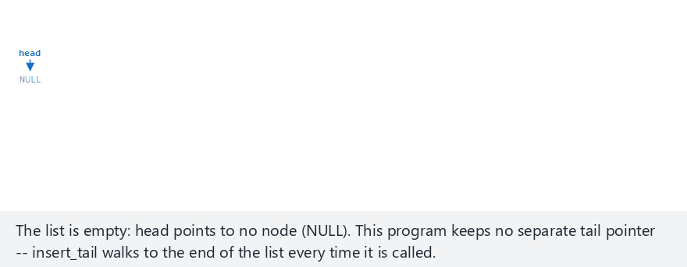
CEN207 Data Structures · Week 2
Singly-list insertion, step by step
RTEU Computer Engineering · Fall 2026–2027
86
Notes:
Watch insert_tail specifically — with no tail pointer, it has to walk past every existing node first.

Slide 87
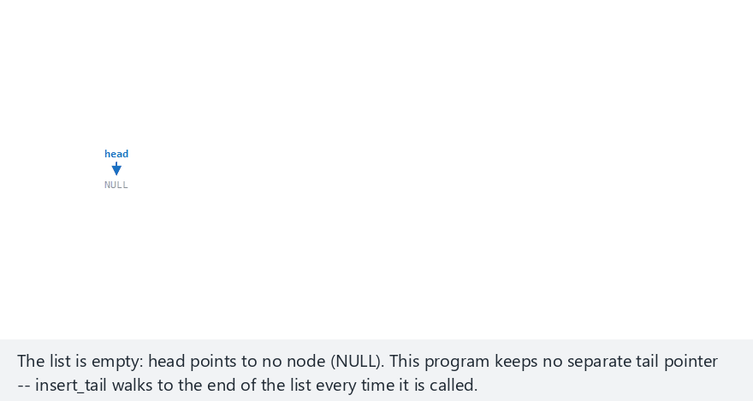
CEN207 Data Structures · Week 2
Edge case — the two steps, swapped
RTEU Computer Engineering · Fall 2026–2027
87
Notes:
This illustration never touches the real list — it exists purely to show why the write order in insert_after truly matters.

Slide 88
CEN207 Data Structures · Week 2
Code — insert_head()
Node *insert_head(Node *head, int value) {
Node *n = malloc(sizeof(Node));
n->data = value;
n->next = head; /* points at the old head */
return n; /* new node is head now */
}
RTEU Computer Engineering · Fall 2026–2027
88
Notes:
One malloc, one pointer write, one return — insert_head never even looks at the rest of the list.

Slide 89
CEN207 Data Structures · Week 2
Code — insert_after(): order matters
void insert_after(Node *prev, int value) {
Node *n = malloc(sizeof(Node));
n->data = value;
n->next = prev->next; /* STEP 1: new first */
prev->next = n; /* STEP 2: then link */
}
RTEU Computer Engineering · Fall 2026–2027
89
Notes:
Swap these two lines and prev->next already equals n by the time step one reads it — the new node ends up pointing at itself.

Slide 90
CEN207 Data Structures · Week 2
Complexity and common mistakes
• insert_head: O(1) — no walking at all
• insert_tail (no tail pointer): walks to the end — O(n)
• insert_after: O(1) once prev is already found
• Mistake: swapping STEP 1 and STEP 2 — cuts the list
RTEU Computer Engineering · Fall 2026–2027
90
Notes:
insert_after itself is O(1), but finding prev in the first place, via search, usually is not.

Slide 91
CEN207 Data Structures · Week 2
Deleting by value
• Special case: the value is at the head
• Otherwise: prev/cur walk together, searching
• Found: prev->next = cur->next — the bypass arrow
• Then free(cur) — the node is gone
RTEU Computer Engineering · Fall 2026–2027
91
Notes:
The bypass arrow is the entire trick: nothing points at cur any more, so it is simply unreachable, ready to be freed.

Slide 92
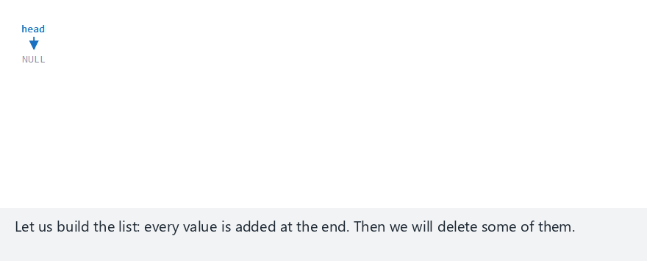
CEN207 Data Structures · Week 2
Singly-list deletion, step by step
RTEU Computer Engineering · Fall 2026–2027
92
Notes:
Watch prev and cur move together — prev always trails one step behind cur, ready to be relinked the moment cur is found.

Slide 93
CEN207 Data Structures · Week 2
Edge case — deleting the tail, then a missing value
RTEU Computer Engineering · Fall 2026–2027
93
Notes:
Deleting the tail is not a separate case in this code at all — it falls naturally out of the same prev/cur scan.

Slide 94
CEN207 Data Structures · Week 2
Code — delete_value()
Node *delete_value(Node *head, int value,
bool *removed) {
*removed = false;
if (head == NULL) return NULL;
if (head->data == value) { /* delete head */
Node *tmp = head;
head = head->next;
free(tmp);
*removed = true;
return head;
}
/* … prev/cur scan, bypass, free(cur) … */
}
RTEU Computer Engineering · Fall 2026–2027
94
Notes:
The head case is handled separately here because head itself, not just some node's next field, has to change.

Slide 95
CEN207 Data Structures · Week 2
Complexity and common mistakes
• Deleting the head: O(1), no search needed
• Deleting anywhere else: O(n) to find it
• Mistake: forgetting the head is a special case
• Mistake: advancing cur before saving prev
RTEU Computer Engineering · Fall 2026–2027
95
Notes:
If prev is not updated in lockstep with cur, the bypass arrow ends up pointing from the wrong node entirely.

Slide 96
CEN207 Data Structures · Week 2
Linear search: no shortcuts
• No index arithmetic — a list has no arr[k]
• Walk from head, comparing one node at a time
• Found: return its position; exhausted: return -1
RTEU Computer Engineering · Fall 2026–2027
96
Notes:
This is the single biggest thing a list gives up compared to an array — there is no way to jump straight to position k.

Slide 97
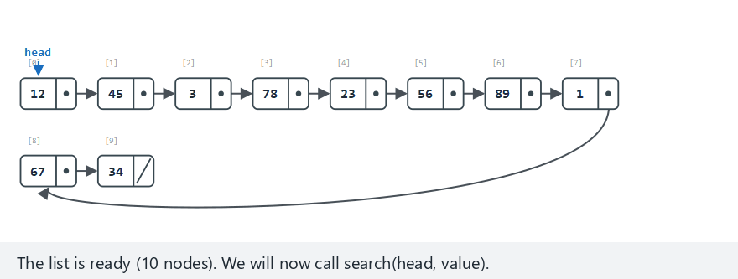
CEN207 Data Structures · Week 2
Singly-list search, step by step
RTEU Computer Engineering · Fall 2026–2027
97
Notes:
Watch the comparison counter climb — every node visited costs one comparison, whether or not it is the one being searched for.

Slide 98
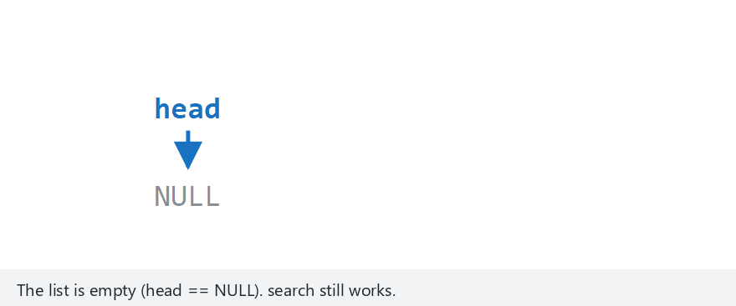
CEN207 Data Structures · Week 2
Edge case — searching an empty list
RTEU Computer Engineering · Fall 2026–2027
98
Notes:
An empty list means the for-loop's condition, cur != NULL, fails immediately — search returns -1 without ever comparing anything.

Slide 99
CEN207 Data Structures · Week 2
Code — search()
int search(Node *head, int value) {
int index = 0;
for (Node *cur = head; cur != NULL;
cur = cur->next) {
if (cur->data == value)
return index; /* found here */
index++;
}
return -1; /* not found */
}
RTEU Computer Engineering · Fall 2026–2027
99
Notes:
This entire function fits on one slide — nothing in today's lecture gets cut from it.

Slide 100
CEN207 Data Structures · Week 2
Complexity
• Every search: O(n) — no index to jump to
• Contrast: arr[k] on an array is O(1)
• This exact gap drives the section 11 comparison
RTEU Computer Engineering · Fall 2026–2027
100
Notes:
Keep this O(n) number in mind — it is the single biggest argument in the arrays-versus-lists table two sections from now.

Slide 101
CEN207 Data Structures · Week 2
Reversing in place: three pointers
• prev trails, curr leads, next looks ahead
• Save next before overwriting curr->next
• Flip curr->next to point at prev
• Both pointers then step one node forward
RTEU Computer Engineering · Fall 2026–2027
101
Notes:
Three pointers doing a coordinated dance, one node at a time, is the entire algorithm — no recursion, no extra memory.

Slide 102
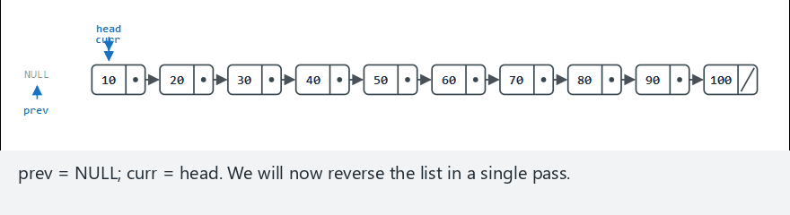
CEN207 Data Structures · Week 2
Singly-list reversal, step by step
RTEU Computer Engineering · Fall 2026–2027
102
Notes:
Watch every arrow flip one at a time, always in the same order: save next, flip curr's arrow, advance both pointers.

Slide 103
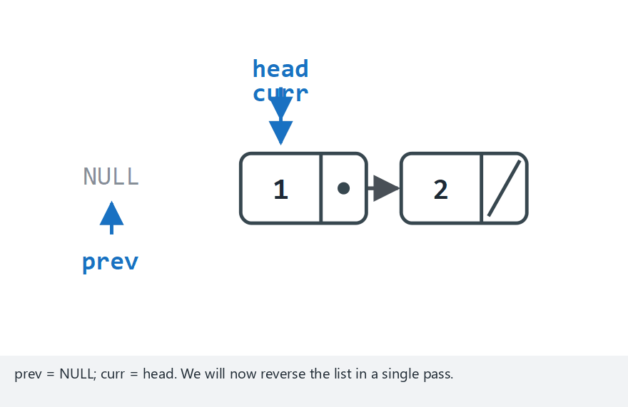
CEN207 Data Structures · Week 2
Edge case — just two nodes
RTEU Computer Engineering · Fall 2026–2027
103
Notes:
Even the smallest non-trivial case runs through the exact same three-pointer dance, just for one iteration instead of many.

Slide 104
CEN207 Data Structures · Week 2
Code — reverse()
Node *reverse(Node *head) {
Node *prev = NULL;
Node *curr = head;
while (curr != NULL) {
Node *next = curr->next; /* save rest */
curr->next = prev; /* flip arrow */
prev = curr;
curr = next;
}
return prev; /* new head */
}
RTEU Computer Engineering · Fall 2026–2027
104
Notes:
This whole function also fits on one slide, and it is worth reading it line by line, out loud, at least once.

Slide 105
CEN207 Data Structures · Week 2
Complexity
• One pass, one flip per node — O(n) time
• No extra nodes allocated — O(1) space
• Compare: reversing an array also needs no extra pointers
RTEU Computer Engineering · Fall 2026–2027
105
Notes:
In-place reversal, with no extra memory beyond three pointers, is the main reason this algorithm is worth learning by heart.

Slide 106
CEN207 Data Structures · Week 2
Mini-quiz
If you flip curr->next to prev before saving curr->next into a temporary next variable, what breaks?
RTEU Computer Engineering · Fall 2026–2027
106
Notes:
Let the class trace through what curr->next actually holds at each step before the answer.

Slide 107
CEN207 Data Structures · Week 2
Answer
The rest of the list is lost. Once curr->next points backward, there is no way left to reach the nodes that used to follow it.
RTEU Computer Engineering · Fall 2026–2027
107
Notes:
This is the exact same "save before you overwrite" lesson as insert_after's step order, just showing up again in a different operation.

Slide 108
CEN207 Data Structures · Week 2
7. Doubly Linked Lists
RTEU Computer Engineering · Fall 2026–2027
108
Notes:
Section 7 adds a second pointer per node, in exchange for being able to walk in both directions.

Slide 109
CEN207 Data Structures · Week 2
A question to start
A singly list can only walk forward. What has to change to walk backward too?
RTEU Computer Engineering · Fall 2026–2027
109
Notes:
The answer is almost too obvious once it's said out loud — but it changes how every operation has to be written.

Slide 110
CEN207 Data Structures · Week 2
Intuition — a two-way street
• Singly list: a one-way street, forward only
• Doubly list: a two-way street, both directions
• Every node carries two signs: next and prev
• Turning around costs nothing extra — just follow prev
RTEU Computer Engineering · Fall 2026–2027
110
Notes:
The extra pointer is not free, though — it is one more field to keep correct on every single insert and delete.

Slide 111
CEN207 Data Structures · Week 2
insert_after: four pointers to fix, not two
• Singly list's insert_after: fix 2 pointers
• Doubly list: also fix the new node's prev
• And the old next's prev, if it exists
• If cur was the tail, update list->tail too
RTEU Computer Engineering · Fall 2026–2027
111
Notes:
Every pointer that used to skip over the insertion point now has a matching pointer coming back the other way — both need fixing.

Slide 112
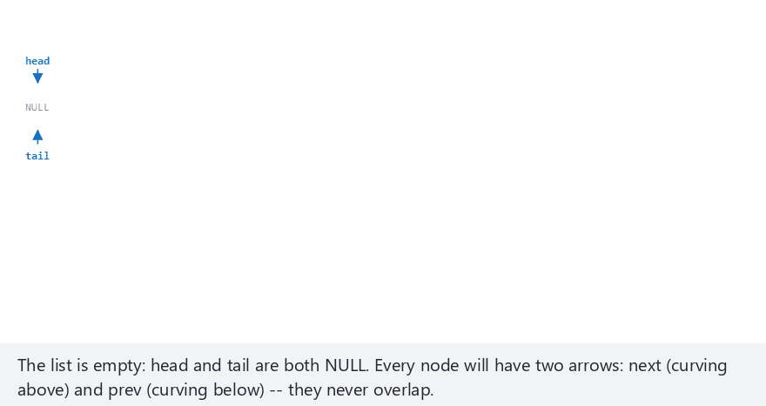
CEN207 Data Structures · Week 2
Doubly-list insertion, step by step
RTEU Computer Engineering · Fall 2026–2027
112
Notes:
Watch the two arrows on every node — next curving above the row, prev curving below — updated together, never just one.

Slide 113
CEN207 Data Structures · Week 2
Edge case — inserting right after the tail
RTEU Computer Engineering · Fall 2026–2027
113
Notes:
Inserting after the current tail means the new node becomes the new tail — list->tail itself has to be updated, not just a next pointer.

Slide 114
CEN207 Data Structures · Week 2
Code — insert_after()
bool insert_after(List *list, int target, int v) {
for (Node *cur = list->head; cur; cur = cur->next) {
if (cur->data == target) {
Node *n = malloc(sizeof(Node));
n->data = v; n->prev = cur; n->next = cur->next;
if (cur->next) cur->next->prev = n;
else list->tail = n; /* cur was the tail */
cur->next = n;
return true;
}
}
return false;
}
RTEU Computer Engineering · Fall 2026–2027
114
Notes:
Four pointer writes in total: the new node's own prev and next, the old next's prev (or list->tail), and cur's next.

Slide 115
CEN207 Data Structures · Week 2
Code — delete_value(): no scan for prev
bool delete_value(List *list, int value) {
for (Node *cur = list->head; cur; cur = cur->next) {
if (cur->data == value) {
if (cur->prev) cur->prev->next = cur->next;
else list->head = cur->next;
if (cur->next) cur->next->prev = cur->prev;
else list->tail = cur->prev;
free(cur);
return true;
}
}
return false;
}
RTEU Computer Engineering · Fall 2026–2027
115
Notes:
cur->prev is read directly here — the singly version had to track a separate prev variable by hand while scanning.

Slide 116
CEN207 Data Structures · Week 2
Complexity and common mistakes
• Finding the target: O(n), same as singly
• Relinking, once found: O(1) either direction
• Mistake: forgetting to update tail after the tail moves
• Mistake: skipping the new node's prev link
RTEU Computer Engineering · Fall 2026–2027
116
Notes:
The search cost never improves with a second pointer — only the relinking step, and the ability to walk backward, changes.

Slide 117
CEN207 Data Structures · Week 2
Mini-quiz
Why does a doubly list's delete_value need no separate prev-tracking variable, unlike the singly version?
RTEU Computer Engineering · Fall 2026–2027
117
Notes:
Point back to the delete_value code slide before the answer.

Slide 118
CEN207 Data Structures · Week 2
Answer
Every node already stores its own `prev`. The singly version had to track prev by hand while scanning; the doubly version just reads cur->prev directly.
RTEU Computer Engineering · Fall 2026–2027
118
Notes:
That stored prev field is the entire reason doubly lists exist — everything else follows from having it available at every node.

Slide 119
CEN207 Data Structures · Week 2
8. Circular Lists and the Josephus Problem
RTEU Computer Engineering · Fall 2026–2027
119
Notes:
Section 8 removes NULL entirely — the list wraps around instead of ending — and uses that shape to solve a very old puzzle.

Slide 120
CEN207 Data Structures · Week 2
A question to start
What if the last node's next pointed back at the first node, instead of NULL?
RTEU Computer Engineering · Fall 2026–2027
120
Notes:
There is no obvious reason not to try this — and it turns out to be exactly what the Josephus problem needs.

Slide 121
CEN207 Data Structures · Week 2
Intuition — people seated in a circle
• No "first" seat and no "last" seat, really
• Walk far enough and you are back where you started
• A circular list has no NULL to stop a walk
• Something else — a count, a condition — must stop it
RTEU Computer Engineering · Fall 2026–2027
121
Notes:
Forgetting this is the classic circular-list bug: a loop written to stop at NULL simply never stops at all.

Slide 122
CEN207 Data Structures · Week 2
One pointer, no separate head
• tail points at the last-inserted node
• tail->next is the head — no extra field
• A single node points at itself — a tiny loop
• Deleting needs a forward scan — there is no prev
RTEU Computer Engineering · Fall 2026–2027
122
Notes:
Keeping only tail, and deriving head from tail->next, is a small but deliberate design choice this program makes.

Slide 123
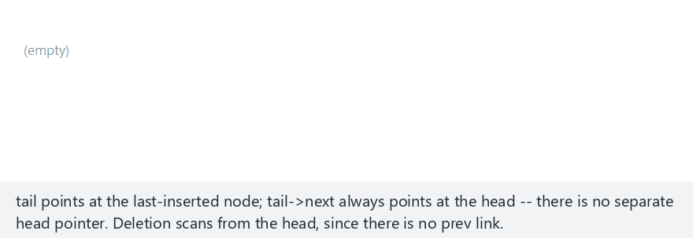
CEN207 Data Structures · Week 2
Circular-list operations, step by step
RTEU Computer Engineering · Fall 2026–2027
123
Notes:
Watch the wrap-around arrow, drawn as a curve under the row, connecting the last node straight back to the first.

Slide 124
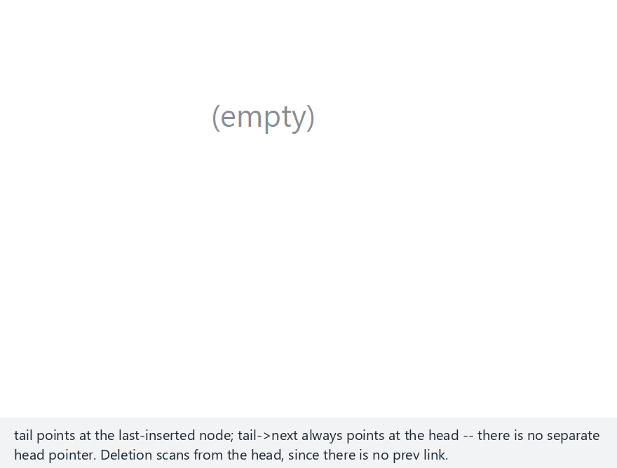
CEN207 Data Structures · Week 2
Edge case — the last node, deleted
RTEU Computer Engineering · Fall 2026–2027
124
Notes:
A one-node circular list points at itself; deleting that single node has to leave the list genuinely empty, tail set back to NULL.

Slide 125
CEN207 Data Structures · Week 2
Code — insert_tail()
Node *insert_tail(Node *tail, int value) {
Node *n = malloc(sizeof(Node));
n->data = value;
if (tail == NULL) {
n->next = n; /* points at itself */
return n;
}
n->next = tail->next; /* new node -> old head */
tail->next = n; /* old tail -> new node */
return n;
}
RTEU Computer Engineering · Fall 2026–2027
125
Notes:
The empty-list case is special precisely because there is no head->next relationship yet to preserve — the new node has to loop back to itself.

Slide 126
CEN207 Data Structures · Week 2
Complexity and common mistakes
• Insert at the tail: O(1), same trick as before
• Delete by value: O(n) scan — no prev link
• Mistake: checking cur == NULL to stop a traversal
• A circular list needs a step count, not a NULL
RTEU Computer Engineering · Fall 2026–2027
126
Notes:
This mistake alone causes more infinite loops than any other bug in this week's material.

Slide 127
CEN207 Data Structures · Week 2
A short history
• c. 67 CE — Flavius Josephus, siege of Yodfat
• Legend: 41 soldiers, every 3rd one eliminated
• Josephus reportedly placed himself at the survivor's spot
• A single circular list solves the whole puzzle today
RTEU Computer Engineering · Fall 2026–2027
127
Notes:
Whether the legend is exactly true or not, the elimination pattern it describes is precisely what this algorithm simulates.

Slide 128
CEN207 Data Structures · Week 2
Every k-th person is eliminated
• n people stand in a circle, numbered 1..n
• Count k-1 steps forward from the last survivor
• Eliminate the person you land on
• Repeat until only one person remains
RTEU Computer Engineering · Fall 2026–2027
128
Notes:
Every elimination is just one bypass arrow, exactly like circular delete — the whole problem reduces to the operation just shown.

Slide 129
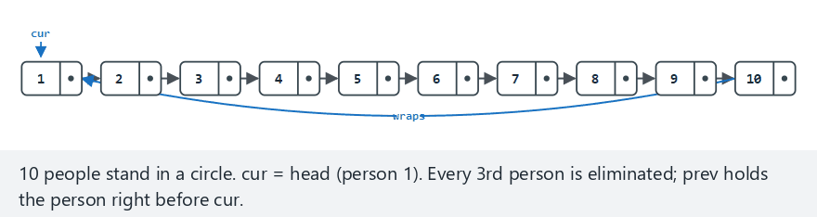
CEN207 Data Structures · Week 2
The Josephus problem, step by step
RTEU Computer Engineering · Fall 2026–2027
129
Notes:
Watch the circle shrink by exactly one node per elimination, the wrap-around arrow redrawn each time.

Slide 130
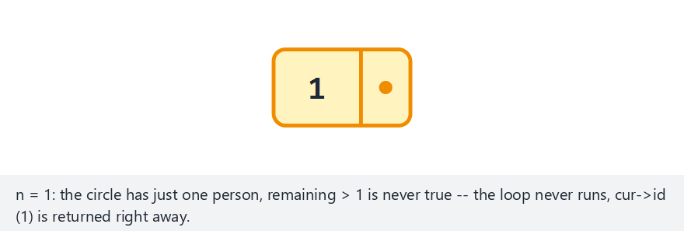
CEN207 Data Structures · Week 2
Edge case — a circle of one
RTEU Computer Engineering · Fall 2026–2027
130
Notes:
With only one person in the circle, the elimination loop's remaining > 1 condition is false immediately — nobody is ever removed.

Slide 131
CEN207 Data Structures · Week 2
Code — josephus()
int josephus(int n, int k) {
Node *cur = head;
int remaining = n;
while (remaining > 1) {
for (int s = 1; s < k; s++) { /* k-1 steps */
prev = cur;
cur = cur->next;
}
prev->next = cur->next; /* remove cur */
cur = prev->next;
remaining--;
}
return cur->id; /* the survivor */
}
RTEU Computer Engineering · Fall 2026–2027
131
Notes:
The inner for-loop counts exactly k-1 steps forward — the same bypass arrow from circular delete then removes whoever it lands on.

Slide 132
CEN207 Data Structures · Week 2
Complexity
• Simulating directly: O(n · k) in the worst case
• A closed-form recurrence gives the survivor in O(n)
• J(1)=0, J(n) = (J(n-1) + k) mod n
RTEU Computer Engineering · Fall 2026–2027
132
Notes:
The simulation is what the animation shows step by step; the recurrence is a shortcut to just the final answer, no circle required.

Slide 133
CEN207 Data Structures · Week 2
Mini-quiz
With k = 1, every count is just "the next person". Who survives a circle of 10?
RTEU Computer Engineering · Fall 2026–2027
133
Notes:
Let the class walk through what k=1 actually means before the answer.

Slide 134
CEN207 Data Structures · Week 2
Answer
Person 10 — the last one in line. With k=1 there is no skipping at all: elimination just proceeds in plain order, 1 through 9.
RTEU Computer Engineering · Fall 2026–2027
134
Notes:
k=1 is the simplest possible case, and a good sanity check that the general algorithm still behaves the way plain intuition expects.

Slide 135
CEN207 Data Structures · Week 2
9. XOR Linked Lists: A Curiosity
RTEU Computer Engineering · Fall 2026–2027
135
Notes:
Section 9 is a memory-saving trick worth knowing about, but the mistakes slide near the end is the part that matters most.

Slide 136
CEN207 Data Structures · Week 2
A question to start
A doubly list spends two pointer fields per node. Could one field somehow hold both neighbors at once?
RTEU Computer Engineering · Fall 2026–2027
136
Notes:
It sounds impossible at first — you cannot literally store two addresses in the space of one — and yet there is a trick.

Slide 137
CEN207 Data Structures · Week 2
npx = prev XOR next
• Store one field: prev's address XOR next's address
• Arriving from a known neighbor known, recover the other:
• other = npx XOR known
• XOR quietly "cancels" the neighbor you came from
RTEU Computer Engineering · Fall 2026–2027
137
Notes:
XOR-ing a value with itself always gives zero — that single fact is the entire trick behind this whole structure.

Slide 138
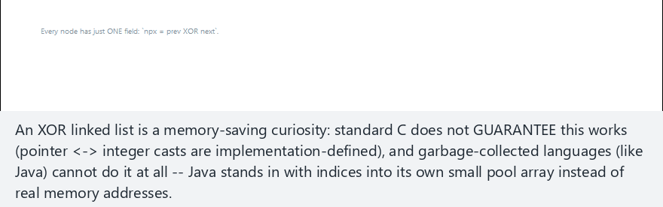
CEN207 Data Structures · Week 2
XOR list traversal, step by step
RTEU Computer Engineering · Fall 2026–2027
138
Notes:
Watch each node's hex address and npx value on screen — the traversal literally computes the next address, live, at every step.

Slide 139
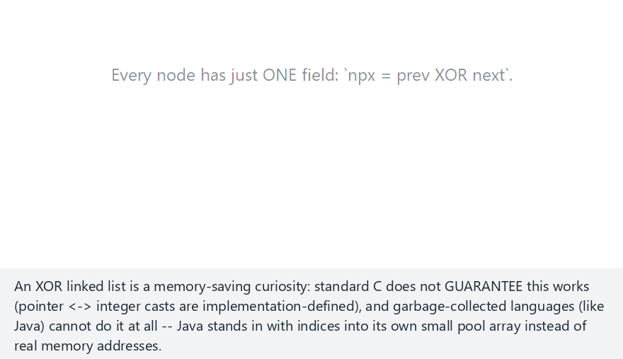
CEN207 Data Structures · Week 2
Edge case — inserting at the tail of an empty list
RTEU Computer Engineering · Fall 2026–2027
139
Notes:
A single node in an empty list is both head and tail at once — its npx is just its one real neighbor, XOR'd with NULL.

Slide 140
CEN207 Data Structures · Week 2
Code — the struct and the XOR trick
typedef struct Node {
int data;
uintptr_t npx; /* XOR of prev and next */
} Node;
static Node *xor_node(uintptr_t npx, Node *known) {
return (Node *)(npx ^ (uintptr_t)known);
}
RTEU Computer Engineering · Fall 2026–2027
140
Notes:
xor_node is the one helper every other function in this program calls — it is where the trick actually lives.

Slide 141
CEN207 Data Structures · Week 2
Code — traverse_forward()
void traverse_forward(Node *head) {
Node *prev = NULL, *cur = head;
while (cur != NULL) {
printf(" %d", cur->data);
Node *next = xor_node(cur->npx, prev);
prev = cur; cur = next;
}
}
RTEU Computer Engineering · Fall 2026–2027
141
Notes:
prev starts as NULL, exactly the way an ordinary singly traversal starts — nothing else about the loop's shape has changed.

Slide 142
CEN207 Data Structures · Week 2
Complexity
• Insert at head or tail: O(1), same as before
• Every traversal step: one extra XOR — still O(1) each
• Memory saved: one pointer field per node
RTEU Computer Engineering · Fall 2026–2027
142
Notes:
The time complexity does not actually improve over a doubly list — the entire benefit here is memory, not speed.

Slide 143
CEN207 Data Structures · Week 2
Why this is a curiosity, not a habit
• C does not guarantee pointer↔integer round-trips this way
• uintptr_t casts back to a pointer are implementation-defined
• A garbage-collected language (Java) cannot do this at all
• Real code: use a plain doubly linked list instead
RTEU Computer Engineering · Fall 2026–2027
143
Notes:
This is the single most important slide in this section — the trick is clever, but it is not something to actually ship.

Slide 144
CEN207 Data Structures · Week 2
Mini-quiz
Why can a garbage collector never support an XOR linked list the way C's malloc can?
RTEU Computer Engineering · Fall 2026–2027
144
Notes:
Let the class connect this back to what a garbage collector actually has to do.

Slide 145
CEN207 Data Structures · Week 2
Answer
A GC needs to find every live pointer to trace and possibly move it. An address hidden inside an XOR'd integer is invisible to that scan — the GC cannot see it as a pointer.
RTEU Computer Engineering · Fall 2026–2027
145
Notes:
Java's simulation in the demo code works around exactly this by using array indices instead of real memory addresses.

Slide 146
CEN207 Data Structures · Week 2
10. Skip Lists
RTEU Computer Engineering · Fall 2026–2027
146
Notes:
Section 10 asks whether a linked list can ever get binary search's O(log n), and answers yes, with one extra idea.

Slide 147
CEN207 Data Structures · Week 2
A question to start
A sorted array gets binary search, O(log n). A sorted linked list cannot jump to the middle. Is O(log n) search possible anyway?
RTEU Computer Engineering · Fall 2026–2027
147
Notes:
The obstacle is that a list has no index at all, so "jump to the middle" is not even a meaningful operation — yet.

Slide 148
CEN207 Data Structures · Week 2
A short history
• 1990 — William Pugh, University of Maryland
• A randomized alternative to balanced search trees
• Each key gets a random "coin-flip" height
• Simpler to implement correctly than a balanced tree
RTEU Computer Engineering · Fall 2026–2027
148
Notes:
Pugh's own selling point was exactly this: the expected performance of a balanced tree, with far less code to get right.

Slide 149
CEN207 Data Structures · Week 2
Intuition — a local road and an express lane
• Level 0: the full sorted list — every key
• Level 1: an express lane — only some keys
• Start on the express lane; drop down when it overshoots
• Fewer stops than checking every key one by one
RTEU Computer Engineering · Fall 2026–2027
149
Notes:
More express lanes, more levels, keep shrinking the number of stops — this demo uses just two levels to keep it visible.

Slide 150
CEN207 Data Structures · Week 2
Search: go right, or drop down
• At the current level, is cur->forward[i]->value < target?
• Yes: step right, staying on this level
• No: drop down one level and try again
• Reaching level 0 and stepping once more: the answer
RTEU Computer Engineering · Fall 2026–2027
150
Notes:
Every search starts at the highest level and works its way down, never going back up once it has dropped.

Slide 151
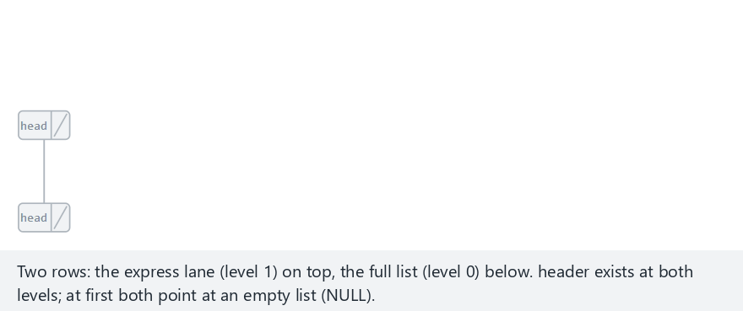
CEN207 Data Structures · Week 2
Skip list search, step by step
RTEU Computer Engineering · Fall 2026–2027
151
Notes:
Watch the search start on the express lane, drop to the full list only once it overshoots, then take one final step.

Slide 152
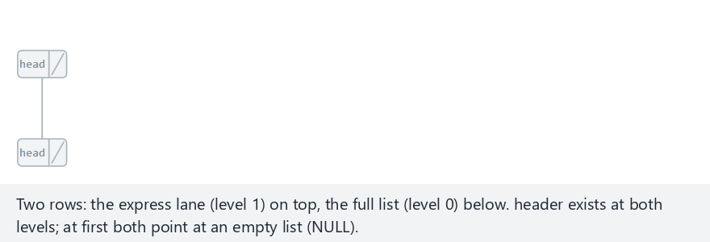
CEN207 Data Structures · Week 2
Edge case — only one node on the express lane
RTEU Computer Engineering · Fall 2026–2027
152
Notes:
With almost nothing on the express lane, most of the search still has to happen down at level 0.

Slide 153
CEN207 Data Structures · Week 2
Code — sl_search()
int sl_search(SkipList *sl, int value, int *cmp) {
Node *cur = sl->header;
for (int i = MAX_LEVEL-1; i >= 0; i--) {
while (cur->forward[i] &&
cur->forward[i]->value < value) {
cur = cur->forward[i]; /* go right */
(*cmp)++;
}
/* … else: drop down one level … */
}
cur = cur->forward[0];
return cur && cur->value == value;
}
RTEU Computer Engineering · Fall 2026–2027
153
Notes:
The outer for-loop counts levels down from the top; the inner while-loop is the only place that ever moves cur to the right.

Slide 154
CEN207 Data Structures · Week 2
Complexity and common mistakes
• Enough express levels: O(log n) expected search
• Every key stuck at level 0 only: degrades to O(n)
• Mistake: stopping instead of dropping down a level
• This demo's levels are fixed, not really flipped live
RTEU Computer Engineering · Fall 2026–2027
154
Notes:
A real implementation flips a coin for each key's level at insert time — this demo fixes the levels in advance so every run is reproducible.

Slide 155
CEN207 Data Structures · Week 2
Mini-quiz
If every key in a skip list happened to get level 1 only (no express lane at all), what does search cost, in Big-O?
RTEU Computer Engineering · Fall 2026–2027
155
Notes:
Let the class connect this back to what level 0 alone actually is.

Slide 156
CEN207 Data Structures · Week 2
Answer
O(n). With no express lane, level 0 is the only level left — search degrades to the same linear scan as a plain linked list.
RTEU Computer Engineering · Fall 2026–2027
156
Notes:
This is worth sitting with: a skip list's speed is never guaranteed, only expected — its worst case is exactly a plain list.

Slide 157
CEN207 Data Structures · Week 2
11. Arrays vs. Linked Lists
RTEU Computer Engineering · Fall 2026–2027
157
Notes:
Section 11 puts everything from today side by side, as one table, to make the trade-off explicit.

Slide 158
CEN207 Data Structures · Week 2
Arrays vs. linked lists
Operation | Array | Linked list
Access by index | O(1) | O(n)
Insert/delete at front | O(n) | O(1)
Search by value | O(n) | O(n)
RTEU Computer Engineering · Fall 2026–2027
158
Notes:
Only two rows actually differ — index access and front insertion — and they differ in opposite directions.

Slide 159
CEN207 Data Structures · Week 2
When to choose which
• Need arr[k] constantly? Arrays win outright
• Frequent front-inserts, unknown final size? Lists win
• Cache-friendly, contiguous scans? Arrays win
• Never shift existing data on insert? Lists win
RTEU Computer Engineering · Fall 2026–2027
159
Notes:
There is no universally "better" structure here — the right choice depends entirely on which operation the program actually does most.

Slide 160
CEN207 Data Structures · Week 2
Mini-quiz
You are building a stack that only ever grows and shrinks at one end. Array or list?
RTEU Computer Engineering · Fall 2026–2027
160
Notes:
Let the class think about which single operation a stack actually needs.

Slide 161
CEN207 Data Structures · Week 2
Answer
Either works well — both give O(1) at one end: a dynamic array's append, or a list's insert_head. The real deciding factor is whether you also need arr[k].
RTEU Computer Engineering · Fall 2026–2027
161
Notes:
Next week's stacks and queues will make this choice concrete, with real implementations built on both.

Slide 162
CEN207 Data Structures · Week 2
Summary — arrays and matrices
Idea | Key fact
Array insert/delete | Shifting; O(n) worst, O(1) at the end
Dynamic array | Doubling; O(1) amortized append
Row-major layout | i*COLS+j; match the walk to the layout
Sparse matrix | Triplets; fast transpose O(nnz+COLS)
RTEU Computer Engineering · Fall 2026–2027
162
Notes:
Four ideas, and every one of them is really about the same question: what has to move, and how much, when the data changes.

Slide 163
CEN207 Data Structures · Week 2
Summary — linked lists
Idea | Key fact
Singly list | insert_head O(1); insert_after: order matters
Doubly / circular | Two links; tail->next is the head
Josephus | Circular list, one bypass per elimination
XOR / skip list | One-field trick; randomized O(log n)
RTEU Computer Engineering · Fall 2026–2027
163
Notes:
Every one of these five list variants is still, underneath, just nodes and pointers — nothing here required any new kind of memory.

Slide 164
CEN207 Data Structures · Week 2
The big picture
Arrays trade flexible insertion for O(1) indexing; linked lists trade indexing for O(1) insertion anywhere you already are. Every structure this week picks one side of that same trade-off.
RTEU Computer Engineering · Fall 2026–2027
164
Notes:
If a student remembers only one sentence from today, this is the one worth remembering.

Slide 165
CEN207 Data Structures · Week 2
Self-check round
Four short questions. Think before the answer appears on the next slide. Full exercises are in the week notes.
RTEU Computer Engineering · Fall 2026–2027
165
Notes:
These mirror the self-check quiz at the end of the written notes, one question per slide, with a shorter set here.

Slide 166
CEN207 Data Structures · Week 2
1. Inserting at index 0 in a 20-element array: how many elements move?
RTEU Computer Engineering · Fall 2026–2027
166
Notes:
Ask, wait, then advance.

Slide 167
CEN207 Data Structures · Week 2
All 20 — the entire array shifts right by one slot.
RTEU Computer Engineering · Fall 2026–2027
167
Notes:
The same worst case from the very first mini-quiz of the day, just with a bigger array.

Slide 168
CEN207 Data Structures · Week 2
2. Why is a dynamic array's append still called O(1), if growing costs O(n)?
RTEU Computer Engineering · Fall 2026–2027
168
Notes:
Recall the amortized-cost argument from section 1.

Slide 169
CEN207 Data Structures · Week 2
The O(n) growth is rare, and its cost amortizes: averaged over n appends, the total stays under 2n.
RTEU Computer Engineering · Fall 2026–2027
169
Notes:
Amortized is an average over many operations, never a promise about any single one of them.

Slide 170
CEN207 Data Structures · Week 2
3. In insert_after, why must n->next = prev->next happen before prev->next = n?
RTEU Computer Engineering · Fall 2026–2027
170
Notes:
Recall the order-swap edge case from section 6.

Slide 171
CEN207 Data Structures · Week 2
Reversed, prev->next already equals n by the time step one reads it — the new node ends up pointing at itself.
RTEU Computer Engineering · Fall 2026–2027
171
Notes:
A self-loop like that silently cuts off everything that used to follow prev in the list.

Slide 172
CEN207 Data Structures · Week 2
4. Why does a skip list's search cost degrade to O(n) with no express lane?
RTEU Computer Engineering · Fall 2026–2027
172
Notes:
Recall the last mini-quiz of section 10.

Slide 173
CEN207 Data Structures · Week 2
With no upper level, level 0 is the only level left — search becomes the same one-key-at-a-time walk as a plain linked list.
RTEU Computer Engineering · Fall 2026–2027
173
Notes:
A skip list's speed always depends on how many express levels actually exist above level 0.

Slide 174
CEN207 Data Structures · Week 2
Next week
Week 3 — Stacks and Queues
LIFO and FIFO built directly on the array and linked-list tools from this week — the same nodes, the same shifting array, now disciplined into one entry/exit point.
RTEU Computer Engineering · Fall 2026–2027
174
Notes:
Every stack and queue next week is built from exactly one of today's two structures, with the operations simply restricted to one end.

Slide 175
CEN207 Data Structures · Week 2
References (1/2)
• Course syllabus, Week 2: docs/syllabus/syllabus.en.md
• Cormen, Leiserson, Rivest, Stein. *Introduction to
Algorithms*, 4th ed. MIT Press
• Sedgewick, Wayne. Algorithms, 4th ed. Addison-Wesley
• Knuth. The Art of Computer Programming, Vol. 1, 3rd ed.
RTEU Computer Engineering · Fall 2026–2027
175
Notes:
These are the same references listed at the end of the week's written notes.

Slide 176
CEN207 Data Structures · Week 2
References (2/2)
• Pugh (1990) — skip lists
• McCarthy (1956) — Lisp cons cells
• Flavius Josephus, The Jewish War — the elimination problem
• williamfiset/Algorithms · Programiz DSA
RTEU Computer Engineering · Fall 2026–2027
176
Notes:
The historical references — Pugh, McCarthy, Josephus — are what today's "short history" slides drew on.

