Slide 1

CEN207 Data Structures · Week 1
Introduction, Big-O and Pointers
CEN207 Data Structures — Week 1
Asst. Prof. Dr. Uğur CORUH · Fall 2026–2027
RTEU Computer Engineering · Fall 2026–2027
Notes:
Welcome to week one — today builds the two foundations every later week stands on: how to measure cost, and how memory actually works.

Slide 2
CEN207 Data Structures · Week 1
Today's plan (3 hours)
Hour | Topic
1 | Course plan · what a data structure is · linear vs non-linear
2 | Big-O: search, growth, loops, space Anim 1–5
3 | Pointers, stack/heap, TLV/PER Anim 6–13 · C workshop Anim 14
Learning outcomes: LO.1 (linear/non-linear structures) · LO.2 (time and space complexity) · LO.7 (choose the right structure)
RTEU Computer Engineering · Fall 2026–2027
2
Notes:
Fourteen short animations carry most of today's lecture; each appears once, with a second look at its trickiest case.

Slide 3
CEN207 Data Structures · Week 1
This week's concepts — where
Concept | Where
Data structure, linear vs non-linear | Sections 1–2
Big-O, growth, best/worst/average, space | Section 3
Pointers, structs | Section 4
Stack, heap, TLV/PER, C workshop | Sections 5–7
RTEU Computer Engineering · Fall 2026–2027
3
Notes:
Every term gets a full definition the first time it appears; this table just says where to find it again.

Slide 4
CEN207 Data Structures · Week 1
How the code examples work
• Every idea has a complete C and Java program
• C: gcc -std=c11 -Wall -Wextra -o /tmp/x file.c && /tmp/x
• Java: javac -d /tmp/j File.java && java -cp /tmp/j File
• Sources: code/week-01/c/ and code/week-01/java/
• Each program's expected output is in the week notes
RTEU Computer Engineering · Fall 2026–2027
4
Notes:
Open a terminal now if you want to run these live; every snippet on today's slides compiles and runs exactly as shown.

Slide 5
CEN207 Data Structures · Week 1
Course logistics: how you are graded
• One project, built all semester: C first, then Java
• Two checkpoints: a midterm check in C, a final in Java
• Two quizzes — no separate homework
• Weekly notes like this one, English and Turkish
• Full grading breakdown: the course syllabus
RTEU Computer Engineering · Fall 2026–2027
5
Notes:
In class we only touch the highlights — read the syllabus, project guide and prerequisites page before next week.

Slide 6
CEN207 Data Structures · Week 1
Course logistics: teams and resources
• Team size: up to 3 students per project team
• No team changes after week 3
• Project guide: docs/project-guide/
• Prerequisites: docs/prerequisites/ (C toolchain, background)
• Older syllabus PDF conflicts with class? Ask, don't guess
RTEU Computer Engineering · Fall 2026–2027
6
Notes:
Pick a team early — the rule exists so a team's work has time to build momentum before it locks in.

Slide 7
CEN207 Data Structures · Week 1
The map of this week — and of the course
This week builds | Every later week adds
How to measure cost (Big-O) | One more way to arrange data
A picture of memory (pointers) | Judged with the same Big-O tool
RTEU Computer Engineering · Fall 2026–2027
7
Notes:
Data structures is a course about exactly two things: how to arrange data in memory, and how much that arrangement costs.

Slide 8
CEN207 Data Structures · Week 1
1. What Is a Data Structure?
RTEU Computer Engineering · Fall 2026–2027
8
Notes:
Section 1 asks the most basic question of the whole course, before we touch any code at all.

Slide 9
CEN207 Data Structures · Week 1
A question to start
Your contacts app finds "Alice" among ten thousand names almost instantly. Unsorted, the very same phone would scan every name.
RTEU Computer Engineering · Fall 2026–2027
9
Notes:
The arrangement of the names IS the difference — that arrangement is what we call a data structure.

Slide 10
CEN207 Data Structures · Week 1
A short history
• 1960s — "data structure" enters common use in CS
• 1968 — Knuth's TAOCP Vol. 1 studies lists, stacks, trees
• 1974 — Liskov & Zilles: the abstract data type (ADT)
• ADT = what a structure does, not how it is built
RTEU Computer Engineering · Fall 2026–2027
10
Notes:
The ADT distinction — what versus how — is one this course leans on constantly, starting informally today.

Slide 11
CEN207 Data Structures · Week 1
Intuition: furniture for data
• A filing cabinet, a bookshelf, a stack of trays
• Each holds the same kind of content
• Each is good at different things
• No single "best" arrangement — only trade-offs
RTEU Computer Engineering · Fall 2026–2027
11
Notes:
A stack of trays is fast to add/take from the top, terrible for finding something in the middle — that is the whole idea.

Slide 12
CEN207 Data Structures · Week 1
A data structure, precisely
A way of organizing data so that specific operations — access, search, insert, delete — can be done at a known, analyzable cost.
RTEU Computer Engineering · Fall 2026–2027
12
Notes:
"Known, analyzable cost" is the part that turns a vague idea of "organizing data" into something this course can measure.

Slide 13
CEN207 Data Structures · Week 1
Why there isn't just one
Operation | Why it isn't free
Access | Some layouts compute a position; others walk from the start
Search | Unsorted: check one by one. Sorted: can be halved
Insert / Delete | Some shift everything after; others relink two pointers
RTEU Computer Engineering · Fall 2026–2027
13
Notes:
You cannot usually have all four operations be fast at once in the same structure — that trade-off is today's real subject.

Slide 14
CEN207 Data Structures · Week 1
Mini-quiz
Why is there no single "best" data structure that beats every other one at everything?
RTEU Computer Engineering · Fall 2026–2027
14
Notes:
Let the class answer before advancing.

Slide 15
CEN207 Data Structures · Week 1
Answer
Every layout makes a trade-off: what makes access fast (e.g. a sorted array) tends to make insertion slow, and vice versa. No exceptions.
RTEU Computer Engineering · Fall 2026–2027
15
Notes:
This one sentence is the reason the rest of the semester introduces one new structure per week.

Slide 16
CEN207 Data Structures · Week 1
2. Linear vs Non-linear: the Map of the Course
RTEU Computer Engineering · Fall 2026–2027
16
Notes:
Every structure this semester falls into exactly one of these two families — this map is worth remembering.

Slide 17
CEN207 Data Structures · Week 1
A question to start
Your last five songs played form a single line. A company's org chart branches. Is that just about drawing, or a real structural fact?
RTEU Computer Engineering · Fall 2026–2027
17
Notes:
It changes what operations are cheap or expensive — that is the whole point of today's second section.

Slide 18
CEN207 Data Structures · Week 1
Definitions
• Linear: every element has exactly one "next"
• You can always ask "what comes next?" — one answer
• Non-linear: an element can have several "next"s
• Traversing means choosing which branch to follow
RTEU Computer Engineering · Fall 2026–2027
18
Notes:
A tree node can have several children; a graph node can connect to several others — no single "next" any more.

Slide 19
CEN207 Data Structures · Week 1
The course, sorted: linear structures
Structure | When | Defining trade-off
Array | Week 2 | O(1) access; O(n) insert/delete in the middle
Linked list | Week 2 | O(n) access; O(1) insert/delete once there
Stack (LIFO) | Week 3 | Touch one end only; every op O(1)
Queue (FIFO) | Week 3 | Add one end, remove the other; every op O(1)
RTEU Computer Engineering · Fall 2026–2027
19
Notes:
All four are linear — every element still has exactly one next.

Slide 20
CEN207 Data Structures · Week 1
The course, sorted: non-linear and by-key
Structure | When | Defining trade-off
Binary tree, heap | Week 4 | O(log n) when balanced, up to 2 children
Graph | Weeks 5–6 | Any number of connections; networks, maps
Hash table (by key) | Week 7 | O(1) average, by key, not position
Files (on disk) | Weeks 13–15 | Same trade-offs, paid in disk I/O
RTEU Computer Engineering · Fall 2026–2027
20
Notes:
Hash tables and files are still linear in how their slots sit — only the access pattern, by key, is new; Week 7 makes this explicit.

Slide 21
CEN207 Data Structures · Week 1
Common mistakes
• "Non-linear" does not mean "disorganized"
• "Sorted" is not the same as "linear" — different axes
• A hash table's slots are linear; access by key is new
RTEU Computer Engineering · Fall 2026–2027
21
Notes:
A tree and a graph are extremely structured — they simply allow more than one "next".

Slide 22
CEN207 Data Structures · Week 1
Mini-quiz
Is a stack of plates linear or non-linear? Why?
RTEU Computer Engineering · Fall 2026–2027
22
Notes:
Let the class answer, then advance.

Slide 23
CEN207 Data Structures · Week 1
Answer
Linear. Every plate (except the top) has exactly one plate above it, and (except the bottom) exactly one below it — one "next".
RTEU Computer Engineering · Fall 2026–2027
23
Notes:
A single, unambiguous next in both directions is exactly the linear definition.

Slide 24
CEN207 Data Structures · Week 1
Mini-quiz
Is a family tree linear or non-linear?
RTEU Computer Engineering · Fall 2026–2027
24
Notes:
Let the class answer, then advance.

Slide 25
CEN207 Data Structures · Week 1
Answer
Non-linear. A parent can have several children, so there is more than one "next" from a given person.
RTEU Computer Engineering · Fall 2026–2027
25
Notes:
This is the same branching idea as the org chart from two slides ago.

Slide 26
CEN207 Data Structures · Week 1
3. Performance Analysis: Counting Steps, Not Seconds
RTEU Computer Engineering · Fall 2026–2027
26
Notes:
This is the biggest section today — the tool, Big-O, that every later week uses to judge a structure.

Slide 27
CEN207 Data Structures · Week 1
A question to start
You write a function that searches an array. It works. Is it fast? A stopwatch tells you about your laptop today — not about the algorithm.
RTEU Computer Engineering · Fall 2026–2027
27
Notes:
What we want is a property of the algorithm itself: how its work grows as the input grows.

Slide 28
CEN207 Data Structures · Week 1
A short history
• 1894 — Bachmann introduces capital-O notation
• Early 1900s — Landau popularizes it (a "Landau symbol")
• 1960s — computer science adopts it for algorithm cost
• 1976 — Knuth's article standardizes O/Ω/Θ for CS
RTEU Computer Engineering · Fall 2026–2027
28
Notes:
The notation predates computers by decades — it originally described how closely one function approximates another.

Slide 29
CEN207 Data Structures · Week 1
Intuition: count the steps
Count how many times the algorithm does its basic unit of work — one comparison, one array access — as a function of input size n.
RTEU Computer Engineering · Fall 2026–2027
29
Notes:
That count depends only on the algorithm and n — never on the machine, the language, or today's CPU load.

Slide 30
CEN207 Data Structures · Week 1
Linear search: try every box
Starts at the front, checks one element after another until it finds the target or runs out. Needs no particular order in the data.
RTEU Computer Engineering · Fall 2026–2027
30
Notes:
We will watch it count comparisons on an 11-element array, hunting for a value in the middle.

Slide 31
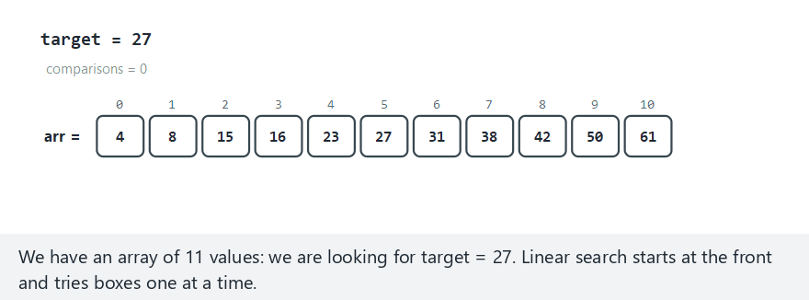
CEN207 Data Structures · Week 1
Linear search, step by step
RTEU Computer Engineering · Fall 2026–2027
31
Notes:
Normal example: 11 values, target in the middle. Watch the comparison counter climb one box at a time.

Slide 32
CEN207 Data Structures · Week 1
Edge case — target not in the array
RTEU Computer Engineering · Fall 2026–2027
32
Notes:
When the target is missing, linear search still checks every single box before it can say so — the true worst case.

Slide 33
CEN207 Data Structures · Week 1
Code — linear_search (the loop)
for (int i = 0; i < n; i++) {
(*comparisons)++;
if (arr[i] == target)
return i;
}
RTEU Computer Engineering · Fall 2026–2027
33
Notes:
One comparison per iteration, counted explicitly — this is exactly what the animation just counted on screen.

Slide 34
CEN207 Data Structures · Week 1
Linear search: the result
• Worst case (last element, or absent): n comparisons
• Best case (first element): 1 comparison
• Cost grows directly with n — this is O(n)
RTEU Computer Engineering · Fall 2026–2027
34
Notes:
A million-element array would need up to a million comparisons in the worst case — that direct growth is O(n).

Slide 35
CEN207 Data Structures · Week 1
Binary search: eliminate half every time
If the array is sorted: check the middle. Too small? Discard the left half. Too big? Discard the right half. Repeat.
RTEU Computer Engineering · Fall 2026–2027
35
Notes:
We will search for the same target, 42, that just took linear search 9 comparisons.

Slide 36
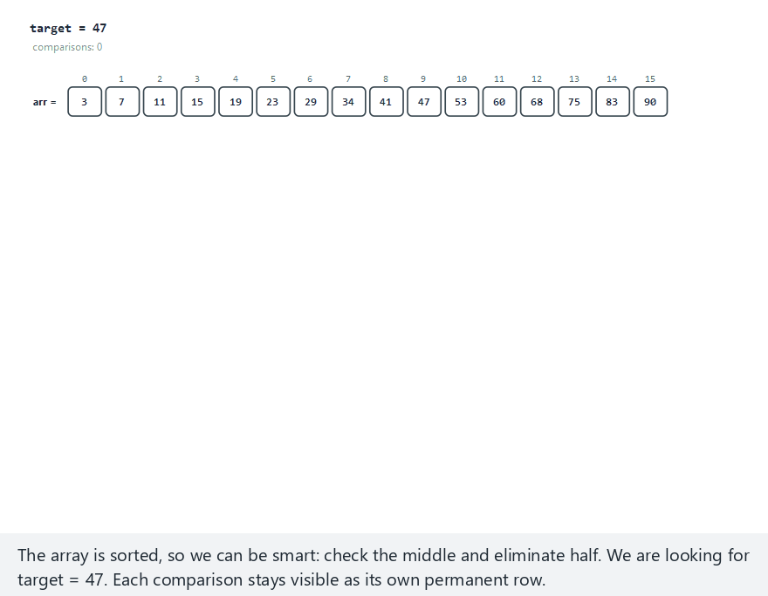
CEN207 Data Structures · Week 1
Binary search, step by step
RTEU Computer Engineering · Fall 2026–2027
36
Notes:
Normal example: 16 sorted values, target found. Watch lo, hi and mid close in on the answer.

Slide 37
CEN207 Data Structures · Week 1
Edge case — not found: lo crosses hi
RTEU Computer Engineering · Fall 2026–2027
37
Notes:
31 values this time; the range keeps halving until lo is greater than hi — nothing left to check.

Slide 38
CEN207 Data Structures · Week 1
Code — binary_search (core step)
int mid = lo + (hi - lo) / 2;
(*comparisons)++;
if (arr[mid] == target)
return mid;
if (arr[mid] < target)
lo = mid + 1;
else
hi = mid - 1;
RTEU Computer Engineering · Fall 2026–2027
38
Notes:
One comparison eliminates half of whatever is left — that halving is the entire trick.

Slide 39
CEN207 Data Structures · Week 1
Binary search: the result
• The same 42 took 3 comparisons, not 9
• Every comparison throws away half of what is left
• Number of halvings before reaching 1: log₂ n — O(log n)
RTEU Computer Engineering · Fall 2026–2027
39
Notes:
The trade-off: binary search needs the array sorted first, and sorting itself costs more than one search.

Slide 40
CEN207 Data Structures · Week 1
The growth race: shape beats speed
Watch three functions race as n doubles: plain n, n·log₂n (best sorts), and n² (simple sorts, and nested loops in general).
RTEU Computer Engineering · Fall 2026–2027
40
Notes:
Two points on a much larger scale — this animation shows the whole scale at once.

Slide 41
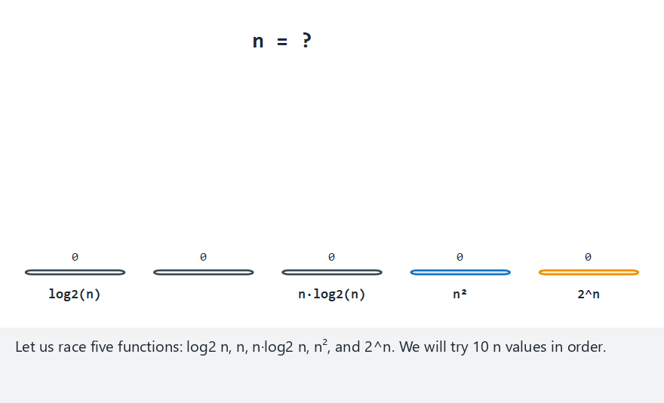
CEN207 Data Structures · Week 1
The growth race, step by step
RTEU Computer Engineering · Fall 2026–2027
41
Notes:
Normal example: n doubling from 1 to 512. Watch n-squared and 2^n pull away from the rest.

Slide 42
CEN207 Data Structures · Week 1
Edge case — 2^n overflows almost at once
RTEU Computer Engineering · Fall 2026–2027
42
Notes:
Starting at n = 400, 2^n is already far too large to draw on the same chart as the others.

Slide 43
CEN207 Data Structures · Week 1
Growth, at realistic sizes
n | n·log₂n | n²
100 | 664 | 10,000
10,000 | 132,877 | 100,000,000
100,000 | 1,660,964 | 10,000,000,000
RTEU Computer Engineering · Fall 2026–2027
43
Notes:
At n = 100,000, n-squared is over 6,000 times larger than n log n — instant on a toy input, very different at scale.

Slide 44
CEN207 Data Structures · Week 1
Code — the growth table
for (int i = 0; i < count; i++) {
long n = ns[i];
double nlogn = (double) n * log2((double) n);
double nsq = (double) n * (double) n;
}
RTEU Computer Engineering · Fall 2026–2027
44
Notes:
This is exactly the loop that produced the table you just saw, for five realistic sizes.

Slide 45
CEN207 Data Structures · Week 1
Big-O, precisely
f(n) is O(g(n)) if, from some point on, f never grows faster than a constant multiple of g. In practice: drop constants, keep the dominant term.
RTEU Computer Engineering · Fall 2026–2027
45
Notes:
You rarely compute the constants formally — you count the steps and read off the fastest-growing term.

Slide 46
CEN207 Data Structures · Week 1
Reading off the dominant term
Steps counted | Dominant term | Big-O
3n + 7 | n | O(n)
n² + 2n + 1 | n² | O(n²)
2·log₂n + 5 | log n | O(log n)
RTEU Computer Engineering · Fall 2026–2027
46
Notes:
The pattern: keep the fastest-growing term, throw away everything smaller and every constant.

Slide 47
CEN207 Data Structures · Week 1
The order, fastest to slowest
O(1) < O(log n) < O(n) < O(n log n) < O(n²) < O(2ⁿ)
You already met the first three today — O(n log n) and O(2ⁿ) arrive later this semester.
RTEU Computer Engineering · Fall 2026–2027
47
Notes:
O(1) is constant-time array access from pointer arithmetic; O(log n) is binary search; O(n) is linear search.

Slide 48
CEN207 Data Structures · Week 1
Building T(n) by hand: a nested loop
A loop inside another loop: for every one of the n outer iterations, the inner loop runs all n of its own — the classic n² source.
RTEU Computer Engineering · Fall 2026–2027
48
Notes:
Instead of trusting the table, let's count a real, counted program and see n-squared appear for ourselves.

Slide 49
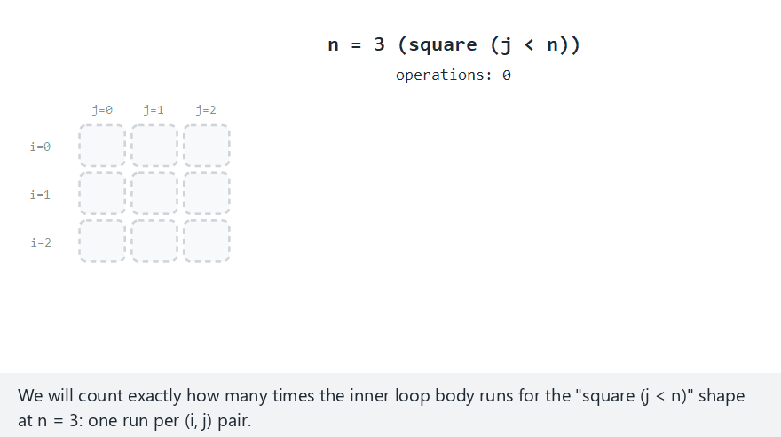
CEN207 Data Structures · Week 1
Counting a nested loop, step by step
RTEU Computer Engineering · Fall 2026–2027
49
Notes:
Normal example: a square loop (j < n), n = 3 shown in full detail, then nine more n values.

Slide 50
CEN207 Data Structures · Week 1
Edge case — a different loop shape
RTEU Computer Engineering · Fall 2026–2027
50
Notes:
A triangle loop (j < i) still runs the inner body n(n-1)/2 times — still O(n squared), a different constant.

Slide 51
CEN207 Data Structures · Week 1
Code — the nested loop
long count = 0;
for (int i = 0; i < n; i++) {
for (int j = 0; j < n; j++) {
count++;
(*operations)++;
}
}
RTEU Computer Engineering · Fall 2026–2027
51
Notes:
The measured count matched n*n exactly for every n tried — T(n) = n squared, plus smaller dropped terms.

Slide 52
CEN207 Data Structures · Week 1
Best, worst, and average case
• Best: target is first checked — 1 comparison
• Worst: target is last, or absent — n comparisons
• Average: (1 + 2 + ... + n) / n = (n + 1) / 2
• Unqualified "Big-O of an algorithm" usually means worst
RTEU Computer Engineering · Fall 2026–2027
52
Notes:
The worst case is the guarantee that matters most when you cannot control the input.

Slide 53
CEN207 Data Structures · Week 1
Space complexity: the same idea, for memory
Big-O counts time by counting steps; space complexity counts memory — extra storage beyond the input itself.
RTEU Computer Engineering · Fall 2026–2027
53
Notes:
A recursive function pushes one stack frame per call; that is extra memory a loop never needs.

Slide 54
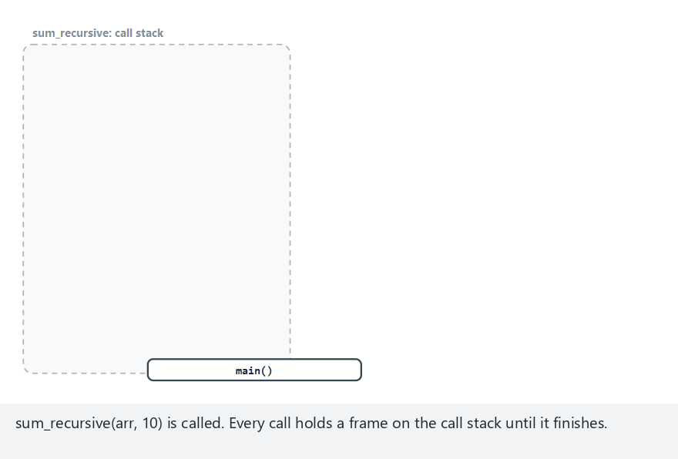
CEN207 Data Structures · Week 1
Recursive vs iterative sum, step by step
RTEU Computer Engineering · Fall 2026–2027
54
Notes:
Normal example: 10 values. Watch the call stack grow one frame per call, then unwind.

Slide 55
CEN207 Data Structures · Week 1
Edge case — deep recursion, 22 frames
RTEU Computer Engineering · Fall 2026–2027
55
Notes:
22 elements means 23 frames at the peak — the stack really can run out for large enough n.

Slide 56
CEN207 Data Structures · Week 1
Code — recursive vs iterative sum
int sum_recursive(const int arr[], int n) {
if (n == 0)
return 0;
return arr[n - 1] + sum_recursive(arr, n - 1);
}
int sum_iterative(const int arr[], int n) {
int total = 0;
for (int i = 0; i < n; i++)
total += arr[i];
return total;
}
RTEU Computer Engineering · Fall 2026–2027
56
Notes:
Both return the same sum. sum_recursive uses O(n) stack space; sum_iterative always uses exactly O(1).

Slide 57
CEN207 Data Structures · Week 1
Common mistakes
• Reading Big-O off the code, not the steps
• Forgetting binary search needs sorted input
• Confusing O(1) with "instant" — it just means "not growing"
• Quoting only worst case when average matters more
RTEU Computer Engineering · Fall 2026–2027
57
Notes:
A hidden loop inside a line (like arr.contains(x)) can quietly turn an O(n) loop into O(n squared).

Slide 58
CEN207 Data Structures · Week 1
Mini-quiz
An algorithm does exactly 5n + 20 basic operations. What is its Big-O?
RTEU Computer Engineering · Fall 2026–2027
58
Notes:
Let the class answer, then advance.

Slide 59
CEN207 Data Structures · Week 1
Answer
O(n). Drop the constant factor (5) and the additive constant (20); only the fastest-growing term, n, survives.
RTEU Computer Engineering · Fall 2026–2027
59
Notes:
This is the "read off the dominant term" table applied directly.

Slide 60
CEN207 Data Structures · Week 1
Mini-quiz
Why can't binary search be used directly on a linked list the way it is on an array?
RTEU Computer Engineering · Fall 2026–2027
60
Notes:
Let the class answer, then advance.

Slide 61
CEN207 Data Structures · Week 1
Answer
Binary search needs O(1) access to the middle by index. A linked list must be walked node by node — already O(n), erasing the gain.
RTEU Computer Engineering · Fall 2026–2027
61
Notes:
Week 2 builds exactly this structure, so this question previews next week directly.

Slide 62
CEN207 Data Structures · Week 1
Mini-quiz
Without qualification, which case does "Big-O of an algorithm" usually mean?
RTEU Computer Engineering · Fall 2026–2027
62
Notes:
Let the class answer, then advance.

Slide 63
CEN207 Data Structures · Week 1
Answer
The worst case: the guaranteed upper bound, useful precisely because it holds no matter what input you are given.
RTEU Computer Engineering · Fall 2026–2027
63
Notes:
Best cases tend to look similar across algorithms, which is exactly why the worst case is more useful to compare.

Slide 64
CEN207 Data Structures · Week 1
4. Pointers and Objects
RTEU Computer Engineering · Fall 2026–2027
64
Notes:
A pointer is the location of a variable, not just its value — today we make that idea completely concrete.

Slide 65
CEN207 Data Structures · Week 1
A question to start
Write swap(a, b) to exchange two variables in the caller. In many languages this is impossible — the function only sees copies.
RTEU Computer Engineering · Fall 2026–2027
65
Notes:
To reach back into the caller's variables, a function needs the LOCATION of each one, not just its value — that location is a pointer.

Slide 66
CEN207 Data Structures · Week 1
A short history
• 1966/1969 — BCPL, then B: address-of, dereference
• 1972 — Dennis Ritchie's C makes pointers central
• 1995 — Java removes raw pointers, keeps references
• References: shared data, no arithmetic, no bad addresses
RTEU Computer Engineering · Fall 2026–2027
66
Notes:
You can still have two Java variables name the same object — you just cannot compute an arbitrary address.

Slide 67
CEN207 Data Structures · Week 1
Intuition: memory as numbered mailboxes
• A variable is a mailbox: address + contents
• &x asks "what is x's mailbox number?"
• A pointer holds another mailbox's number
• Dereferencing (*p): go read that mailbox
RTEU Computer Engineering · Fall 2026–2027
67
Notes:
int x = 3 puts 3 in some mailbox, say number 1000 — &x gets you that 1000.

Slide 68
CEN207 Data Structures · Week 1
The pointer operations
Operation | Syntax | Complexity
Address-of | &x | O(1)
Declare | int *p; | O(1)
Assign an address | p = &x; | O(1)
Dereference (read/write) | *p / *p = v; | O(1)
RTEU Computer Engineering · Fall 2026–2027
68
Notes:
Every one of these is O(1) — following a pointer is always a single jump, never a search.

Slide 69
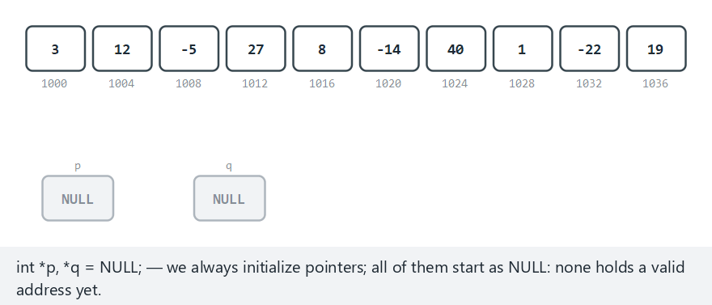
CEN207 Data Structures · Week 1
A variable, its address, a pointer
RTEU Computer Engineering · Fall 2026–2027
69
Notes:
Normal example: five operations — address-of, write through, copy (alias), move, add through the alias.

Slide 70
CEN207 Data Structures · Week 1
Edge case — a NULL-pointer dereference
RTEU Computer Engineering · Fall 2026–2027
70
Notes:
A write through a NULL pointer is never executed here — it is flagged as undefined behavior instead.

Slide 71
CEN207 Data Structures · Week 1
Code — pointers: address, alias, NULL
int *p = NULL, *q = NULL;
p = &v[i];
*p = val;
q = p;
*q += k;
if (r != NULL)
*r = val;
RTEU Computer Engineering · Fall 2026–2027
71
Notes:
q = p copies the ADDRESS, not the value — q and p now alias the same variable.

Slide 72
CEN207 Data Structures · Week 1
Java: reference vs value, side by side
int[] box = {3};
int[] alias = box;
alias[0] = 5;
int y = x;
y = 99;
RTEU Computer Engineering · Fall 2026–2027
72
Notes:
alias is a second name for the SAME array as box; y is an independent COPY of x — same syntax shape, opposite behavior.

Slide 73
CEN207 Data Structures · Week 1
Pointer arithmetic: p + k, not k bytes
p + k never moves k bytes — it moves k × sizeof(*p) bytes. int is 4 bytes, so p + 1 skips 4 bytes, not 1.
RTEU Computer Engineering · Fall 2026–2027
73
Notes:
This is the O(1) arithmetic that array indexing, arr[i], compiles down to.

Slide 74
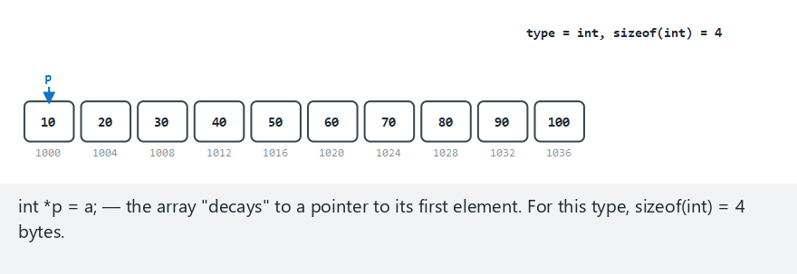
CEN207 Data Structures · Week 1
Pointer arithmetic, step by step
RTEU Computer Engineering · Fall 2026–2027
74
Notes:
Normal example: an int array, five valid offsets. Watch each computed address and its dereferenced value.

Slide 75
CEN207 Data Structures · Week 1
Edge case — out-of-range offsets
RTEU Computer Engineering · Fall 2026–2027
75
Notes:
A negative offset and one past the end are both flagged as undefined behavior, never dereferenced.

Slide 76
CEN207 Data Structures · Week 1
Code — pointer arithmetic
int a[N];
int *p = a;
if (k < 0 || k >= N) {
/* out of range: undefined behavior (UB) */
} else {
void *addr = (void *) (p + k);
int v = *(p + k);
}
RTEU Computer Engineering · Fall 2026–2027
76
Notes:
Java has no pointer arithmetic at all — only a[k], and an out-of-range k throws a clear exception.

Slide 77
CEN207 Data Structures · Week 1
Pointer to a struct, and ->
A struct groups fields into one value. (*p).field is so common C gives it a shorthand: p->field.
RTEU Computer Engineering · Fall 2026–2027
77
Notes:
A pointer to a struct lets you reach — and modify — the ORIGINAL struct, not a copy of it.

Slide 78
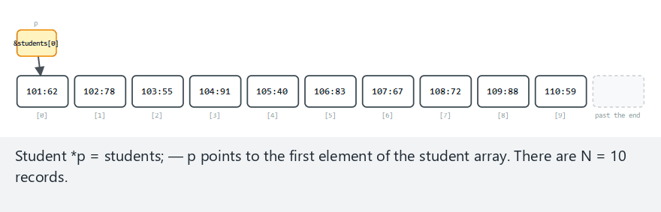
CEN207 Data Structures · Week 1
Struct pointer, walking an array
RTEU Computer Engineering · Fall 2026–2027
78
Notes:
Normal example: 10 students, 2 grade updates. Watch (*p).id, p->grade, and p++ advance by sizeof(Student).

Slide 79
CEN207 Data Structures · Week 1
Edge case — one student only
RTEU Computer Engineering · Fall 2026–2027
79
Notes:
p reaches "one past the end" immediately — legal to HOLD, but never to dereference.

Slide 80
CEN207 Data Structures · Week 1
Code — walking an array of structs
Student *p = students;
for (; p != students + N; p++) {
int id = (*p).id;
int grade = p->grade;
p->grade = new_grade;
}
RTEU Computer Engineering · Fall 2026–2027
80
Notes:
(*p).id and p->id are the same value — the arrow is purely a shorthand, nothing more.

Slide 81
CEN207 Data Structures · Week 1
Common mistakes
• Using int *p; before it points anywhere (wild pointer)
• int *p, x; — only p is a pointer, not x
• Confusing * in a declaration vs an expression
• Java's exception is not the same as C's undefined behavior
RTEU Computer Engineering · Fall 2026–2027
81
Notes:
Java checks every dereference and fails loudly; C simply does whatever the hardware does with a bad address.

Slide 82
CEN207 Data Structures · Week 1
Mini-quiz
Given int *p = &x;, what is the difference between p and *p?
RTEU Computer Engineering · Fall 2026–2027
82
Notes:
Let the class answer, then advance.

Slide 83
CEN207 Data Structures · Week 1
Answer
p is the address stored in the pointer (x's address). *p is the value at that address (x's value).
RTEU Computer Engineering · Fall 2026–2027
83
Notes:
Same variable, two completely different questions depending on whether you dereference it.

Slide 84
CEN207 Data Structures · Week 1
Mini-quiz
Why does Java need no -> operator at all?
RTEU Computer Engineering · Fall 2026–2027
84
Notes:
Let the class answer, then advance.

Slide 85
CEN207 Data Structures · Week 1
Answer
Every object/array variable in Java is already a reference — . always means "follow it, then access the field".
RTEU Computer Engineering · Fall 2026–2027
85
Notes:
C needs both . (for values) and -> (for pointers); Java only ever needs one.

Slide 86
CEN207 Data Structures · Week 1
5. Memory Layout: Stack, Heap, and Who Cleans Up
RTEU Computer Engineering · Fall 2026–2027
86
Notes:
This is the single most important fact about memory you will use all semester.

Slide 87
CEN207 Data Structures · Week 1
A question to start
A function declares a local array and returns. What happens to it? Now compare: a function mallocs a block and returns without freeing.
RTEU Computer Engineering · Fall 2026–2027
87
Notes:
The two questions have completely different answers — that difference is today's whole subject.

Slide 88
CEN207 Data Structures · Week 1
A short history
• Stack — one frame per call, back to Algol 60
• `malloc`/`free` — earliest Unix C libraries, early 1970s
• Garbage collection — McCarthy, Lisp, 1959
• Java (1995) made GC mainstream for everyday programming
RTEU Computer Engineering · Fall 2026–2027
88
Notes:
GC is much older than most people assume — it predates Java by 36 years.

Slide 89
CEN207 Data Structures · Week 1
Intuition: a neat pile vs a warehouse
• Stack: every call pushes a frame; return pops it
• Always LIFO, always automatic, always fast
• Heap: you ask for a block; it stays until given back
• Nobody does that "giving back" for you in C
RTEU Computer Engineering · Fall 2026–2027
89
Notes:
Pushing or popping a stack frame is just moving one pointer — that is why it is so fast.

Slide 90
CEN207 Data Structures · Week 1
Stack vs heap, side by side
 | Stack | Heap
Allocates | Compiler, automatically | You: malloc (C) / new (Java)
Freed | Automatically, on return | C: free(). Java: the GC
Speed | Extremely fast | Slower: finds a free block
RTEU Computer Engineering · Fall 2026–2027
90
Notes:
A stack overflow is deep recursion outrunning a small, fixed region; the heap is much larger but slower.

Slide 91
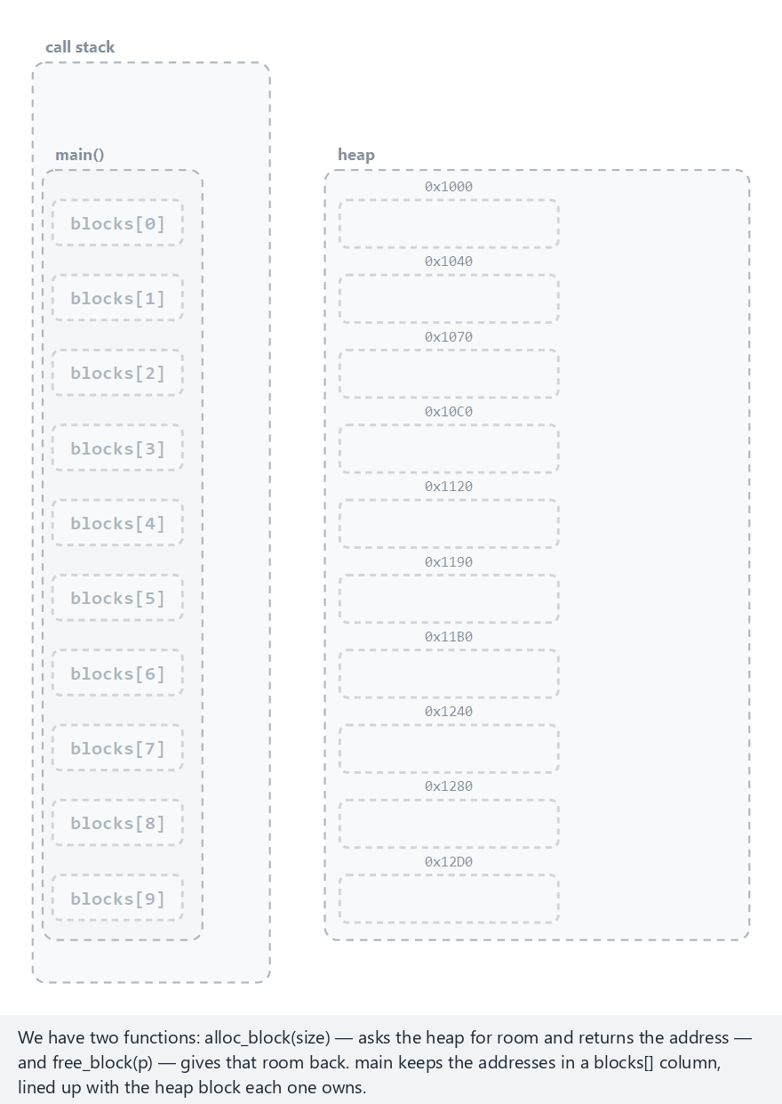
CEN207 Data Structures · Week 1
How a stack frame connects to a heap block
RTEU Computer Engineering · Fall 2026–2027
91
Notes:
Normal example: 10 blocks, properly owned, some freed. Watch main's blocks[] column point at each heap row.

Slide 92
CEN207 Data Structures · Week 1
Edge case — a dangling pointer, flagged
RTEU Computer Engineering · Fall 2026–2027
92
Notes:
A second alias still holds a freed block's old address; using it is flagged as UB, never executed.

Slide 93
CEN207 Data Structures · Week 1
Code — alloc_block / free_block
static int *alloc_block(int size) {
int *p = malloc(size * sizeof(int));
return p;
}
static void free_block(int *p) {
free(p);
}
RTEU Computer Engineering · Fall 2026–2027
93
Notes:
p is local to alloc_block's own frame — only the RETURNED address survives once that frame pops.

Slide 94
CEN207 Data Structures · Week 1
Java: new and garbage collection
In C, forgetting free — or using a pointer after freeing it — is entirely your job to avoid. Java removes free from the language.
RTEU Computer Engineering · Fall 2026–2027
94
Notes:
An object lives on the heap until the garbage collector proves nothing can reach it any more.

Slide 95
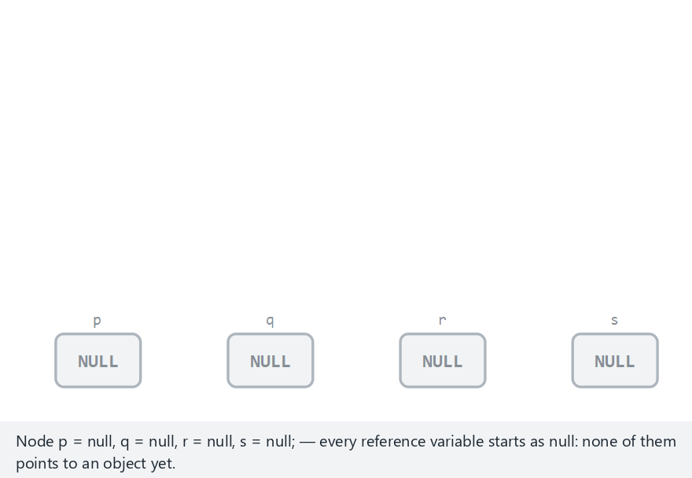
CEN207 Data Structures · Week 1
Java references, aliasing, GC
RTEU Computer Engineering · Fall 2026–2027
95
Notes:
Normal example: a reference chain, ordinary collection. Watch objects become unreachable and get swept.

Slide 96
CEN207 Data Structures · Week 1
Edge case — a cycle, still collected
RTEU Computer Engineering · Fall 2026–2027
96
Notes:
Two objects point at each other, but once NO root reaches either, both are collected — reachability, not reference counting.

Slide 97
CEN207 Data Structures · Week 1
Code — Java references: alias and cycle
Node p = new Node();
Node q = p;
p.ref = q;
q.ref = p;
p = null;
q = null;
RTEU Computer Engineering · Fall 2026–2027
97
Notes:
In C, this exact pattern would leak forever — C has no garbage collector to notice the cycle is unreachable.

Slide 98
CEN207 Data Structures · Week 1
Common mistakes
• Dangling pointer: use pointer after free, not NULL
• Double free: freeing the same pointer twice
• Forgetting free on an early-return path (a leak)
• Assuming Java's GC makes leaks impossible (it does not)
RTEU Computer Engineering · Fall 2026–2027
98
Notes:
An object you keep an unneeded reference to cannot be collected, and still "leaks" in effect.

Slide 99
CEN207 Data Structures · Week 1
Preview: array layout vs linked layout
An array reserves one contiguous block: arr[i] is a single calculation, O(1). A linked list scatters nodes, joined by pointers.
RTEU Computer Engineering · Fall 2026–2027
99
Notes:
Next week you build exactly this linked structure — today is only the preview.

Slide 100
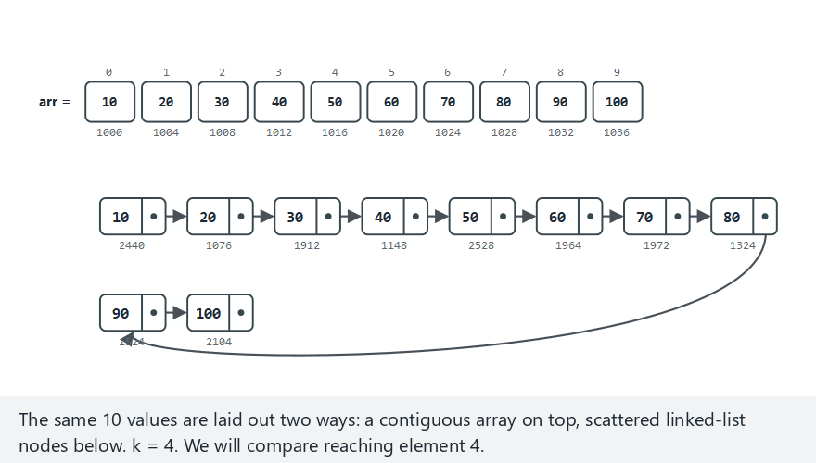
CEN207 Data Structures · Week 1
Array vs linked layout, step by step
RTEU Computer Engineering · Fall 2026–2027
100
Notes:
Normal example: 10 values, k = 4. Compare one computed address versus four hops through next.

Slide 101
CEN207 Data Structures · Week 1
Edge case — the last element: most hops
RTEU Computer Engineering · Fall 2026–2027
101
Notes:
The array still reaches the last element in one step; the linked list needs every single hop from the head.

Slide 102
CEN207 Data Structures · Week 1
Code — building a linked list
Node *head = NULL;
for (int i = N - 1; i >= 0; i--) {
Node *node = malloc(sizeof(Node));
node->data = arr[i];
node->next = head;
head = node;
}
RTEU Computer Engineering · Fall 2026–2027
102
Notes:
Same n values, opposite access cost: array O(1), linked list O(n) — same data, completely different shape.

Slide 103
CEN207 Data Structures · Week 1
Mini-quiz
A function declares int arr[100]; locally and returns a pointer to it. What is wrong?
RTEU Computer Engineering · Fall 2026–2027
103
Notes:
Let the class answer, then advance.

Slide 104
CEN207 Data Structures · Week 1
Answer
arr lives on the stack, in that frame. The instant the function returns, the frame is popped — the pointer is dangling already.
RTEU Computer Engineering · Fall 2026–2027
104
Notes:
The fix: allocate with malloc instead, so the memory survives the function returning.

Slide 105
CEN207 Data Structures · Week 1
Mini-quiz
Why does free(block); block = NULL; — in that order — matter?
RTEU Computer Engineering · Fall 2026–2027
105
Notes:
Let the class answer, then advance.

Slide 106
CEN207 Data Structures · Week 1
Answer
free needs the real address. NULLing first makes free(NULL) do nothing — the block leaks, its address lost forever.
RTEU Computer Engineering · Fall 2026–2027
106
Notes:
The order is not a style choice — reversing it silently creates a memory leak.

Slide 107
CEN207 Data Structures · Week 1
Mini-quiz
Why can a dangling pointer never occur in Java the way it does in C?
RTEU Computer Engineering · Fall 2026–2027
107
Notes:
Let the class answer, then advance.

Slide 108
CEN207 Data Structures · Week 1
Answer
Java has no free: an object is only reclaimed once the GC proves nothing can reach it — never while still reachable.
RTEU Computer Engineering · Fall 2026–2027
108
Notes:
There is never a moment where a reachable reference points at memory already taken back.

Slide 109
CEN207 Data Structures · Week 1
6. ASN.1, BER TLV, and PER TLV
RTEU Computer Engineering · Fall 2026–2027
109
Notes:
How do two completely different programs agree, byte for byte, on a structured record?

Slide 110
CEN207 Data Structures · Week 1
A question to start
Two programs, different languages, different machines, exchange a record as bytes. A raw struct layout is not portable at all.
RTEU Computer Engineering · Fall 2026–2027
110
Notes:
The compiler, platform and padding rules all affect a struct's exact byte layout — we need something both sides agree on.

Slide 111
CEN207 Data Structures · Week 1
A short history
• 1984 — ASN.1 born as ITU-T/CCITT X.409
• 1995 — X.680 series: the modern, current form
• BER (X.690) — self-describing tag + length + value
• PER (X.691, 1994) — packs bits when both sides know the schema
RTEU Computer Engineering · Fall 2026–2027
111
Notes:
ASN.1 with BER still underlies X.509 certificates — the basis of HTTPS — LDAP, and SNMP, invisibly.

Slide 112
CEN207 Data Structures · Week 1
Intuition: an envelope, three parts
• Tag: what kind of value is this?
• Length: how many bytes does it take?
• Value: the content itself
• Universally called TLV
RTEU Computer Engineering · Fall 2026–2027
112
Notes:
A decoder that has never seen your record before can still walk it correctly: read tag, read length, skip that many bytes, repeat.

Slide 113
CEN207 Data Structures · Week 1
The TLV byte layout
Part | Size | What it encodes
Tag | 1 byte | class · primitive/constructed · tag number
Length | 1+ bytes | short form (0–127) or long form (≥128)
Value | Length bytes | the content, or nested TLVs
RTEU Computer Engineering · Fall 2026–2027
113
Notes:
INTEGER is tag 0x02, UTF8String is tag 0x0C, SEQUENCE is tag 0x30 — real ASN.1 universal-class numbers.

Slide 114
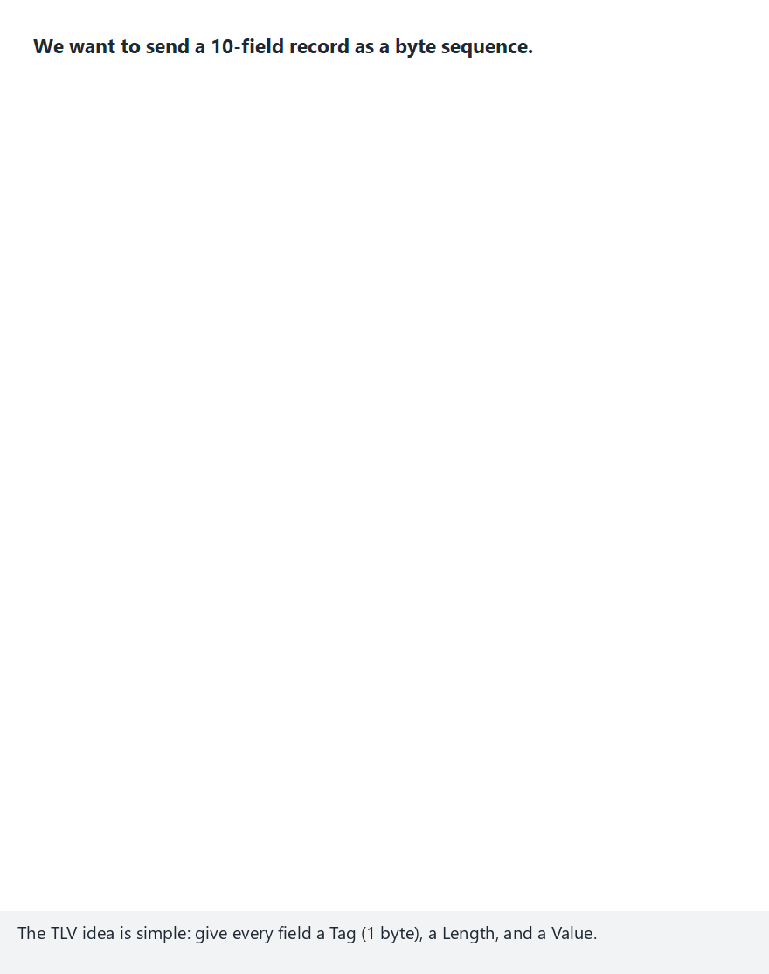
CEN207 Data Structures · Week 1
TLV encoding, field by field
RTEU Computer Engineering · Fall 2026–2027
114
Notes:
Normal example: 10 fields — integers, short strings, booleans — each becomes Tag, Length, Value.

Slide 115
CEN207 Data Structures · Week 1
Edge case — a length that needs the long form
RTEU Computer Engineering · Fall 2026–2027
115
Notes:
A 300-character string's length no longer fits in one byte — the long form spends extra bytes just to say "how many".

Slide 116
CEN207 Data Structures · Week 1
Code — encode_length: short vs long
if (len < 128) {
out[0] = (unsigned char) len;
return 1;
}
int n = 0;
while (len > 0) {
tmp[n++] = (unsigned char) (len & 0xFF);
len >>= 8;
}
out[0] = (unsigned char) (0x80 | n);
RTEU Computer Engineering · Fall 2026–2027
116
Notes:
The short form is one byte; the long form's top bit set means "the next n bytes ARE the length".

Slide 117
CEN207 Data Structures · Week 1
BER vs PER
 | BER | PER
Self-describing | Yes: tag + length every field | No: schema must be known
Size | Larger: 2+ bytes per field | Much smaller: bits, not bytes
Typical use | X.509, LDAP, SNMP | Bandwidth-critical (cellular)
RTEU Computer Engineering · Fall 2026–2027
117
Notes:
Both encode the same abstract information — BER trades size for self-description, PER trades the reverse.

Slide 118
CEN207 Data Structures · Week 1
PER: exactly as many bits as needed
If both sides know a field's range [min, max], no tag and no length are needed — only ceil(log2(max - min + 1)) bits.
RTEU Computer Engineering · Fall 2026–2027
118
Notes:
The same kind of record as BER, this time packed bit by bit instead of byte by byte.

Slide 119
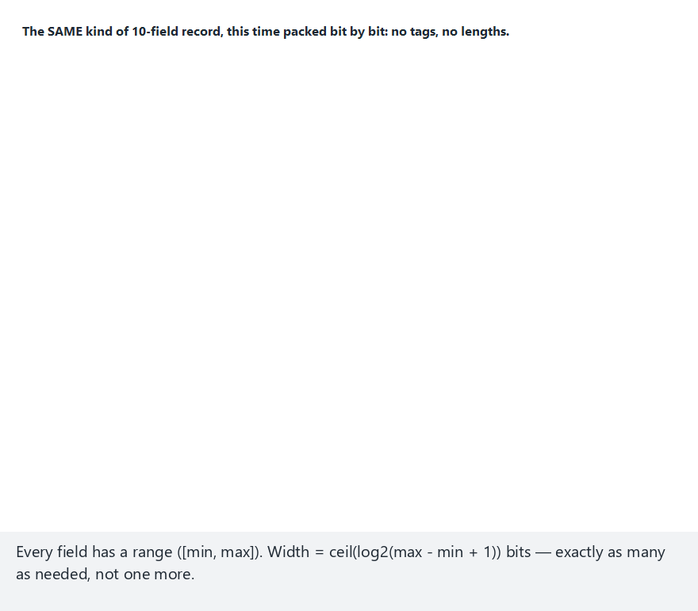
CEN207 Data Structures · Week 1
PER encoding, bit by bit
RTEU Computer Engineering · Fall 2026–2027
119
Notes:
Normal example: 10 fields — name characters, an age, a few constrained numbers — packed into a handful of bytes.

Slide 120
CEN207 Data Structures · Week 1
Edge case — a range of size 1: zero bits
RTEU Computer Engineering · Fall 2026–2027
120
Notes:
When min equals max, there is only one possible value — the receiver already knows it, so NOTHING is sent.

Slide 121
CEN207 Data Structures · Week 1
Code — pack_bits: one bit at a time
int bit = (int) ((value >> i) & 1u);
int byte_index = *bitpos / 8;
int bit_index = 7 - (*bitpos % 8);
/* if (bit) buf[byte_index] |= the bit, MSB first */
(*bitpos)++;
RTEU Computer Engineering · Fall 2026–2027
121
Notes:
PER output is only byte-aligned at the very end, not field by field — bits pack right up against each other.

Slide 122
CEN207 Data Structures · Week 1
Common mistakes
• Forgetting the length prefix, hoping a fixed read works
• Assuming length always fits one byte (only under 128)
• Confusing Length (just V) with the whole TLV's size
• Treating BER and PER bytes as interchangeable — they are not
RTEU Computer Engineering · Fall 2026–2027
122
Notes:
A PER decoder cannot parse BER bytes, or vice versa — two different byte formats for the same schema.

Slide 123
CEN207 Data Structures · Week 1
Mini-quiz
What do the three letters in TLV stand for, and in what order?
RTEU Computer Engineering · Fall 2026–2027
123
Notes:
Let the class answer, then advance.

Slide 124
CEN207 Data Structures · Week 1
Answer
Tag, Length, Value — in exactly that order: what kind, how many bytes, then the bytes themselves.
RTEU Computer Engineering · Fall 2026–2027
124
Notes:
A decoder never has to guess a size — the length prefix always tells it exactly.

Slide 125
CEN207 Data Structures · Week 1
Mini-quiz
Why is SEQUENCE's tag byte 0x30, not 0x10 (tag number 16 in binary)?
RTEU Computer Engineering · Fall 2026–2027
125
Notes:
Let the class answer, then advance.

Slide 126
CEN207 Data Structures · Week 1
Answer
The top 3 bits are not the tag number: 2 class bits (00) + 1 constructed bit (1, since SEQUENCE holds more TLVs) = 0x30.
RTEU Computer Engineering · Fall 2026–2027
126
Notes:
00 1 10000 in binary is exactly 0x30 — the constructed bit is what changes 0x10 into 0x30.

Slide 127
CEN207 Data Structures · Week 1
7. Hands-on Lab: the C Toolchain
RTEU Computer Engineering · Fall 2026–2027
127
Notes:
Every idea today is worthless until it compiles and runs — this section sets up the workflow for the whole semester.

Slide 128
CEN207 Data Structures · Week 1
Why this matters
From here on, every week hands you C and Java programs to build yourself. The midterm project is graded, in part, on a clean build.
RTEU Computer Engineering · Fall 2026–2027
128
Notes:
This lab sets up, once, the exact workflow you repeat all semester: compile, run, debug.

Slide 129
CEN207 Data Structures · Week 1
The toolchain, briefly
• GCC — Richard Stallman, GNU project, 1987
• GDB — same GNU project, 1986: step through, inspect
• CMake — generates build files for whatever tool you have
• Same CMakeLists.txt builds on Windows, WSL, and Linux
RTEU Computer Engineering · Fall 2026–2027
129
Notes:
A compiler translates source to machine code; a linker stitches it together with the C standard library.

Slide 130
CEN207 Data Structures · Week 1
Code — your first compile
#include <stdio.h>
int main(void) {
printf("Hello, Data Structures!\n");
return 0;
}
gcc -std=c11 -Wall -Wextra -o /tmp/x hello_workshop.c && /tmp/x
RTEU Computer Engineering · Fall 2026–2027
130
Notes:
gcc compiles hello_workshop.c into x; && only runs it if the compile succeeded.

Slide 131
CEN207 Data Structures · Week 1
Compile with warnings on, and read them
-Wall -Wextra catches unused variables, suspicious comparisons, format mismatches. Every program here must compile cleanly.
RTEU Computer Engineering · Fall 2026–2027
131
Notes:
A warning is the compiler telling you something is probably a bug, before you find out the hard way at runtime.

Slide 132
CEN207 Data Structures · Week 1
A small bug hunt
int average_buggy(const int arr[], int n) {
if (n == 0) return 0;
int sum = 0;
for (int i = 0; i < n; i++)
sum = sum + arr[i];
return sum / n;
}
RTEU Computer Engineering · Fall 2026–2027
132
Notes:
The average it prints is wrong — sum and n look right, but something in the last line is not.

Slide 133
CEN207 Data Structures · Week 1
Finding it with gdb
The method: set a breakpoint, run, inspect a variable, confirm or refute a hypothesis. Watch it happen live, step by step.
RTEU Computer Engineering · Fall 2026–2027
133
Notes:
This scales to bugs far subtler than the one we are about to find.

Slide 134
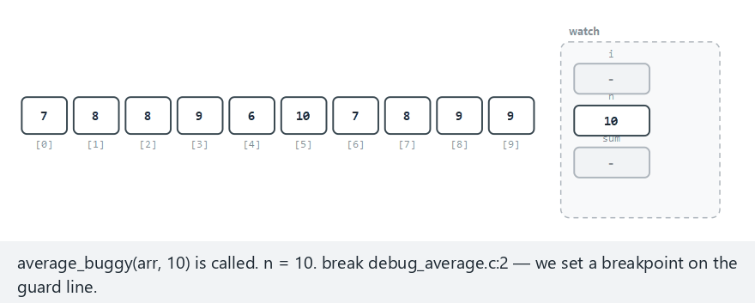
CEN207 Data Structures · Week 1
Debugger stepping, live
RTEU Computer Engineering · Fall 2026–2027
134
Notes:
Normal example: 10 elements. Watch i, sum and n in the watch panel as we step, then print sum / n.

Slide 135
CEN207 Data Structures · Week 1
Edge case — the empty-array guard
RTEU Computer Engineering · Fall 2026–2027
135
Notes:
n == 0 stops the program right at the guard line — dividing by zero would be undefined behavior.

Slide 136
CEN207 Data Structures · Week 1
The gdb session
(gdb) break debug_average.c:11
(gdb) run
(gdb) print sum
(gdb) print sum / n
(gdb) print (double) sum / n
(gdb) continue
RTEU Computer Engineering · Fall 2026–2027
136
Notes:
sum/n gives 7 (integer division); (double) sum/n gives the real answer, 7.666... — the bug was only in the final division.

Slide 137
CEN207 Data Structures · Week 1
Code — CMakeLists.txt
cmake_minimum_required(VERSION 3.20)
project(week1_cmake_demo C)
add_executable(week1_cmake_demo main.c)
cmake -S . -B build && cmake --build build
RTEU Computer Engineering · Fall 2026–2027
137
Notes:
The first command CONFIGURES: reads CMakeLists.txt, checks the compiler. The second BUILDS: compiles and links.

Slide 138
CEN207 Data Structures · Week 1
A note on Visual Studio
Build → Build Solution compiles; Debug → Start Debugging (F5) runs under the debugger; clicking the margin sets a breakpoint.
RTEU Computer Engineering · Fall 2026–2027
138
Notes:
Visual Studio can open a CMakeLists.txt directly — the same file from the last slide works unchanged.

Slide 139
CEN207 Data Structures · Week 1
Common mistakes
• Forgetting -std=c11: different behavior per machine
• Committing a build/ folder or .exe files to Git
• Running a stale executable after a failed compile
• Reaching only for printf, never a two-minute gdb session
RTEU Computer Engineering · Fall 2026–2027
139
Notes:
Always chain the run with && so a failed compile never lets you run yesterday's binary by accident.

Slide 140
CEN207 Data Structures · Week 1
Mini-quiz
What does -Wall -Wextra do, and why does this course require a clean build under it?
RTEU Computer Engineering · Fall 2026–2027
140
Notes:
Let the class answer, then advance.

Slide 141
CEN207 Data Structures · Week 1
Answer
It enables a wide set of warnings. They usually point at real bugs — requiring a clean build fixes them immediately.
RTEU Computer Engineering · Fall 2026–2027
141
Notes:
Not discovered later, at runtime, the hard way.

Slide 142
CEN207 Data Structures · Week 1
Mini-quiz
What is the difference between what cmake -S . -B build and cmake --build build each do?
RTEU Computer Engineering · Fall 2026–2027
142
Notes:
Let the class answer, then advance.

Slide 143
CEN207 Data Structures · Week 1
Answer
The first configures: generates build files, compiles nothing. The second builds: invokes that tool to compile and link.
RTEU Computer Engineering · Fall 2026–2027
143
Notes:
Configure once (usually), build every time you change the source.

Slide 144
CEN207 Data Structures · Week 1
Summary — foundations of the semester
Idea | Key fact
Data structure | Known, analyzable cost — always a trade-off
Linear vs non-linear | One "next" vs possibly several
Big-O | Upper bound on growth; read off the dominant term
Space complexity | Same idea, applied to extra memory
RTEU Computer Engineering · Fall 2026–2027
144
Notes:
Every later week adds one more structure, judged with exactly these same tools.

Slide 145
CEN207 Data Structures · Week 1
Summary — memory and encoding
Idea | Key fact
Pointer / reference | Stores an address; &, *, ->
Stack / heap | Automatic, LIFO / requested, released explicitly
TLV / BER / PER | Self-describing bytes, or bits packed by schema
C toolchain | gcc, gdb, CMake — compile, run, debug
RTEU Computer Engineering · Fall 2026–2027
145
Notes:
Pointers, the stack and the heap are the picture of memory every later week assumes you already have.

Slide 146
CEN207 Data Structures · Week 1
The big picture
Two tools, built today — Big-O to measure cost, and a picture of memory — judge every single structure for the rest of term.
RTEU Computer Engineering · Fall 2026–2027
146
Notes:
If a student remembers only one sentence from today, this is the one worth remembering.

Slide 147
CEN207 Data Structures · Week 1
Self-check round
Five short questions. Think before the answer appears. Full exercises and a ten-question quiz are in the week notes.
RTEU Computer Engineering · Fall 2026–2027
147
Notes:
These mirror the self-check quiz at the end of the written notes, one question per slide, a shorter set here.

Slide 148
CEN207 Data Structures · Week 1
1. Why can two different, correct algorithms have very different Big-O?
RTEU Computer Engineering · Fall 2026–2027
148
Notes:
Ask, wait, then advance.

Slide 149
CEN207 Data Structures · Week 1
Big-O measures the number of steps, not whether the answer is right
Linear search and binary search both correctly find a value, at O(n) and O(log n) respectively.
RTEU Computer Engineering · Fall 2026–2027
149
Notes:
Correctness and cost are two completely separate questions.

Slide 150
CEN207 Data Structures · Week 1
2. Order these from fastest- to slowest-growing: O(n log n), O(1), O(n), O(log n), O(n²)
RTEU Computer Engineering · Fall 2026–2027
150
Notes:
Ask, wait, then advance.

Slide 151
CEN207 Data Structures · Week 1
O(1) < O(log n) < O(n) < O(n log n) < O(n²)
RTEU Computer Engineering · Fall 2026–2027
151
Notes:
This exact order comes back every single week for the rest of the semester.

Slide 152
CEN207 Data Structures · Week 1
3. Why does binary search require a sorted array?
RTEU Computer Engineering · Fall 2026–2027
152
Notes:
Ask, wait, then advance.

Slide 153
CEN207 Data Structures · Week 1
Comparing to the middle only helps if one side is guaranteed smaller and the other larger
That guarantee is exactly what "sorted" means. Linear search relies on no ordering.
RTEU Computer Engineering · Fall 2026–2027
153
Notes:
Without sorted order, discarding a whole half would be a guess, not a guarantee.

Slide 154
CEN207 Data Structures · Week 1
4. In a BER TLV encoding, what does the Length field actually count?
RTEU Computer Engineering · Fall 2026–2027
154
Notes:
Ask, wait, then advance.

Slide 155
CEN207 Data Structures · Week 1
The bytes in the Value that immediately follow — not the whole TLV's size
The SEQUENCE example had Length = 8, but the whole encoded SEQUENCE was 10 bytes.
RTEU Computer Engineering · Fall 2026–2027
155
Notes:
Length never counts the Tag byte or its own Length byte(s).

Slide 156
CEN207 Data Structures · Week 1
5. Why does p->x exist, and what is it shorthand for?
RTEU Computer Engineering · Fall 2026–2027
156
Notes:
Ask, wait, then advance.

Slide 157
CEN207 Data Structures · Week 1
p->x is shorthand for (*p).x: dereference, then access the field
It exists because this exact combination is extremely common in C code.
RTEU Computer Engineering · Fall 2026–2027
157
Notes:
Dereference-then-access is such a frequent pattern that C gave it its own operator.

Slide 158
CEN207 Data Structures · Week 1
Next week
Week 2 — Linked Lists
Build a chain of individually allocated nodes, connected by exactly the pointers you met today, living on today's heap.
RTEU Computer Engineering · Fall 2026–2027
158
Notes:
The O(1)-insert-anywhere, O(n)-access trade-off from today's preview, now in full: insertion, deletion, traversal, measured.

Slide 159
CEN207 Data Structures · Week 1
References (1/2)
• Course syllabus, Week 1: CEN207-2026-2027-Guz-Izlence.en.md
• Knuth. The Art of Computer Programming, Vol. 1, 3rd ed.
• Liskov, Zilles. "Programming with Abstract Data Types," 1974
• Knuth. "Big Omicron and Big Omega and Big Theta," 1976
• Cormen, Leiserson, Rivest, Stein. Introduction to Algorithms, 3rd ed.
RTEU Computer Engineering · Fall 2026–2027
159
Notes:
These are the same references listed at the end of the week's written notes.

Slide 160
CEN207 Data Structures · Week 1
References (2/2)
• Sedgewick, Wayne. Algorithms, 4th ed.
• Kernighan, Ritchie. The C Programming Language, 2nd ed.
• Liang. Introduction to Java Programming, 10th ed.
• ITU-T X.680 / X.690 / X.691 — ASN.1, BER, PER
• GNU (GCC, GDB) and Kitware (CMake) documentation
RTEU Computer Engineering · Fall 2026–2027
160
Notes:
The historical references — Bachmann, Landau, Knuth, Liskov, Cayley's spirit of counting structures — are what today's "short history" slides drew on.

